Slide 1
Signal Recycling Cavity Gouy Phase and Mode Matching
Stefan Ballmer
Matt Todd
2025/07/14
CE-T2500015 LIGO-T2500240

Slide 2
Problem
The most critical thermal lensing in a DRFPMI:
ITM bulk lens from arm absorption, affecting the SRC.
How does the mode matching between the arm eigenmode and SRC eigenmode change due to ITM thermal lens?
Method:
Look at 1st-order changes in the strength of the thermal lens (but all orders in the thermal lens profile
A) Via Ray Transfer Matrices for LG10 mode.
B) Via Perturbation theory for all higher order modes.
Conclusion:
The SRC Gouy phase has a huge impact on this coupling.

Slide 3
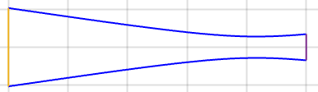
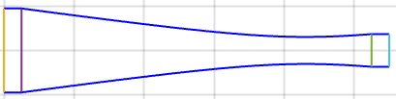
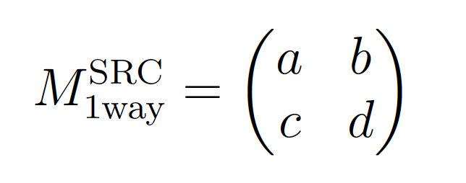
Setup
Model the cavity with a “flat” termination i.e.
put half the ITM curvature at the beginning and …
…half the SRM curvature at the end ➔
Describe entire one-way SRC (from ITM to SRM) as single Ray Transfer Matrix:
ad-bc=1
Distance=0

Slide 4
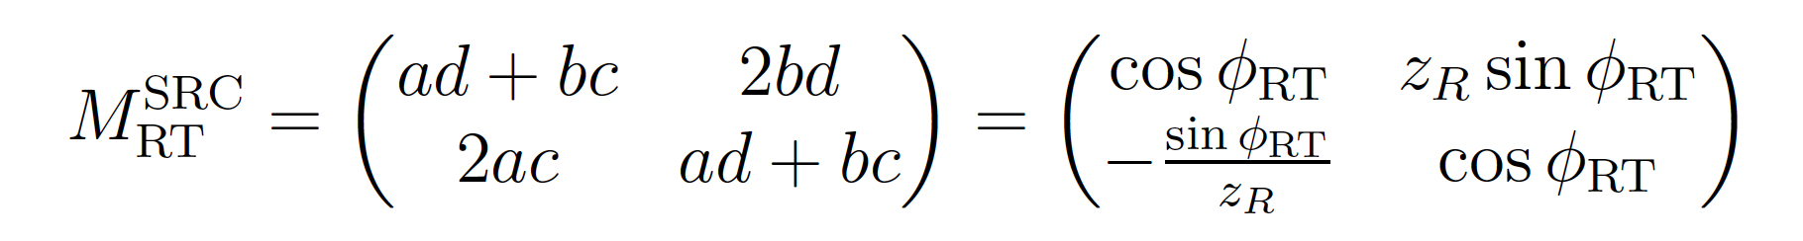
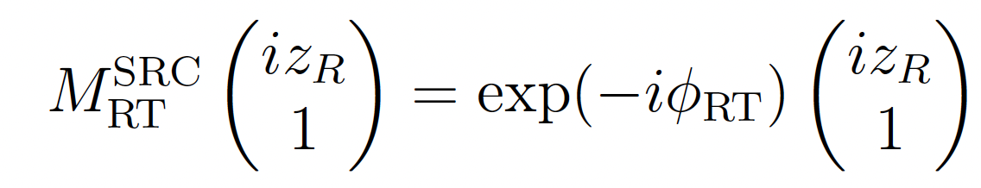
Then…
Round Trip Ray Transfer Matrix:
z_{R} the Rayleigh length on “flat” beam on ITM (i.e. z_{R}= 𝜋 w²_{ITM}/𝜆)
And the Eigenvalue equation:

Slide 5
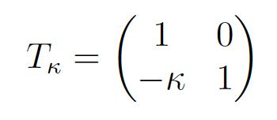
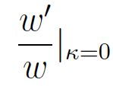
Thermal Lens
Now introduce a Thermal Lens at the beginning and end of the telescope.
Calculate the mode match sensitivity parameter at ITM and SRM, where ‘ = d/d𝜅
Note: This is the only DoF for Mode Mismatch (curvature matches optic)

Slide 6
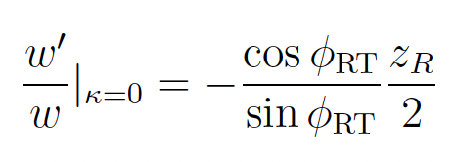
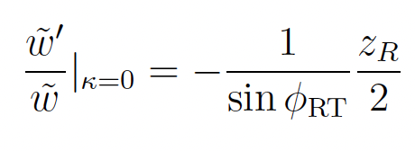
Sensitivity to Mode Mismatch
Calculate the mode match sensitivity parameter at
ITM: SRM: where ‘ = d/d𝜅

Slide 7

Perturbation Theory for HOM
We can use a perturbation theory approach to find the perturbed eigenmode for any thermal lens (all orders in radial profile, but first order in lens strength) Details in CE-T2500015.
As input, we need the actual thermal lens
More precisely its matrix elements
A) For a steady-state, uniform absorption with Gaussian heating profile, and neglecting radiative cooling on the surface, this was analytically calculated in CE-T2500014.
B) But we can use this approach for any realistic thermal lens for the ITM.

Slide 8
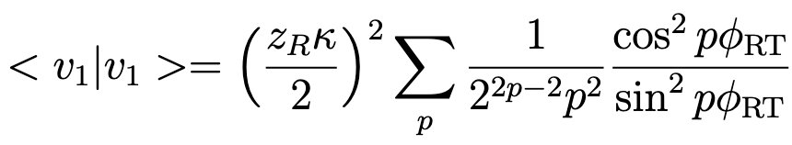
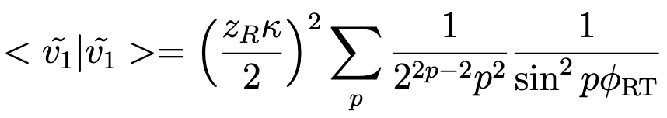
Perturbation Theory for HOM
For Thermal Lense A):
Result for power loss (field loss in square root):
ITM:
SRM:

Slide 9
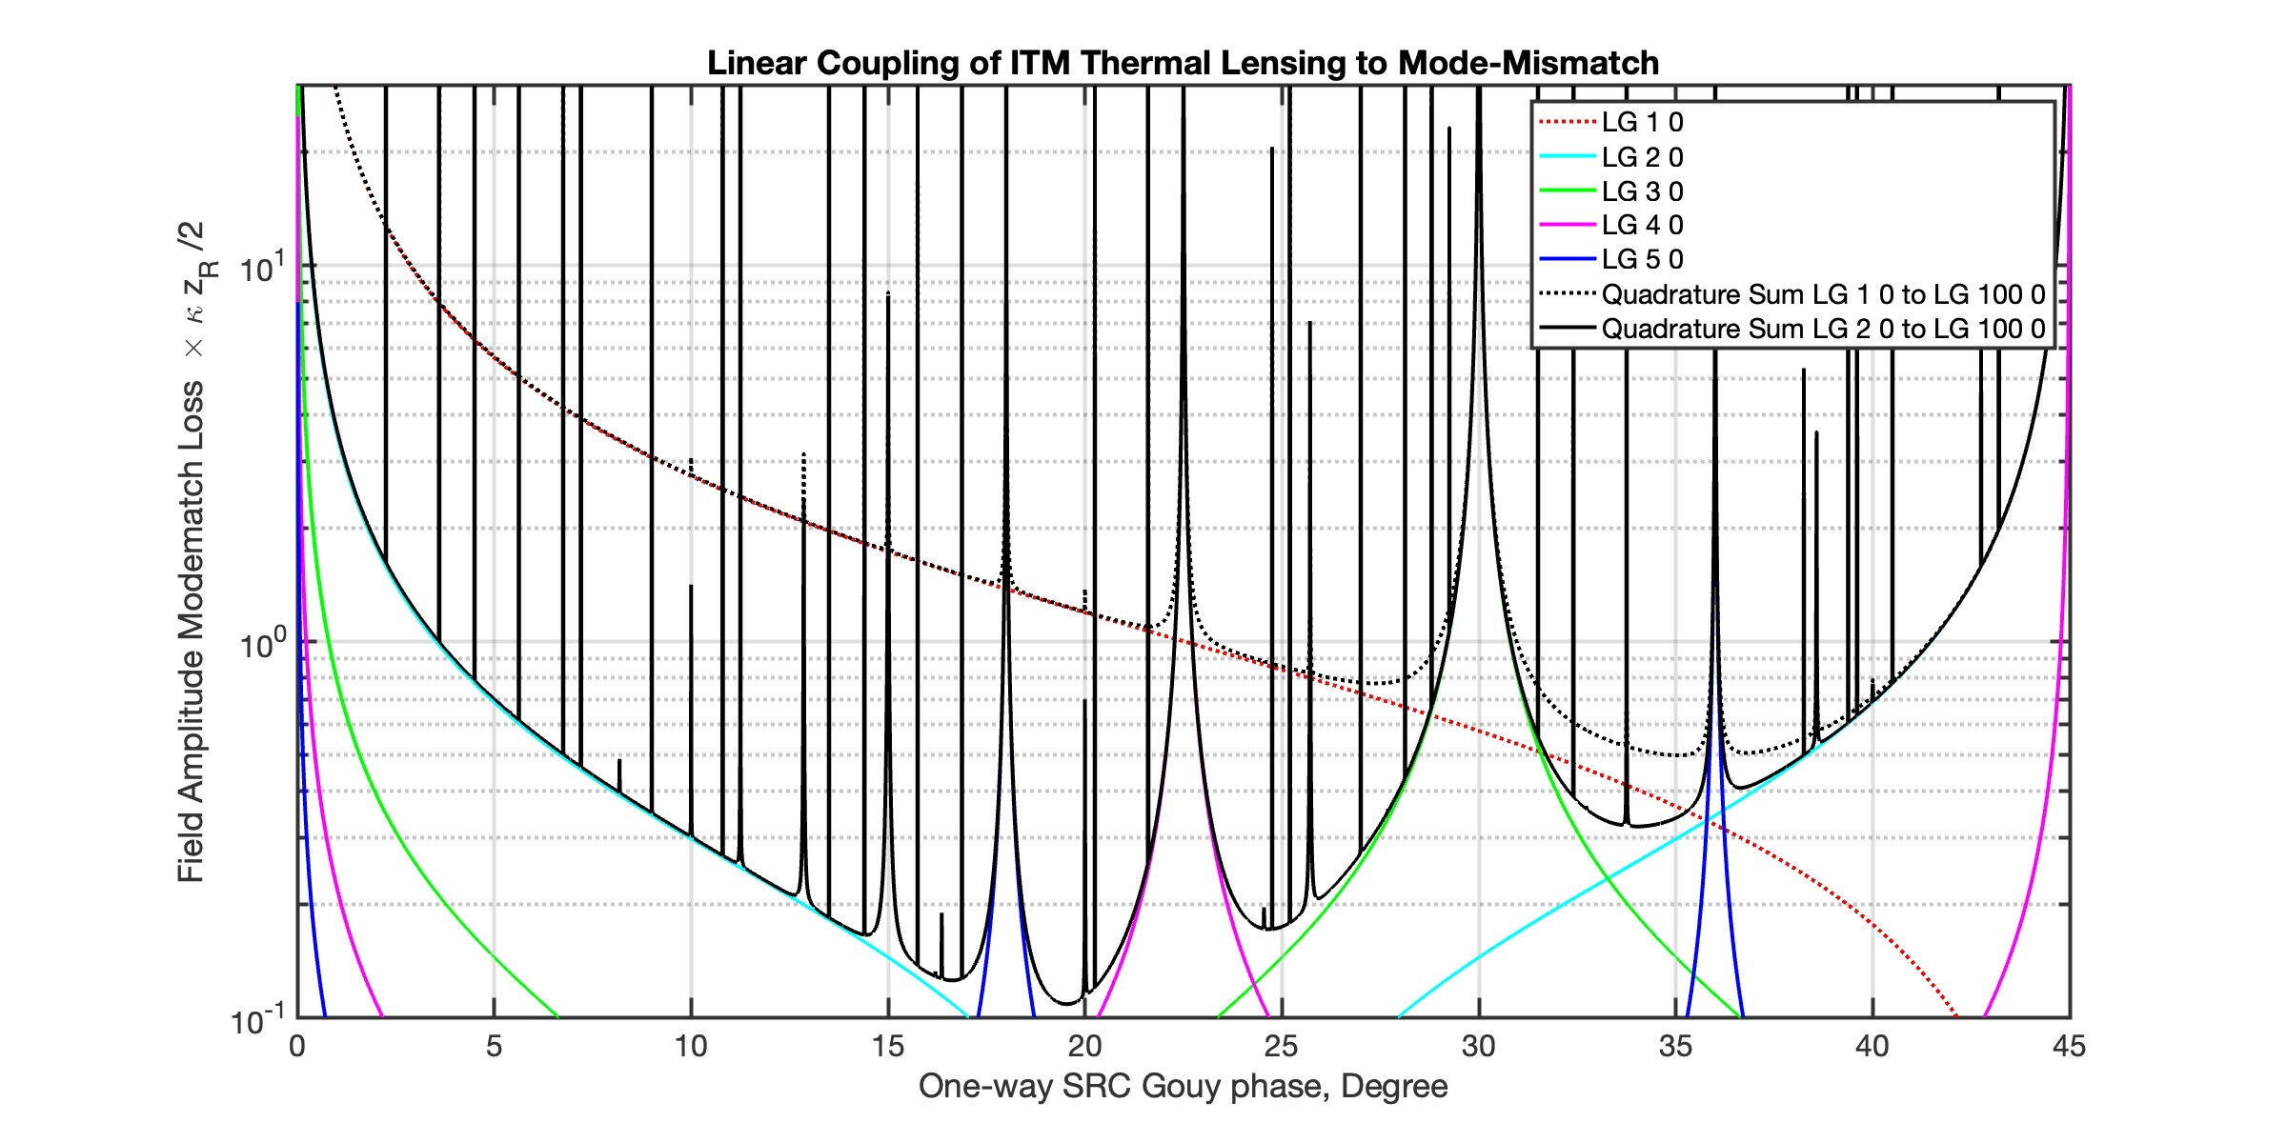
ITM mismatch

Slide 10
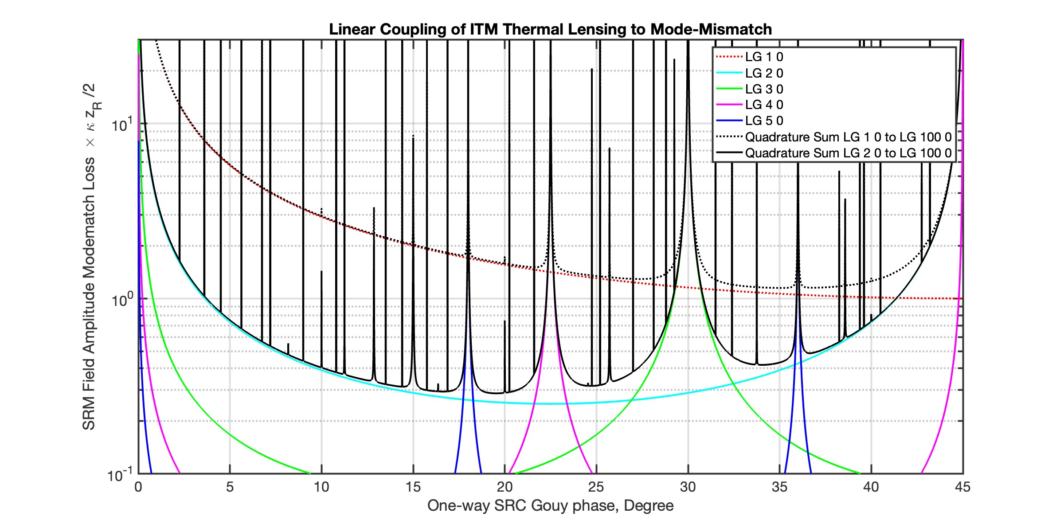
SRM mismatch

Slide 11
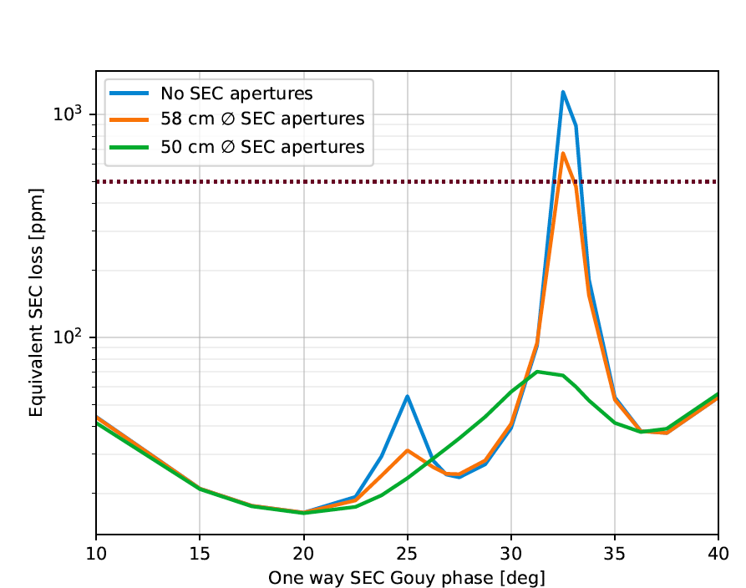
Kevin’s Equivalent SEC Loss Plot

Slide 12
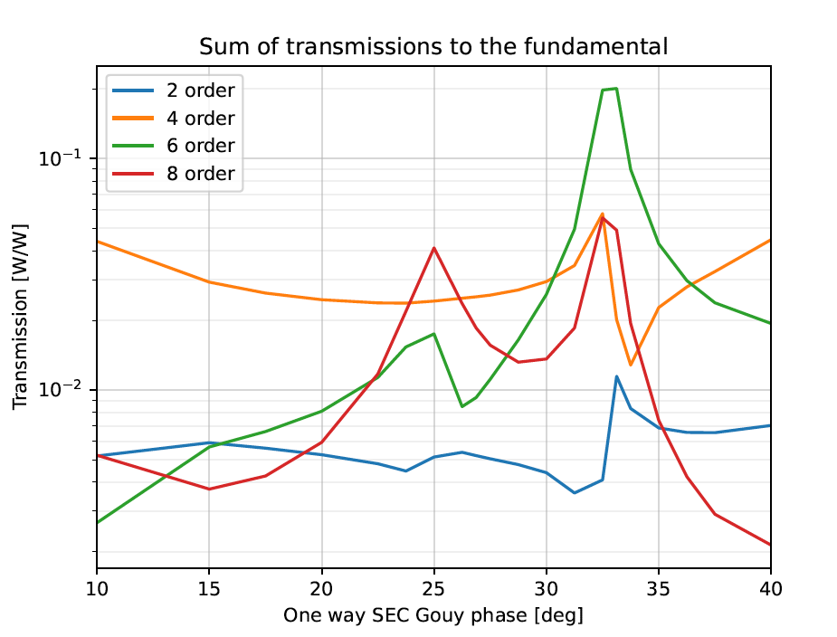
Kevin’s Transmission plot

Slide 13
Conclusions
Advanced LIGO (Gouy phase ~20∘) is limited by quadratic lenses as opposed to HOM aberrations
by approximately a factor of 10
The optimal SRC Gouy phase for CE depends on whether we
Plan to have a good quadratic correction actuator (e.g. displacement stage for M1)

Slide 14
Limitations and Still TBD
Analysis assumes unchanged arm mode
Not exactly true, but SRC mode change is definitively dominant
Analysis is in only first order in lens strength
Should be good enough to find a good design location (consistent with only seeing quadratic recycling gain degradation)
Analysis does not take SRC Finesse and HOM losses into account
Analysis des not look at effects of mis-matched fields
Such a squeezing mis-rotation peaks
The plots are for a specific thermal lens
Close to realistic for uniform absorption
Should repeat analysis for center and off-center point absorbers…
… and as a function of heating time

