Slide 1
The Evolution of Collaborations and Detectors for Gravitational Waves in the US and Europe
David Shoemaker
MIT
22 October 2025
CE-G2500077

Slide 2
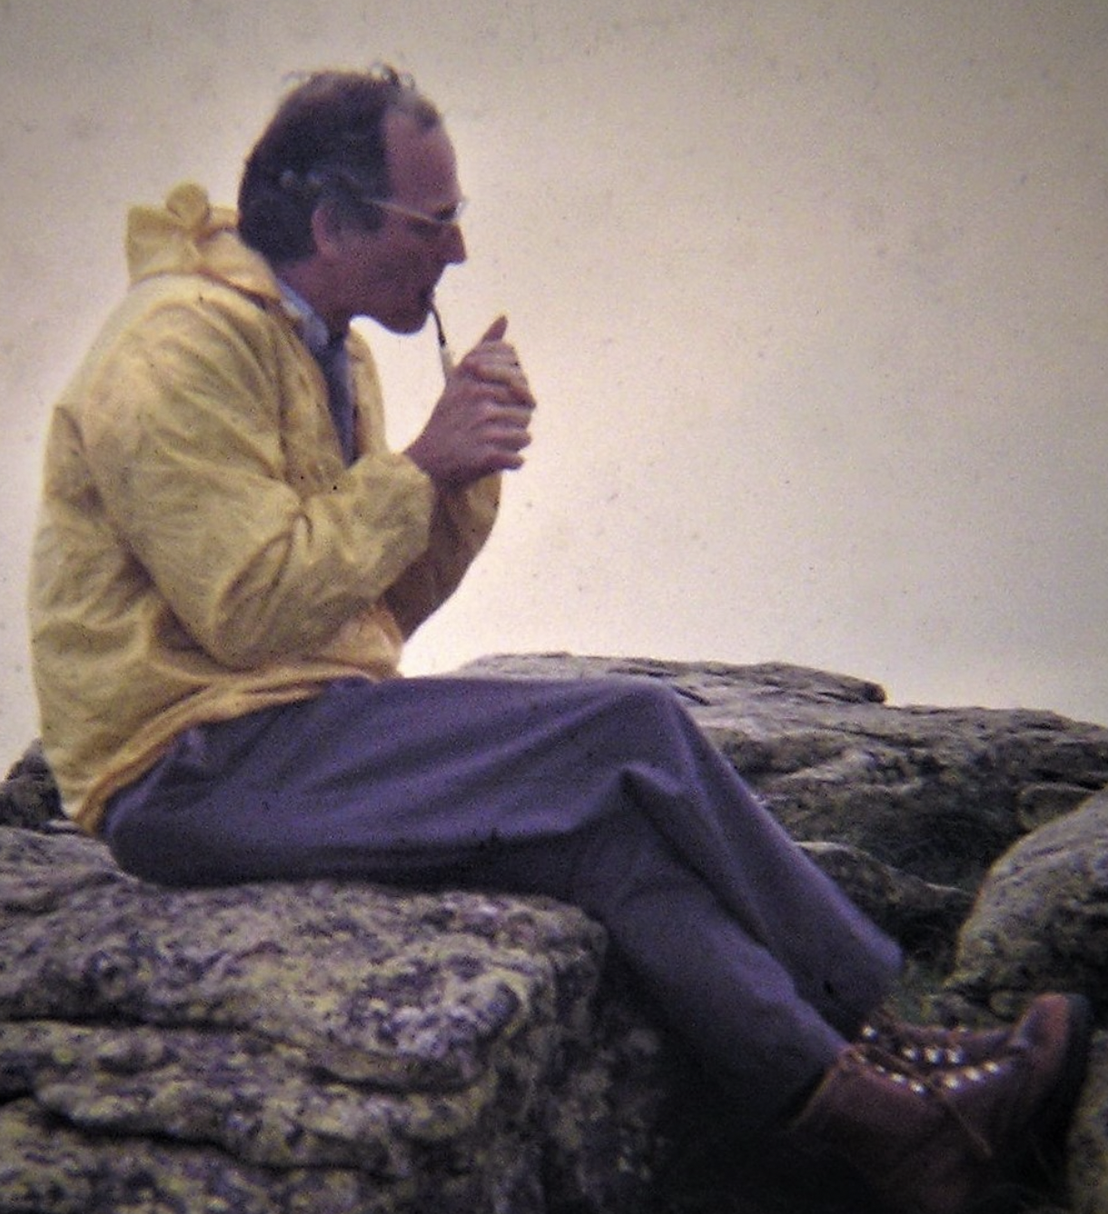
Rai Weiss
September 29, 1932, Berlin, Germany
August 25, 2025, Cambridge, Massachusetts, U.S.
1972 Internal Report –
roadmap for making instruments that work
1975 discussion with Kip –
triggering the activity at Caltech leading to LIGO
1983 Blue book with MIT-Caltech authors –
put LIGO on a firm quantified basis
1986 NSF Blue Ribbon Panel – Convinced Garwin
1990 10,001 analyses to manage Drever’s imagination
1994 Designing and watching over the beam tube realization
1997 Launching the LSC; current Analysis domains
2000 Constant presence at the LIGO Sites, LIGO BT leaks
Mentoring many of the leaders of the field

Slide 3
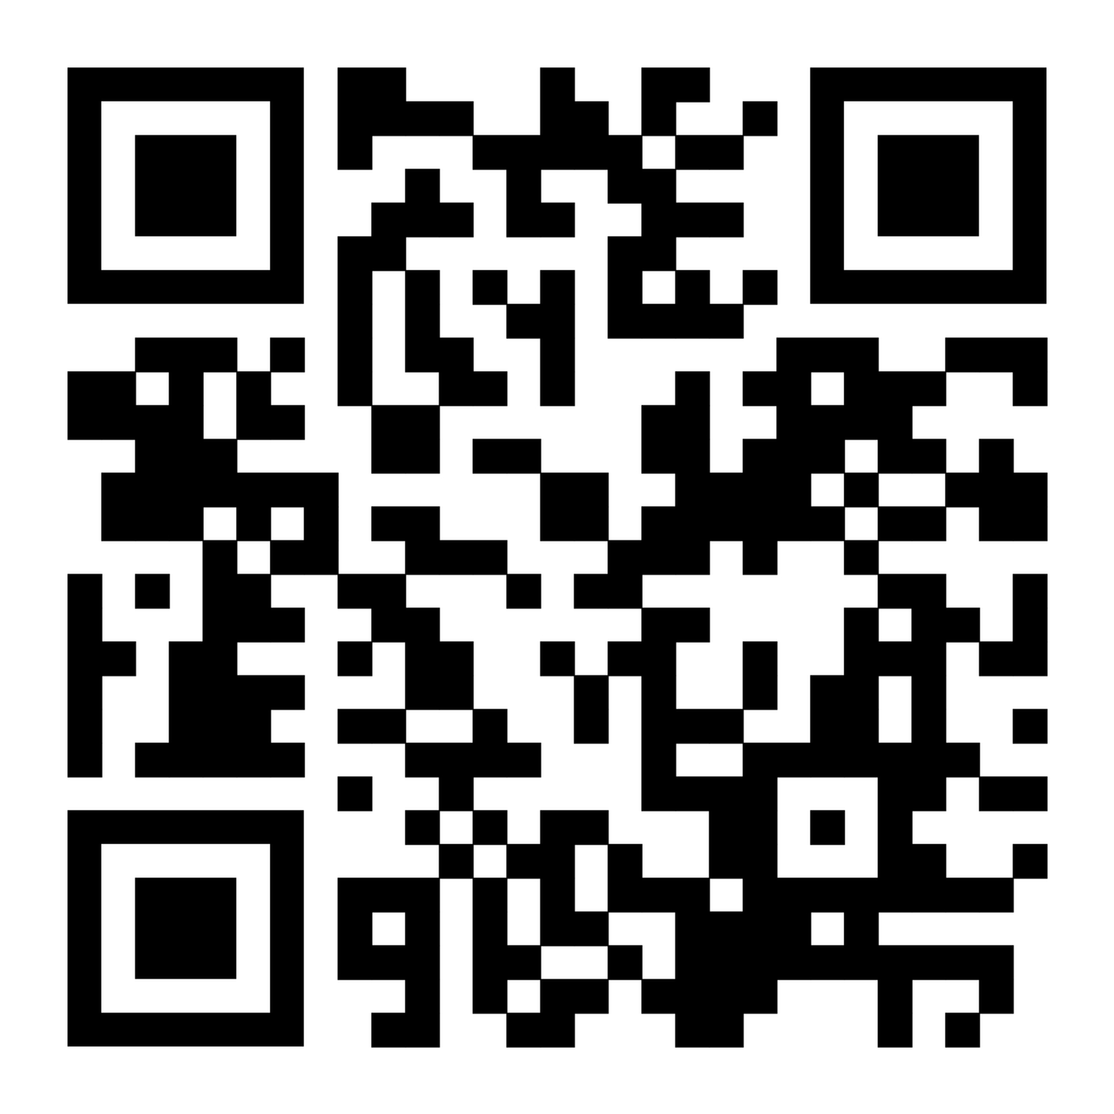
Weiss group
Timeline
CMB+GW

Slide 4
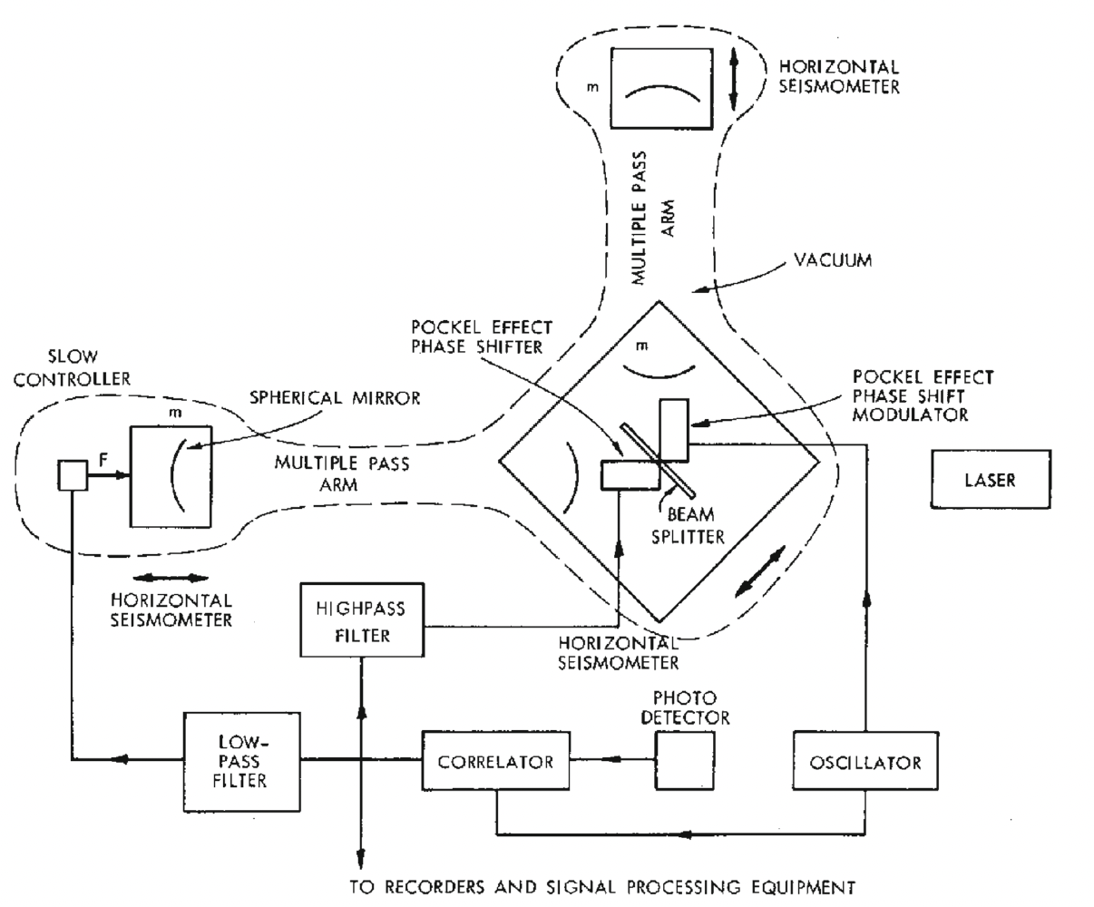
Rai Weiss
https://link.springer.com/article/10.1007/s10714-022-03021-3
https://link.springer.com/article/10.1007/s10714-022-03022-2
Electromagnetically coupled broadband gravitational antenna
1972 Internal Report – roadmap for making instruments that work
Both analysis and instrument concept show Dicke’s influence
Basic concept sketched
‘Basis Set’ of stochastic forces and optical sensing limitations, with conceptual designs and derivation of requirements

Slide 5
Objectives
Give a reminder of the growth of the observational field
  Limited to terrestrial interferometric detectors
Tease out some differences and repercussions; a personal view
Organized around Epochs:
  Prototypes on a range of scales
  Coalescence of Experimental groups
  Observatory proposals
  Observatory design and construction
    Start of the Collaboration Epoch
  Observatory Operations and Upgrades
  Next-generation Observatories

Slide 6
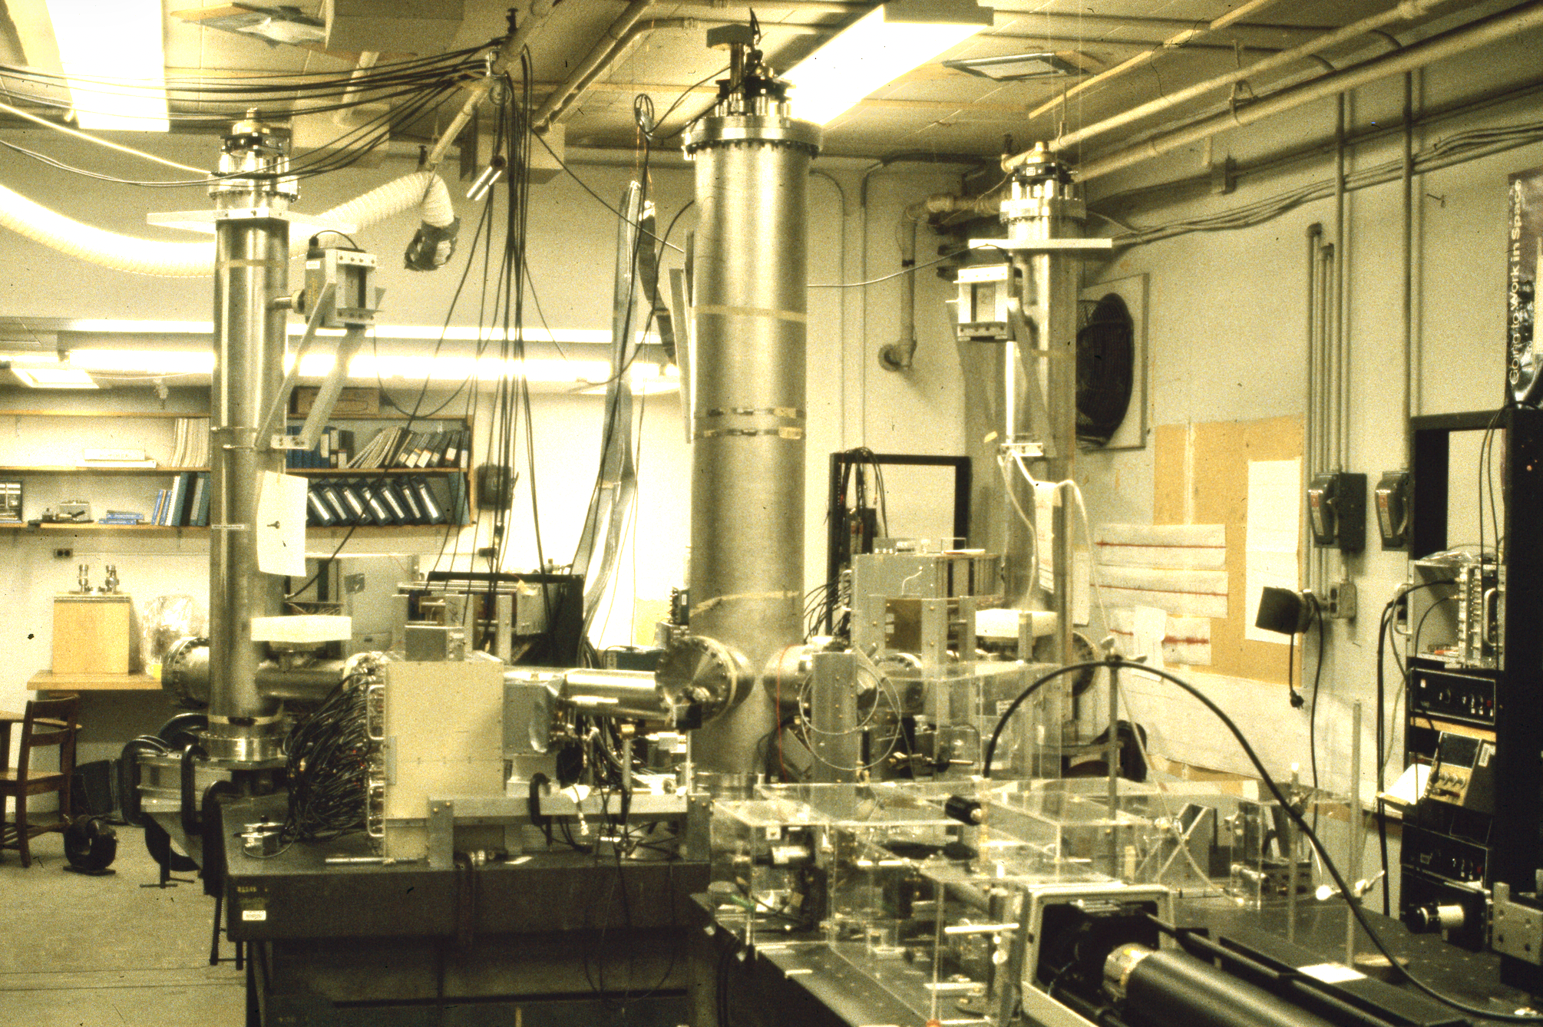
1970-80 R&D
Glasgow/Caltech
  Developing ideas for interferometry; Fabry-Perot cavities,
  power and signal recycling (Drever, Hough, Strain, Meers…)
Orsay
  Bringing forward interferometry topologies, frequency stabilization, and Nd:YAG lasers (Brillet)
Pisa
  Trying first active isolation controls, then multiple 6 degree-of-freedom pendulums (Giazotto)
Early MIT experimental effort started from the 1972 report
  1.2m Michelson interferometer using Delay Lines in the arms, data acquisition and instrument monitoring, a search for signals – a complete system, of marginal sensitivity (Weiss, Dewey, Livas, Shoemaker…)

Slide 7
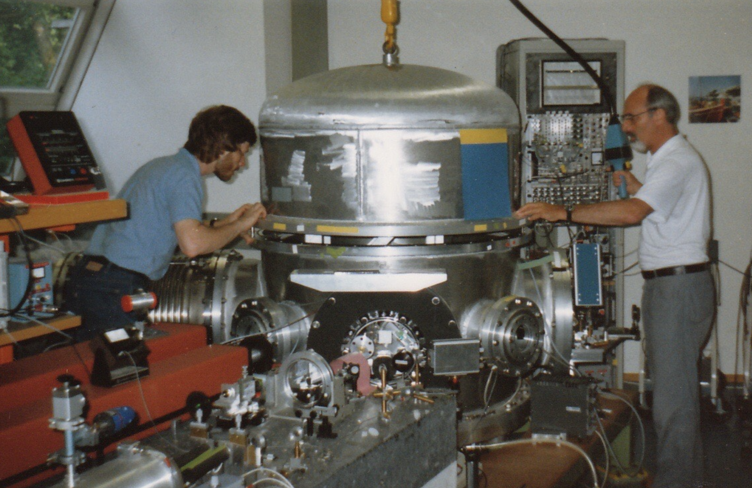
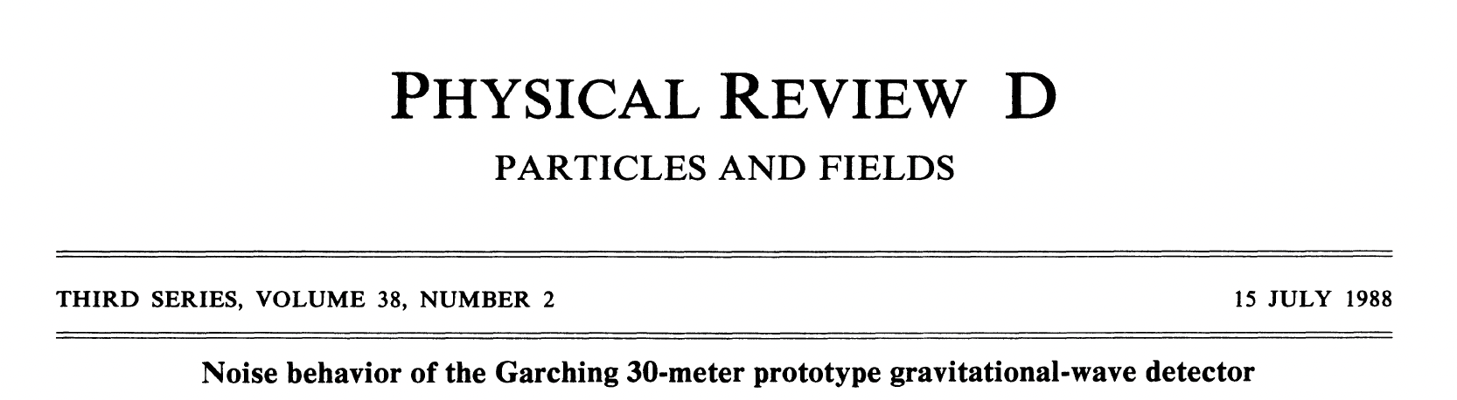
1970-80 R&D: Garching Group
(Schilling, Rüdiger, Maischberger, Winkler, Schnupp)
Seasoned instrument builders, in MPI Astrophysics
Backed up by electronics and mechanics specialists and shops
Built the best room-temperature Weber bars, saw nothing
Received Weiss’ proposal to NSF by back door; adopted interferometry
Built several prototypes, final one of 30m armlength
Perfectly suited to work through Weiss’ 1972 paper, providing experimental basis to complement Weiss’ ‘theory’ paper
Gave LIGO credibility,
and a model for how to do lab work
As for NR, the Max Planck approach key

Slide 8
By the mid-1980s…
Viable notions of the instrumentation for full-scale detectors
Independent studies of full-scale detectors from
US, France/Italy, Germany, UK
Initial efforts at analyzing data
Initial concepts for managing quantum noise
Growing interest by funding agencies of this new field
Most work was undertaken in isolated groups, in ‘friendly competition’

Slide 9
Experimental group Coalescence
Driven by Weiss and the NSF, Caltech and MIT joined forces
  After some early efforts, Robbie Vogt named director, at Caltech (1987)
  Brought authority, project experience, and engineering resources
  Dictated changes in MIT and Caltech experimental groups,
  instilled ‘Project’ mentality, and led to some loss of staff
Orsay and Pisa joined forces
  Real complementarity in instrument skills (lasers, seismic isolation)
  Brillet had optics and interferometry experience; was a leader in laser stabilization
  Giazotto had project experience from HEP (and good connections)
Garching→Hannover (Danzmann) and Glasgow joined forces
  Similar working vision, similar interests

Slide 10
European group bifurcation
Glasgow/Hannover and Pisa/Orsay shifted from Pan-European work to
really independent effort
What caused this split?
Giazotto took advantage of an opening to get funding for Virgo (1992/3)
  In some measure a violation of agreements for pan-European planning
Germany and Glasgow believed firmly in the need for prototypes
  Not Pisa and Orsay – Desire not to incur the delay of realizing prototypes
  This may have had long-term effects in depriving Virgo of new generations of commissioners
  With hindsight, some Virgo design decisions might have been avoided
  Glasgow/Garching may have believed that Orsay/Pisa lacked necessary experience/judgement

Slide 11
Key LIGO Prototype developments
Weiss 1972: need both displacement AND phase sensitivity
  Demonstrate that the test masses can isolated from seismic etc. noise such that the apparent displacement from GW will dominate, in some freq. range
  Demonstrate required ability to measure a phase shift due to a GW
Caltech 40m prototype
  Did not have an optical sensing system that would work for LIGO
  …but did show good enough isolation of the masses >500 Hz; 1995
MIT 5m prototype
  Did have an optical system that resembled a very simplified LIGO
  Was shot-noise limited (circulating power) to required level; 1999
LIGO Lab – and NSF – convinced of need for these demonstrations
  Virgo could use these as proof of principle as well

Slide 12
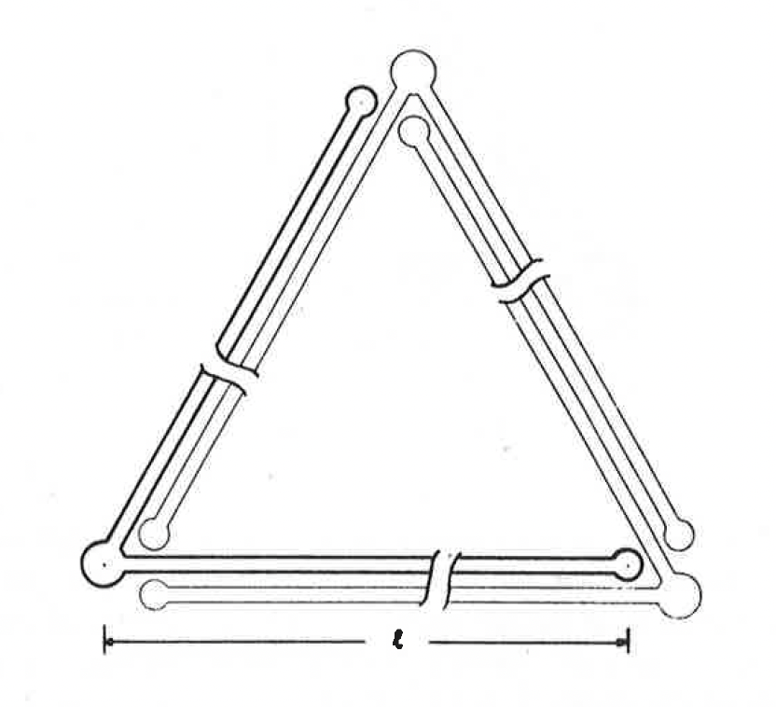
European Observatory proposals
Germany and UK had plans for one or two km-scale observatories
  A triangular configuration to be in Germany (1985) made good
  progress in the funding arena, until…
  The Berlin Wall came down (1989)
  GEO-600 was a fallback, with significant local funding
France and Italy conceived of Virgo (1989)
  Opportunistic jump forward by Giazotto in Italy cast a die in European relations
  Particle physics funding sources
  Kernel of the Virgo ‘experiment’ Collaboration formed
MPQ 101

Slide 13
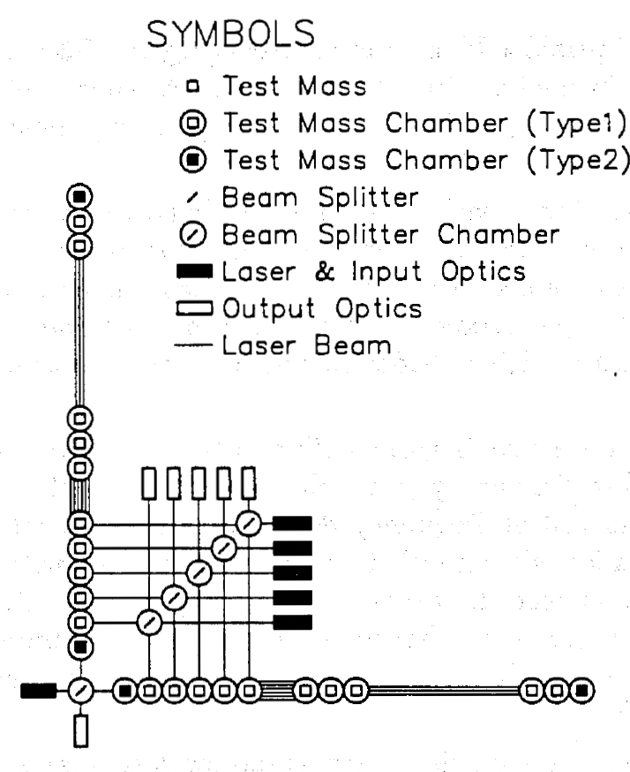
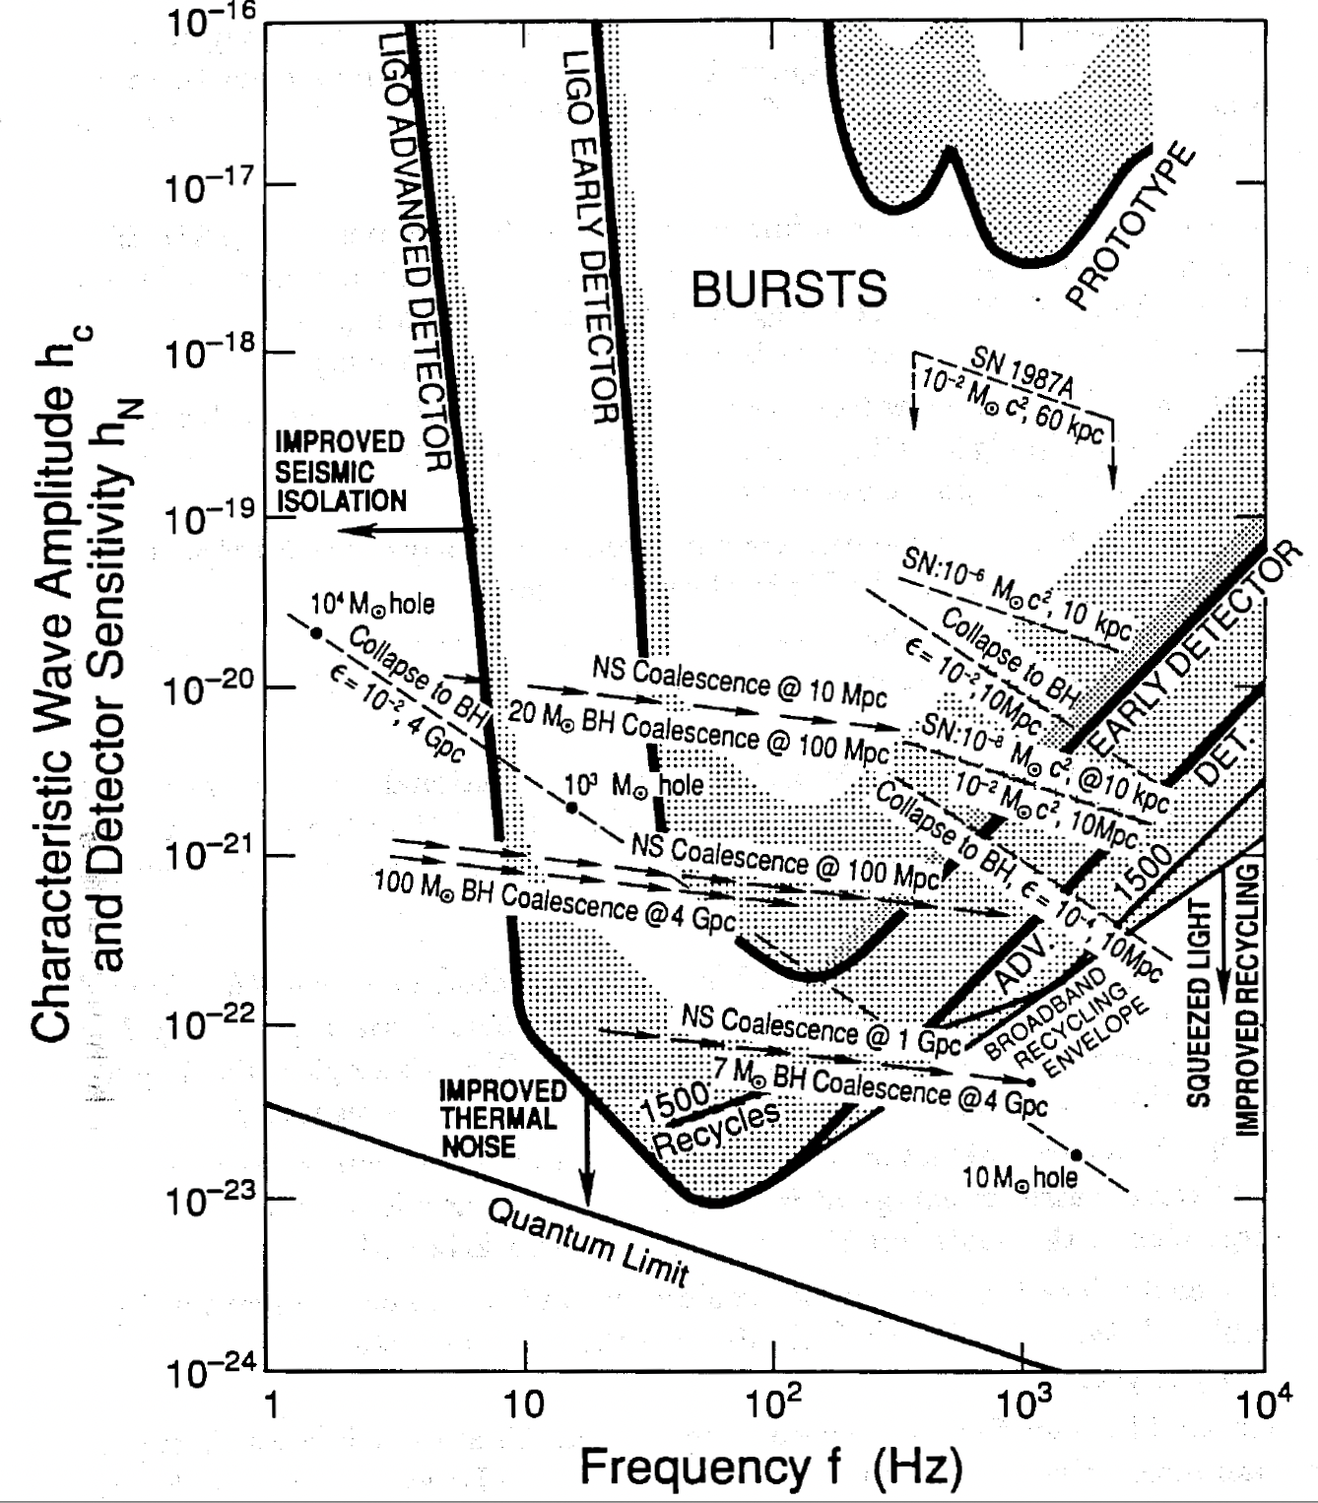
LIGO proposal (1989, 1994)
Decision to jump from 40m to 4km (no intermediate step); Weiss’ insight
Two detectors, large separation, considered necessary
National Science Foundation funding (under the Physics Division)
Significant rescoping from Drever’s initial vision to a realistic approach
  6 interferometers per site, rapid test-mass swap, etc.
  …replaced by 1 detector Livingston, and 1 full-length and one half-length at Hanford
Joint MIT-Caltech work to prepare the proposal and defend it key to transformation to a single team, facilitated by Vogt and a ‘circle the wagons’ mentality
Carried the message that detection was plausible, but that
‘advanced detectors’ would be inevitable and probably required
  Infrastructure prepared for better sensitivity
Significant activity in the NSF (Isaacson, Bardon) to support LIGO

Slide 14
Observatory proposal Epoch Astrophysics
Early efforts in data analysis
  1992 Sam Finn “Detection, measurement and gravitational radiation”
  1996 Bruce Allen’s GRASP
  1995 LIGO Research Community; open to all, informal, led to…
Most of those proposing and working on instruments mostly AMO, precision measurement, or ’project’ people
  Many really interested in the measurement science – not GWs
Astrophysics arguments to motivate the building of detectors from the ‘external’ astro community
  Typically with one or several ‘liaisons’ to the Projects (e.g., Kip)
Analysis, data quality, confidence, MMA developed in student theses and ‘demonstration’ observing runs using the prototypes
  At MIT, ‘science’ was a necessary ingredient for a PhD

Slide 15
Measurement Theory and Experiment
Thorne and Braginsky groups important for LIGO’s success
  For Virgo, one example is Jean-Yves Vinet and optics calculations
Broader measurement theory community lively contributor
Quantum measurement concerns and opportunities
  Initially pretty simple stuff – shot noise, modulation schemes
  Caves’ insights triggered a slow tsunami of a more sophisticated view of quantum noise
  Coupling of shot noise to radiation pressure via signal recycling
  Now to frequency-dependent squeezing and speedmeters, etc.
Interferometer configurations
  Glasgow an important contributor – Strain, Meers
Thermal noise (Levin)
‘Ordinary’ development of designs enabled by theorists’ insights
  Light scattering (LIGO Baffles)
  Huygen’s principle applied to optical modeling

Slide 16
Observatory design and construction: LIGO
Drever, and then Vogt, separated from LIGO
  Did not conform to obligatory constraints of successful Project discipline
Barish (Director) and Sanders (Project Manager), 1994 – 2006
  Brought HEP Big Science Project insights and practice.
  Key step forward.
Robust support from the NSF; collaborative interaction with NSF
Significant participation (intellectually, funding) from UK, Germany
  N.B.: Continued fallout from the ‘Bifurcation’
Caltech was Project Lead; MIT key to design and realization, but minor engineering and management role
  MIT (the Institution) uninterested in Project responsibilities;
  Caltech did not want equal partnership
  Continues to today (…and tomorrow)

Slide 17
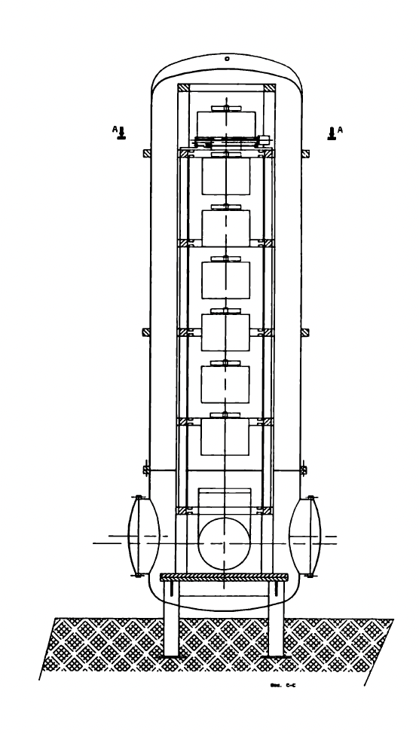
Observatory design and construction: Virgo
Initially France and Italy, site in Italy; 1991 Collaboration formally established
  Leadership alternating between Giazotto and Brillet
3km baseline (LIGO is 4km)
  Provides a standing barrier to LIGO-Virgo equality in sensitivity
Low frequency instrument design focus
  Giazotto targeted GW signals from Pulsars ~10 Hz
  (Note that Virgo and LIGO have now similar realized
  low-frequency sensitivity)
Facility buildings tightly designed around isolators
  Creates challenges for modifications
Instrument, like LIGO, needed a series of fixes and upgrades
  Was there a negative consequence of the lack of prototypes?
https://www.ego-gw.it/wp-content/uploads/sites/12/2020/04/VIRGO_Proposal_1989_VIR-0517B-15.pdf?utm_source=chatgpt.com

Slide 18
The Virgo Organization
  Early Collaboration a handful of University/Institute groups in Italy and France
  focused on building the initial detector (1993)
    Experimenters did not initially welcome others, e.g., astro/GR folks
    Now many nations and groups involved, with Observational Science included (2004)
    Basic Collaboration structure and ‘charter’ has remained the same
  Individual groups obtain funds for subsystems;
  design, build, deliver, commission, maintain (and maintain control of) hardware
  Top level Virgo design determined by consensus of groups in Virgo
  Establishment 2000 of European Gravitational Observatory (EGO) at site
    Intended to be a source of technical maintenance, not a scientific partner
  Spokesperson has the role of establishing consensus for the instrument plan
  and key design issues (as well as now the Observational Science)
    Only ‘moral’ authority; decision discussions are on their own time line

Slide 19
The LIGO Organization: LIGO Laboratory
1997: Creation of LIGO Laboratory
  In parallel with the creation of LIGO Scientific Collaboration
LIGO Lab: Caltech and MIT only. Not a “Collaboration”
  Employees carrying out job responsibilities; hierarchical organization
Observatory activities are Lab responsibility (and staff)
  Visitors possible under Lab direction
Campuses focused on R&D, engineering, and management
NSF supports via ‘cooperative agreement’ with Caltech
  MIT on subaward
  5-year funding cycle gives stability
  Separate proposals for upgrades (e.g., Advanced LIGO)
…and Lab members are LSC members – mutually supportive

Slide 20
(Aspen Center for Physics meetings)
Les Houches for LIGO
Collection of meetings organized by Caltech/MIT (Syd Meshkov)
Yearly from 1995 to 2001, molted into GWADW (Elba etc.)
Focus was always on ‘future detectors’ – aLIGO, then beyond
First meeting simple reporting of R&D
Second meeting discussion of need to focus on relevance (1996)
  Choices of ‘competing’ ideas for design elements
  Complemented by NSF asking LIGO Lab to review proposals
This process led to the initial concept for Advanced LIGO
  Key insight: Glasgow monolithic suspensions to manage thermal noise
  → Setting requirements on seismic isolation for aLIGO
A key event – the focusing of R&D

Slide 21
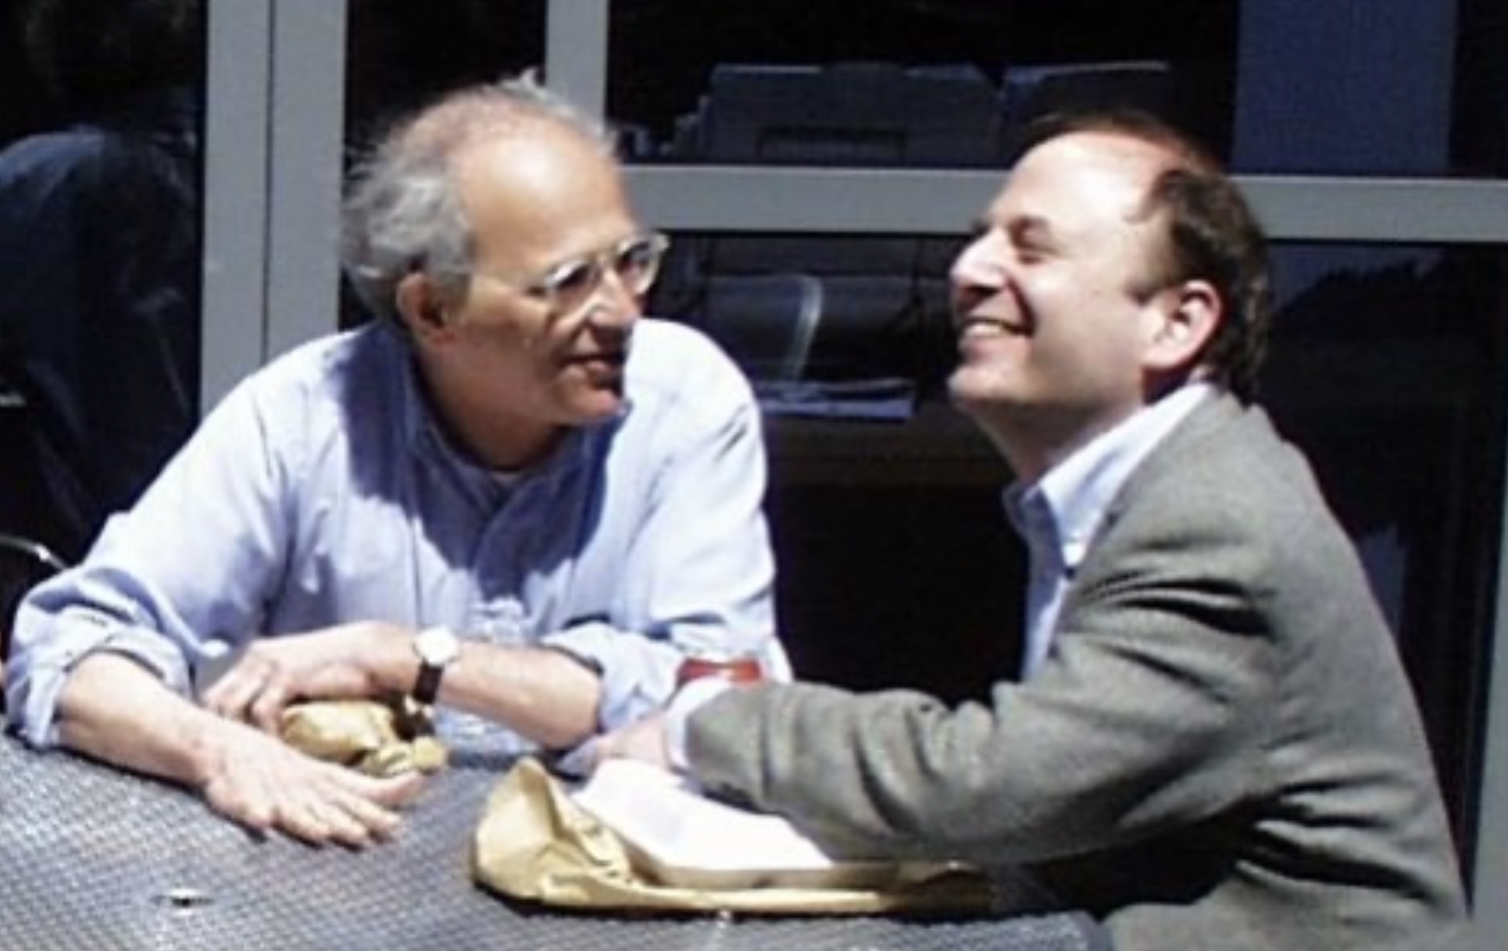
The LIGO Organization: LSC
1997: Creation of LIGO Scientific Collaboration
Not a significant source of deliverable instrumentation to the Observatories; Caltech and MIT produce operations equipment
…but LSC a very important contributor of R&D for new instrumentation
Contributing to the science from LIGO the main criteria for membership
Principal foci: Data Quality, Data Analysis, Astrophysical Interpretation
  And a lot of bureaucracy to measure and monitor contributions
  ‘Payment’ in authorship of LSC papers; 24→18→ 13 month proprietary period
UK, Germany, Australia strong elements in the LSC (…not in Virgo…)

Slide 22
LSC vs Virgo approaches to Instrumentation
Both recognize importance of engaging the hardware R&D community
Virgo gives responsibility to the distributed community for deliverables to the detector
  Serves to maintain a wide group of instrument scientists and funding
  Enables (and suffers from) pan-European collaboration and social environment
  Presents challenges for systems design, project management
LIGOLab/LSC has a two-step approach
  LSC Working Groups develop ideas (Initially at Aspen, 1996)
  Presented to LIGO Lab when demonstrated to be useful for detector
  LIGO Lab takes over engineering, fabrication, installation, ownership

Slide 23
Current LSC, Virgo, KAGRA → IGWN
All strain data are analyzed by all members of all 3 Collaborations
  Papers are signed jointly
  Instrument specific tasks – calibration, data quality – separate
Successes: development of analysis pipelines, scientific interpretation, published papers
Problems: different rules, separate decision-making processes, imbalances in computing contributions → inefficiencies and a sense of inequity in members
Solution chosen: combine the 3 Collabs under one set of rules.
~2500 persons, checks on contributions, bureaucracy
Hope is to reduce the highly variable levels and values of contribution
Data remain proprietary for a period of a year+
(For some future talk: not a long-term sustainable path!)

Slide 24
Observatory Operations and Upgrades
LIGO and Virgo detectors have undergone a series of upgrades
  Detection rate grows as cube of sensitivity!
  Now, e.g., the most spectacular application of quantum sensing
To date, all instruments stop and start observing together
  May be an error from the greater astrophysics perspective
Virgo and LIGO use many similar technologies
  Seismic isolation approach very different (multiple pendulums vs. servos)
  Virgo did not adopt a key optical upgrade (‘mode-stable input/output cavities’)
  May entail a significant ‘downtime’ in coming years for Virgo
Strategy for observation, interface with Astro world needs evolution

Slide 25
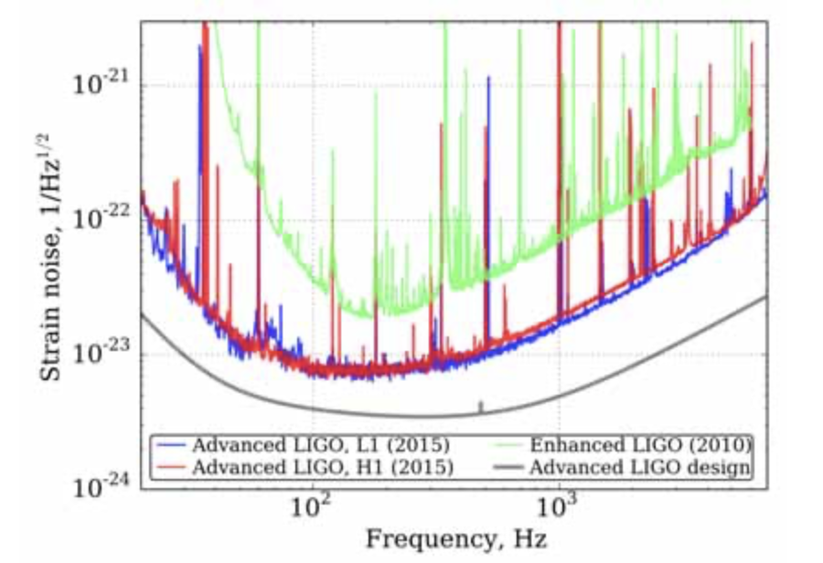
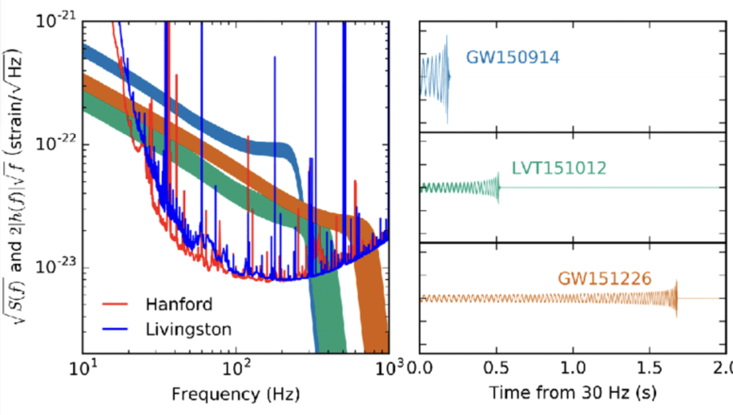
Advanced LIGO
Key elements that enabled 1st detection:
Reduction of stochastic forces
  Seismic noise
  Thermal noise
Reduction of sensing noise
  Lower-loss optics
  Change in light coupling cavities
  Increase in circulating power
  …after the comment yesterday about ‘noise curves’ I had no choice but to include some!

Slide 26
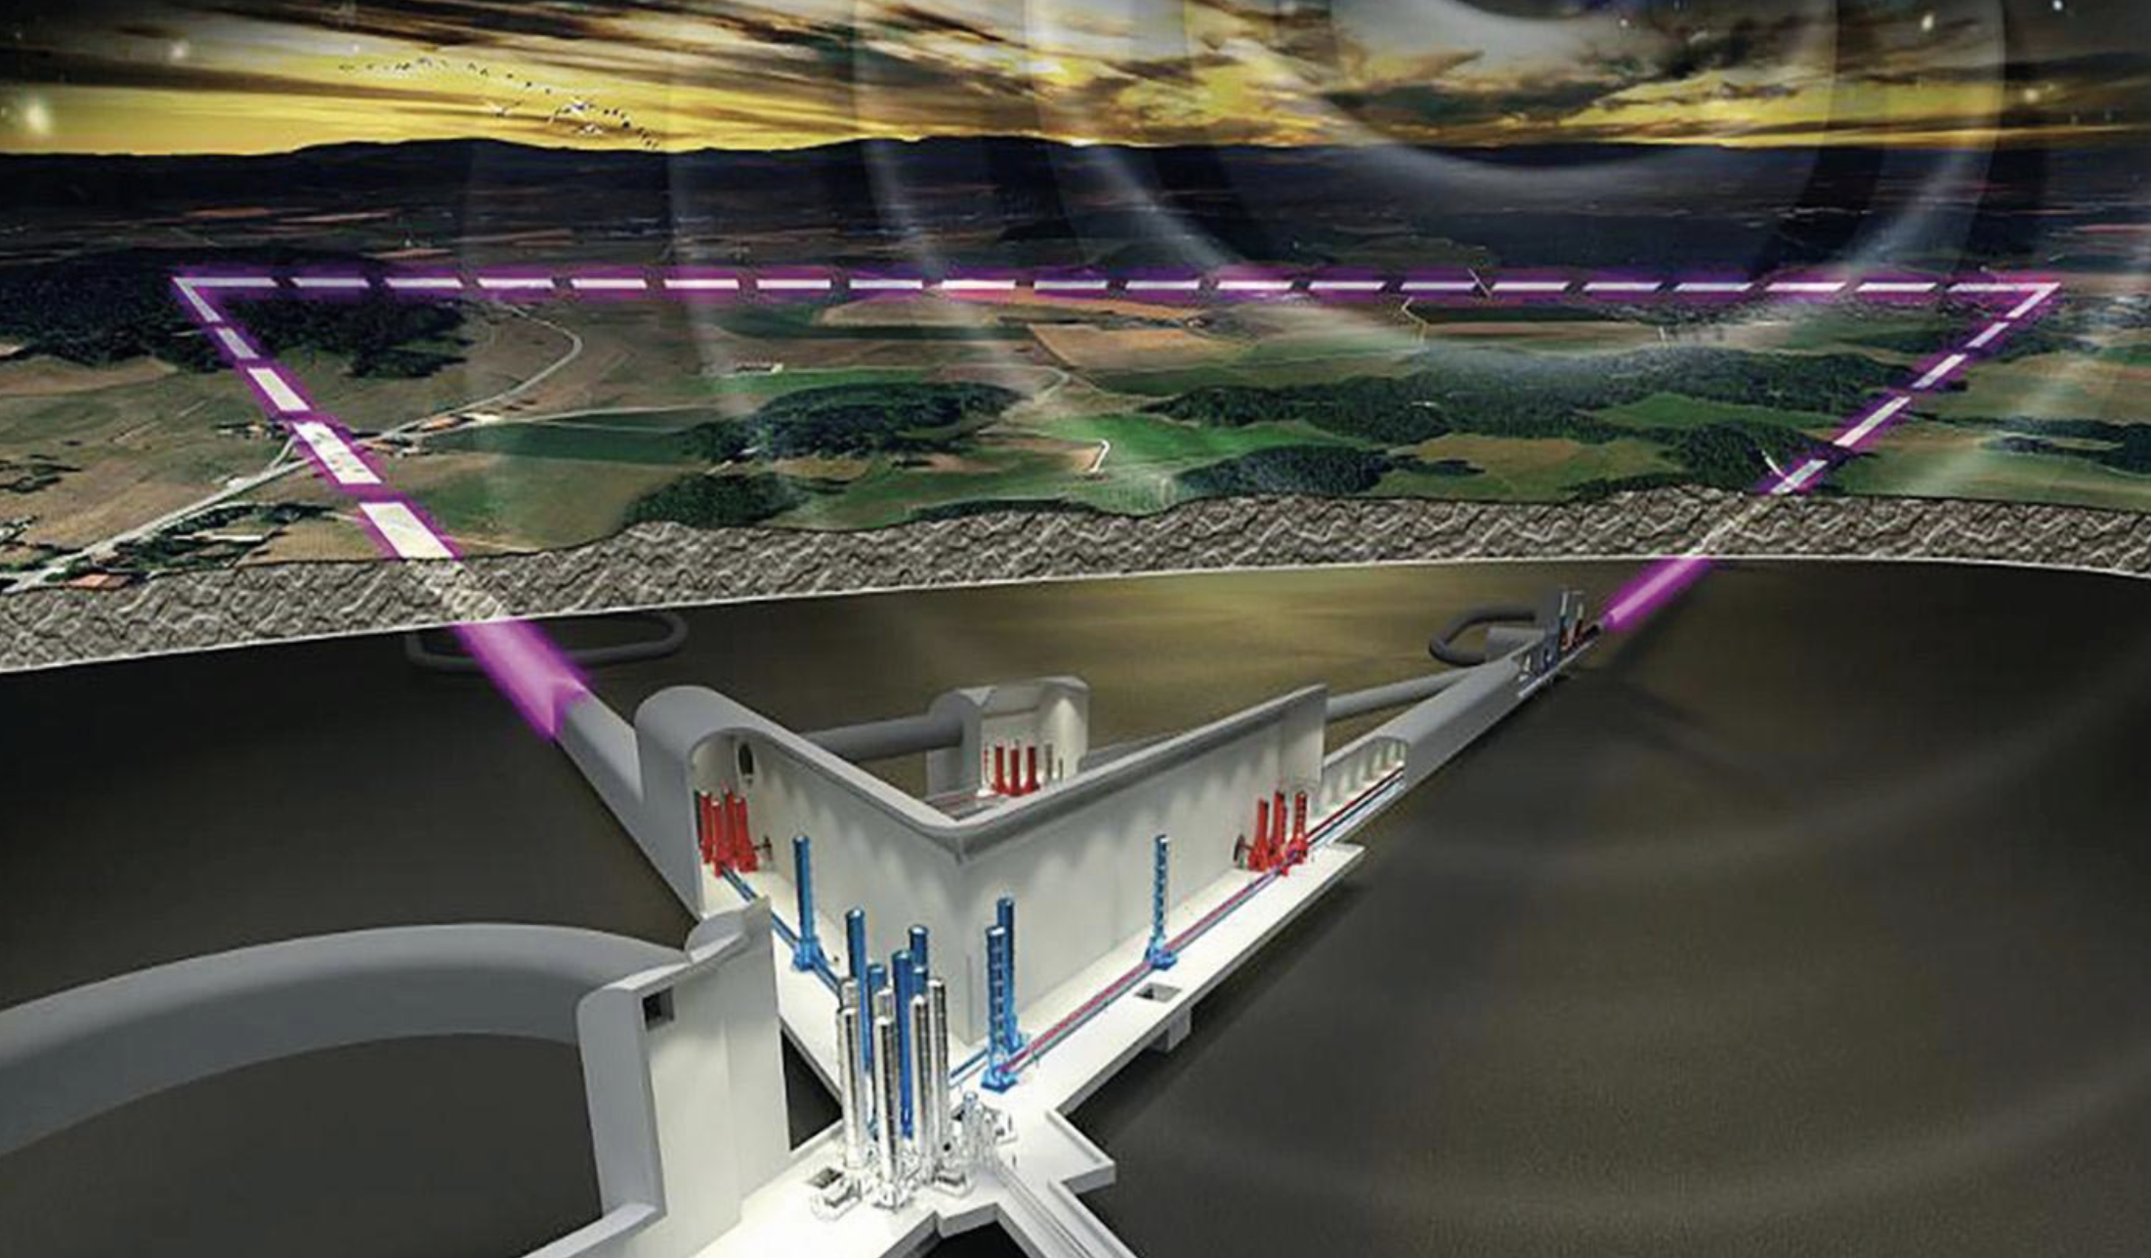
Next-generation Observatories: ET
Einstein Telescope very well advanced in the funding/political/organizational senses
Interestingly focus is again on low frequencies
  Goals: pre-merger MMA guidance; IMBH
  Drives the instrument underground to reduce gravity gradients – arm length of 10 (or 15) km
  Drives the plan for low- and high-frequency detectors, cryogenics
  Brings expense and challenges – and potential great science
Instrument goals require significant technical advances -- very motivating for the ET instrument community!
See differences north-south Europe once again
  Sites, configurations, organization…cultural, or chance?
  But this time UK and Germany may put focus on Europe, not US, for next-generation
See tensions between ‘the Collaboration’ and ‘The ET Organization’
  Funding agencies need control; the Scientists want ownership
See tensions ET vs Virgo –
  Limited number of skilled experimentalists;
  Much more generous funding for ET than Virgo

Slide 27
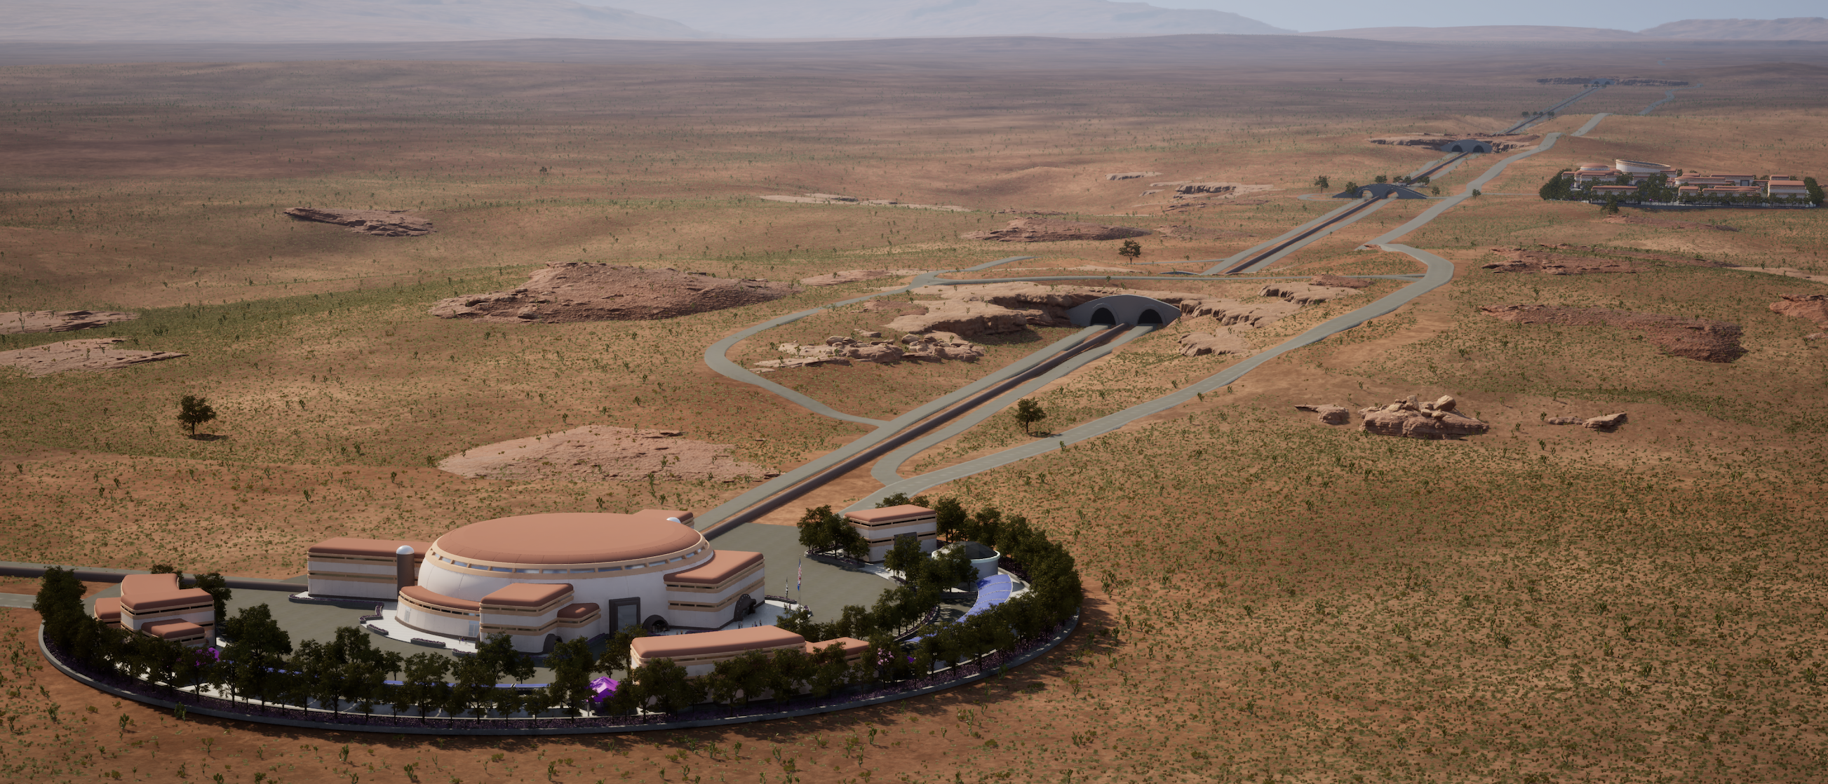
Next-generation
Observatories: CE
Cosmic Explorer the planned next US Terrestrial GW Observatory
Started much later than ET, less developed, smaller community
A giant LIGO (40km instead of 4km); surface, room temperature
  Low-risk approach for the observatory, and the initial detector
  Generates less excitement for the instrument scientists
  Plan on evolution of the detector over ~50-year lifetime of Observatory
Ever closer connection CE-LIGO Lab
  Anticipate a single entity in future
Greatest risk and challenge: making constructive relationships
with the indigenous peoples whose land will host CE
  TMT as a cautionary tale

Slide 28
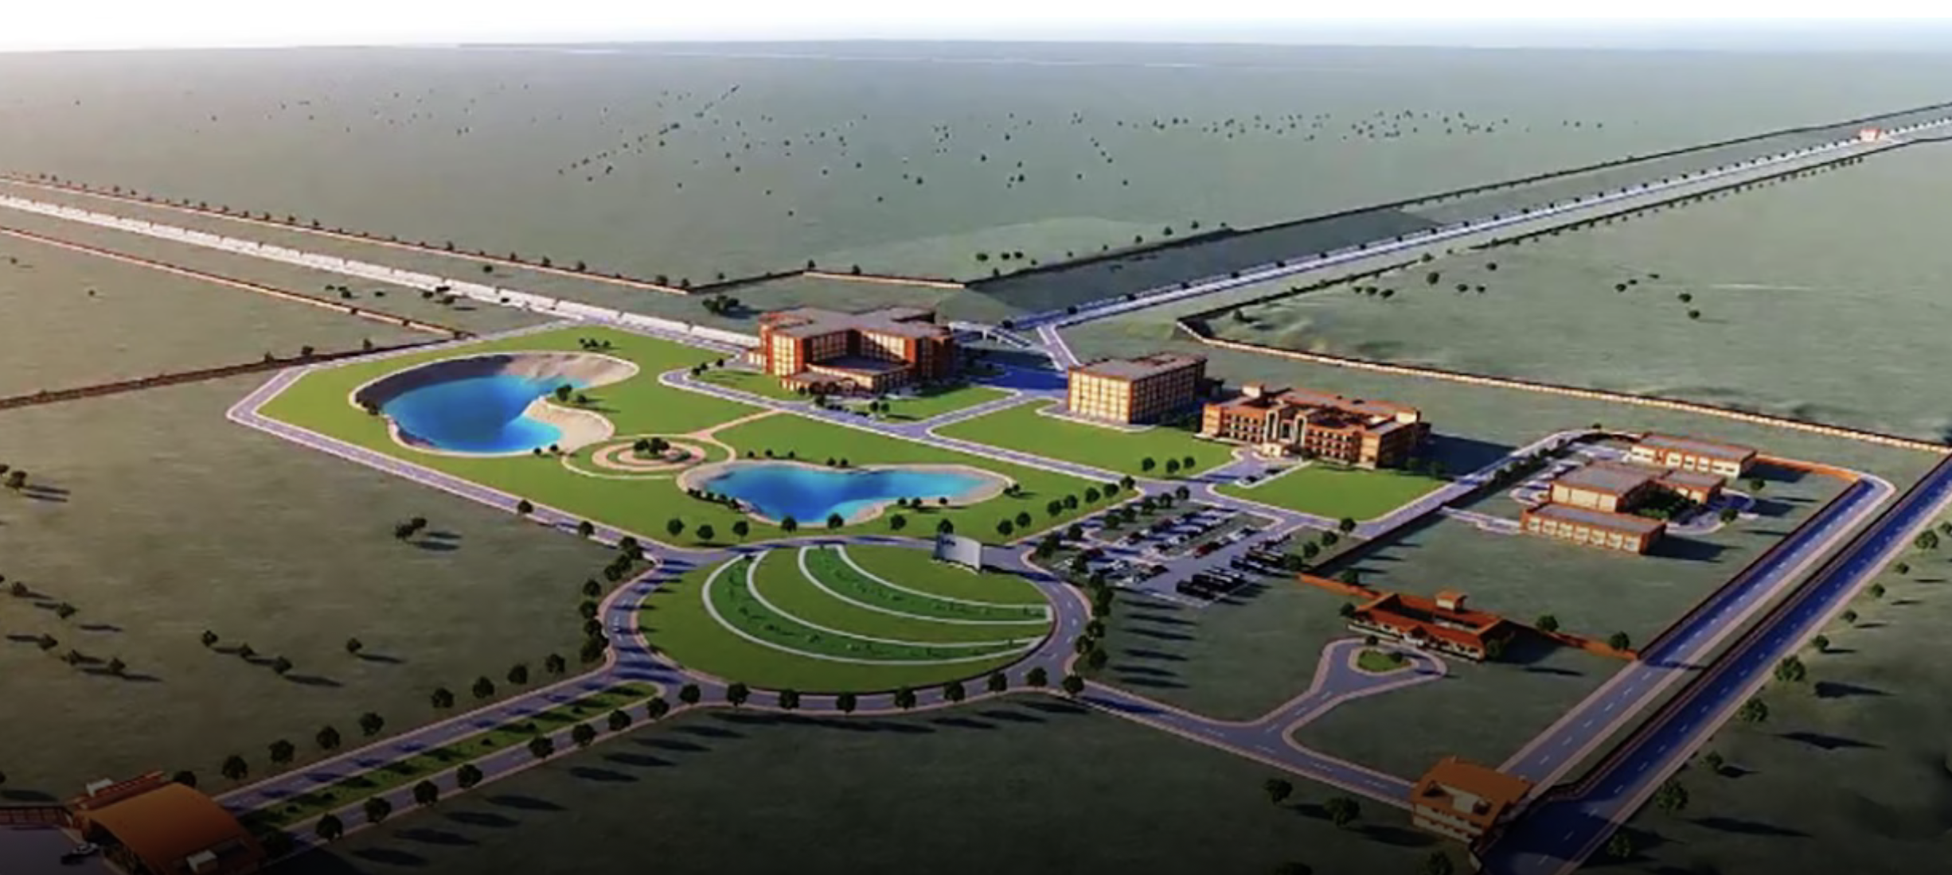
CE and ET network
Evident that the Observatories will need each other to leverage the data
  ET initially conceived before first detections, and planned to be the ‘one’ next generation detector
  Now likely that US-based CE will be built, as a single detector
    40km and 20km is the ‘baseline’ but unlikely to be funded
  LIGO-India, using components from US LIGO in an Indian Observatory, will likely form the 3rd leg of the tripod; progress there has been slow
    Could (should) be adopted by CE/ET as a central element of the
    next-generation program

Slide 29
Closing thoughts – personal opinions!
We have learned how to design, build, and operate successful detectors
  Net uptime with upgrades is suboptimal
  Virgo’s performance limited by its organization
Have developed Collaborations which deliver excellent science
  Early-career scientists can get lost in thousand-person organizations
  Proprietary data and payment in authorship unattractive elements
Have visions of technology to make 10x improvement
  ET excessively complicated
  CE may not have timely funding and site options
…but we have a new field of GW observation! All worth it.

