Slide 1
The Evolution of Collaborations and Detectors for Gravitational Waves in the US and Europe
David Shoemaker
MIT
22 October 2025
CE-G2500077

Slide 2
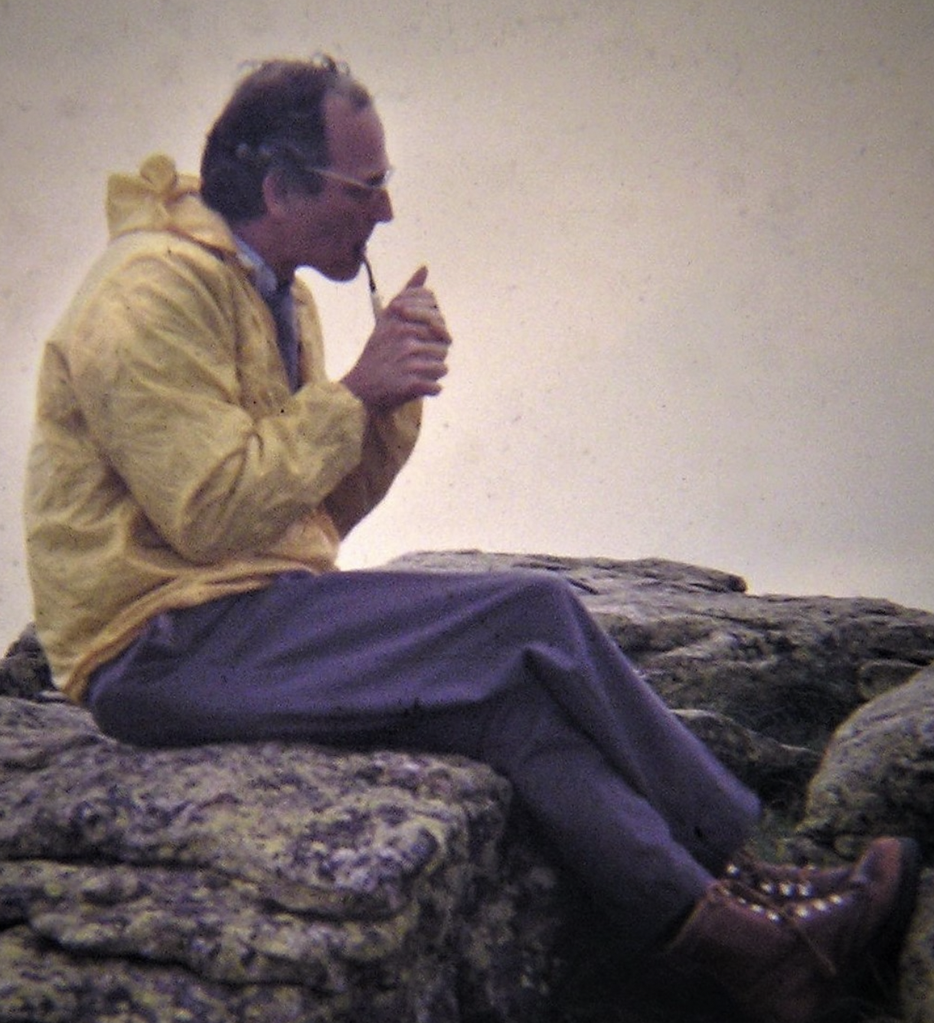
Talk – and field – possible due to Rai Weiss
September 29, 1932, Berlin, Germany
August 25, 2025, Cambridge, Massachusetts, U.S.
1972 Internal Report – roadmap for making instruments that work
1975 discussion with Kip – triggering the activity at Caltech leading to LIGO
1983 Blue book with MIT-Caltech authors – put LIGO on a firm quantified basis
1986 NSF Blue Ribbon Panel – Convinced Garwin
1990 10,000 analyses to manage Drever’s imagination
1994 Designing and watching over the beam tube realization
1997 Launching the LSC; current Analysis domains
2000 Constant presence at the LIGO Sites, LIGO BT leaks
Mentoring many of the leaders of the field

Slide 3
Objectives
Give a reminder of the growth of the observational field
Tease out some differences and repercussions; a personal view
Organized around Epochs:
  Prototypes on a range of scales
  Experimental group Coalescence
  Observatory proposals
  Observatory design and construction
    Start of the Collaboration Epoch
  Observatory Operations and Upgrades
  Next-generation Observatories

Slide 4
1970-80 Prototypes
Early MIT experimental effort had delayed and minimal funding
  1.2m Michelson interferometer using Delay Lines in the arms, data acquisition and instrument monitoring, a search for signals – a complete system, of marginal sensitivity
Garching group moves from ‘bars’ to interferometers
  Brings significant discipline, engineering, and funding to the effort
  Follows Rai’s Roadmap to demonstrate understanding. Key step forward
Glasgow/Caltech
  Working with separate Fabry-Perot cavities, developing ideas for interferometry – power and signal recycling
Orsay
  Bringing forward interferometry topologies, frequency stabilization, and Nd:YAG lasers
Pisa
  Trying first active isolation controls, then 6 degree-of-freedom pendulums

Slide 5
By the mid-1980s…
Viable notions of the instrumentation for full-scale detectors
Independent studies of full-scale detectord from US, France/Italy, Germany/UK
Initial efforts at analyzing data
Initial concepts for managing quantum noise
Growing interest by funding agencies of this new field
Most work was undertaken in isolated groups, in ‘friendly competition’

Slide 6
Experimental group Coalescence
Driven by Weiss and the NSF, Caltech and MIT joined forces
  After some early efforts, Robbie Vogt named director, at Caltech (‘87)
  Brought authority, project experience, and engineering resources
  Dictated changes in working life, and some loss of staff as a consequence
Orsay and Pisa joined forces
  Real complementarity in instrument skills (lasers, seismic isolation)
  Giazotto had project experience from HEP (and good connections)
Garching→Hannover and Glasgow joined forces
  Similar working vision, similar interests
Notable: this led to a long-standing bifurcation of activities in Europe

Slide 7
European group bifurcation
What caused this split?
Giazotto took advantage of an opening to get funding for Virgo
  In some measure a violation of agreements for pan-European planning
Germany and Glasgow believed firmly in the need for prototypes
  Not Pisa and Orsay – Desire not to incur the delay of realizing prototypes
  This may have had long-term effects in depriving Virgo of new generations of commissioners
  With hindsight, some Virgo design decisions might have been avoided
  Glasgow/Garching may have believed that Orsay/Pisa lacked necessary experience/judgement

Slide 8
Observatory proposals
Germany and UK had plans for one or two km-scale observatories
  A triangular configuration to be in Germany made good progress in the funding arena, until…The Berlin Wall came down
  GEO-600 was a fallback, with significant local funding
France and Italy conceived of Virgo
  Opportunistic jump forward by Giazotto in Italy cast a die in European relations
  Particle physics funding sources
  Kernel of the Virgo ‘experiment’ Collaboration formed
US
  Decision to jump from 40m to 4km (no intermediate step); Weiss’ insight
  National Science Foundation funding (under the Physics Division)
  Significant rescoping from Drever’s initial vision to a realistic approach
  Joint MIT-Caltech work to prepare the proposal and defend it key to transformation to a single team, facilitated by Vogt and a ‘circle the wagons’ mentality

Slide 9
Observatory proposal Epoch Astrophysics
Most of those proposing and working on instruments mostly AMO, precision measurement, or ’project’ people
  Many really interested in the measurement science – not GWs
Astrophysics arguments to motivate the building of detectors from the ‘external’ astro community
  Typically with one or several ‘liaisons’ to the Projects
Analysis, data quality, confidence, MMA developed in student theses and ‘demonstration’ observing runs
  At MIT, ‘science’ was a necessary ingredient for a PhD

Slide 10
Observatory design and construction: LIGO
Drever, and then Vogt, separated from LIGO
  Did not conform to obligatory constraints of successful Project discipline
Barish (Director) and Sanders (Project Manager), 1994 –
  Brought HEP Big Science Project insights and practice.
  Key step forward.
Robust support from the NSF; collaborative interaction with NSF
Significant participation (intellectually, funding) from UK, Germany
  N.B.: Continued fallout from the ‘Bifurcation’
Caltech was Project Lead; MIT key to design and realization, but minor engineering and management role
  MIT (the Institution) uninterested in Project responsibilities;
  Caltech did not want equal partnership
  Continues to today (…and tomorrow)

Slide 11
Observatory design and construction: Virgo
Virgo: Initially France and Italy, site in Italy; 1991 Collaboration formally established
  Leadership alternating between Giazotto and Brillet
3km baseline (LIGO is 4km)
  Provides a standing barrier to LIGO-Virgo equality in sensitivity
Low frequency instrument design focus
  Giazotto targeted Pulsars with GW signals ~10 Hz
  (Note that Virgo and LIGO have now similar realized low-frequency sensitivity)
Facility buildings tightly designed around isolators
  Creates challenges for modifications
Instrument, like LIGO, needed a series of fixes and upgrades
  Was there a negative consequence of the lack of prototypes?

Slide 12
The Virgo Organization (instrument perspective)
  Early Collaboration a handful of University/Institute groups in Italy and France focused on building the initial detector
    Now many nations and groups involved, with Observational Science included
    Basic Collaboration structure and ‘charter’ has remained the same
  Individual groups obtain funds for subsystems; design, build, deliver, commission, maintain (and maintain control of) hardware
  Top level Virgo design determined by consensus of groups in Virgo
    (not EGO)
  Establishment 2000 of European Gravitational Observatory (EGO) at site
    Intended to be a source of technical maintenance, not a scientific partner
  Spokesperson has the role of establishing consensus for the instrument plan and key design issues (as well as now the Observational Science)
    Only ‘moral’ authority; decision discussions are on their own time line

Slide 13
The LIGO Organization
Early efforts in data analysis
  1992 Sam Finn “Detection, measurement and gravitational radiation”
  1996 Bruce Allen’s GRASP
  1995 LIGO Research Community; open to all, informal, led to…
1997: Creation of LIGO Lab and LIGO Scientific Collaboration
  Contributing to the science from LIGO the main criteria for membership.
  Principal foci: Data Quality, Data Analysis, Astrophysical Interpretation
    And a lot of bureaucracy to measure and monitor contributions
    ‘Payment’ in authorship of LSC papers; 24→18→ 13 month proprietary period
  Not a significant source of deliverable instrumentation to the Observatories; Caltech and MIT produce operations equipment
  …but LSC a very important contributor of R&D for new instrumentation
  UK, Germany, Australia strong elements in the LSC (…not in Virgo…)
  LIGO Lab: Caltech and MIT only. Not a “Collaboration”
    Employees carrying out job responsibilities; hierarchical organization

Slide 14
Current LSC, Virgo, KAGRA → IGWN
All strain data are analyzed by all members of all 3 Collaborations
  Papers are signed jointly
  Instrument specific tasks – calibration, data quality – separate
Problems: different rules, separate decision-making processes, imbalances in computing contributions → inefficiencies and a sense of inequity in members
Solution chosen: combine the 3 Collabs under one set of rules.
~2500 persons, checks on contributions, bureaucracy
…and clearly still highly variable levels and values of contribution
Data remain proprietary for a period of a year+

Slide 15
Observatory Operations and Upgrades
LIGO and Virgo detectors have undergone a series of upgrades
  Detection rate grows as cube of sensitivity!
To date, all instruments stop and start observing together
  May be an error from the greater astrophysics perspective
Virgo and LIGO use many similar technologies
  Seismic isolation approach very different (multiple pendulums vs. servos)
  Virgo did not adopt a key optical shift (‘mode-stable input/output cavities’)
  May entail a significant ‘downtime’ in coming years for Virgo
Instruments available 75-90% of clock time
  Triple coincidence around 50%

Slide 16
Next-generation Observatories: ET
Einstein Telescope very well advanced in the funding/political/organizational senses
Interestingly focus is again on low frequencies
  Goals: pre-merger MMA guidance; IMBH
  Drives the instrument underground to reduce gravity gradients
  Drives the plan for low- and high-frequency detectors
  Brings expense and challenges – and potential great science
Instrument goals require significant technical advances
  This has been very motivating for the ET instrument community!
See differences north-south Europe once again
  Sites, configurations, organization…cultural, or chance?
  But this time UK and Germany may put focus on Europe, not US, for next-generation
See tensions between ‘the Collaboration’ and ‘The ET Organization’
  Funding agencies need control; the Scientists want ownership
See tensions ET vs Virgo –
  Limited number of skilled experimentalists;
  Much more generous funding for ET than Virgo

Slide 17
Next-generation Observatories: CE
Cosmic Explorer the next US Terrestrial GW Observatory
Started much later than ET, less developed, smaller community
A giant LIGO (40km instead of 4km); surface, room temperature
  Low-risk approach for the observatory, and the initial detector
  Generates less excitement for the instrument scientists
  Assume evolution of the detector over ~50-year lifetime of Observatory
Ever closer connection CE-LIGO Lab
  Anticipate a single entity in future
Greatest risk and challenge: making constructive relationships with the indigenous peoples whose land will host CE
  TMT as a cautionary tale

Slide 18
CE and ET network
Evident that the Observatories will need each other to leverage the data
  ET initially conceived before first detections, and planned to be the ‘one’ next generation detector (triangle configuration)
  Now likely that US-based CE will be built, as a single detector
    40km and 20km is the ‘baseline’ but unlikely to be funded
  LIGO-India, using components from US LIGO in an Indian Observatory, will likely form the 3rd leg of the tripod; progress there has been slow
    Could be adopted by CE/LIGO as a central element of the program

Slide 19
Closing thoughts – personal opinions!
Have learned how to design, build, and operate successful detectors
  Net uptime with upgrades is suboptimal
  Virgo limited by its organization
Have developed Collaborations which deliver excellent science
  Early-career scientists can get lost in thousand-person organizations
  Proprietary data and payment in authorship unattractive elements
Have visions of technology to make 10x improvement
  ET excessively complicated
  CE may not have timely funding and site options
…but we have a new field of GW observation! All worth it.

