Slide 1


Observatory Conceptual Design
Joey Shapiro Key
for the Cosmic Explorer Project

Slide 2
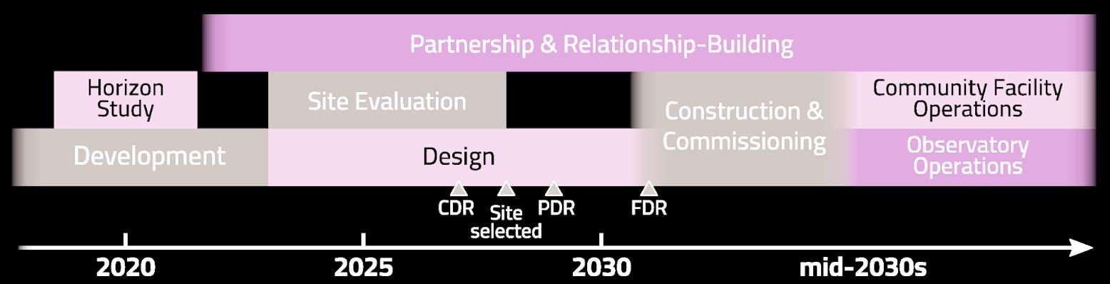
Cosmic Explorer Conceptual Design
  Cosmic Explorer Project Design Phases
  Conceptual Design (3+years)
  Preliminary Design ~$75M (2-3 years)
  Final Design ~$100M (2 years)

Slide 3
Cosmic Explorer Conceptual Design
  Science traceability
  Facility design
  Detector design
  Systems engineering
  Computing design
  CE Project Office
  Partnership and relationship building
  Site evaluation and initial report
  Project evaluation and consulting

Slide 5
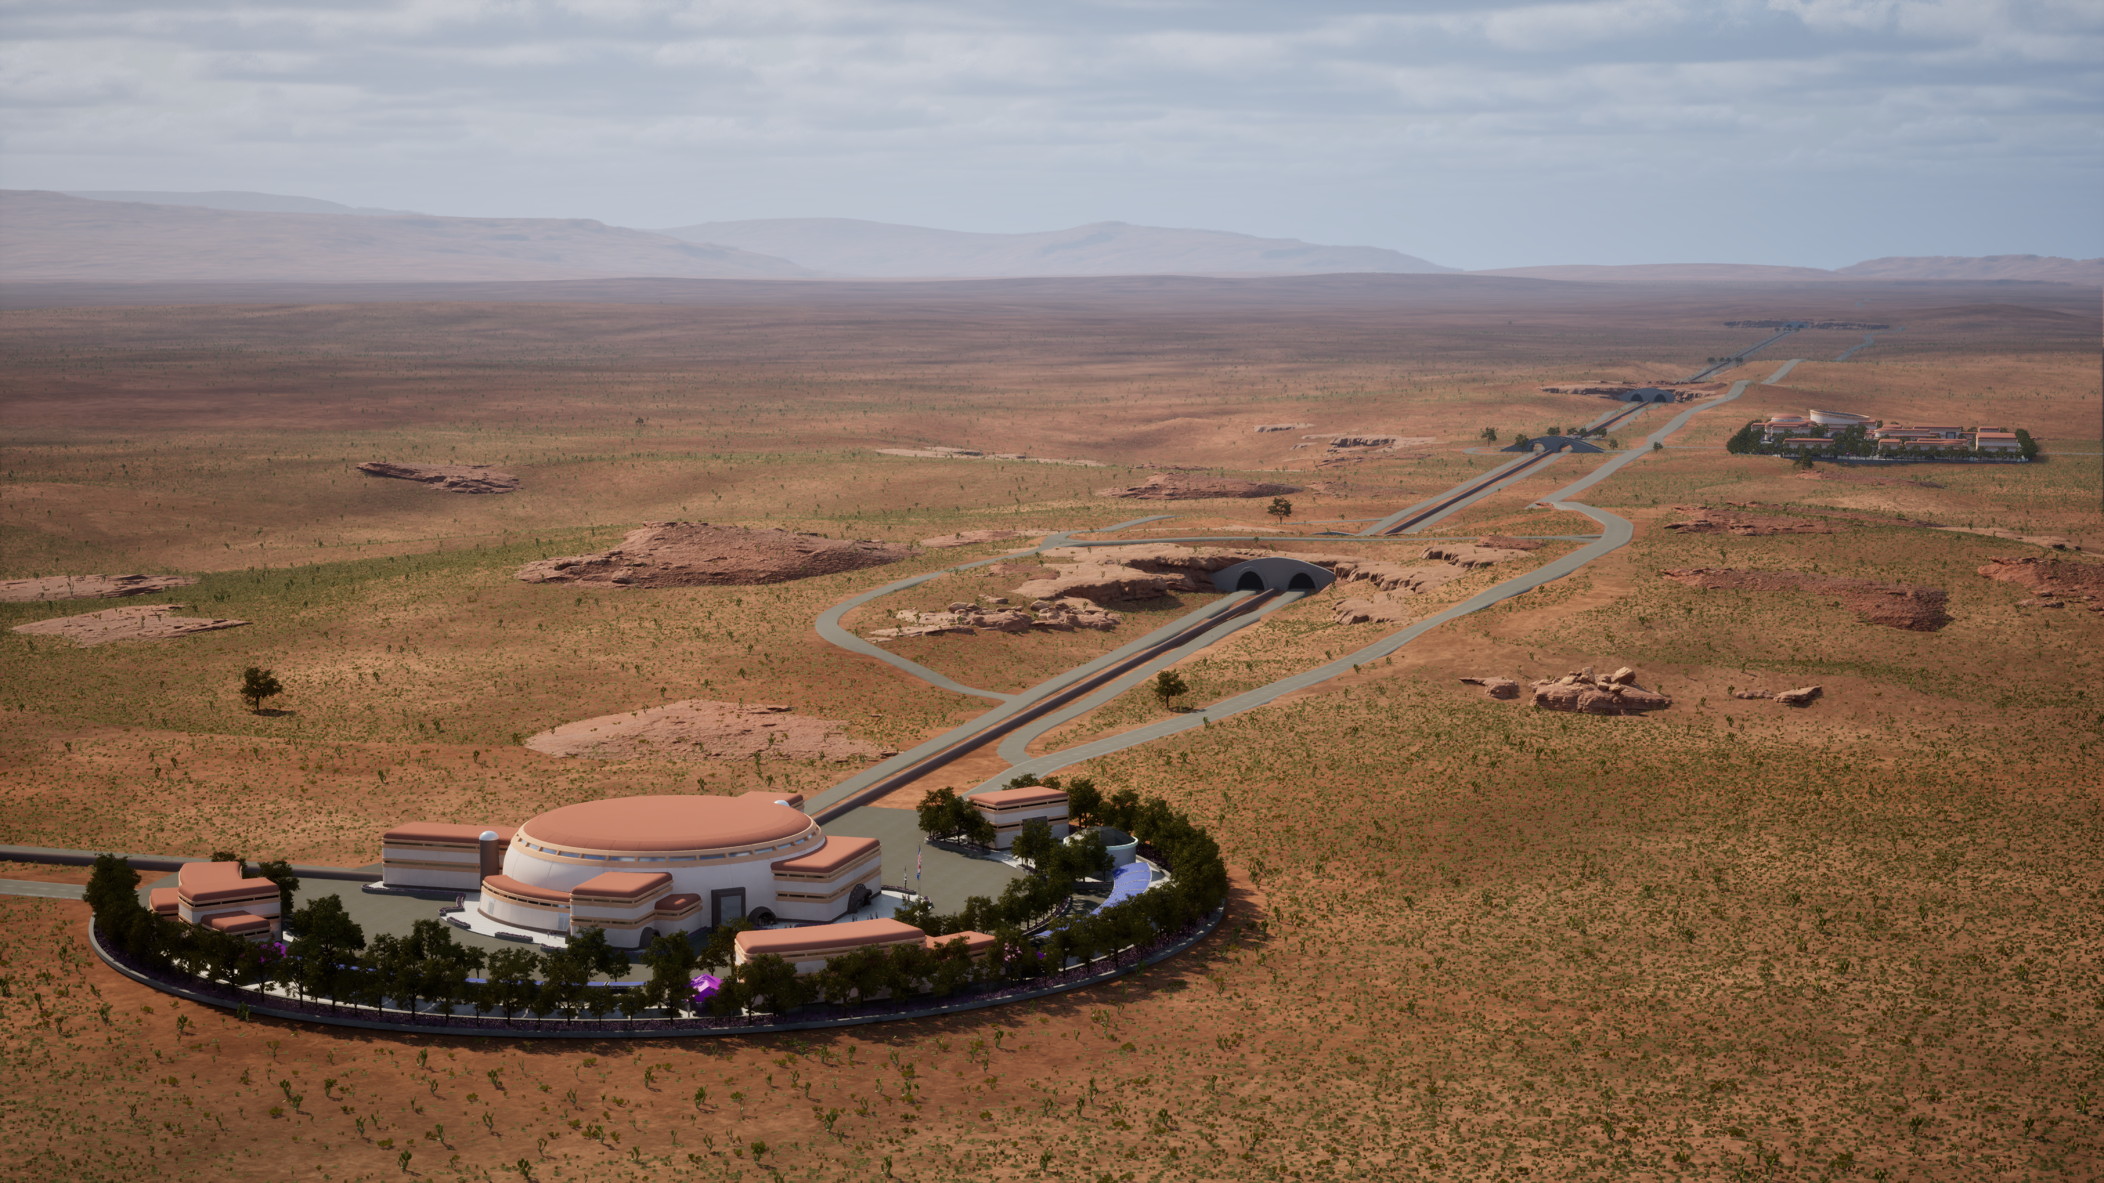
Cosmic Explorer Observatory Sites
  An Interdisciplinary Site Suitability Analysis for Cosmic Explorer (Bristol)
  Site Identification and Evaluation for Cosmic Explorer (Datrier)
  Indigenous and Place-based Partnerships and Responsible Siting
  Community visits
  Cosmic Explorer: An Introduction for Tribes
  CE Project IPP-RS guest speaker series

Slide 6
Cosmic Explorer Consortium
The Cosmic Explorer Consortium is intended to organize and represent the broader Cosmic Explorer community, including scientists across related fields, technical and nontechnical contributors to the Cosmic Explorer Project, people working with Cosmic Explorer, and other interested parties.
Membership in the Cosmic Explorer Consortium does not preclude membership in the Cosmic Explorer Project or in other collaborations.
Members are encouraged to collaborate with each other, as well as scientists outside the Cosmic Explorer Consortium, on projects related to Cosmic Explorer. Commitment to specific Scientific Collaborations is not required to join the Cosmic Explorer Consortium.

Slide 7
Cosmic Explorer Consortium Objectives
1. Bringing together the scientific, technical, individual, interpersonal, cultural, and systems expertise needed for the development and effective use of Cosmic Explorer.
2. Facilitating the contribution of talents and perspectives from across the astronomy and physics community to Cosmic Explorer’s science and technology.
3. Supporting equitable participation in creating, and equitable access in using, the knowledge, infrastructure, and innovations that result from Cosmic Explorer.
4. Working to ensure responsible and fair allocation of necessary and available Consortium resources across people, processes, and priorities.

Slide 8
Cosmic Explorer Consortium Activities
Consortium activities will include, but are not limited to:
coordinating regular Cosmic Explorer Science calls and organizing meetings, workshops, conferences, and schools related to the activities of the Consortium,
contributing to detector technology and science case development for Cosmic Explorer; communicating the potential of Cosmic Explorer through community participation and white paper contributions,
moderating and maintaining the Cosmic Explorer Consortium mailing list to share announcements, scientific news, and other items of community interest.

Slide 9
Cosmic Explorer Consortium Activities
monthly science calls: cosmicexplorer.org/sciencecalls
  alternating times (Europe friendly and Asia/Austrian friendly)
  2 x 25m presentations per call, usually recent CE-related papers or works
  occasional presentations from the CE Project
  any Consortium member can fill a request for a slot
science traceability matrix working groups
neXt-Gen Collaborative Design (XGCD) with ET
  started in January this year
  ~every other month 1.5h long meeting on instrument topics of common interests for ET and CE

Slide 10

Cosmic Explorer Consortium Membership
You are invited to join!
cosmicexplorer.org/consortium
550+ members
CE Consortium membership does not come with any FTE commitment
The CE Consortium is currently steered by a volunteer team. A future elected governance structure is outlined in the CE Consortium document. The volunteer team will host elections and transfer leadership to an elected. team when needed.

Slide 11
Cosmic Explorer Project Office
Directors’ Office
Executive Director
Director of Land and Community Partnerships
Director of Personnel and Organizational Development
Director of Observatories and Facilities
Director of Observational Science
Project Office
Project Administration
Observatory System Leads
Site and Infrastructure
Vacuum Systems
Detector Subsystems
Observational Analysis
Safety and Security
Operations Office Science Coordination
Business Office
Head of Business
Director of Human Resources
Deputy Director of Human Resources
Head of Environment, Health, and Safety
Head of Operations Planning
Head of Cyber-Infrastructure and Computing
Communication Office
Director of Communication and Education
Education and Community Outreach Officer
Communications Officer
Government Relations Coordinator
Tribal Relations Coordinator
Project Advisors CE Consortium

Slide 12

CE evaluation and consulting focus areas
Cosmic Explorer project evaluation and consulting focuses on:
Inclusiveness: valued contributions, sense of belonging
Mentorship: current experiences, supports needed for mentors and mentees
Professional development: new skills and knowledge, career advancement
Organizational efficacy:
  communication, structure, interactions with consortium,
  international collaboration, shared vision
Indigenous and Place-based Partnerships & Responsible Siting

Slide 13
Evaluation data collection strategies
Demographic and engagement survey of CE Project members
Demographic and involvement survey of CE Consortium members
Interviews of CE Project members
Pulse surveys for workshops and professional development activities
Data briefs, reports, and recommendations shared with participants
Discussion with participants and responses from management team

Slide 14
Select recommendations from CE Project data
Cultivate commitment to equitable communication and collaboration
Prioritize in-person engagement opportunities to build relationships and trust
Create intentional support for new and/or early career Project members
Provide structures, training, and resources to enable effective mentorship
Increase role clarity and provide opportunities for role-related skill development
Strengthen communication horizontally (across working groups) and vertically (from Project leaders)
Keep operational goals realistic and flexible, in alignment with staffing and organizational capacities

Slide 15
Cosmic Explorer Observatory Sites
  Up next: complementary work to identify CE sites
  An Interdisciplinary Site Suitability Analysis for Cosmic Explorer (Bristol)
  Site Identification and Evaluation for Cosmic Explorer (Datrier)

