Slide 1
Cosmic Explorer Intensity Noise Controllers
Craig Cahillane
July 28, 2025
CE Optical Design Call

Slide 2
Problem
Low frequency intensity noise may be a limiting noise factor for Cosmic Explorer gravitational wave sensitivity.
Particularly bad could be the intensity-to-frequency noise radiation-pressure-based cross-coupling.
This I2F cross-coupling has the ability to impose frequency noise in a low-frequency regime using the input mode cleaners themselves,
at a point in the input optics chain where we have little recourse to correct for it.
What are some options to combat intensity noise?

Slide 3
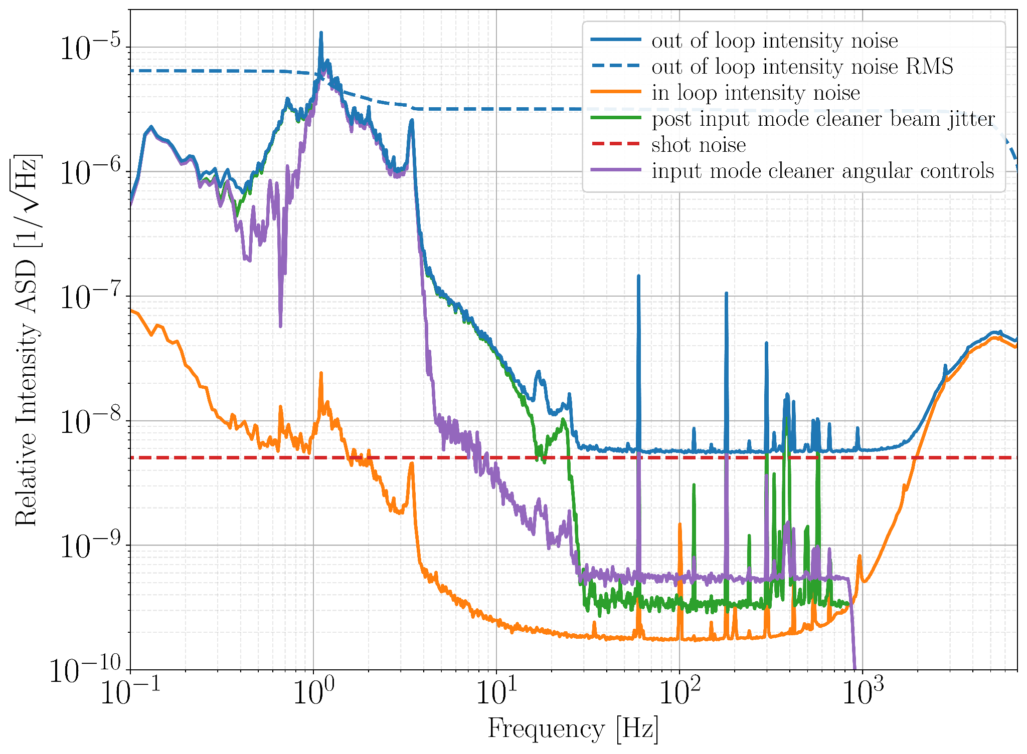
Intensity noise in O3
Similar to O4
IMC Angular Controls
ISS Array Miscentering
Gain Limited
Intensity Noise
Shot Noise

Slide 4
Straightforward Hierarchical Intensity Control Scheme
ISS
Second Loop
PC
Pol
FI
Sensors on PSL and in transmission of every IMC
Want DC coupling
All feedback to the
same AOM
Requires careful bandwidth management:
1st BW > 2nd BW > 3rd BW
IMC1
100 m
PMC
16m
NPRO
1064 nm
IMC2
330 m
AOM
FI
ISS
First Loop
ISS
Third Loop
PRM
Pol
FI

Slide 5
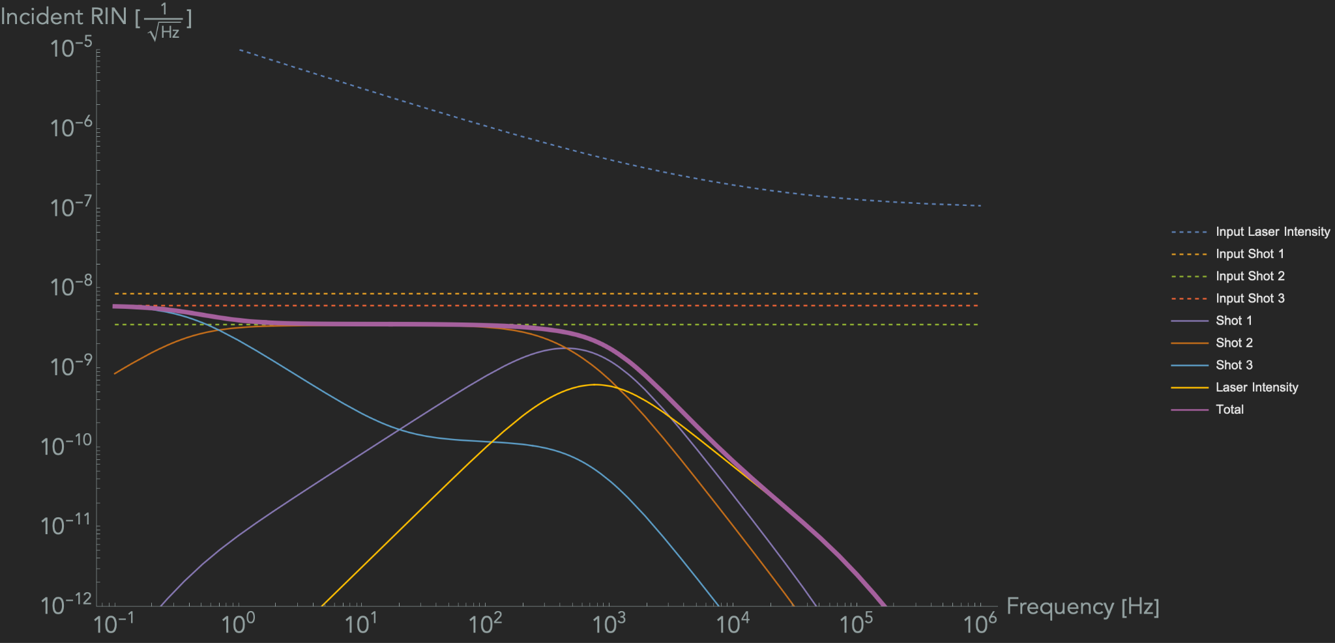
CE Intensity Noisebudget (first pass)
Bandwidths:
1st loop: 10⁵ Hz
2nd loop: 10⁴ Hz
3rd loop: 1 Hz

Slide 6
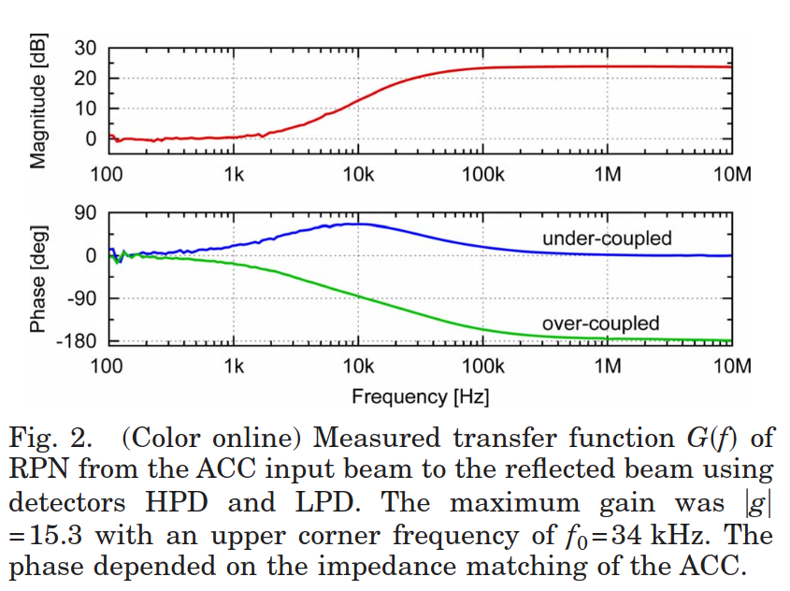

Optical AC Coupling
Idea: Reduce shot noise limit by detecting AC fluctuations above cavity pole directly.
Hurts sensitivity at low frequency
Derived in Patrick Kwee’s thesis from AEI, studied by Kwee and Willke [2],[3],
and measured at LIGO Livingston [4]
Pin
Prefl
Pcav
Ptrans
where a is impedance matching
and h(f) is the normalized cavity pole TF
Cavity must be undercoupled, or else control loop is unstable

Slide 7
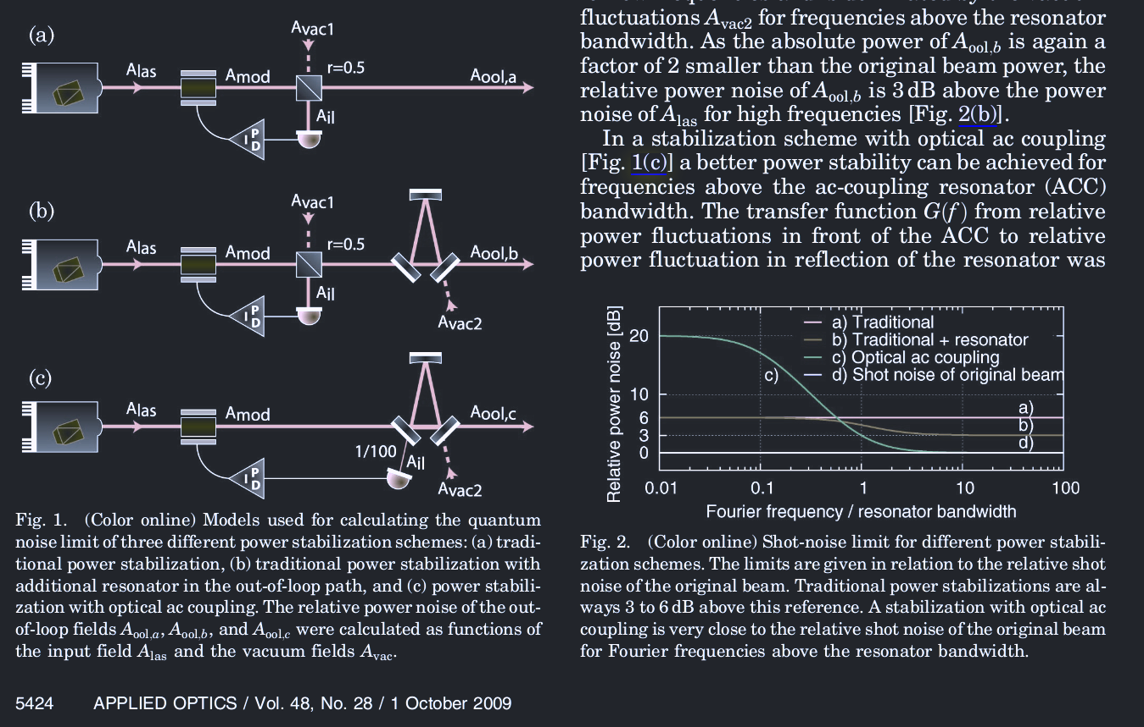
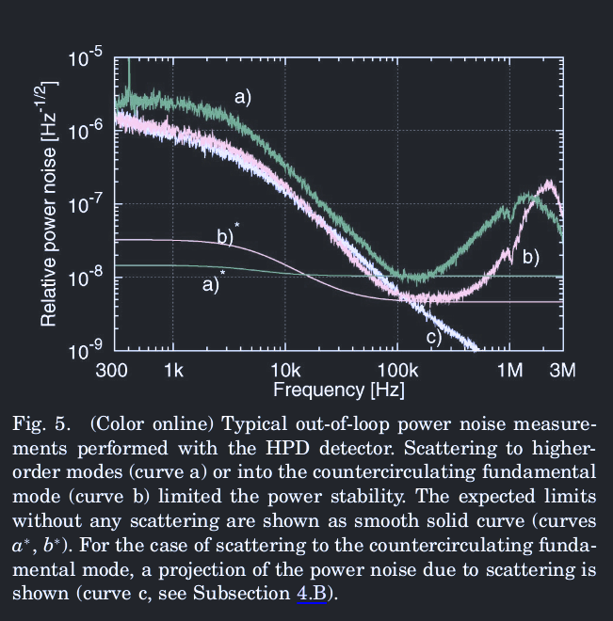
Optical AC coupling only helps the shot noise limit at high frequencies above the cavity pole.
Not where we really want the improvement.

Slide 8
Squeezing and Intensity Noise
Psqz1
Ptrans
Pin
Prefl
Psqz2
ISS array
Can inject squeezing into the ISS improve the shot noise limit on Ptrans
Psqz1 is the main squeezed light path for reducing the intensity noise.
Psqz2 is another path by which quantum noise will be imposed upon Ptrans.
Proof of principle: Valbrutch et. al. https://journals.aps.org/prl/abstract/10.1103/PhysRevLett.121.173601

Slide 9
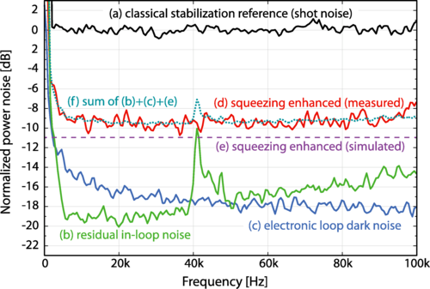
Advantages of Squeezed intensity loop:
Improves low frequency intensity noise (if shot noise limited)
Easy to implement (for LIGO)
Lots of experience in LIGO
Don’t necessarily have to use
Valbrutch et. al. FIG. 3

Slide 10
Optical AC Coupling Hierarchical Intensity Control Scheme
PC
Pol
FI
Sensors on PSL and in reflection of every IMC
Small win from AC coupling in reflection
All feedback to the
same AOM
Requires careful bandwidth management:
1st BW > 2nd BW > 3rd BW
IMC1
100 m
PMC
16m
NPRO
1064 nm
IMC2
330 m
AOM
FI
ISS
First Loop
ISS
Second Loop
ISS
Third Loop
PRM
Pol
FI

Slide 11
Serial Intensity Control Scheme
ISS Third Loop
AOM2
PC
Pol
FI
Sensors on PSL and in reflection of every IMC
Small win from AC coupling in reflection
Feedback to
different AOMs
Can have high bandwidth in all serial loops.
IMC1
100 m
PMC
16m
NPRO
1064 nm
IMC2
330 m
AOM1
FI
ISS
First Loop
ISS
Second Loop
PRM
Pol
FI

Slide 12
Conclusions
Options to combat intensity noise
Push down IMC angular control resonances to be < 1 Hz to avoid limiting CE at 5 Hz.
  Will aLIGO quad suspensions be enough? Probably close enough.
Make ISS array easier to align
  Can investigate ultra-high power photodiodes, see if they can perform for 10000 hours with 100 mW incident.
Squeezed light injection into main ISS array

