Slide 1
Baffle simulation by SIS status
Baffle modeling by SIS
General power deposit views
Low pass filter
NbafShield dependence
Resolution
BRDF

Slide 2
CE arm tube baffle design by SIS
Goal : Quantitative and flexible noise estimation by beam tube baffles in Cosmic Explorer
Physics :
  Eanna Flanagan and Kip Thorne. “Light Scattering and Baffle Configuration for LIGO”, LIGO-T950101-00-R, 1995.
  Proper inclusion of scattering by mirror surface map and BRDF data for large angle scattering
  Noise by reflection by beam tube
Tool : SIS (Stationary Interferometer Simulation) with extensions for CE and baffle scattering
  Documentations : https://dcc.ligo.org/LIGO-T2000311
  Source code and examples : https://git.ligo.org/IFOsim/SIS
To be studied
  Optimal design of the baffle, locations, geometry, material, etc
  Dependence on the mirror phase map

Slide 3
CE arm tube baffle simulation by SIS
Fields in the cavity is calculated including the clipping by all preceding baffles
  Field passing through a baffle propagates to the next baffle using FFT propagation
The noise calculation of reflection and diffraction by baffles discussed in T950101
  Updated by including new information, without approximation needed for numerical calculation, and better methods
Noise by the reflection of the field off the beam tube
Reflection by beam tube
Reflection
noise
diffraction
noise

Slide 4
General power deposit views
Variables in baffleManager.m and are available in the output of getBaffData
loc : distance to source
dP : power on baffle using FFT propagation
dP0 : power on baffle using geometrical prop
PCA : power going through clear aperture
dPout : power out of baffle or on beam tube
dPout(N) = PCA(N-1) - dP(N) – PCA(N)

Slide 5
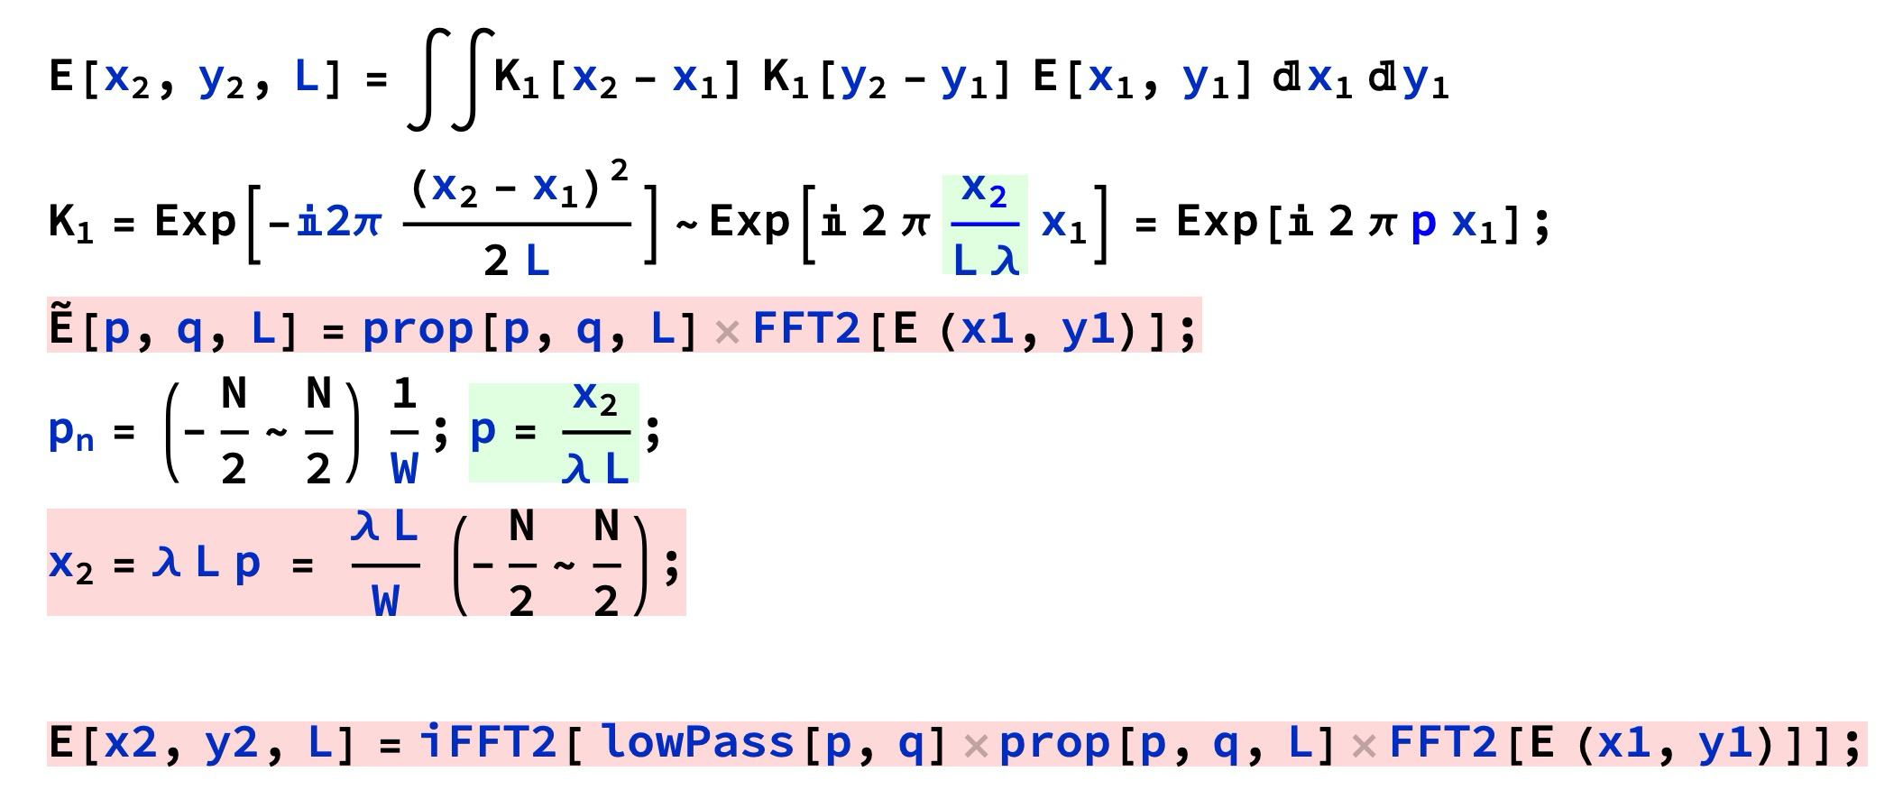
Low pass filter
Low pass = 1 : n < Nc
smoothly connected in between
Low pass = 0 : n > Nc2
Nc is scaled by lowPassVal
Default lowPassVal = 1

Slide 6
Low pass filter
1-PCA
aLIGO : no difference
CE :
baffle at 500:500:40k
with low pass
dP
dPout = PCA(N-1)
- PCA(N) – dP(N)
dPout
no low pass
fake by aliacing
reflection noise K
backward prop without
low pass filter not reliable
No data because dPout < 0

Slide 7
Resolution : 1mm vs 2mm
aLIGO
Rin = 53cm
1mm
2mm
CE 6 baffles
Rin = 30cm

Slide 8
NbafShield dependence aLIGO signal

Slide 9
NbafShield dependence
CE power
N=3
N=9
1-PCA
dP
dPout
Some difference, but small power

Slide 10
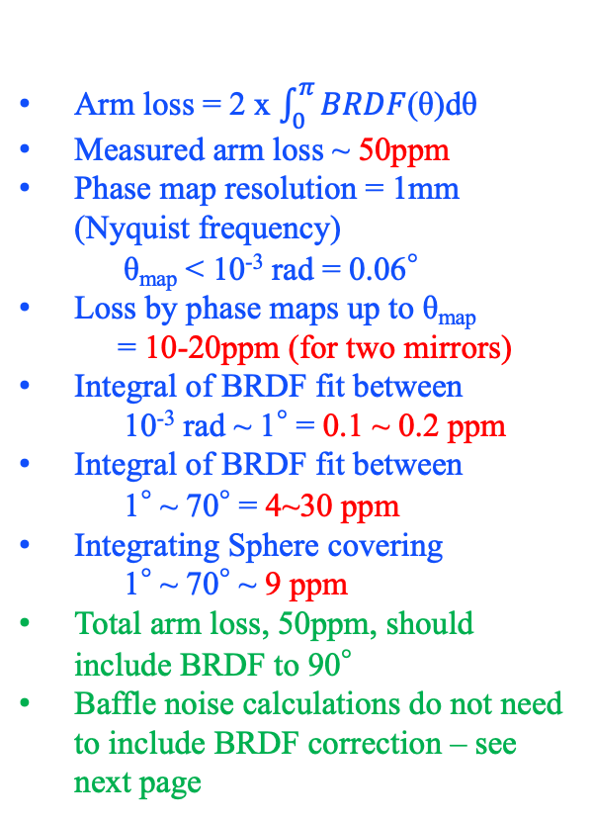
BRDF
Arm loss = 2 x $\int_{0}^{π}{BRDF}$(θ)dθ
Measured arm loss ~ 50ppm
Phase map resolution = 1mm (Nyquist frequency)
θ_{map} < 10⁻³ rad = 0.06°
Loss by phase maps up to θ_{map}
= 10-20ppm (for two mirrors)
Integral of BRDF fit between
10⁻³ rad ~ 1° = 0.1 ~ 0.2 ppm
Integral of BRDF fit between
1° ~ 70° = 4~30 ppm
Integrating Sphere covering
1° ~ 70° ~ 9 ppm
Total arm loss, 50ppm, should include BRDF to 90°
Baffle noise calculations do not need to include BRDF correction – see next page
10-20ppm / 2
~0.2ppm
~15ppm x (0.5~2)

Slide 11
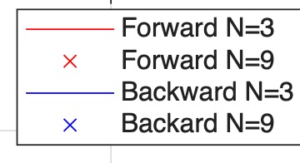
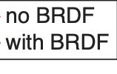
BRDF aLIGO signal – not visible

Slide 12
BRDF aLIGO powers
1-PCA
dP
Solid angle² x dP
Effect of BRDF is observed
in baffle location <300m
Magnitude in this region is small
dPout

