Slide 1



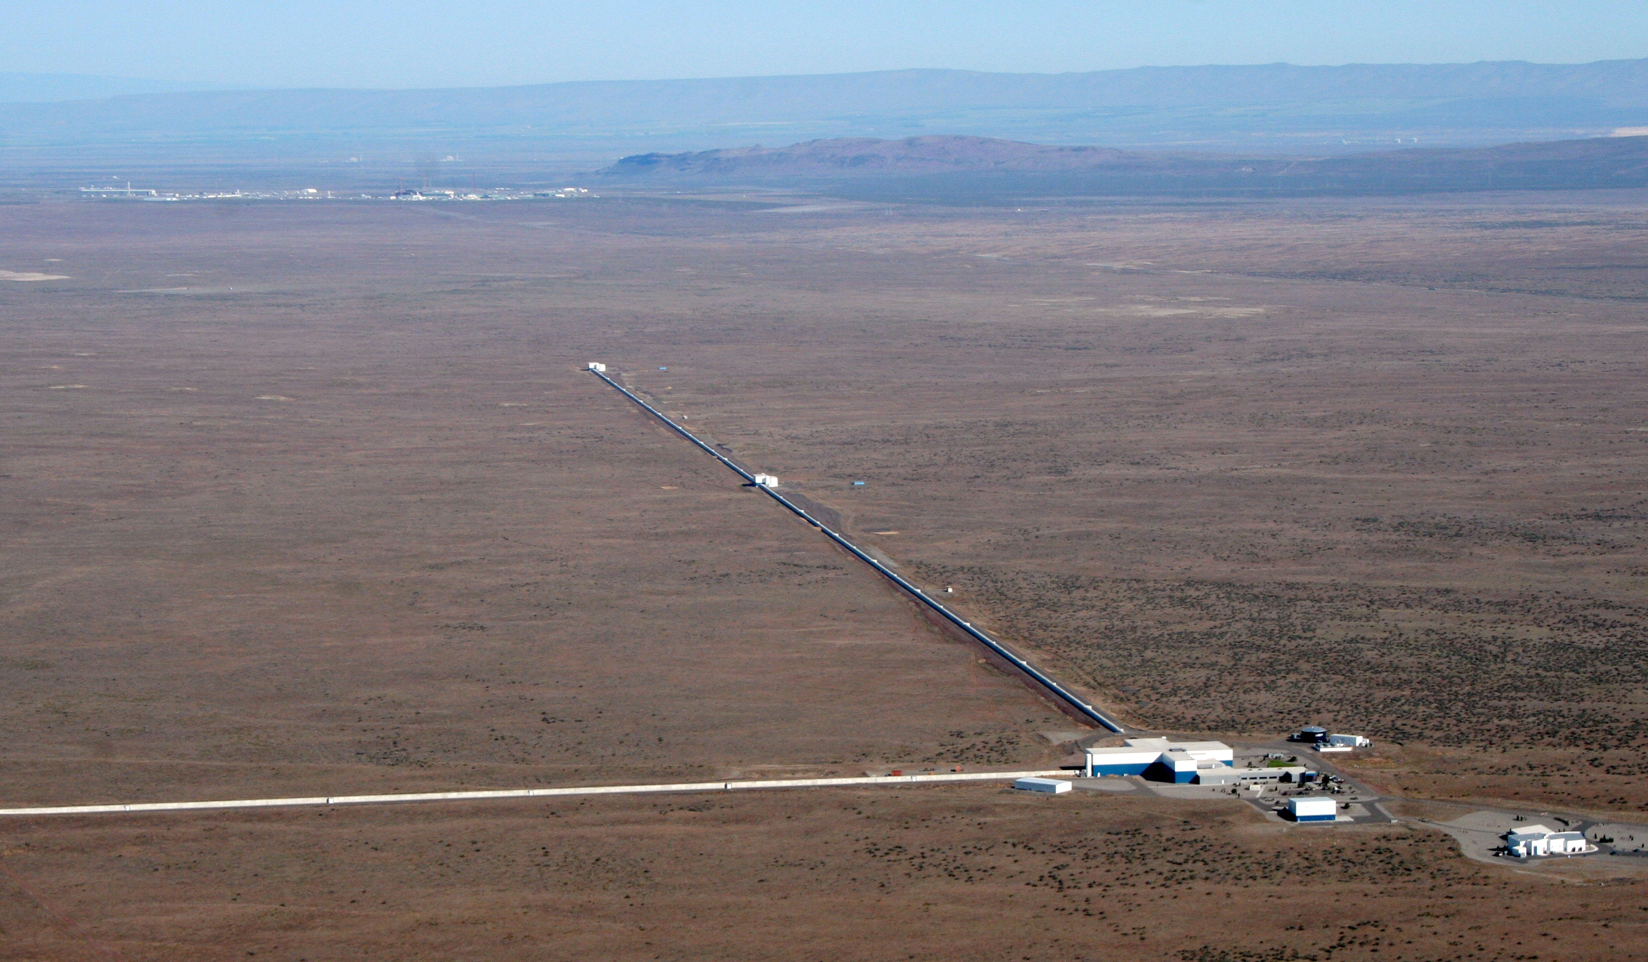
Present and Future Terrestrial GW Detectors
David Shoemaker
MIT Kavli
Slides from many ET, CE and LIGO Collaborators!
LISA Symposium
11 July 2024
CE-G2400052

Slide 2
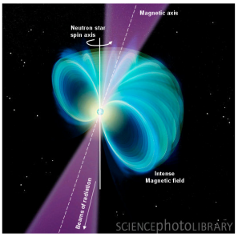
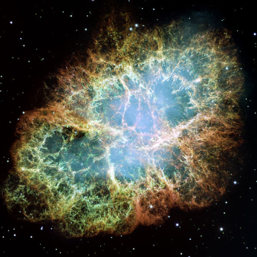
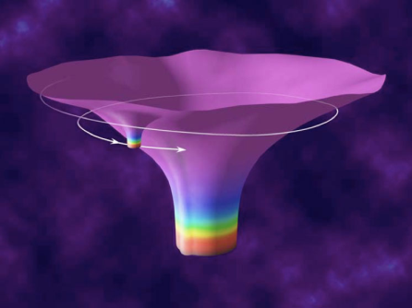
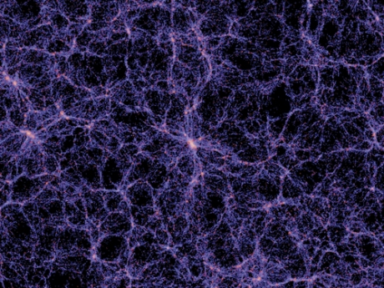
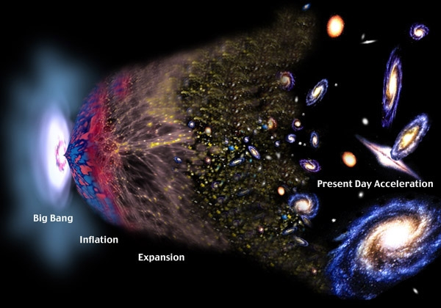
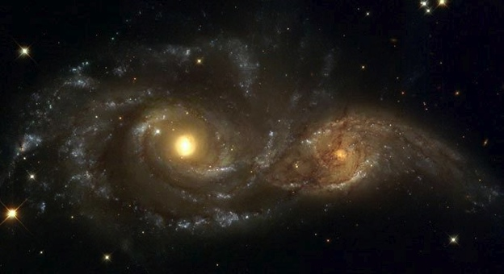
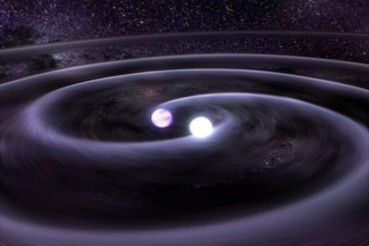
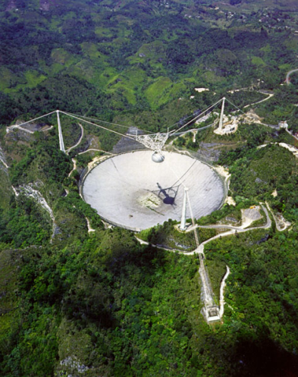
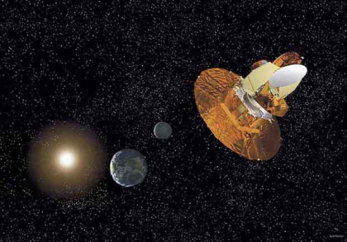
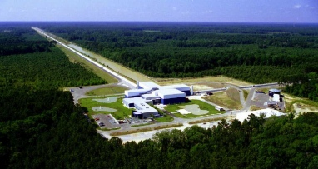
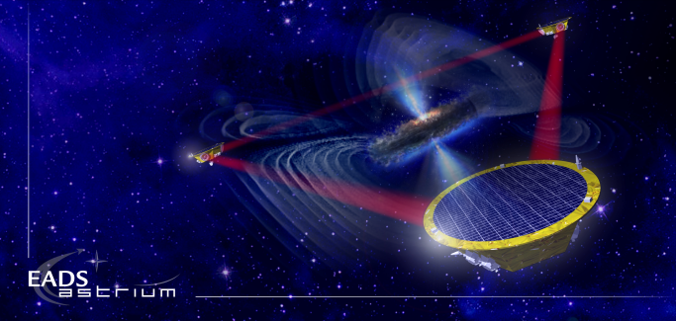
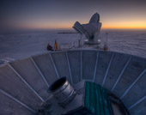
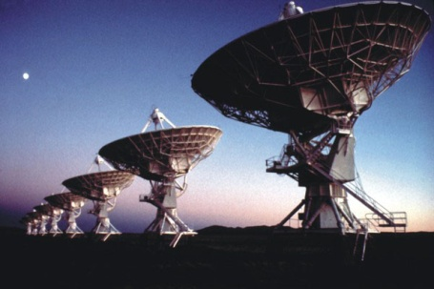
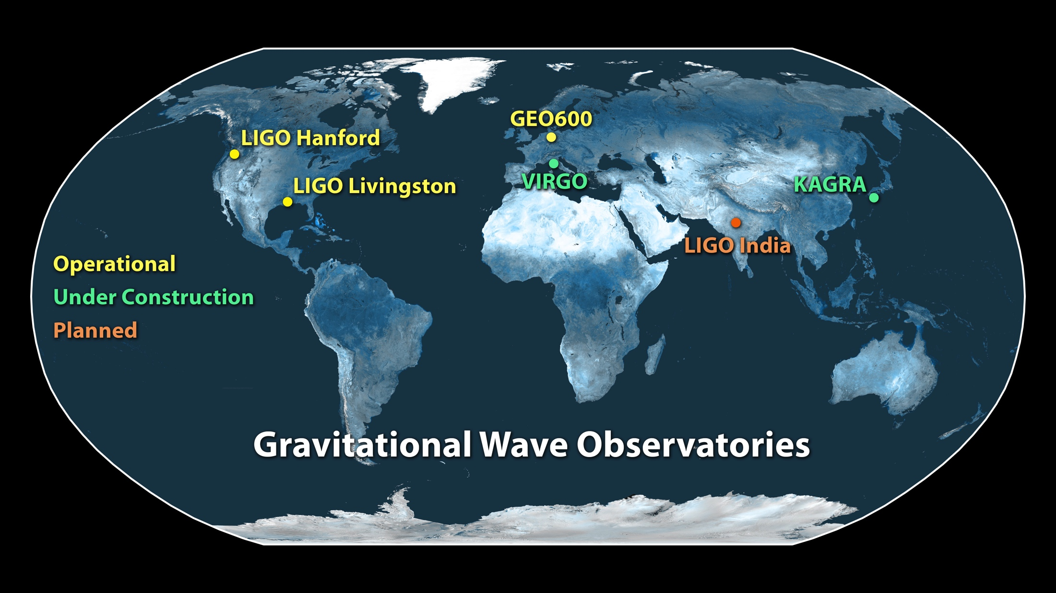
The Gravitational Wave Spectrum
Supernovae
Cosmic Strings
Relic radiation
Extreme Mass Ratio
Inspirals
Spinning NS
BH and NS Binaries
Supermassive BH Binaries
10⁻¹⁶ Hz
10⁻⁹ Hz
10⁻⁴ Hz
10⁰ Hz
10³ Hz
Pulsar timing
Space detectors
Terrestrial interferometers

Slide 3
The Gravitational Wave Spectrum
Supernovae
Cosmic Strings
Relic radiation
Extreme Mass Ratio
Inspirals
Spinning NS
BH and NS Binaries
Supermassive BH Binaries
10⁻¹⁶ Hz
10⁻⁹ Hz
10⁻⁴ Hz
10⁰ Hz
10³ Hz
Pulsar timing
Space detectors
Terrestrial interferometers

Slide 4
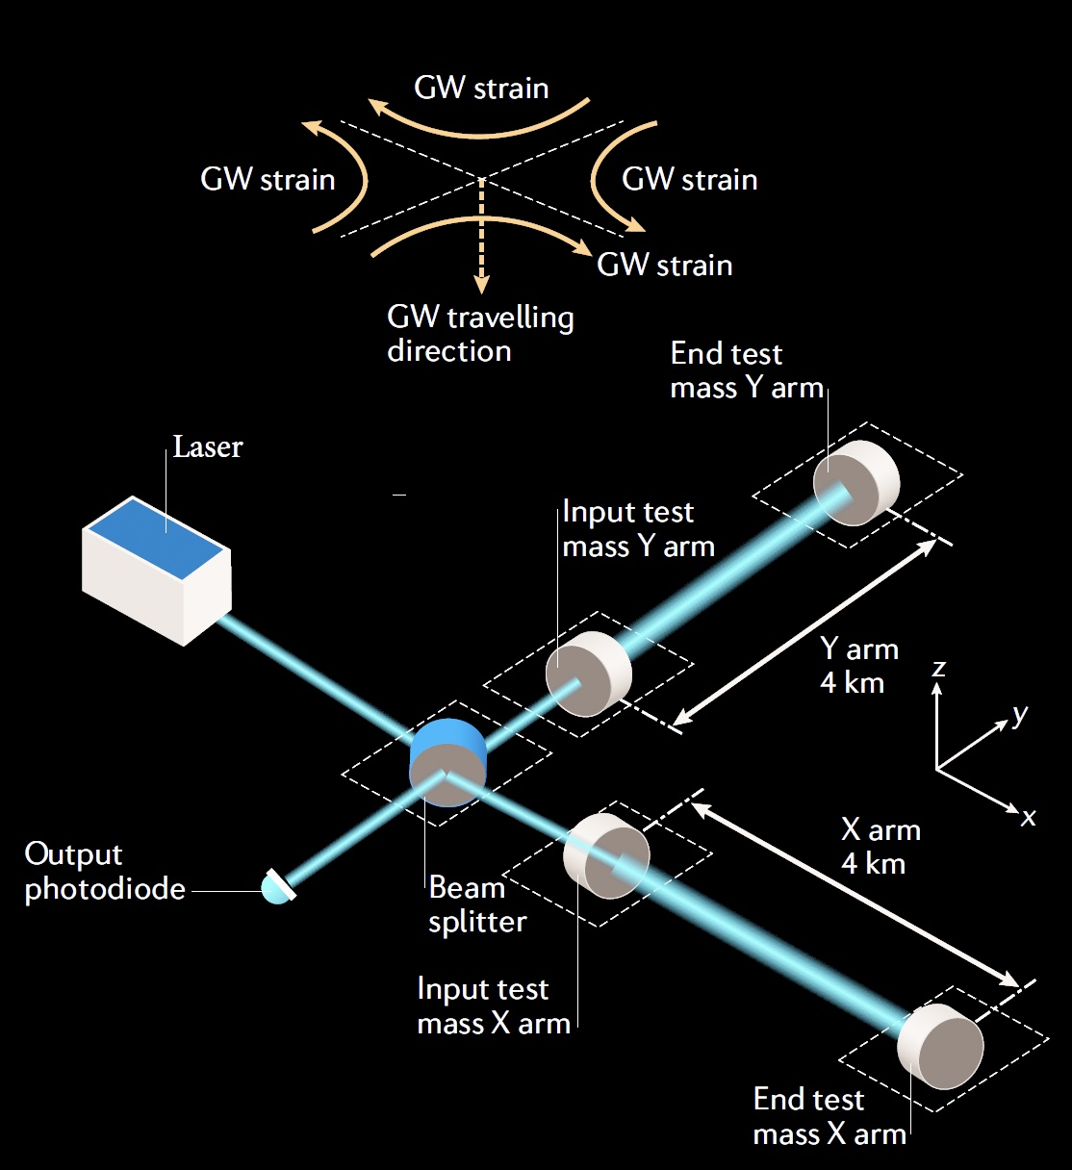
Why are terrestrial detectors limited to f > ~1 Hz?
Passing GW shortens the light path for one arm, lengthens for the other – and then vice-versa
ΔL = h_{GW} · L
Interference at the Beam splitter turns this into a light intensity variation, and a photodiode into an electrical signal
Resolution of the readout limited by quantum effects
Physical motion of the mirrors due to local forces masks the minuscule changes in light path due to GWs

Slide 5
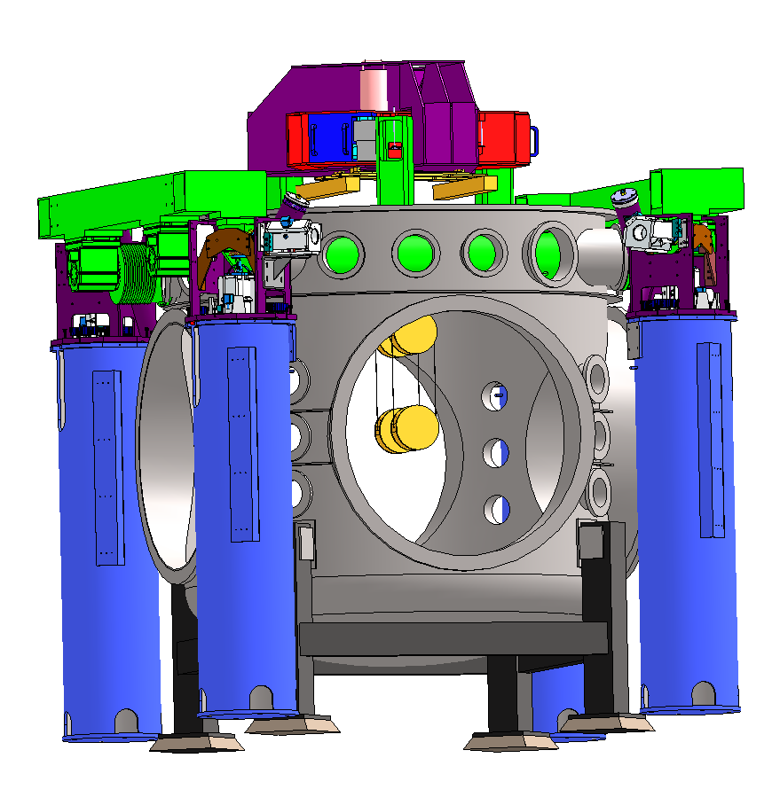
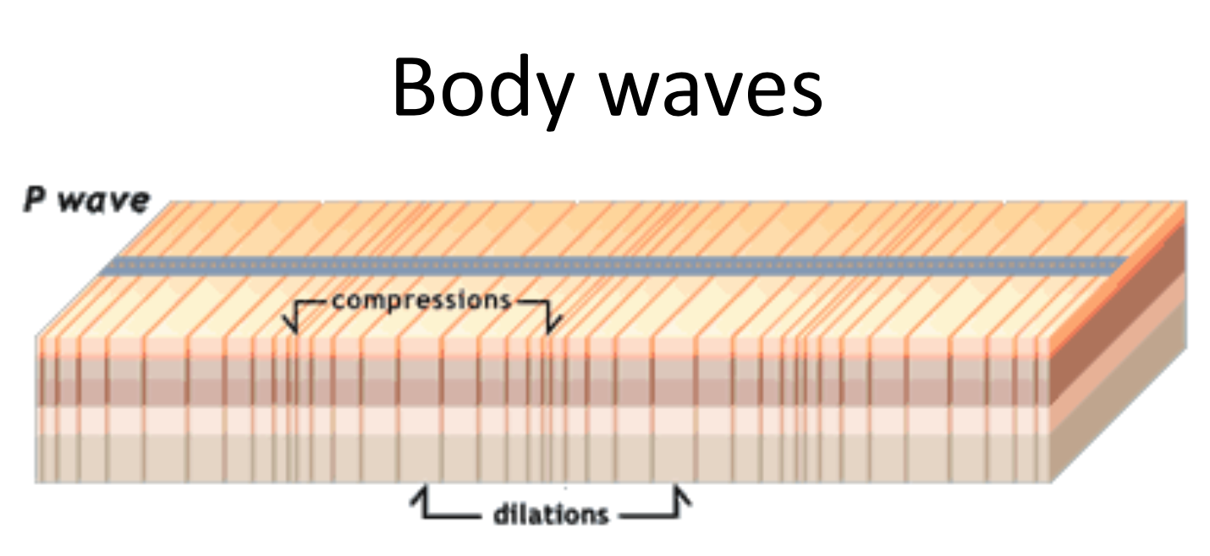
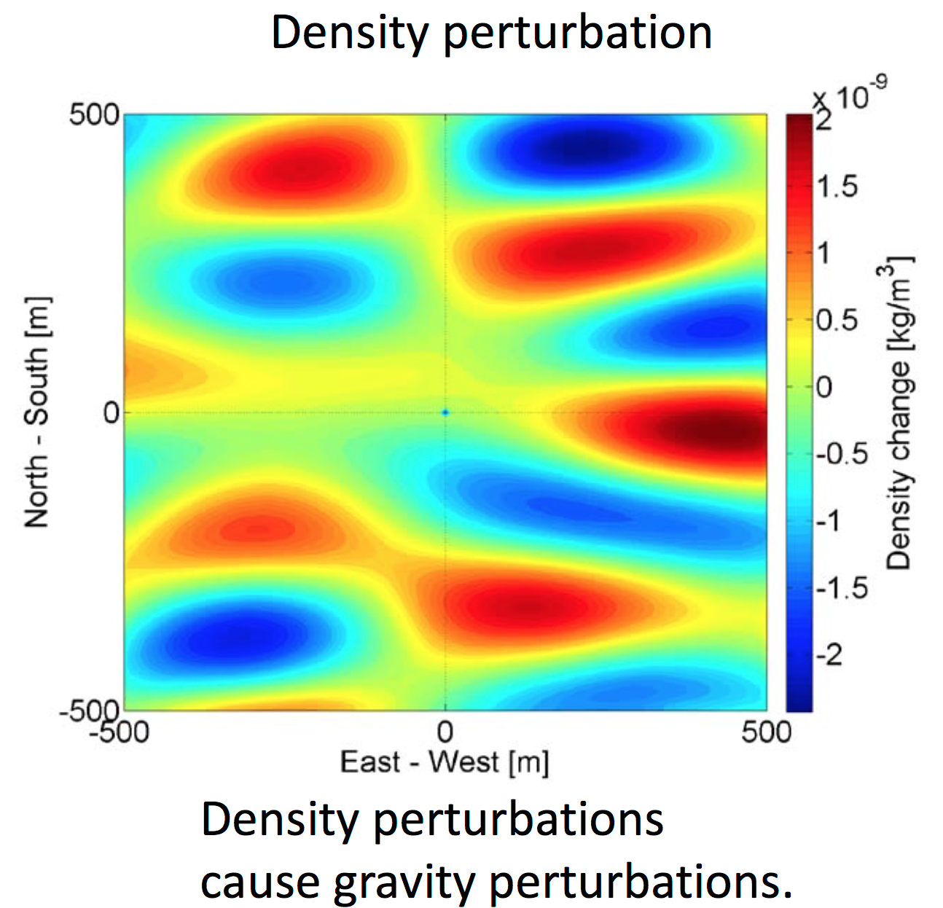
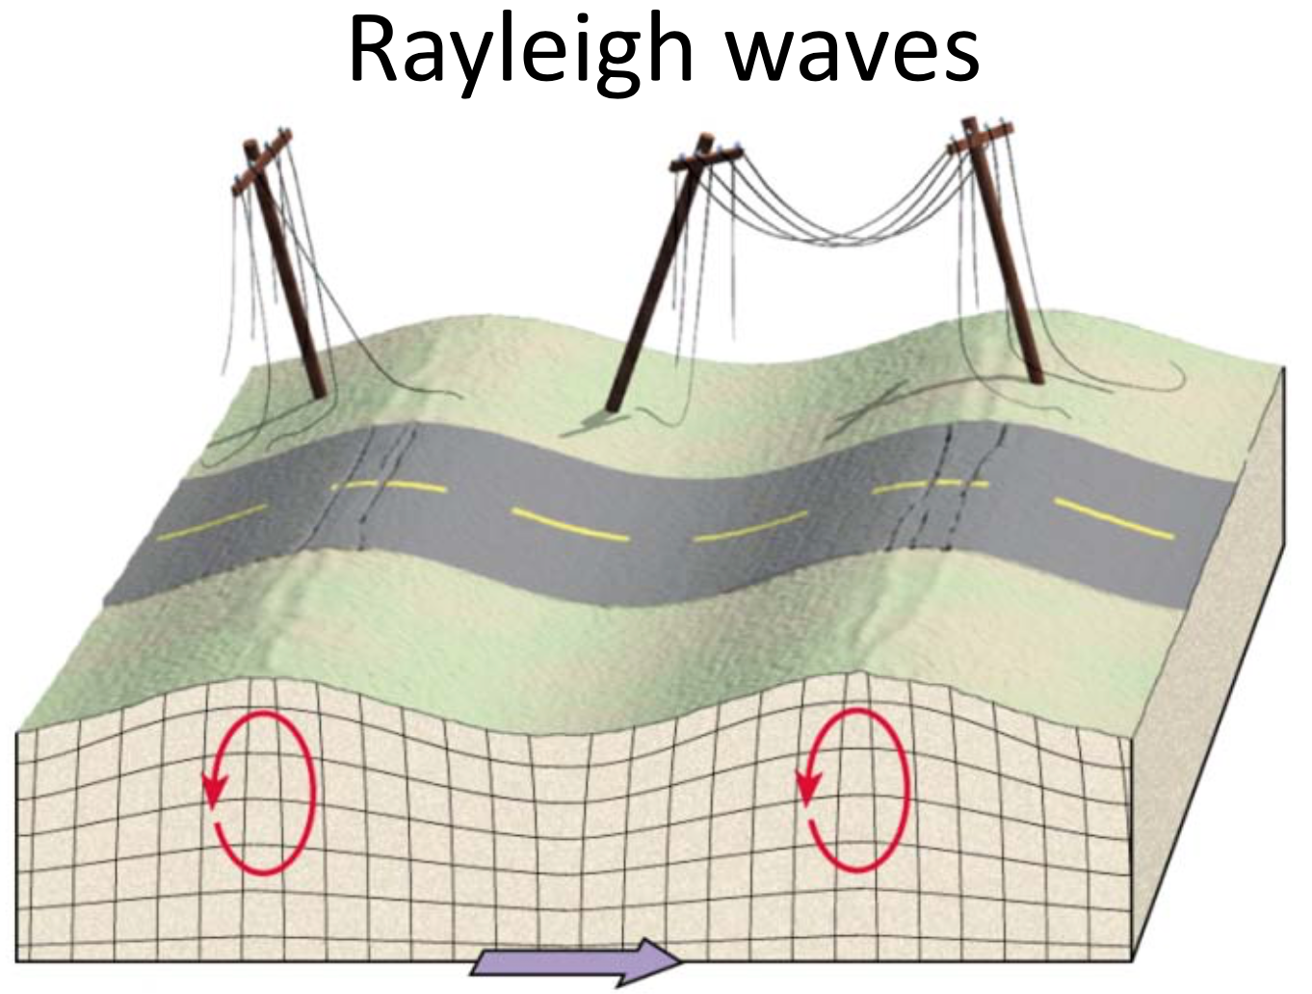
Newtonian background due to seismic environment
In principle, can eliminate all direct mechanical coupling
Can not shield against the wandering net gravity vector
Images: J. Harms
Images: J. Harms

Slide 6
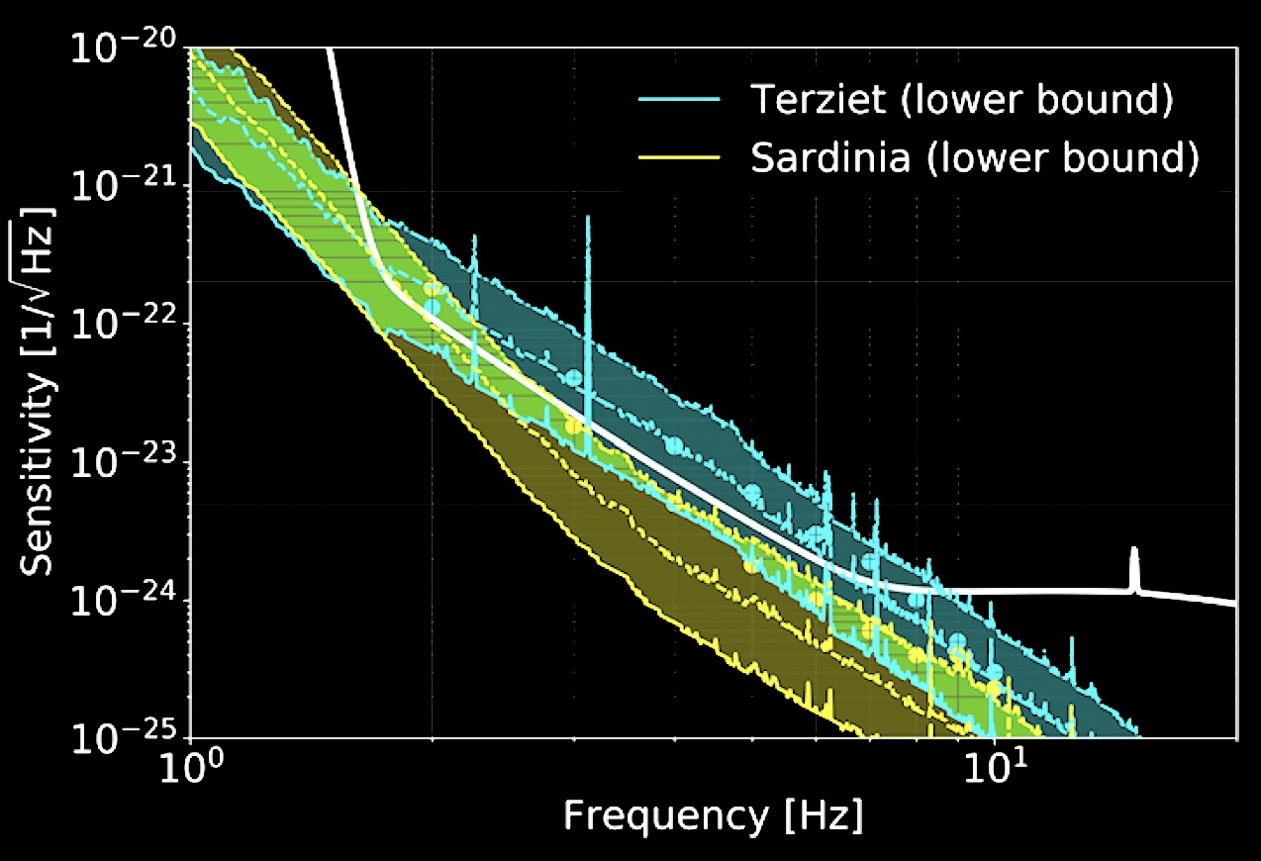
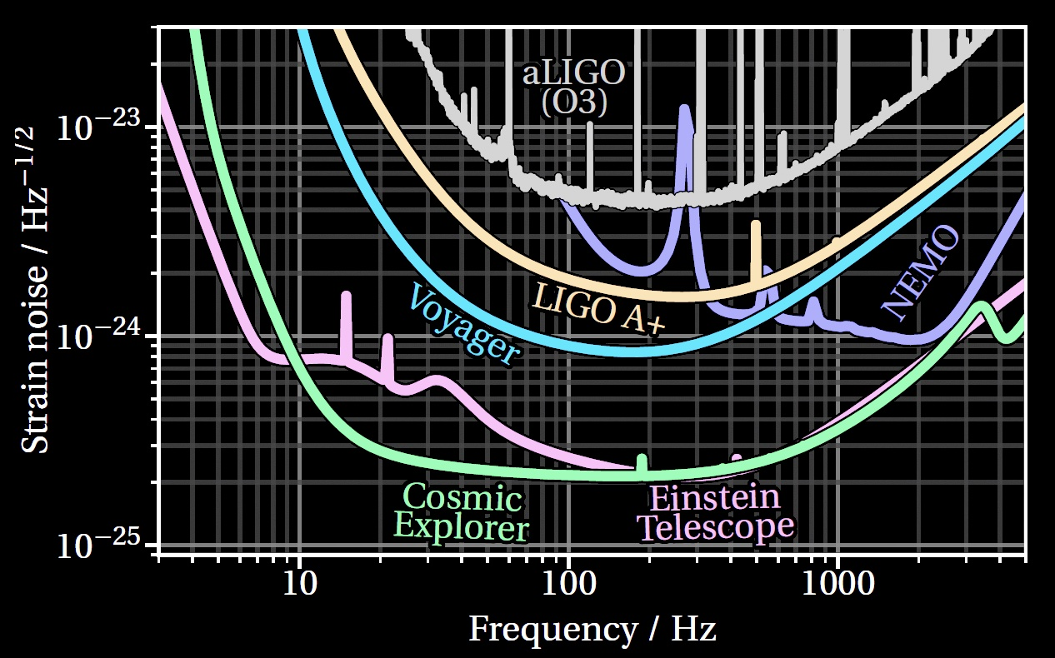
Newtonian background creates a wall at a few Hz
Harms et al. 2022
Newtonian Background falls as ~ 1/f ⁵
Can reduce somewhat by moving underground
  ET vs CE – more later on these two
Can reduce somewhat with arrays of seismometers and subtraction of effect
Forbiddingly large for ~3Hz and lower
Ultimate limit on the lowest frequency detectors on- or under-ground
And thus the largest BH masses detectable
Evans et al. 2023

Slide 7
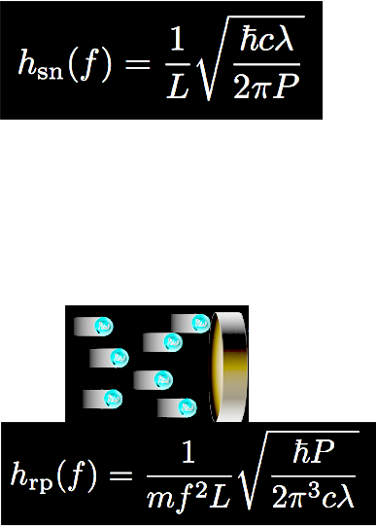
Practical limitations for Terrestrial Detectors
Arm length L – currently in short-antenna limit; path-length shift ΔL from a given strain grows with interferometer arm length. Maximize L !
  ΔL = h_{GW} · L
  LIGO 4km, Virgo and KAGRA 3km
Optical resolution – limited by photon
Poisson counting statistics; maximize laser power P
…but too much power, and the radiation pressure
causes mirror motion which masks the GW
Optimal power – naïve quantum limit
  Working with ~50-100 W

Slide 8
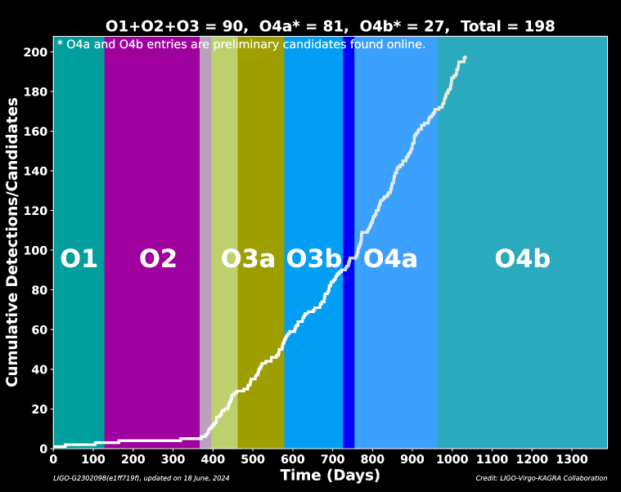

Sensitivity improvements boost signal rate
r_{reach} ∝ 1/h_{sensitivity}
Volume of space accessible –
and sources –grows as ~(sensitivity)³
There are gaps for the upgrades… but so far we make up for it

Slide 9
Sensitivity improvements boost signal rate
r_{reach} ∝ 1/h_{sensitivity}
Volume of space accessible –
and sources –grows as ~(sensitivity)³
There are gaps for the upgrades… but so far we make up for it

Slide 10
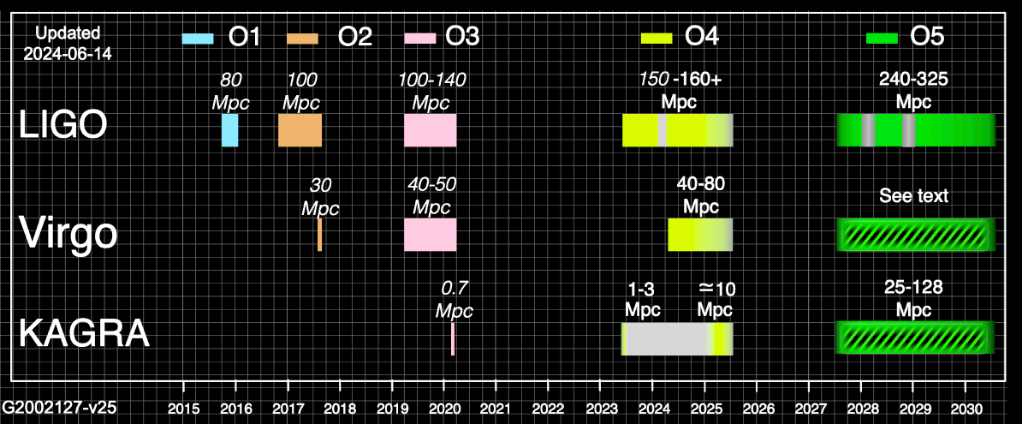
Observing with LIGO, Virgo, KAGRA
Continued interleaved improvements and observing foreseen
Concrete plans through early 2031
Will propose for final 3-4km baseline detectors, to operate in the 2030’s

Slide 11

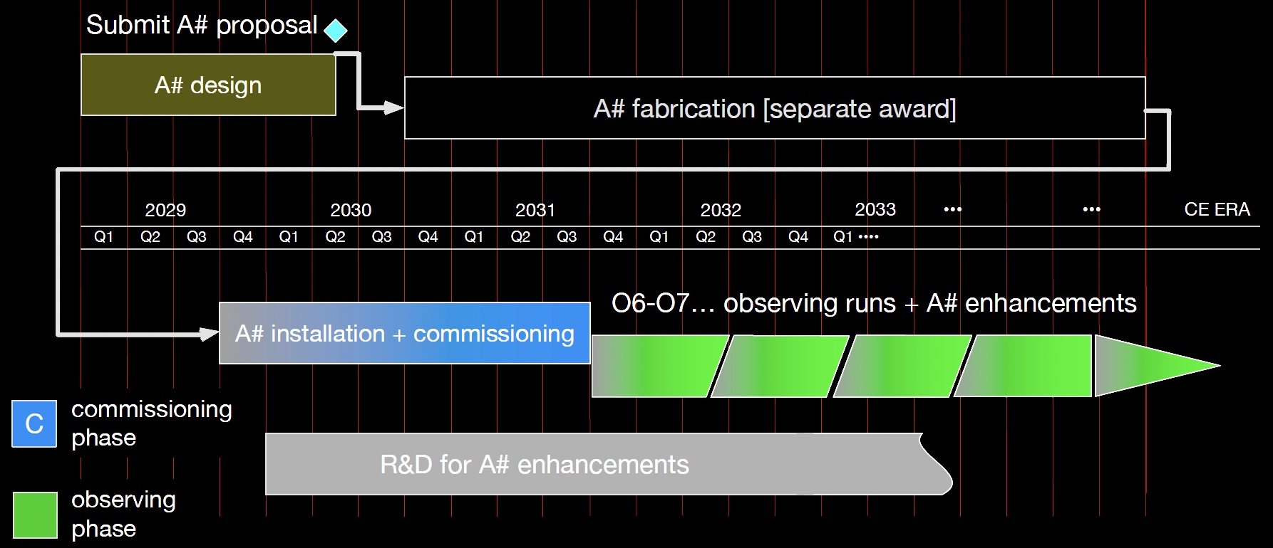
Notional Plans for the current 4km observatories –
2x improvements
~160 Mpc
~275 Mpc
Best guess for LIGO
Virgo similar
Gives improving performance and continuous operation to ~2040
~600 Mpc

Slide 12
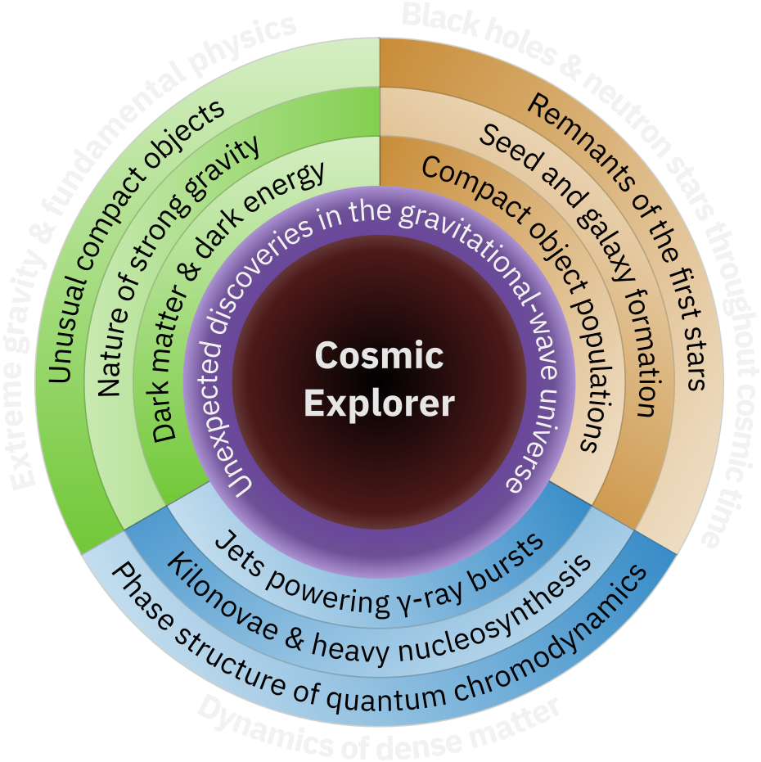
What could we do with 10x better GW detectors?
Greater sensitivity will enable a qualitative growth in the number of observed sources
(10x sensitivity →
few 10⁵ sources per year)
It also increases the resolution of waveforms, enabling more stringent tests of GR and more detailed models of the coalescences
Wider bandwidth can expose Neutron star coalescence and thus dynamics of dense matter

Slide 13
Even better detectors would deliver more science.
How to build a such a 10x better detector?
One Approach:
Make it 10x longer → 10x larger signal
ΔL = h_{GW} · L

Slide 14
Noise due to stochastic forces is independent of armlength
ΔL = h L
The Newtonian Background is the same for 4 or 40km, but the signal is 10x larger
Also unchanged:
  Thermal noise motion (pendulum, substrate, coating)
  Magnetic and electrostatic dynamic forces
…Up to L = 1/2 λ_{GW} – giving an optimal length for a given signal

Slide 15
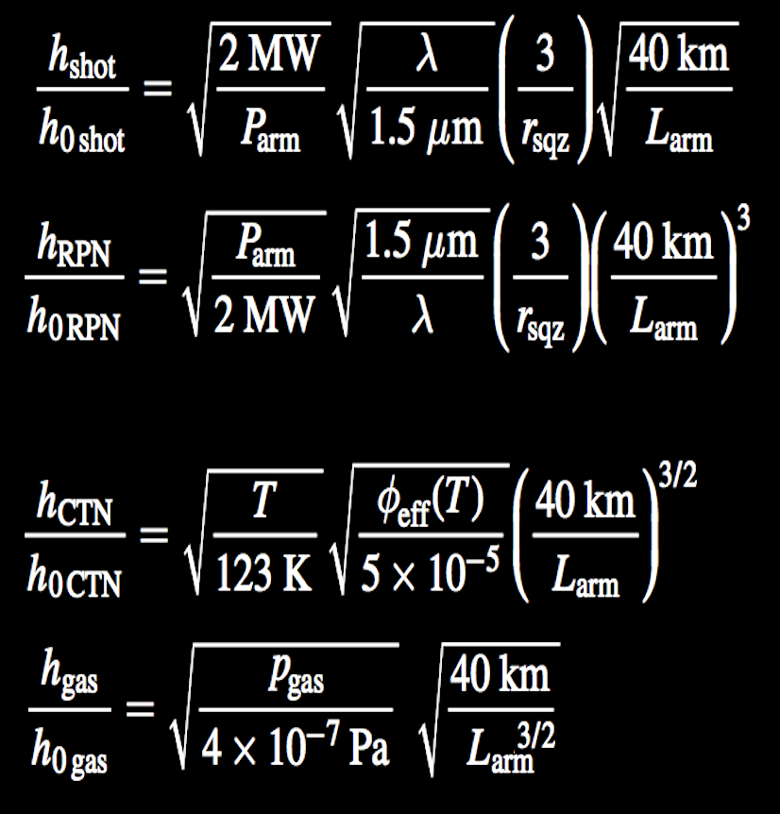
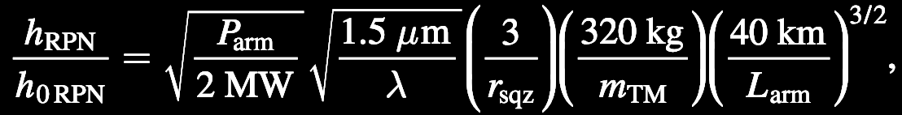
Sensing noises scale with arm length at various powers of 1/L – all get better
Shot Noise
while maintaining bandwidth
Radiation Pressure Noise
while maintaining bandwidth
Coating Thermal Noise
loss angle dependence
Residual Gas Noise
facility limit
15

Slide 16
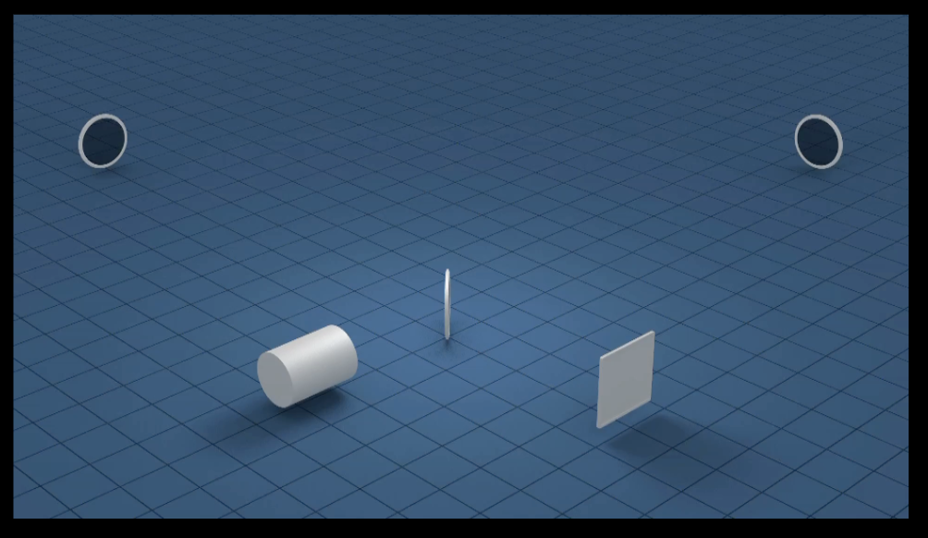
The Infrastructure for a realistic implementation
A sufficient length L of the arms is needed to bring the
GW-induced strain to a measurable level (4km → 40km)
Sensing laser light must travel in an excellent vacuum (10⁻⁹ Torr)
The vacuum system diameter must accommodate a diffraction limited beam over 4 or 40km (~1 m Diameter)
The vacuum system must be straight, level, and protected from the human and natural environment (earthmoving, concrete bed,
aligned to several mm over 4 or 40km, and protected by a concrete cover)
Corner and end buildings with particulate, temperature control;
staff buildings; outreach/public science building (~10,000 m²)

Slide 17
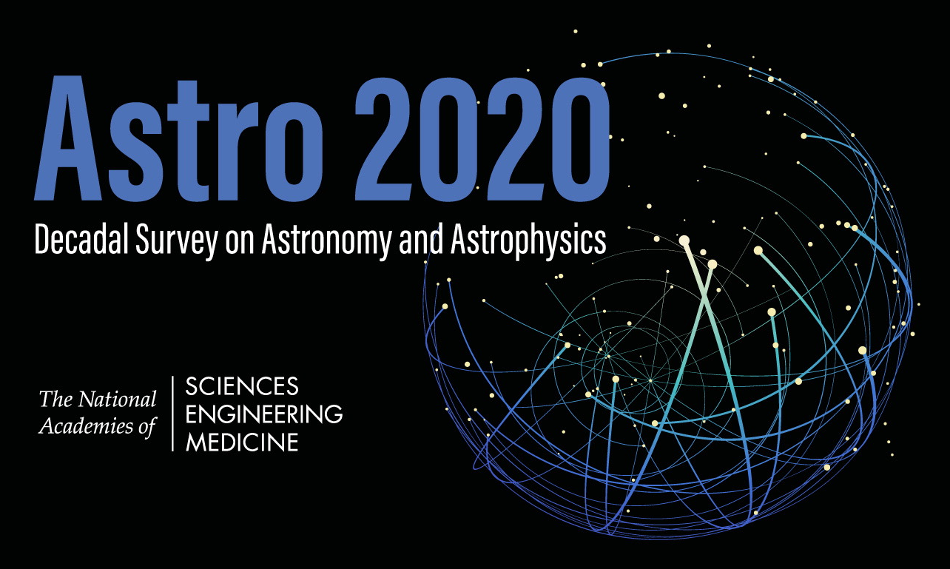

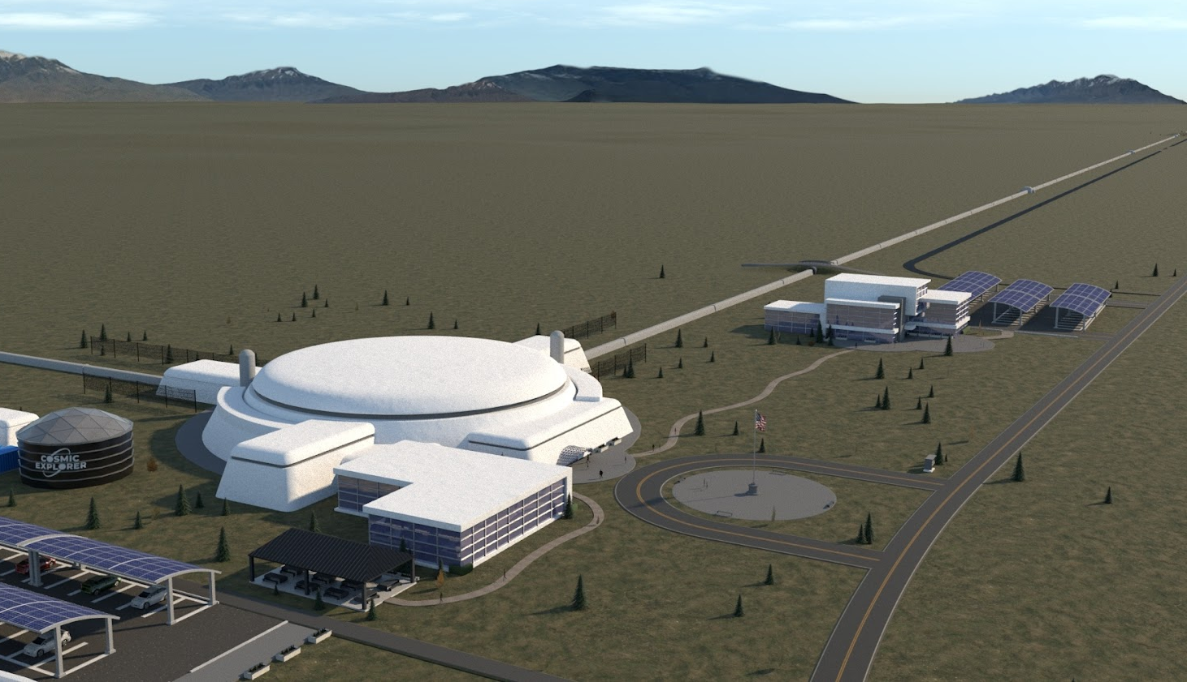
Image: Eddie Anaya (Cal State Fullerton)
US contribution to the next-gen Network (with Einstein Telescope – European project)
LIGO-like concept for a single interferometer per site, on Earth’s surface
CE is a larger, and more technically advanced version of LIGO:
baseline of two widely separated observatories, 40km and 20km arms
cosmicexplorer.org
Image: Eddie Anaya (Cal State Fullerton)
Image: Eddie Anaya (Cal State Fullerton)
Image: Eddie Anaya (Cal State Fullerton)
cosmicexplorer.org
Image: Eddie Anaya (Cal State Fullerton)

Slide 18
CE Detector Design
LIGO is starting to plan upgrades to the LIGO 4km detectors for the ‘Post-O5’ epoch – ~2029 to the start of CE observing (optimistically 2035)
  Room temperature, 1 micron light, fused silica optics, sputtered optical coatings, frequency dependent squeezed light..
Initial CE detectors will use techniques of this LIGO Post-O5 upgrade
Low risk – no significant advances in the detector are needed
  Some work on bigger masses, suspensions, lower-loss optics
(Later CE upgrades can include all insights from CE, ET, quantum sensing…)

Slide 19
CE Infrastructure
Baseline of 40km and 20km observatories
  20km = 1/2 λ_{GW} is ideal for observing ~2kHz endgame of
  neutron-star mergers
  40km is optimized for absolute ‘reach’ to enable all in-scope binaries to be observed
Sites separated by a continental baseline for position information
  Hope that ET in Europe will be built; expect that data will be shared
Working on less expensive vacuum systems (dominates the cost)
Single interferometric detector per site
Earth’s surface construction
  Bad: increased coupling to surface ‘seismic’ noise, and thus Newtonian background – limits low-frequency sensitivity (~7Hz compared to ~5 Hz for ET)
  Good: less expensive than tunneling; no complexity of underground work; future modifications of interferometer layout easier (no new caverns)
Geographically suitable sites can be found in the US (and Canada, Australia…)

Slide 20
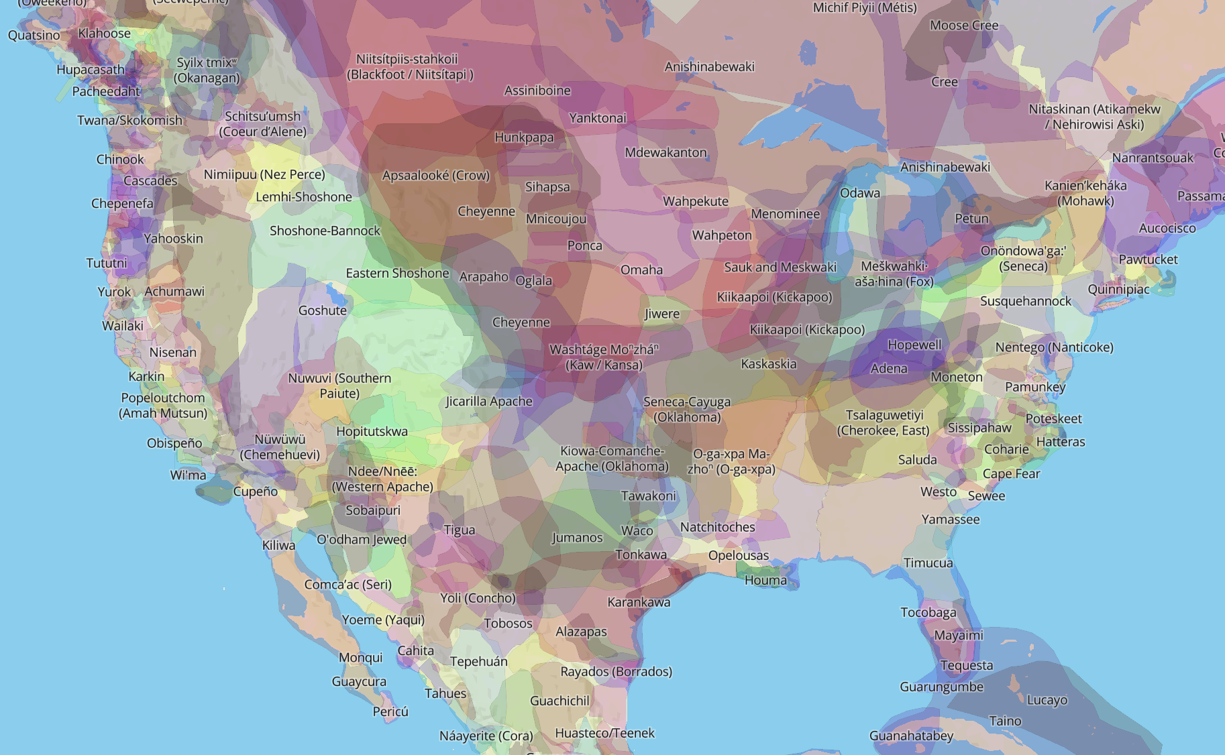
The history of the land will play a pivotal role in this project.
We have the opportunity, and obligation, to work with Indigenous Peoples
We will build synergistic relationships and respect their land, their culture, and their sovereignty.
http://native-land.ca/
If you are not aware of issues surrounding TMT, please read arXiv:2001.00970 .

Slide 21
CE Status
Conceptual Design is now underway
CE Funding approved for this phase
  International contributions (in-kind) – UK, Canada, Australia, Germany
NSF ‘Blue Ribbon’ Panel recommends NSF pursue CE
Goal: observatories by mid-2030’s

Slide 22
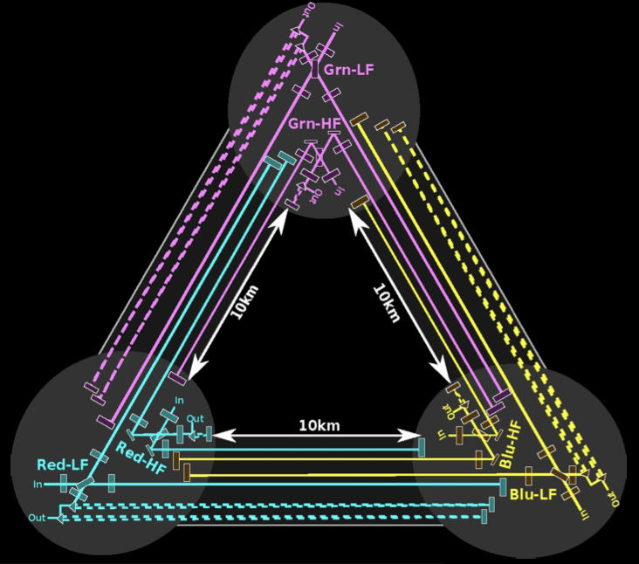
European Vision for the next generation:
Einstein Telescope
ET Design: underground, triangular, 3 detectors consisting of two interferometers each
(high frequency + low frequency ‘xylophone’)
  Cryogenic test masses, longer wavelengths for LF operation
  Underground infrastructure designed for future upgrades
Possible sites:
  Euregio Meuse-Rhine
  Sardinia, Italy
  (possibly) Saxony, Germany
Current envisioned timeframe:
  Construction to begin in 2026
  Science operations to begin in 2035
Status:
  ET is a fully recognized European Project on European Strategy Forum for Research Infrastructures (ESFRI) Roadmap → a key step in getting the project funding lined up.
  ET Project Organization and relevant Boards have been established
  ET Pathfinder facility in Maastricht, Netherlands under construction
  Site evaluation well underway

Slide 23
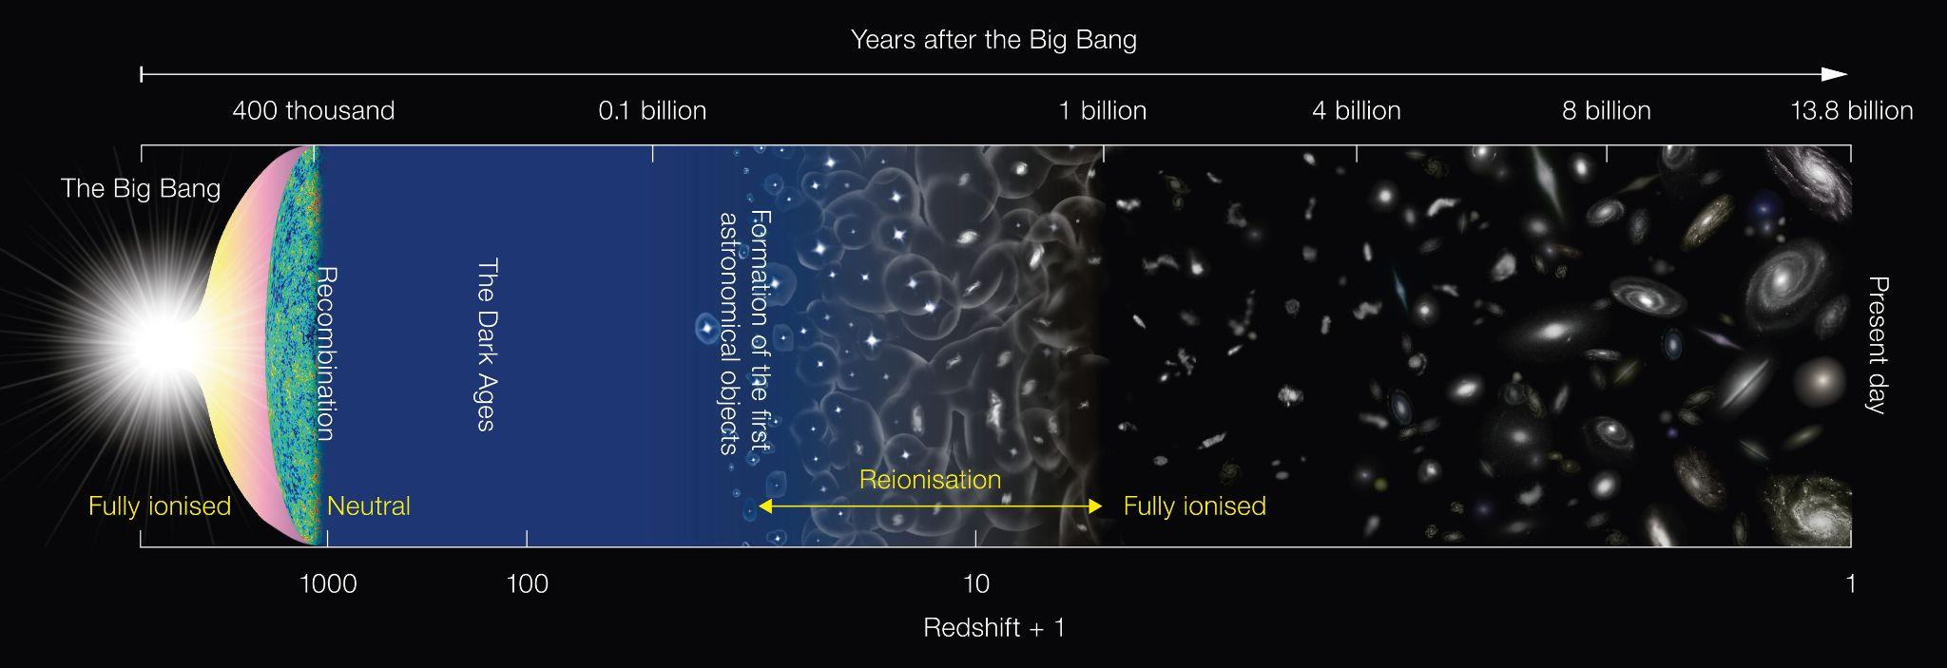
Reach of present and future instruments
Credit: ESO/NAOJ
Cosmic Explorer
and
Einstein Telescope
LIGO
~2033
LIGO
today
Slide: Kevin Kuns

Slide 24
The last page
Ground-based GW observation works, and LIGO, Virgo, and KAGRA observing together
There are lots of sources yet to be observed
Scaling laws show the technical feasibility of better detectors
The US Concept, Cosmic Explorer
  Two sites, one 40km, one 20km
  Surface construction, LIGO Technology
The European Concept, Einstein Telescope
  Underground triangle multiple-interferometer approach
  Pushes detector technology with high power, low temperatures
Both eager to participate in Multi-Messenger Astrophysics
Looking forward to multi-band with LISA!

