Slide 1


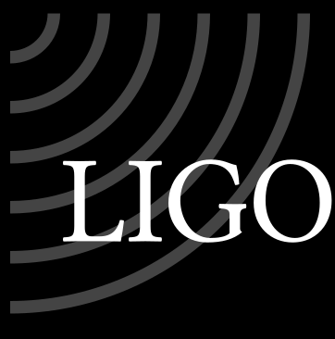
Laser Noise in
Advanced LIGO and
Cosmic Explorer
Craig Cahillane
on behalf of the CE Optical Design Team
XGCD call
June 24, 2024

Slide 2
Motivation
Laser noise is a technical noise source intrinsic to the stability of the laser output.
Without a laser, you’re not going to detect much. The laser stores and carries the GW information as a coherent phase shift, which becomes power modulations at the dark port.
To be able to coherently store the tiny phase shifts imparted by the GW, the laser itself must be extremely stable in three ways:
Frequency
Intensity
Spatially (also called beam jitter)
The native laser source will very likely still be the NPRO 1064 nm laser,
barring significant design changes

Slide 3
Advanced LIGO coupling overview

Slide 4
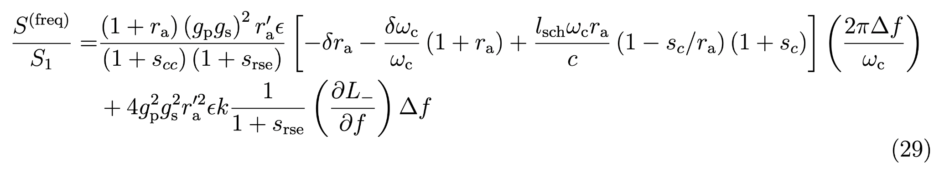
Frequency Noise coupling to DARM
Frequency noise coupling to the dark port from Kiwamu’s sideband picture derivations [15]
First order couplings only, ignores HOMs or cross-couplings. Same for Somiya [16].
Note the dependence on the DARM offset є.
Arm reflectivity difference
Arm pole difference
Schnupp Asymmetry
Radiation pressure coupling

Slide 5
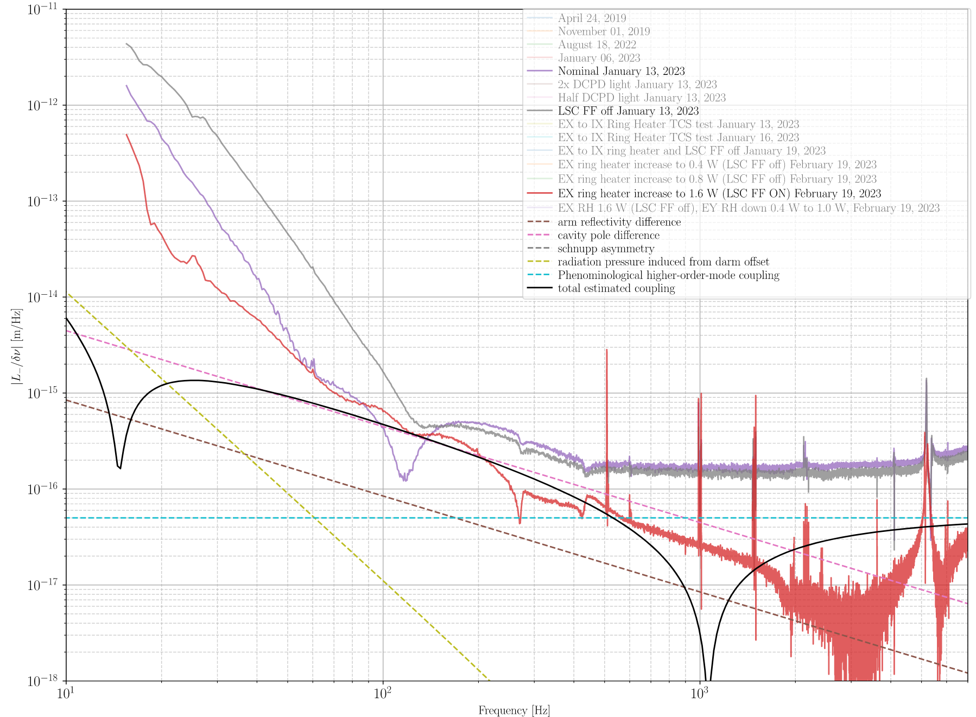
Frequency
to DARM
TF in O4
Analytic curves here plotted from Kiwamu Izumi
analytic IFO
analysis
Feedforward off
Feedforward on,
nominal thermal state
Feedforward on,
altered thermal state

Slide 6
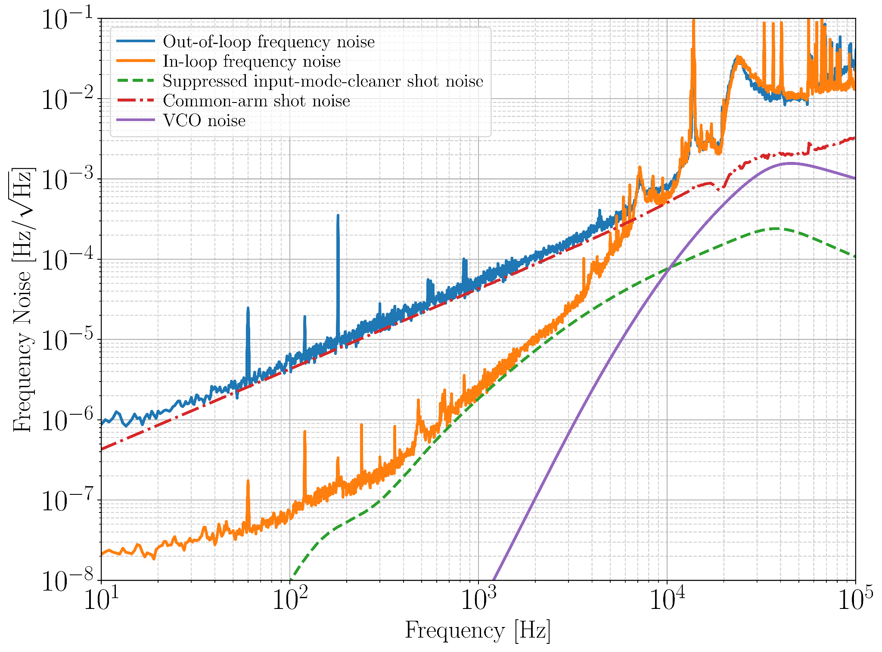
Frequency
noise in O3
Similar to
O4

Slide 7
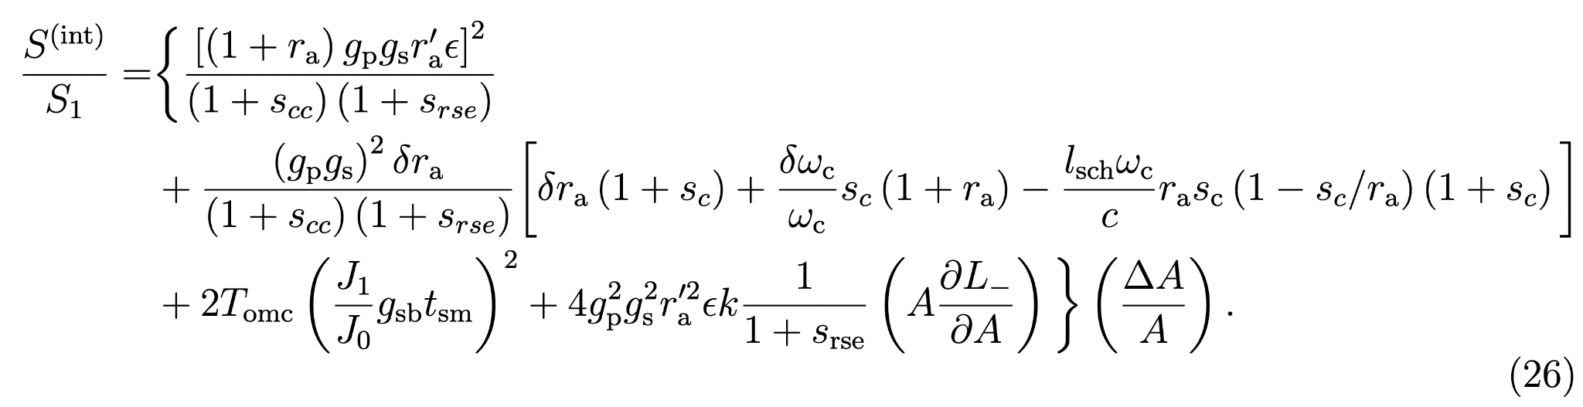
Intensity Noise coupling to DARM
Intensity noise coupling to the dark port from Kiwamu’s sideband picture [15]
Again, HOMs and cross-couplings are ignored as too complicated.
Arm reflectivity
Arm pole
Schnupp Asymmetry
Sideband trans through OMC
Radiation pressure coupling

Slide 8
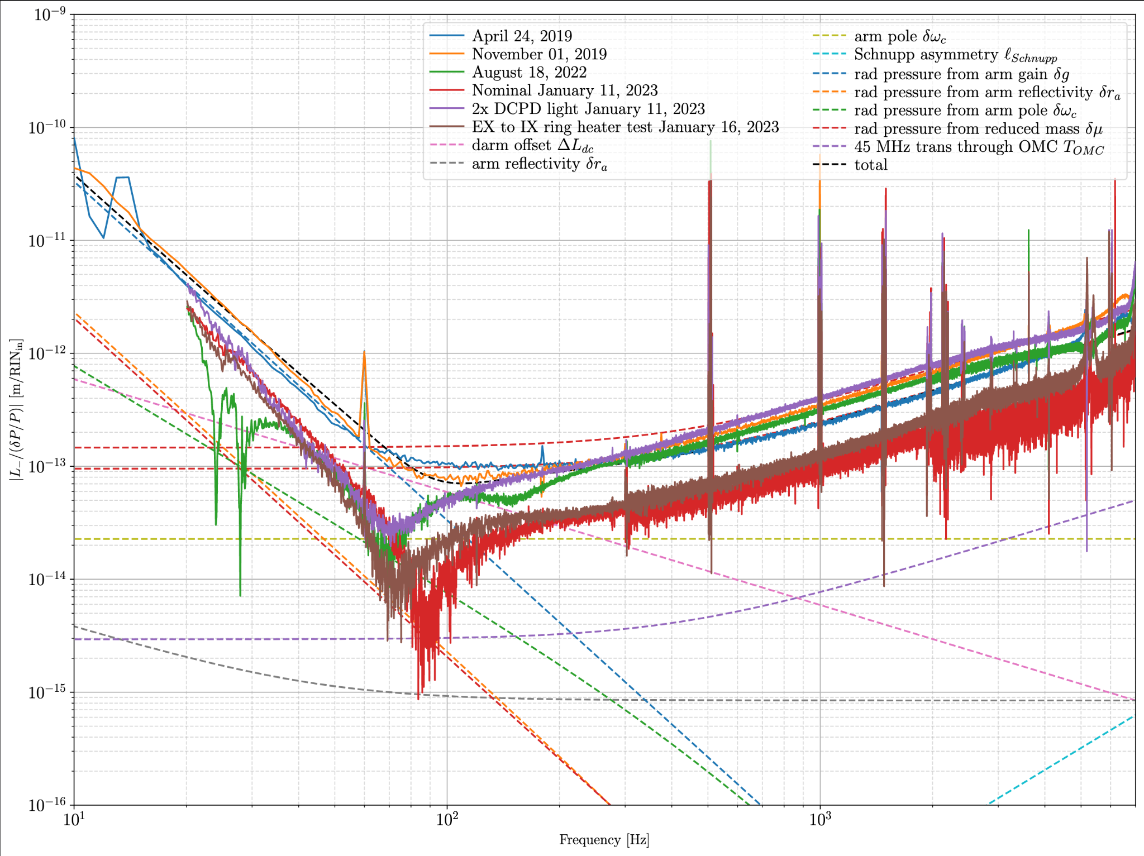
Intensity
to DARM
TF in O4

Slide 9
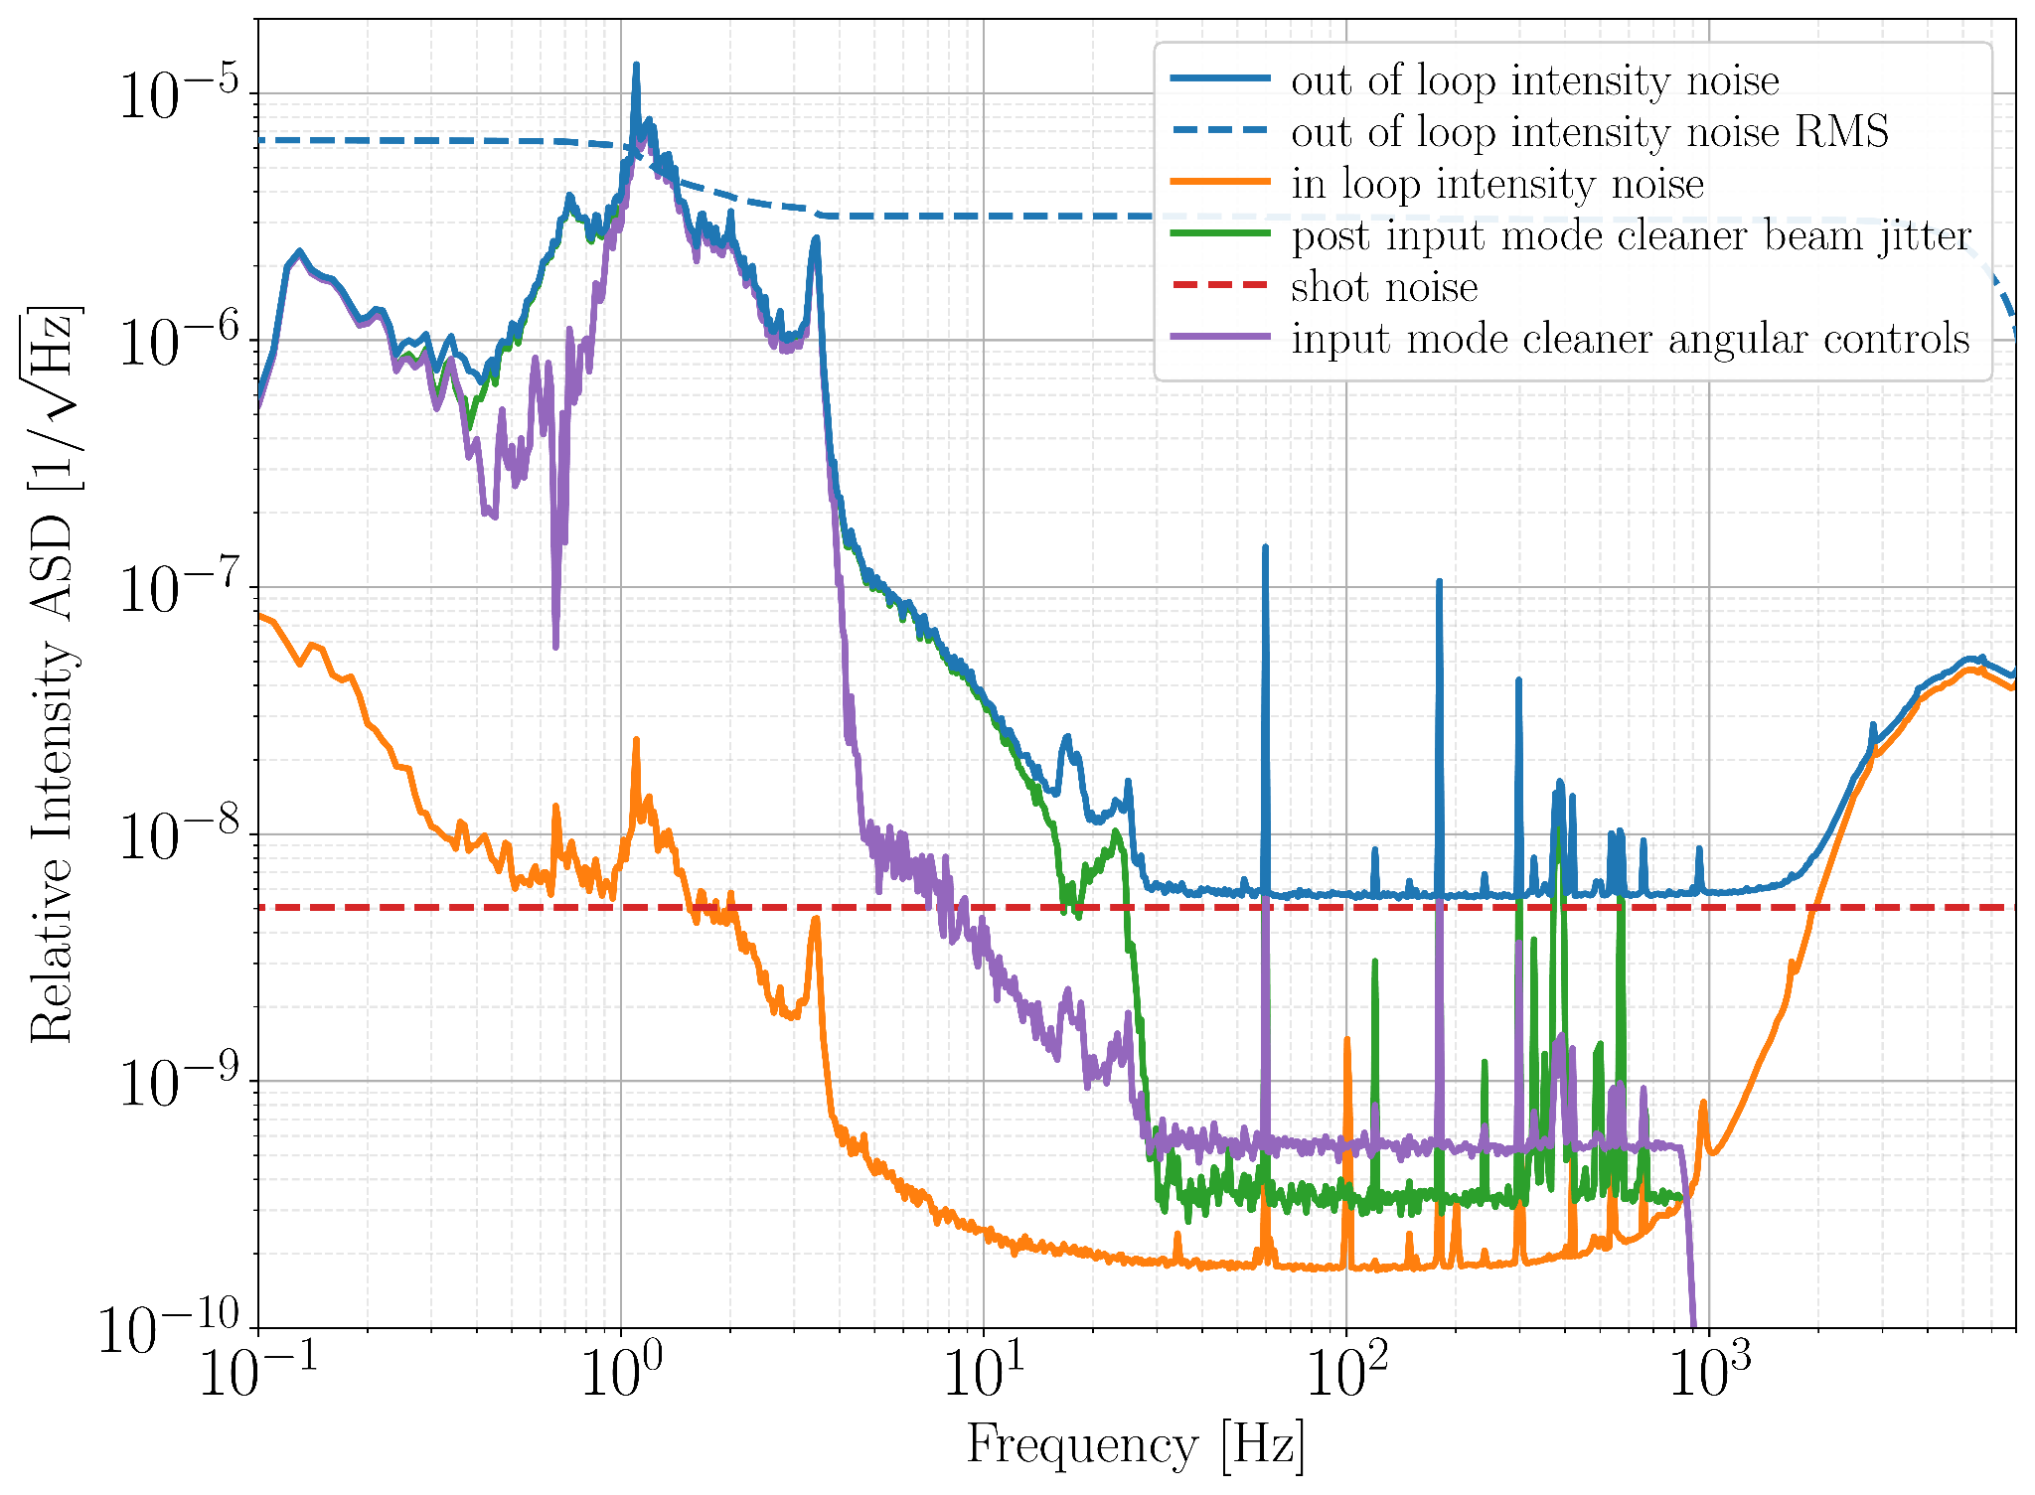
Intensity noise in O3
Similar to O4

Slide 10
Beam jitter
Would normally be rejected via common mode rejection.
Large sourced from PSL table motion, coupling to DARM via static misalignments in the IFO.
Major reduction between O2 and O3 due to High Power Oscillator removal.
Seems to become worse with high power (see Robert Schofield’s alog 70808 [4])
1) Possibly due to worsening IFO thermal state increasing static misalignments?
2) “It might be caused by increased thermal distortion of test mass surfaces around coating defects, resulting in a greater fraction of light scattered and higher vibration coupling through retro-reflected scattered light.”
Appears to be a major limiter of DARM in O4.
Some wins: Removal of 120 Hz peak with SF2 Fan turned off alog 73403 [3]

Slide 11
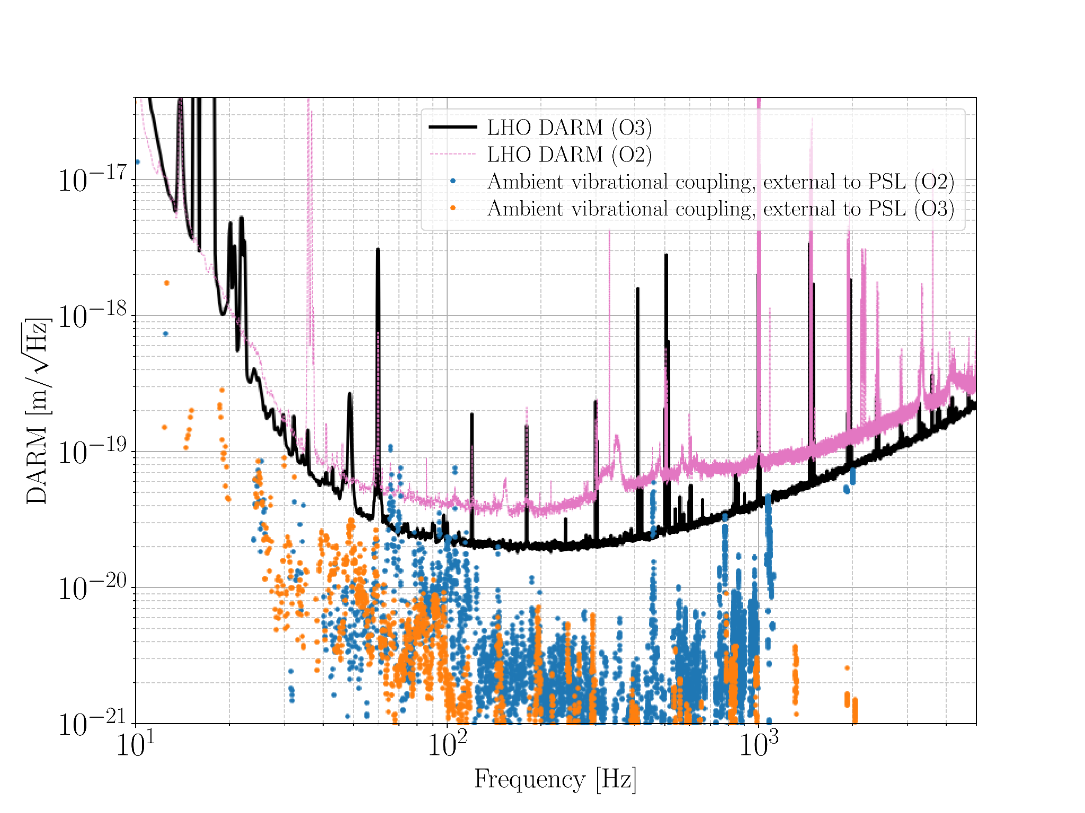

Slide 12
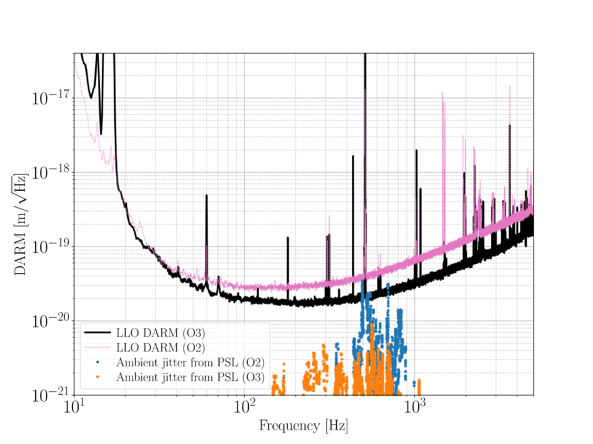

Slide 13
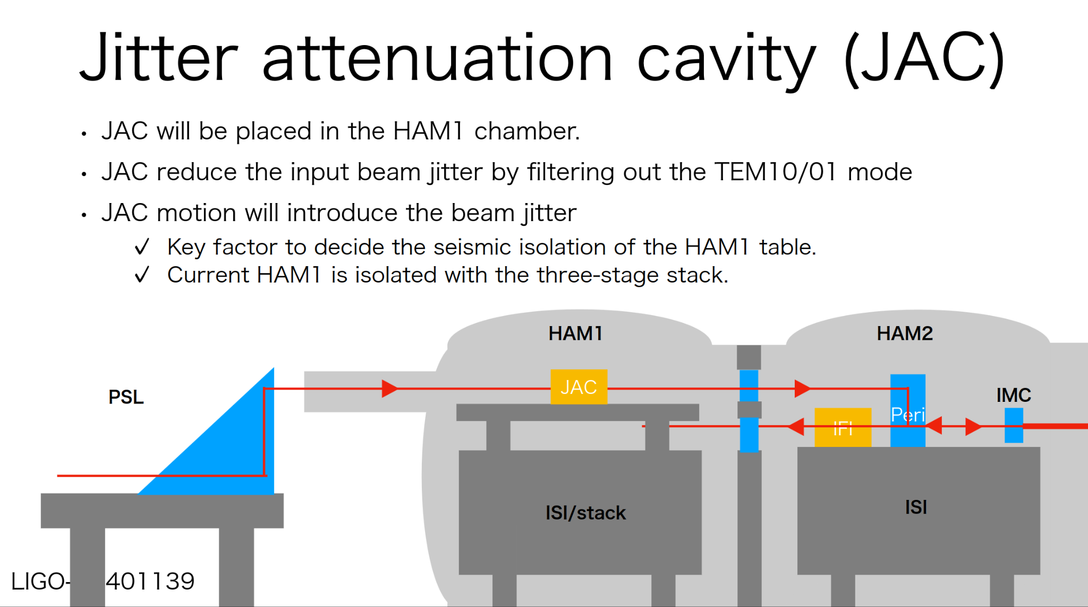
Jitter Attenuation Cavity (JAC)
Idea: Hang a fixed triangle cavity in HAM1 to which the PSL beam is locked. This should provide some 20 dB or more of jitter noise suppression coming from the PSL table, especially at Hanford.
Led by Masayuki Nakano at Caltech [13].

Slide 14
Cosmic Explorer current input optics design

Slide 15
Main problem
 | Advanced LIGO | Cosmic Explorer
Arm Length | 4 km | 40 km
FSR | 38 kHz | 3.8 kHz
CARM pole | 0.4 Hz | 0.04 Hz
For Cosmic Explorer, the arms will be 40 km long.
The free-spectral range of LIGO is 38 kHz.
The free-spectral range of Cosmic Explorer is 3.8 kHz.
Advanced LIGO
vs
Cosmic Explorer
L = 4 km
L = 40 km
Problem: LIGO’s current frequency stabilization bandwidth is around 30 kHz. However, the controller cannot extend beyond the FSR due to the cavity phase dynamics.
Additionally, the extremely low linewidth (0.04 Hz) makes the CE shot noise limit insufficient at 500 Hz.

Slide 16
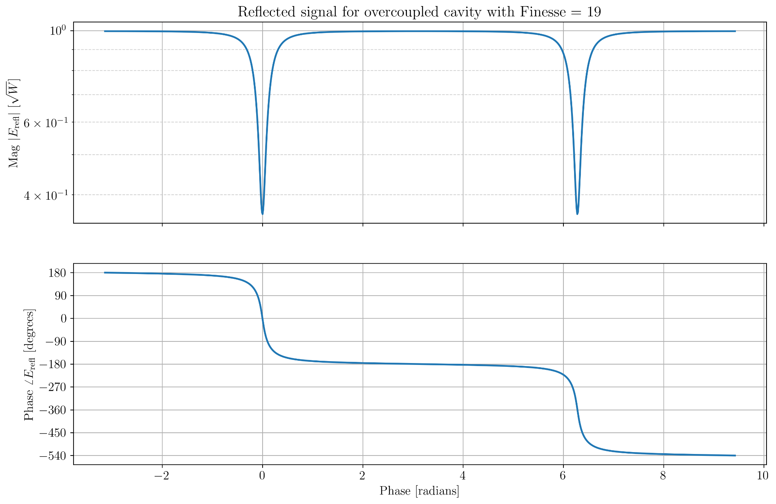
Overcoupled cavity:
Two left hand plane poles,
Two right hand plane zeros
CE-DCC-T2400008
1 FSR = 3.8 kHz
Siggestion: Undercouple the interferometer instead?
Tradeoff: low PRG,
but no phase loss as
poles become LHP
Lock point
360° phase loss
360° phase loss
Hard to control

Slide 17
Suspended Pre-Mode Cleaner Configuration (Evan’s configuration)
PC
FI
FI
NPRO laser,
1064 nm,
200 watts max power
Input Mode Cleaner 1
IMC1
Suspended,
100 meters,
Finesse 700,
Cavity pole 1 kHz,
“Active” feedback to laser to stabilize to long cavity baseline shot noise limit
Input Mode Cleaner 2
IMC2
Suspended,
330 meters,
Finesse 1000,
Cavity pole 300 Hz
“Passively” filters beam with a low cavity pole
PC
FI
PC
FI
Pre Mode Cleaner
PMC
Suspended (?)
16 meters
Clean junk light to improve IMC1 shot noise
PC
FI
FI

Slide 18
Suspended Pre-Mode Cleaner Configuration (Evan’s configuration)
PC
FI
FI
IMC1
PMC
NPRO
IMC2
PC
FI
PC
FI
Three suspended mode cleaner cavities:
PMC: clean junk light to sufficiently lower IMC1 shot noise,
IMC1: feedback to laser frequency with high bandwidth,
IMC2: feedback to IMC2 suspensions with low bandwidth
CARM: feedback to laser with low bandwidth
PC
FI
FI

Slide 19
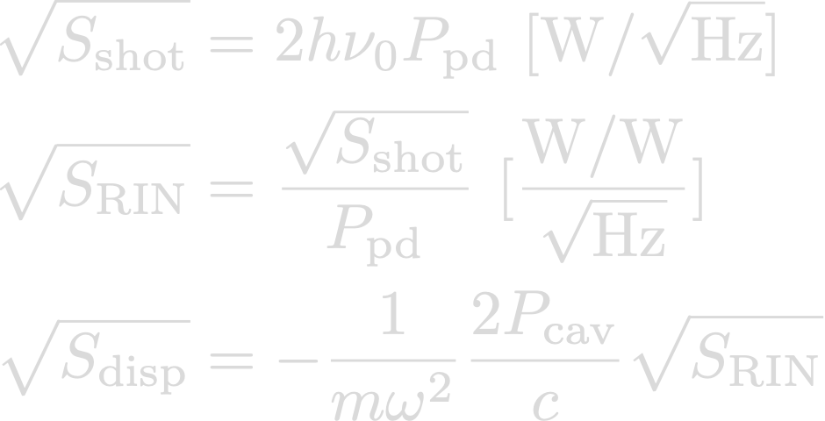
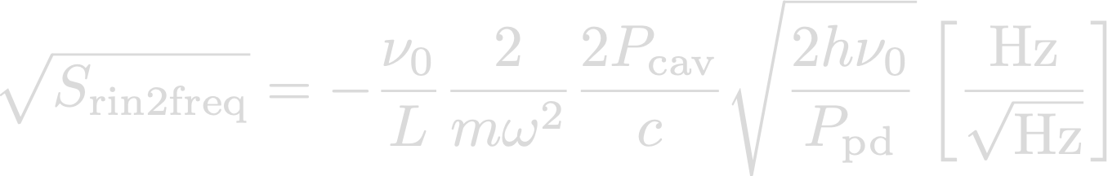
Intensity noise to Frequency Noise in the input optics
x_{disp}
x_{disp}
Pin
Pcav

Slide 20
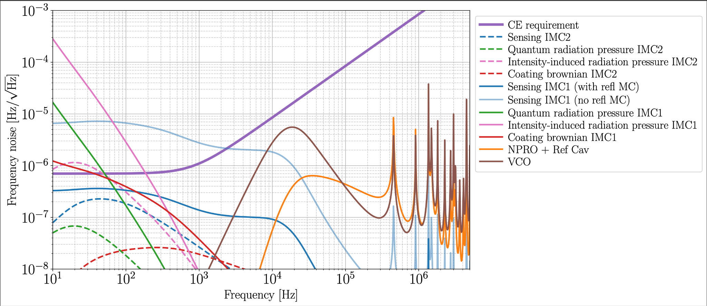
Double IMC frequency noisebudget
(CE estimate, updated since [1])

Slide 21
Problems to consider
What are the requirements on the IMC lengths?
  Can we piggyback on the CE filter cavity beam tube to save on facilities costs?
What are the requirements on the IMC test masses?
  Are Advanced LIGO style triples sufficient? not enough?
Will we need mode sensing and control on the IMCs?
  Want to control the mode matching of IMCs to main IFO
  IMC2 will be especially susceptible to high power thermal transients
  Will beam jitter be a problem (currently is in Advanced LIGO)
What is an acceptable intensity servo?
  Will stabilizing to 100 mW be enough? Do we need AC coupling?
Are there ways we can improve lock acquisition?
  Three input RF sidebands (one non-resonant in the IFO)?
  In-vacuum, suspended, high-power EOMs?
    RF sidebands won’t constrain IMC length, could avoid sideband FM-to-AM

Slide 22
Future Work
Model some of the competing designs for the input optics
Further investigate the impact of thermal compensation on laser noise coupling
Assuming some IFO, estimate transfer function noise requirements for:
  Frequency noise
  Intensity noise
  Jitter noise
  RF phase noise
  RF amplitude noise

Slide 23
Bibliography
[1] Craig Cahillane, Georgia Mansell, Daniel Sigg, “Laser frequency noise in next generation gravitational-wave detectors” https://doi.org/10.1364/OE.439253
[2] Arai, Koji “Finesse simulation for the alignment control signal of the aLIGO input mode cleaner” https://dcc.ligo.org/LIGO-T1300074
[3] T. Akutsu, “Input optics systems of the KAGRA detector during O3GK” https://arxiv.org/abs/2210.05934
[4] B. Willke, “Spatial and temporal filtering of a 10-W Nd:YAG laser with a Fabry–Perot ring-cavity premode cleaner” https://opg.optica.org/ol/fulltext.cfm?uri=ol-23-21-1704&id=62753
[5] C. Mueller, “The Advanced LIGO input optics” https://pubs.aip.org/aip/rsi/article/87/1/014502/367353/The-advanced-LIGO-input-optics
[6] Gabriele Vajente, “Frequency noise coupling through ISC loops”, https://alog.ligo-wa.caltech.edu/aLOG/index.php?callRep=67871
[7] Craig Cahillane, “Frequency and intensity to DARM TFs (January 2023)” https://alog.ligo-wa.caltech.edu/aLOG/index.php?callRep=66866
[8] Robert Schofield, “Broad 120 Hz peak no longer in DARM after PSL periscope tuning and shutdown of SF2” https://alog.ligo-wa.caltech.edu/aLOG/index.php?callRep=73403
[9] Robert Schofield, “Does vibration coupling tend to increase with main laser power? Coupling dropped at PSL by roughly two and at EX by three when power was dropped from 75W to 60W” https://alog.ligo-wa.caltech.edu/aLOG/index.php?callRep=70808
[10] Daniel Sigg, “Interferometer Mode Matching and Reflectivity” https://alog.ligo-wa.caltech.edu/aLOG/index.php?callRep=70985
[11] Kiwamu Izumi, “Beam size jitter coupling” https://dcc.ligo.org/LIGO-T1700353
[12] Daniel Sigg, “Jittery Presentation” https://dcc.ligo.org/LIGO-G1602269
[13] Masayuki Nakano, “Jitter attenuation cavity (JAC) and PSL+” https://dcc.ligo.org/LIGO-G2401139
[14] Craig Cahillane, “Interferometer reflection and the right-half-plane zero” https://dcc.cosmicexplorer.org/CE-T2400008
[15] Kiwamu Izumi, “Frequency Response of the aLIGO Interferometer: part3” https://dcc.ligo.org/LIGO-T1500559/public
[16] Kentaro Somiya, et al. “Frequency noise and intensity noise of next-generation gravitational-wave detectors with RF/DC readout schemes” https://doi.org/10.1103/PhysRevD.73.122005

Slide 24
Extra Slides

Slide 25
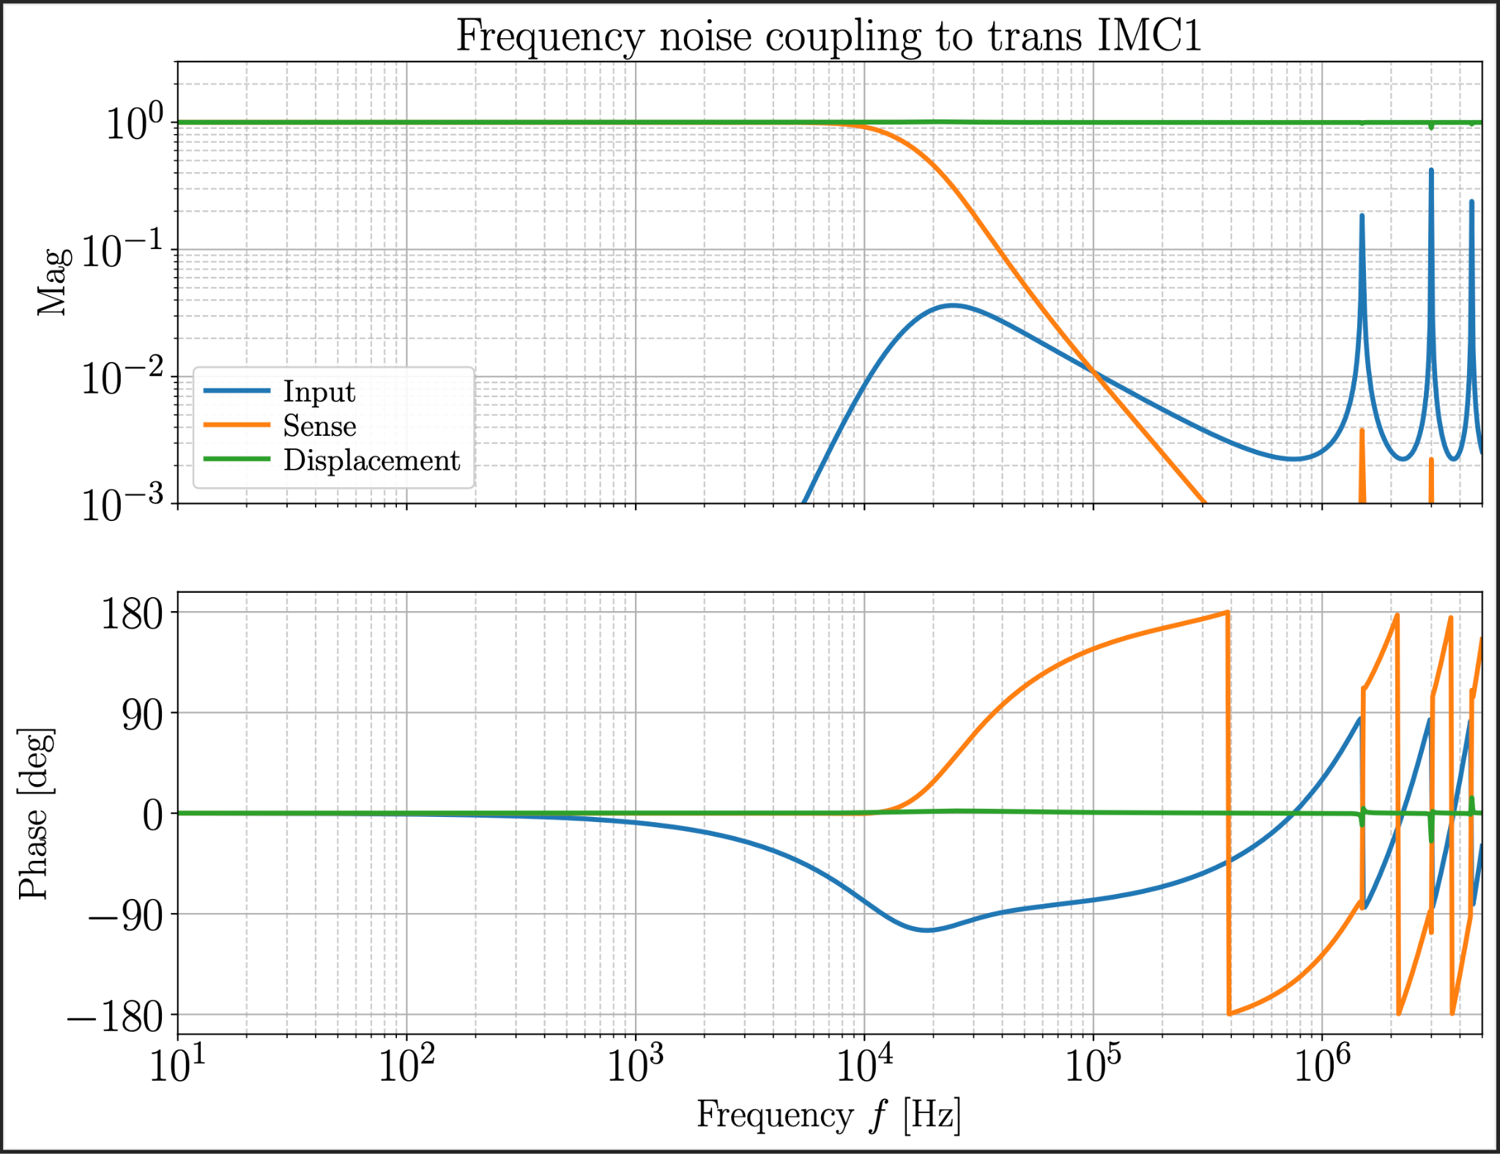
Coupling
Functions
for noise
through
IMC1

Slide 26
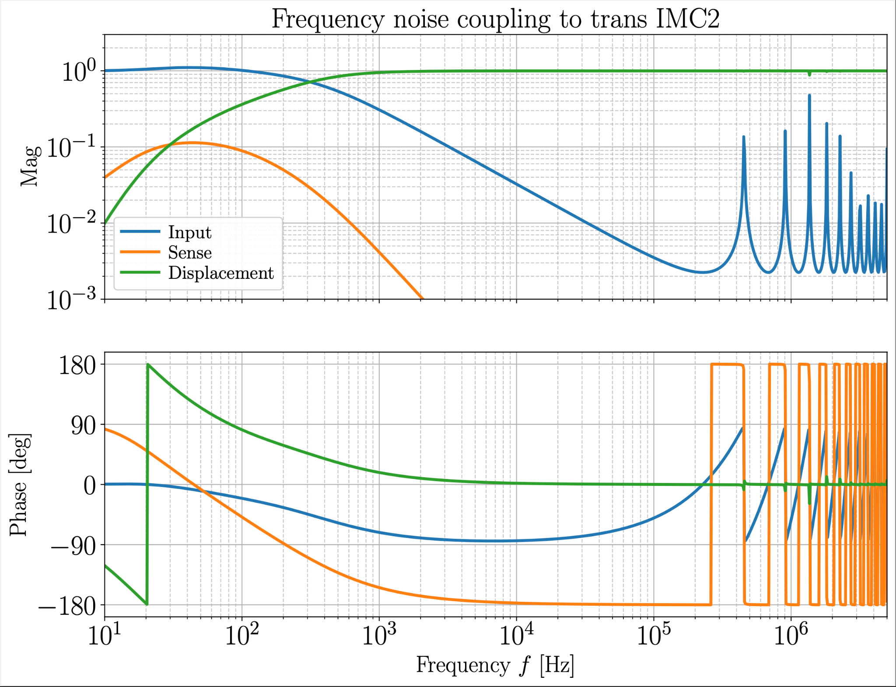
Coupling
Functions
for noise
through
IMC2

Slide 27
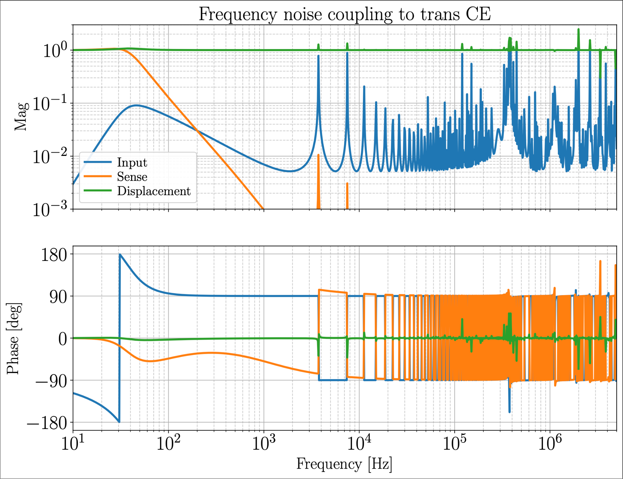
Coupling
Functions
for noise
through
CE

Slide 28
Configurations
One IMC
Two IMCs
FI
2 mirrors
1 beam tube
1 Faraday isolator
4 mirrors
2 beam tubes
2 Faraday isolators
Fabry-Pérot
FI
FI
3 mirrors
1 large beam tube
1 Faraday isolator
Most expensive
6 mirrors
2 large beam tubes
2 Faraday isolators
6 mirrors
2 large beam tubes
2 Faraday isolators
Triangular
FI
FI
FI

Slide 29
Intensity Noise
In Advanced LIGO we stabilize to 30 mW of power.
We anticipate finesse ~ 1500 for IMC2.
With 200 W of input power, we get around 100 kW of power in IMC2.
Shot noise limited RIN:
RIN = 3 x 10⁻⁹ (W/W)/rtHz
Displacement noise from radiation pressure in IMC2:
IN = 2 RIN Pcav/(m c) = 1 x 10⁻¹² m/rtHz
Can induce significant radiation pressure displacement noise for an IMC with 3 kg mirrors, and we have no control authority in IMC2 (thanks to Benno Willke for asking us about this)

Slide 30
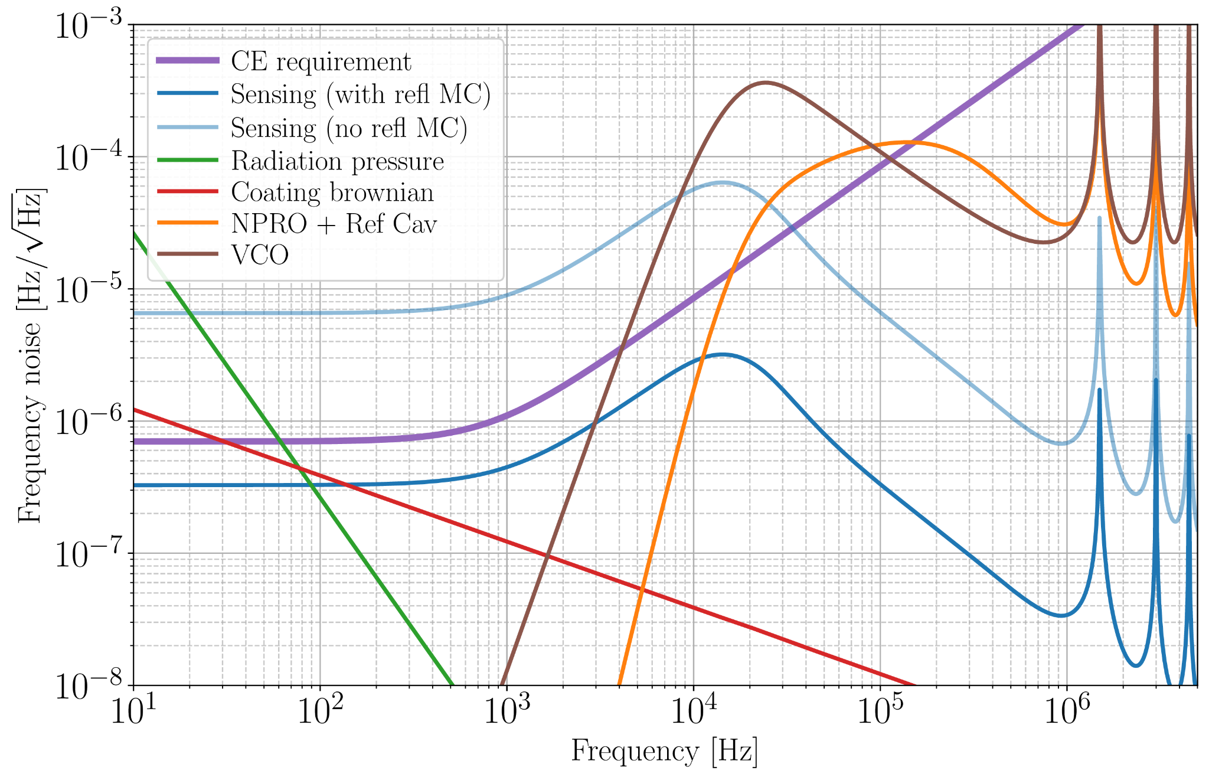
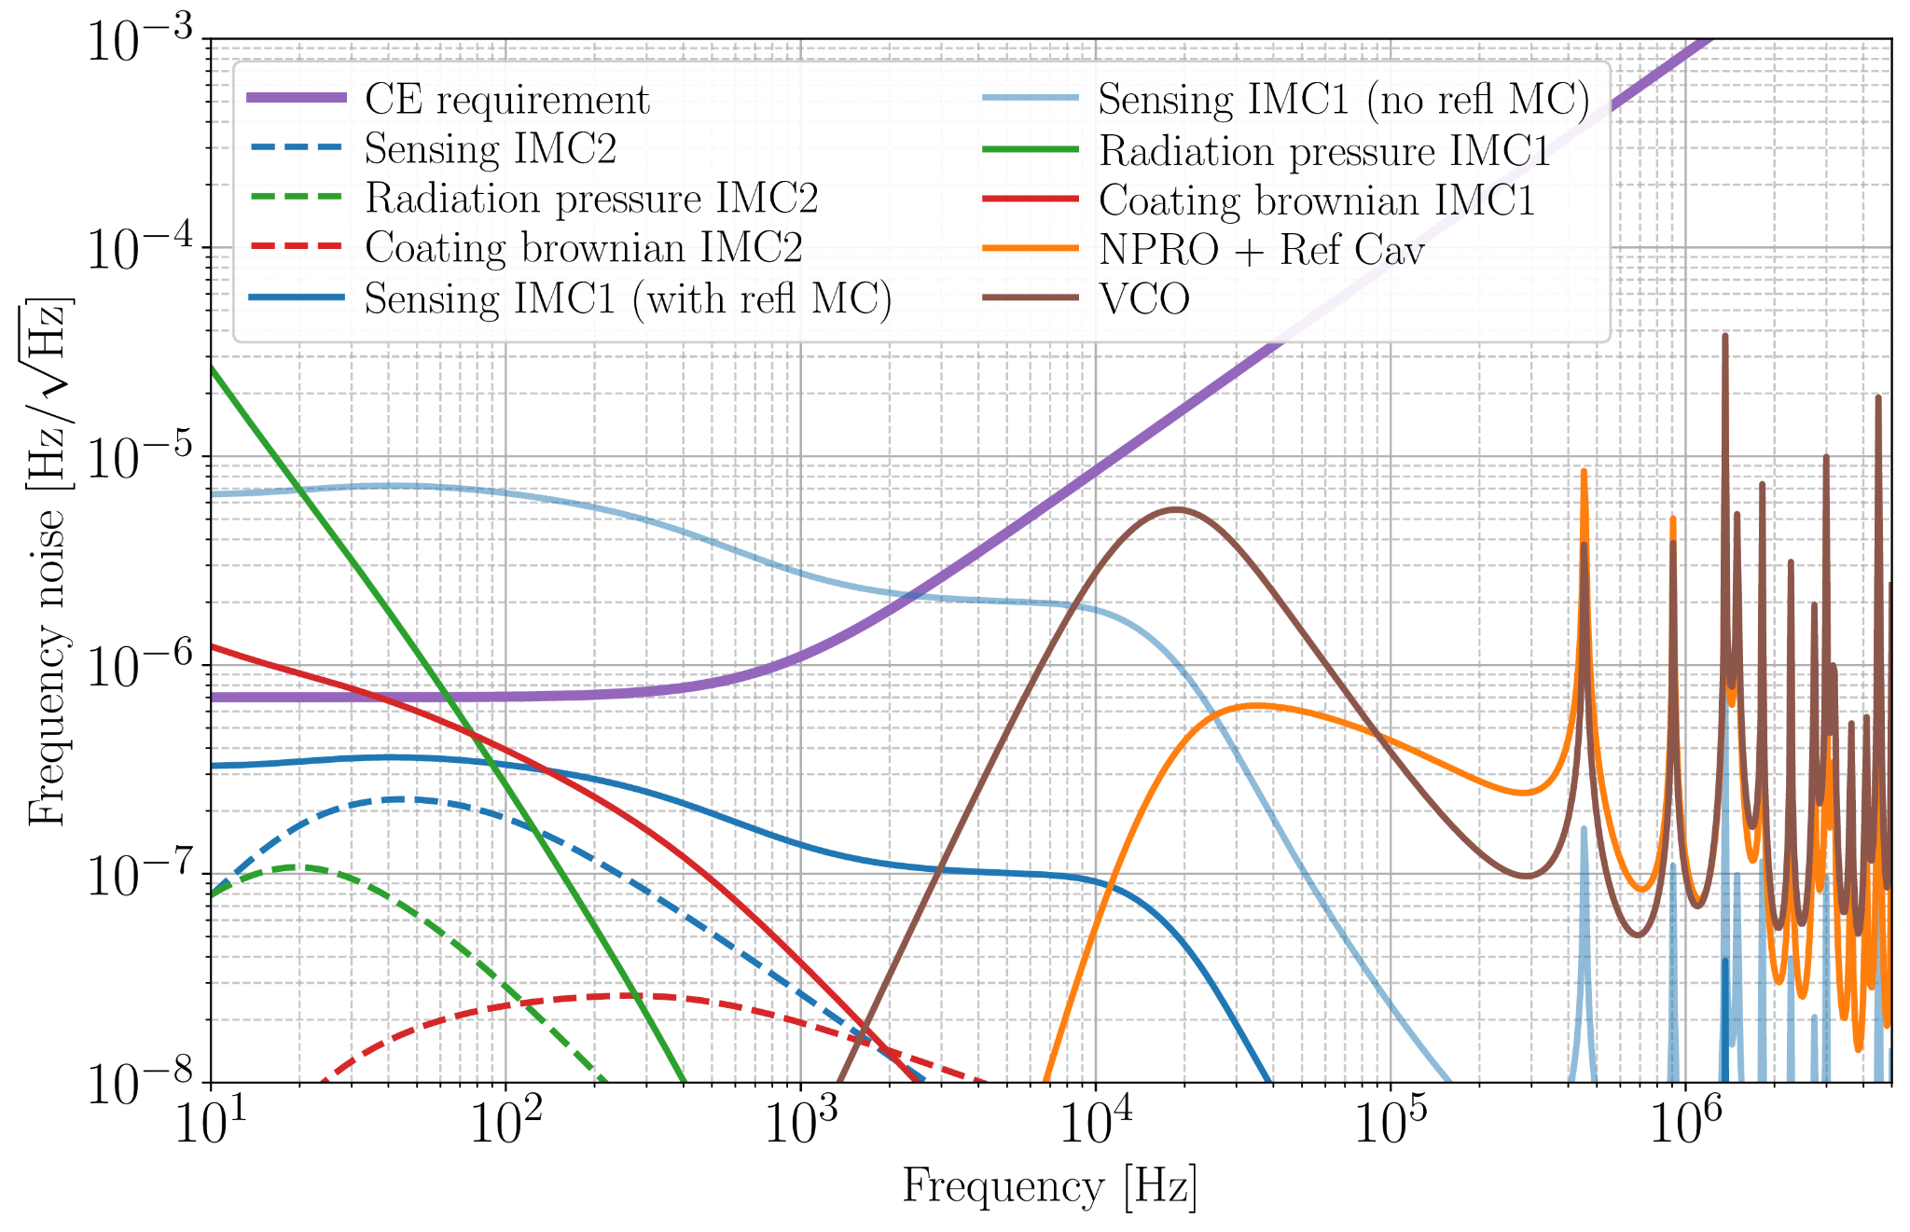
- Finesse = 700
- L_{imc1} = 100 m
- L_{imc2} = 330 m
- FSR_{imc1} = c/(2L) = 1.5 MHz
- FSR_{imc2} = c/(2L) = 450 kHz
- IMC1 pole = 1 kHz
- IMC2 pole = 500 kHz
CE frequency noise requirement:
Determined by the O3 observed HOM frequency to DARM coupling
Double IMC
Single IMC

Slide 31
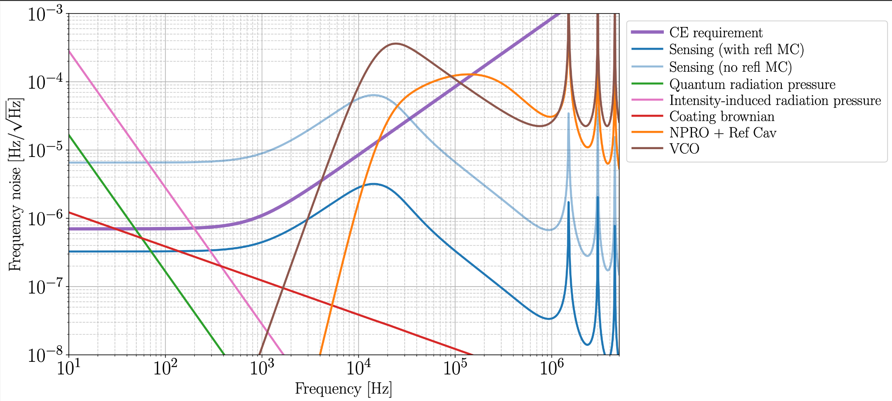
Single IMC noisebudget

