Slide 1

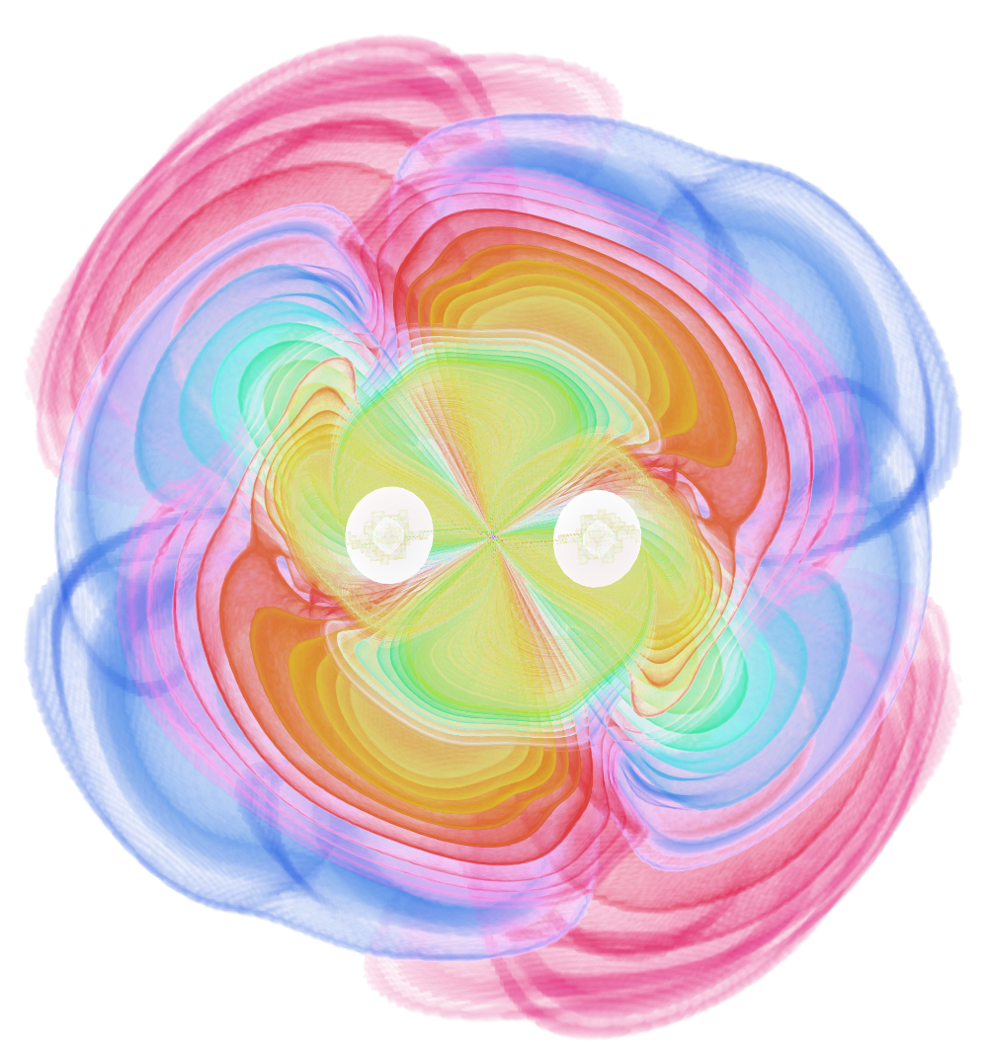



The Gravitational-Wave Messenger
Sylvia Biscoveanu
APS April 2024
@sylvia_bisco
sbisco@northwestern.edu
Image: Ed Seidel (AEI) and Werner Benger (ZIB, AEI)
Notes:
Proposed next-generation ground-based gravitational-wave detector

Slide 2
Outline
Current detectors
  What we’ve learned
  What we cannot learn
Cosmic Explorer
  Design concept
  Science case
  Timeline
Multimessenger synergies
CE Horizon Study
Evans + (inc SB) 2109.09882
CE MPSAC ngGW White Paper
Evans + (inc SB) 2109.09882
CE Trade Study
Gupta+ (inc SB) 2307.10421
Notes:
Start off with some background in the context of current detectors
Next-Generation Gravitational Wave Observatory Subcommittee

Slide 3
Outline
Current detectors
  What we’ve learned
  What we cannot learn
Cosmic Explorer
  Design concept
  Science case
  Timeline
Multimessenger synergies
More Cosmic Explorer at April APS
This afternoon in D10.00002 - Beyond O4: What lies ahead for Terrestrial Gravitational-Wave Detectors, Stefan Ballmer
Saturday afternoon in S10.00002 - Cosmic Explorer: Pushing the gravitational-wave frontier across astronomy, physics, and cosmology, Alessandra Corsi
Notes:
Start off with some background in the context of current detectors
Next-Generation Gravitational Wave Observatory Subcommittee

Slide 4
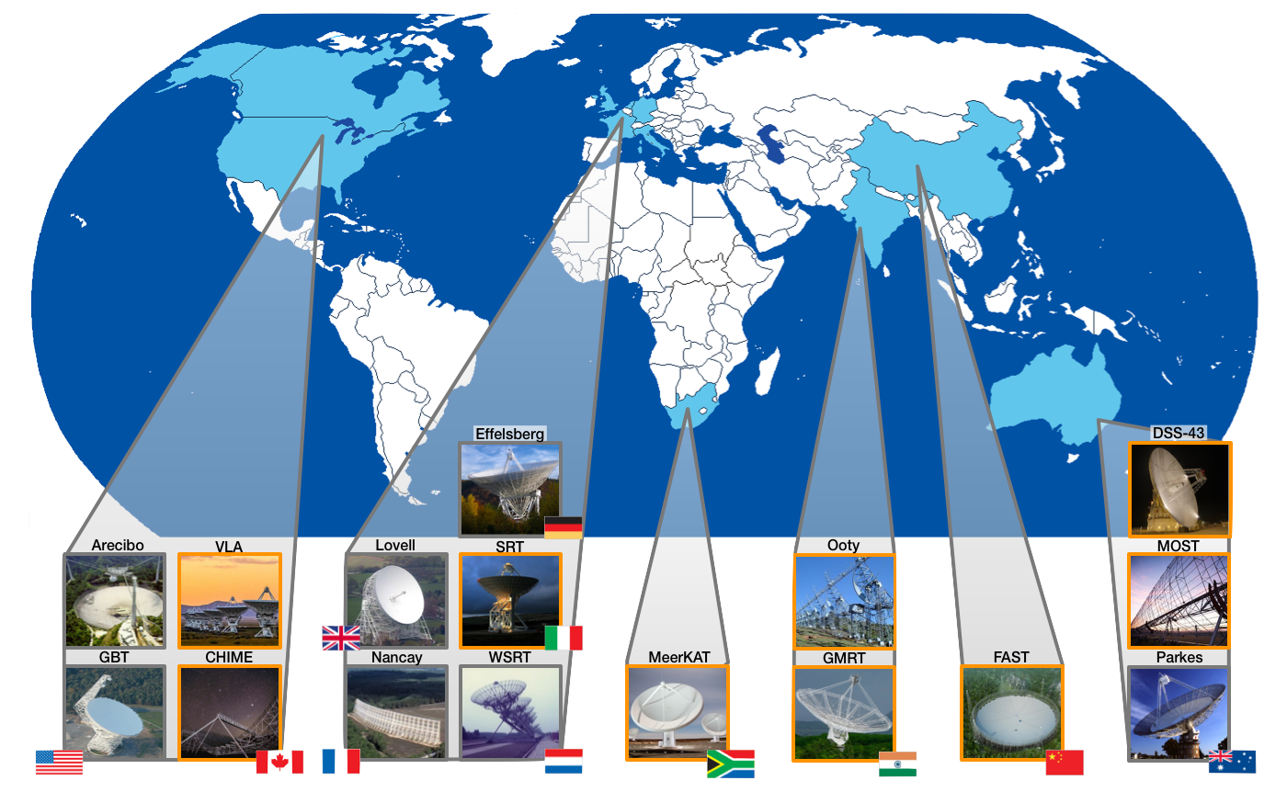
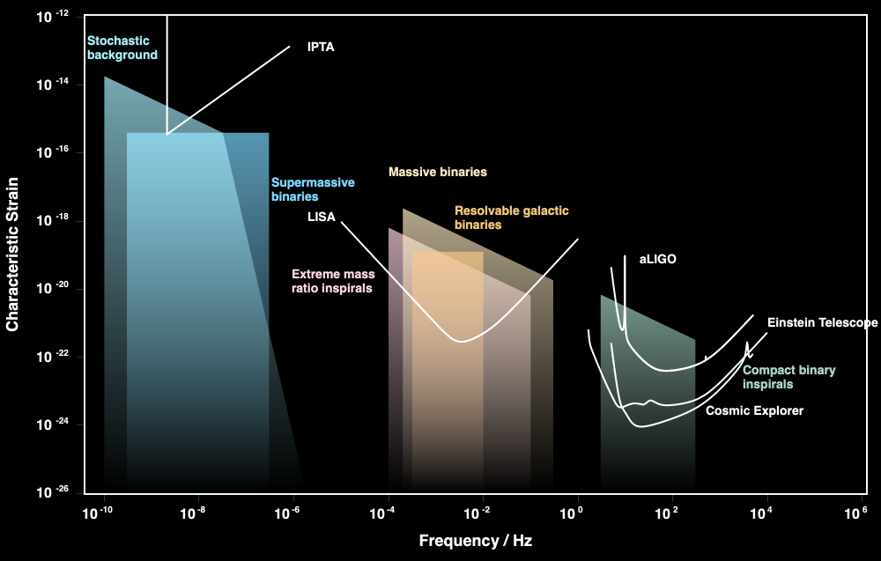
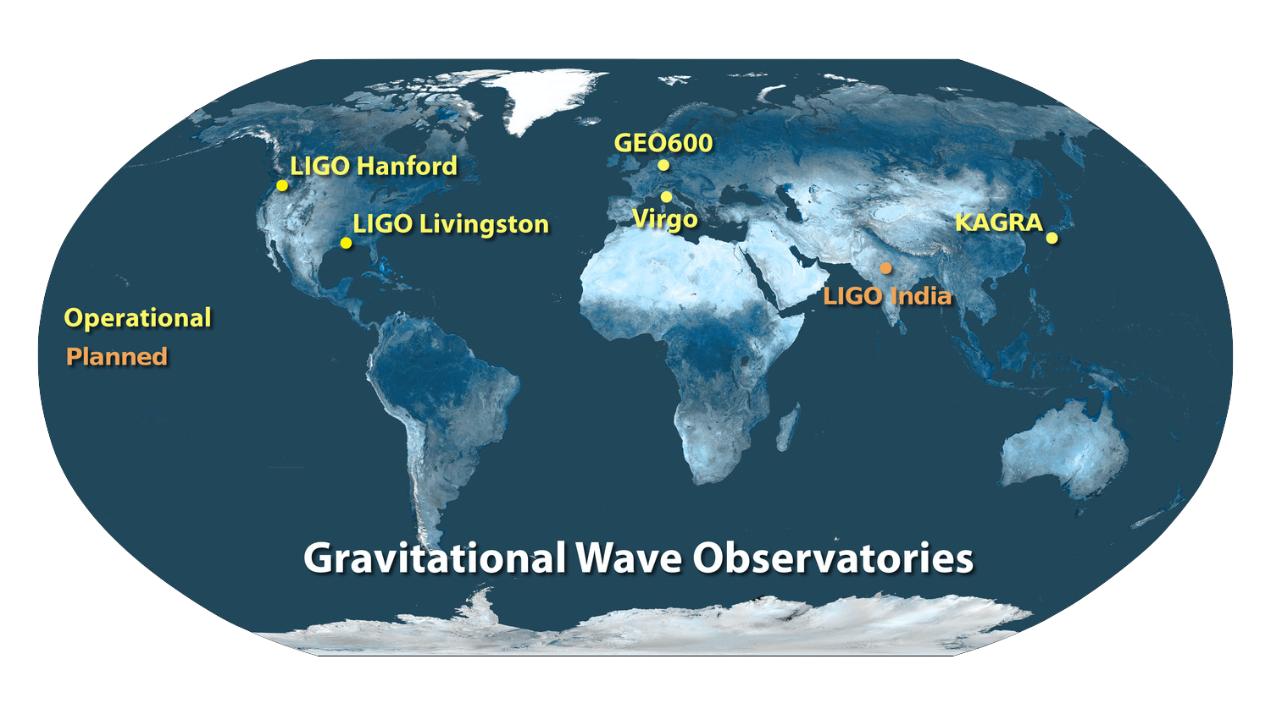


Our observational landscape
Pulsar timing arrays
Ground-based interferometers
gwplotter.com
Notes:
We are now able to probe gravitational waves across many decades in frequency
Sensitivity of key facilities as a function of frequency
Pulsar timing arrays - international effort using radio telescopes around the world

Slide 5
O1+O2+O3 = 90 events
O4a public alerts: 81
Notes:
Current facilities have enabled the observation of more than a hundred gravitational-wave sources

Slide 6
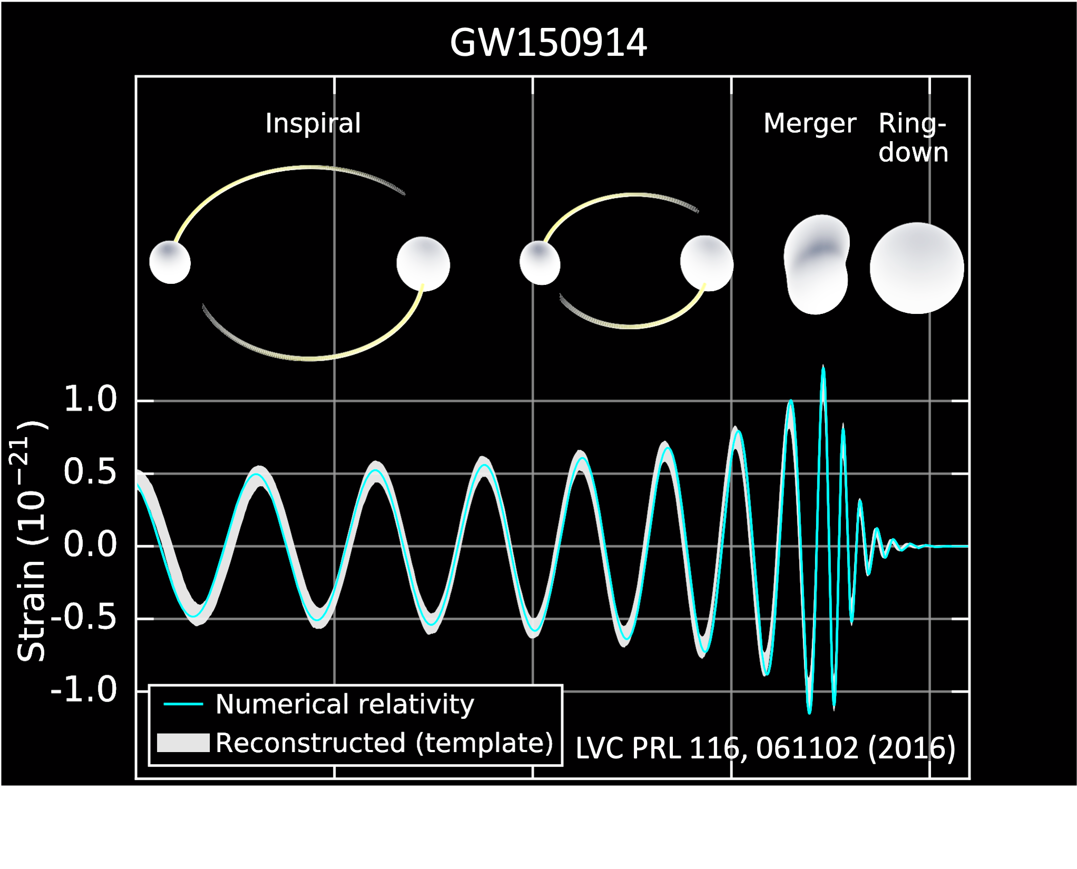
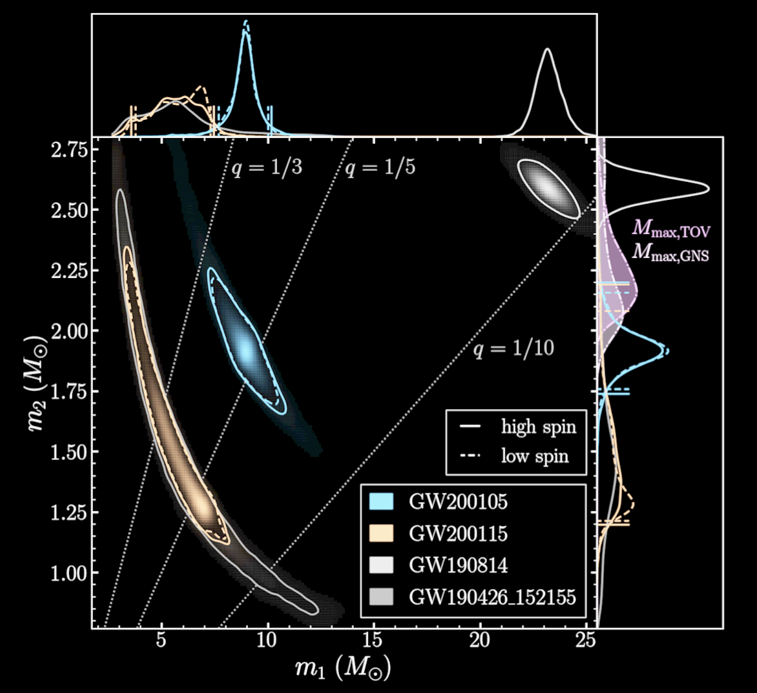
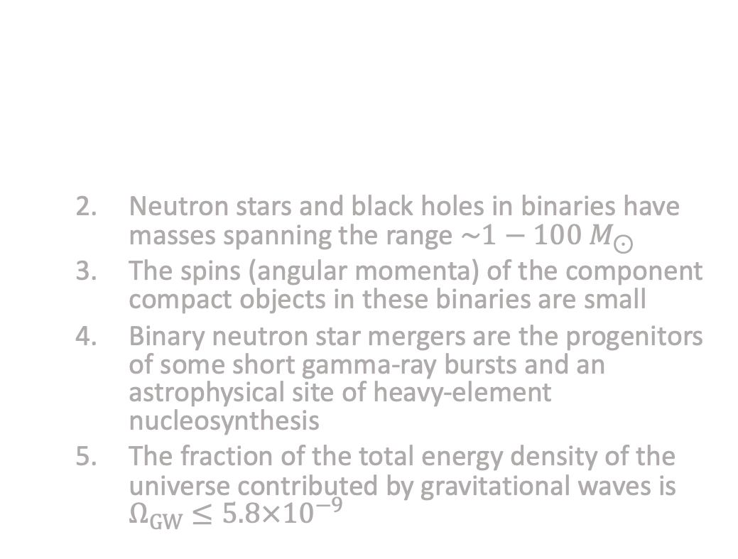
What we’ve learned
The gravitational-wave data obtained by the LIGO-Virgo-Kagra collaboration since 2015 has taught us that:
  Compact object binaries that merge within a Hubble time exist in the Universe
  Neutron stars and black holes in binaries have masses spanning the range $\sim 1−100 M_{⊙}$
  The spins (angular momenta) of the component compact objects in these binaries are small
  Binary neutron star mergers are the progenitors of some short gamma-ray bursts and an astrophysical site of heavy-element nucleosynthesis
  The fraction of the total energy density of the universe contributed by gravitational waves is $Ω_{GW}≤5.8×{10}^{−9}$
LVK ApJL 915, L5 (2021)
Notes:
Measure a dimensionless quantity called strain as a function of time
Strain signal inferred for the first GW event

Slide 7
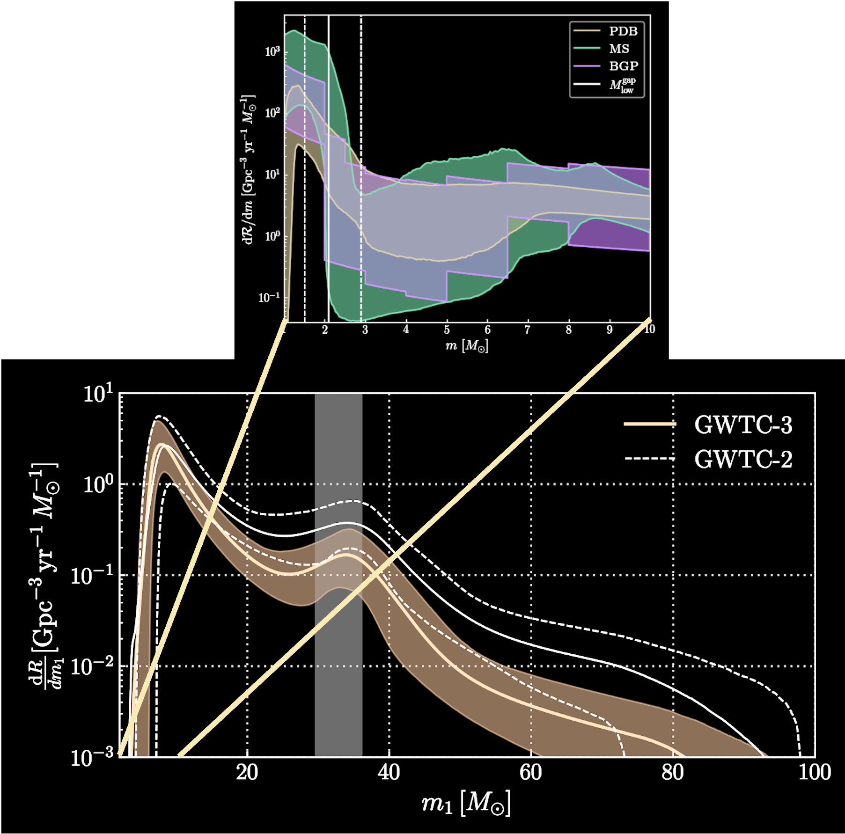
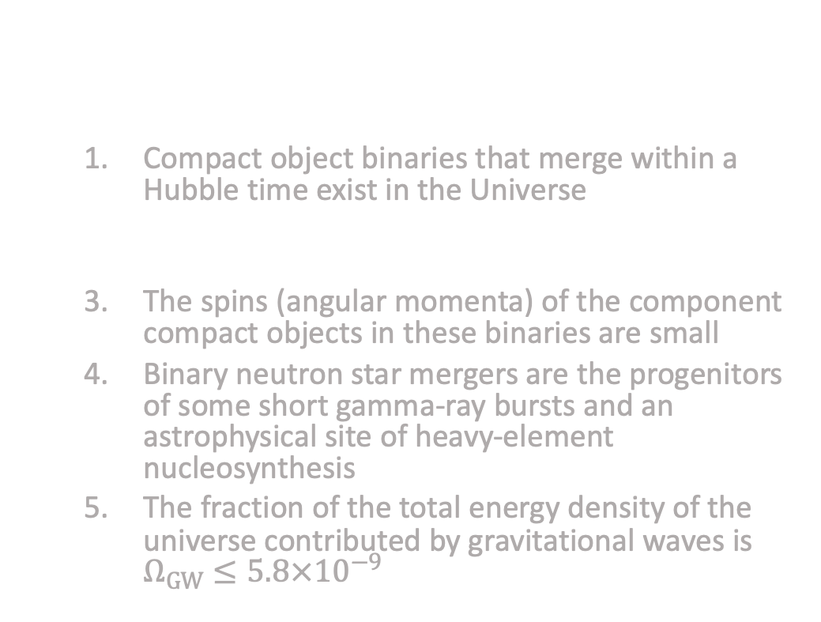
What we’ve learned
The gravitational-wave data obtained by the LIGO-Virgo-Kagra collaboration since 2015 has taught us that:
  Compact object binaries that merge within a Hubble time exist in the Universe
  Neutron stars and black holes in binaries have masses spanning the range $\sim 1−100 M_{⊙}$
  The spins (angular momenta) of the component compact objects in these binaries are small
  Binary neutron star mergers are the progenitors of some short gamma-ray bursts and an astrophysical site of heavy-element nucleosynthesis
  The fraction of the total energy density of the universe contributed by gravitational waves is $Ω_{GW}≤5.8×{10}^{−9}$
LVK PRX 13, 011048 (2023)
Notes:
Explain the plot

Slide 8
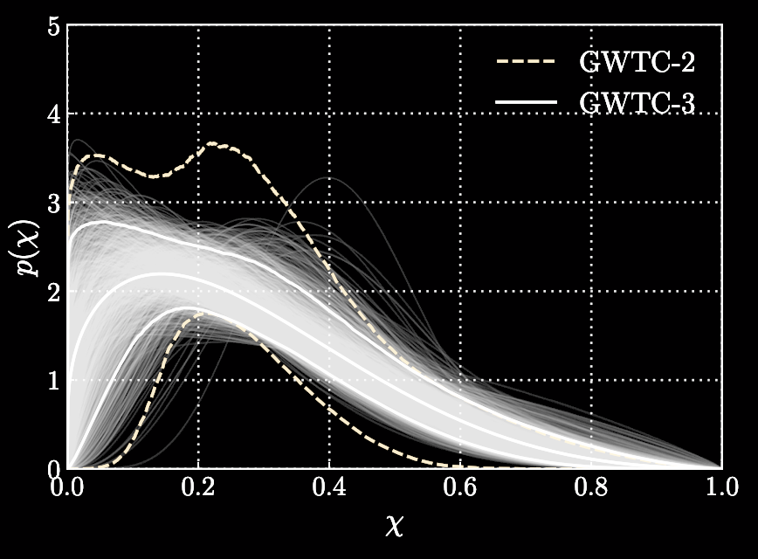
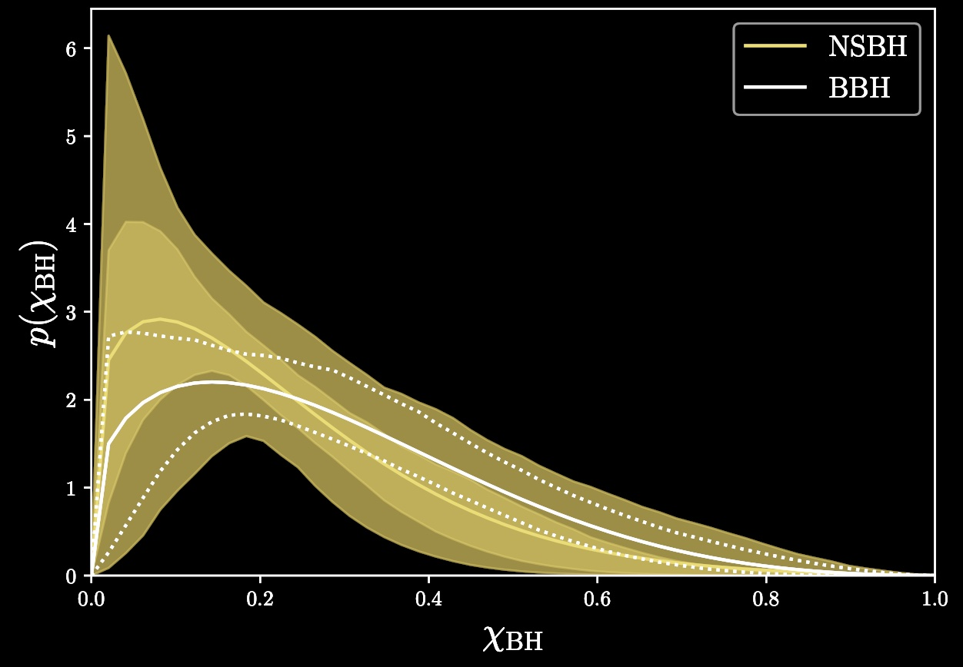
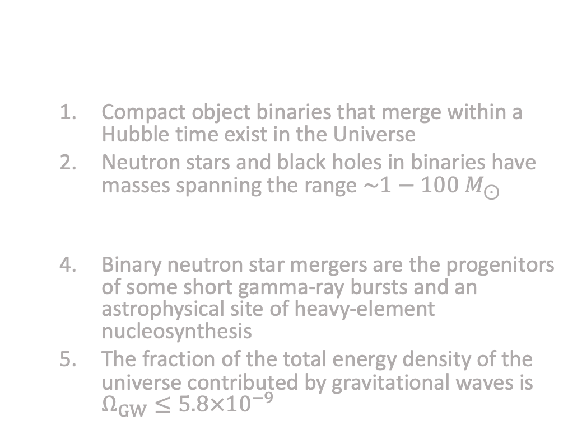
What we’ve learned
Binary black hole spin magnitude
The gravitational-wave data obtained by the LIGO-Virgo-Kagra collaboration since 2015 has taught us that:
  Compact object binaries that merge within a Hubble time exist in the Universe
  Neutron stars and black holes in binaries have masses spanning the range $\sim 1−100 M_{⊙}$
  The spins (angular momenta) of the component compact objects in these binaries are small
  Binary neutron star mergers are the progenitors of some short gamma-ray bursts and an astrophysical site of heavy-element nucleosynthesis
  The fraction of the total energy density of the universe contributed by gravitational waves is $Ω_{GW}≤5.8×{10}^{−9}$
LVK PRX 13, 011048 (2023)
Neutron star-black hole spin magnitude
SB+ MNRAS 518, 5298 (2022)

Slide 9
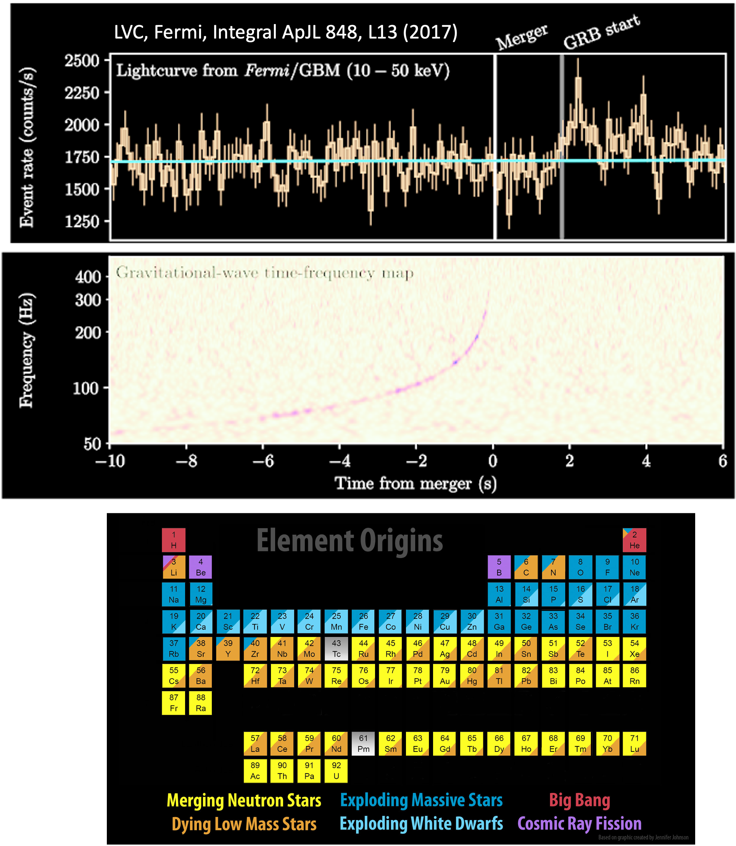
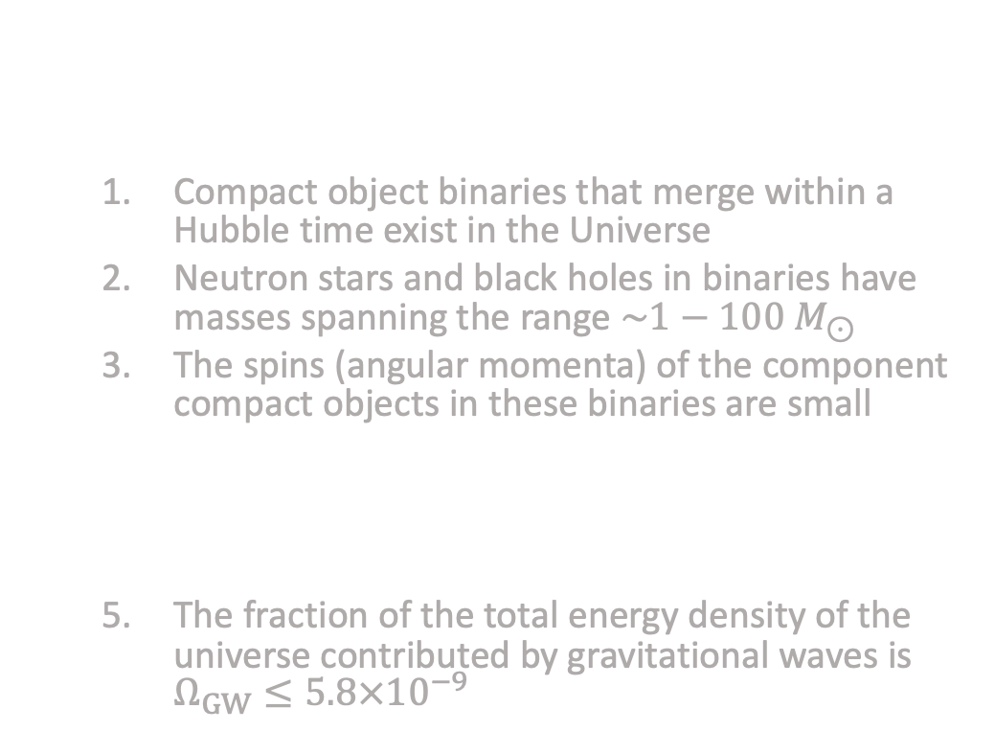
What we’ve learned
The gravitational-wave data obtained by the LIGO-Virgo-Kagra collaboration since 2015 has taught us that:
  Compact object binaries that merge within a Hubble time exist in the Universe
  Neutron stars and black holes in binaries have masses spanning the range $\sim 1−100 M_{⊙}$
  The spins (angular momenta) of the component compact objects in these binaries are small
  Binary neutron star mergers are the progenitors of some short gamma-ray bursts and an astrophysical site of heavy-element nucleosynthesis
  The fraction of the total energy density of the universe contributed by gravitational waves is $Ω_{GW}≤5.8×{10}^{−9}$

Slide 10
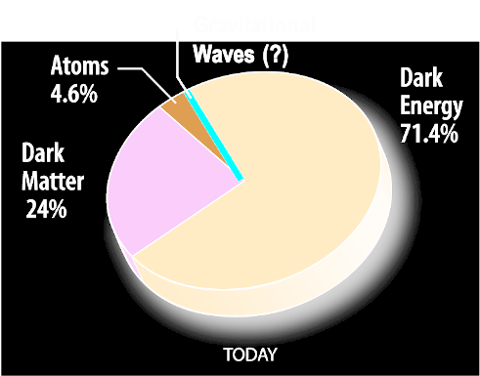
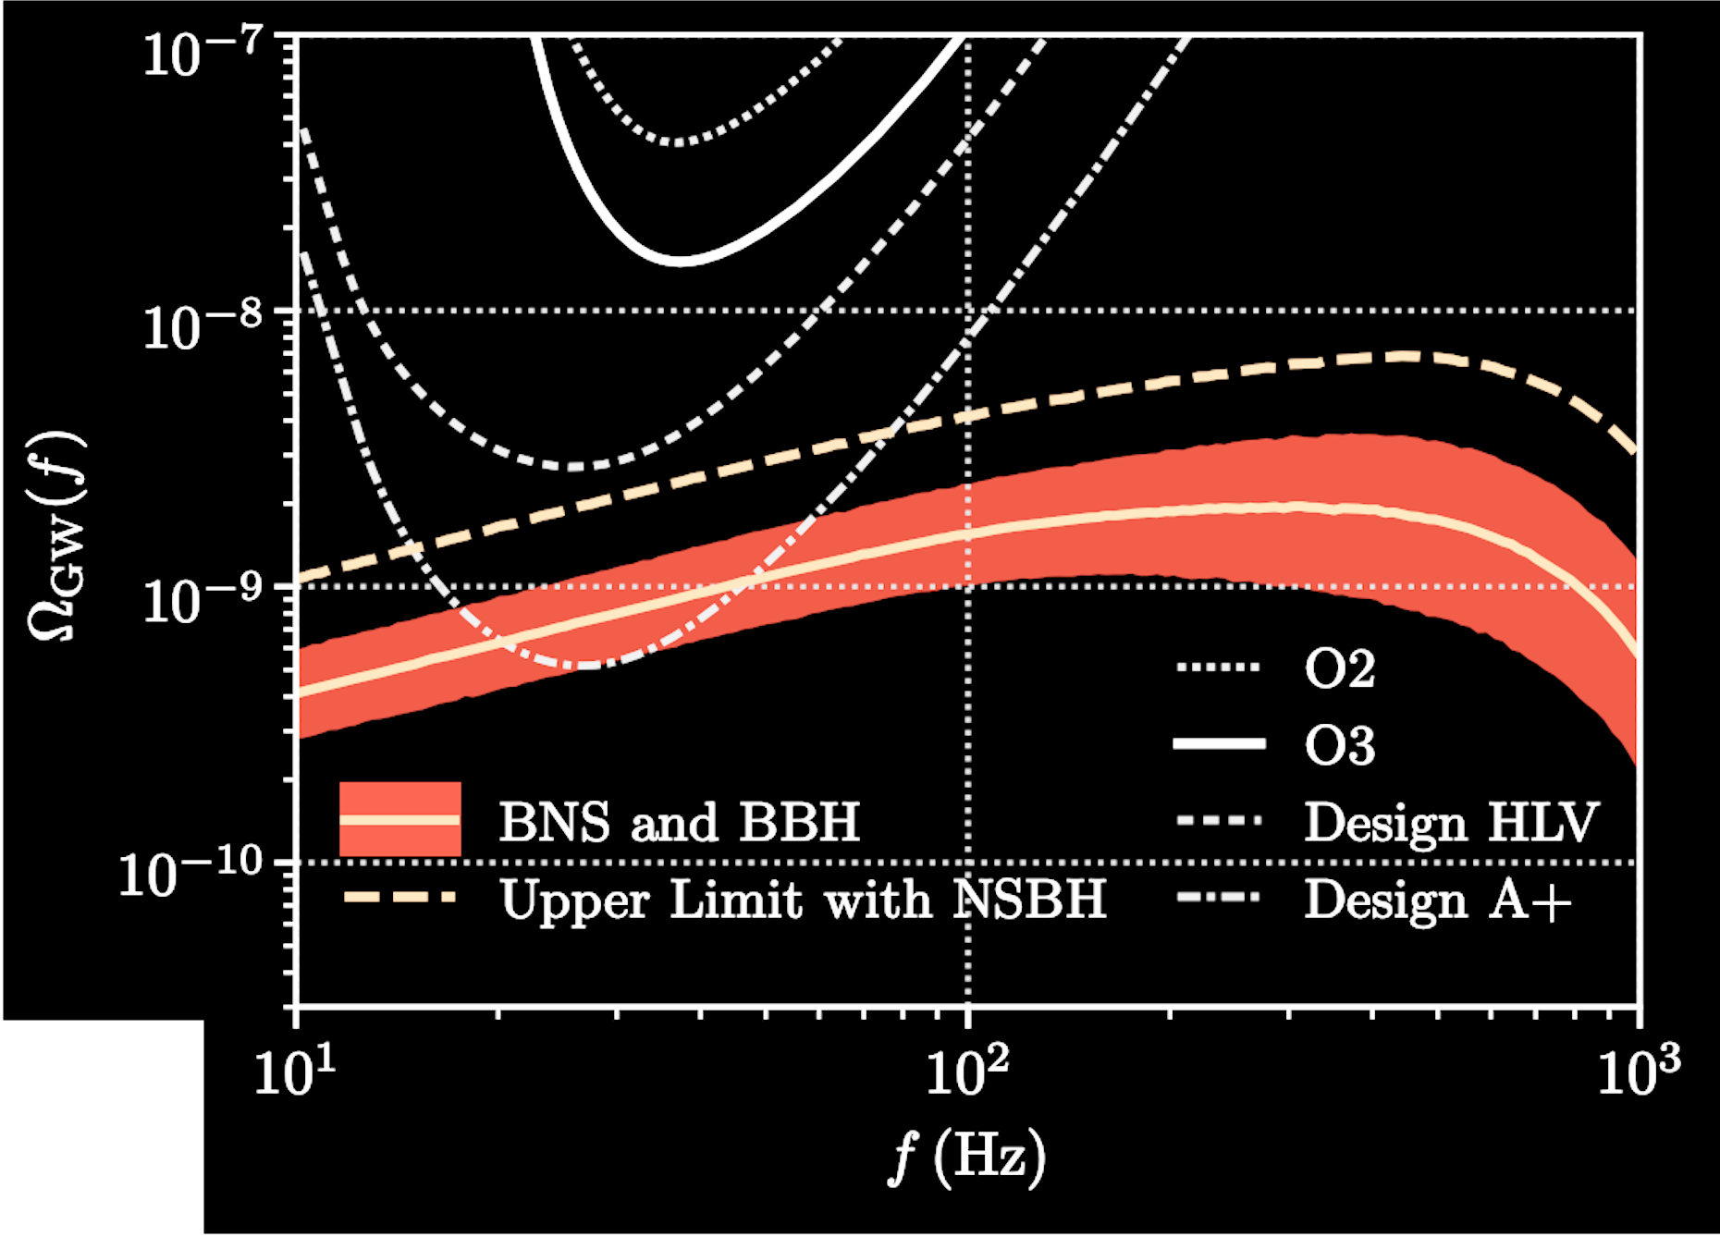
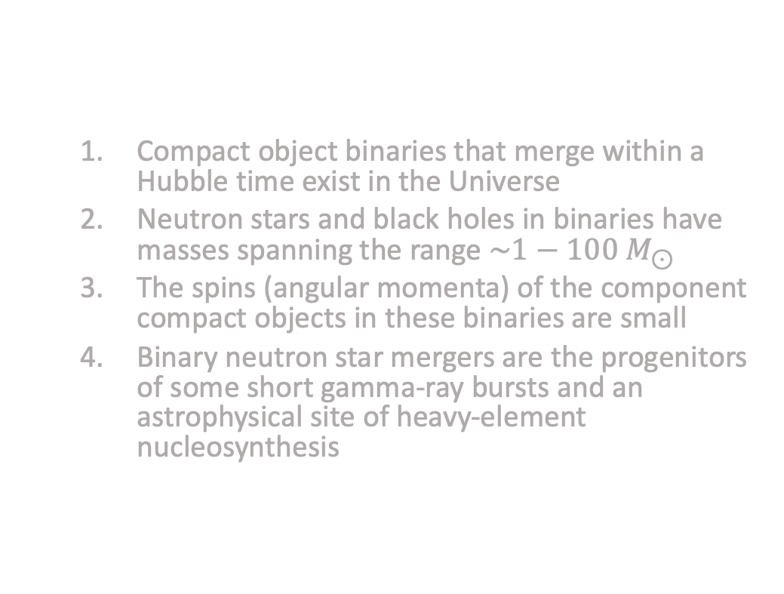
What we’ve learned
The gravitational-wave data obtained by the LIGO-Virgo-Kagra collaboration since 2015 has taught us that:
  Compact object binaries that merge within a Hubble time exist in the Universe
  Neutron stars and black holes in binaries have masses spanning the range $\sim 1−100 M_{⊙}$
  The spins (angular momenta) of the component compact objects in these binaries are small
  Binary neutron star mergers are the progenitors of some short gamma-ray bursts and an astrophysical site of heavy-element nucleosynthesis
  The fraction of the total energy density of the universe contributed by gravitational waves is $Ω_{GW}≤5.8×{10}^{−9}$
LVK PRD 104, 022004 (2021)
Notes:
90% credibility for flat spectrum

Slide 11
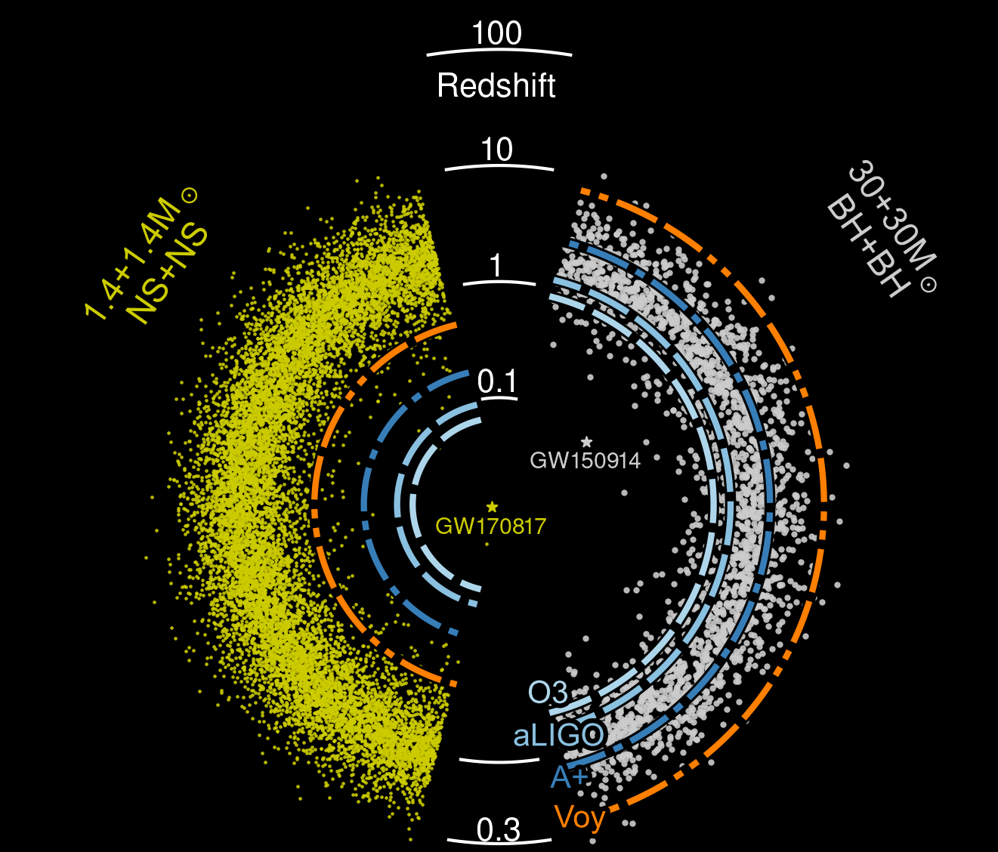
What we can’t learn… yet
Binary neutron star mergers beyond cosmic noon
Precision measurements of the neutron star equation of state
Binary neutron star postmerger signal
Binary mergers including Population III and primordial black holes
Gravitational-wave memory effect
Cosmological stochastic gravitational-wave backgrounds
Notes:
Crucial science questions that we cannot yet answer

Slide 12
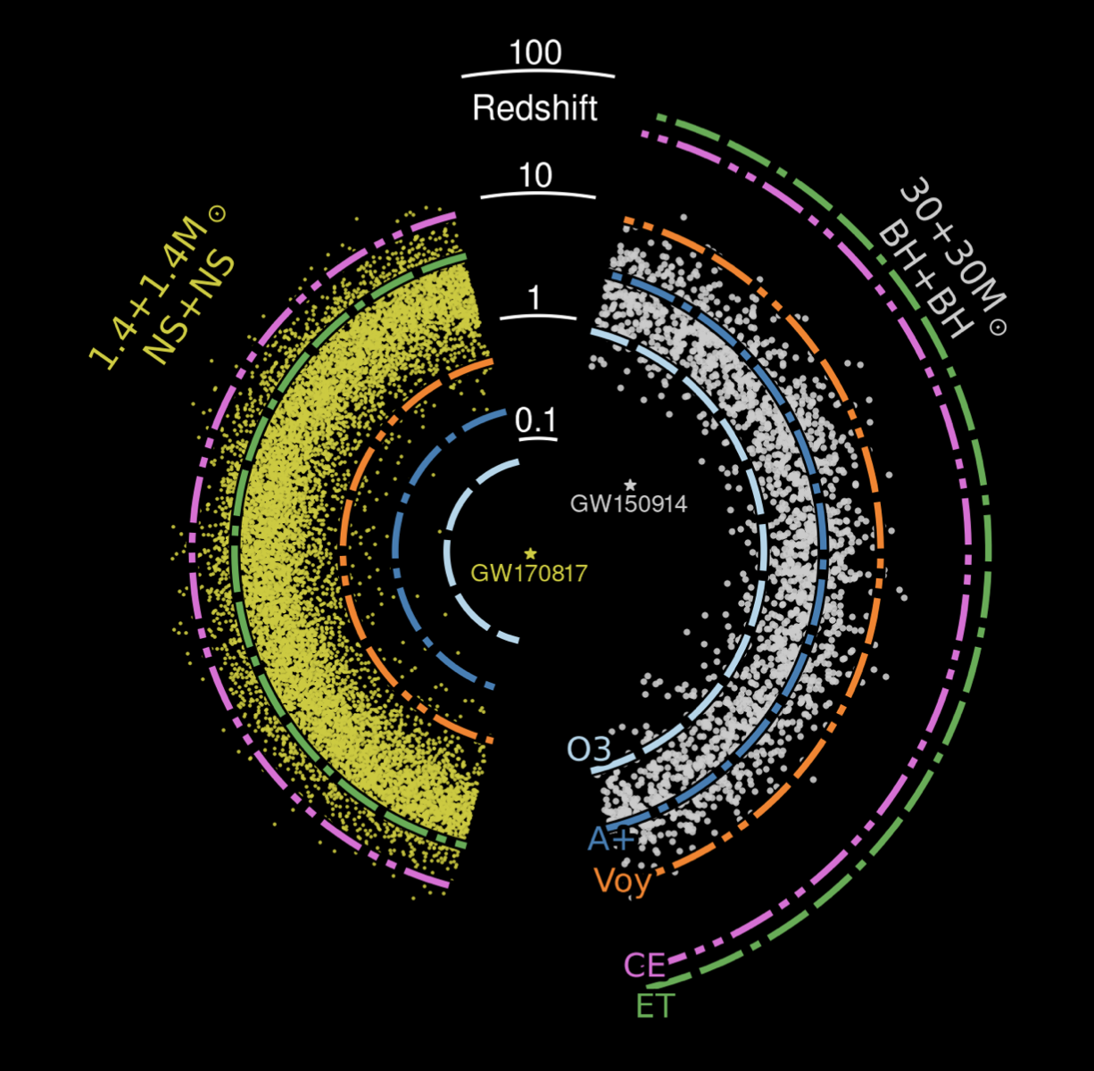

The next generation
US-based concept planned for the late 2030s
European concept with triangular design
CE Horizon Study
Evans + (inc SB) 2109.09882
Notes:
Equal mass, SNR>8

Slide 13
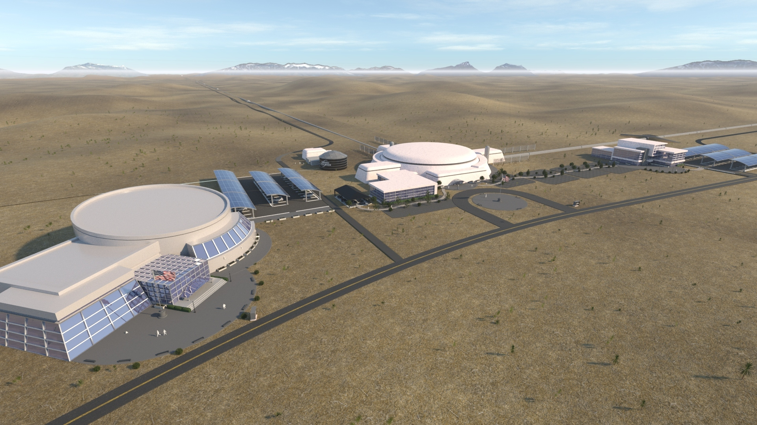
Cosmic Explorer
Reference design includes two facilities widely separated in the US
  40km + 20km (tunable)
Image: Edward Anaya, Virginia Kitchen, Angela Nguyen, and Joshua R. Smith

Slide 14
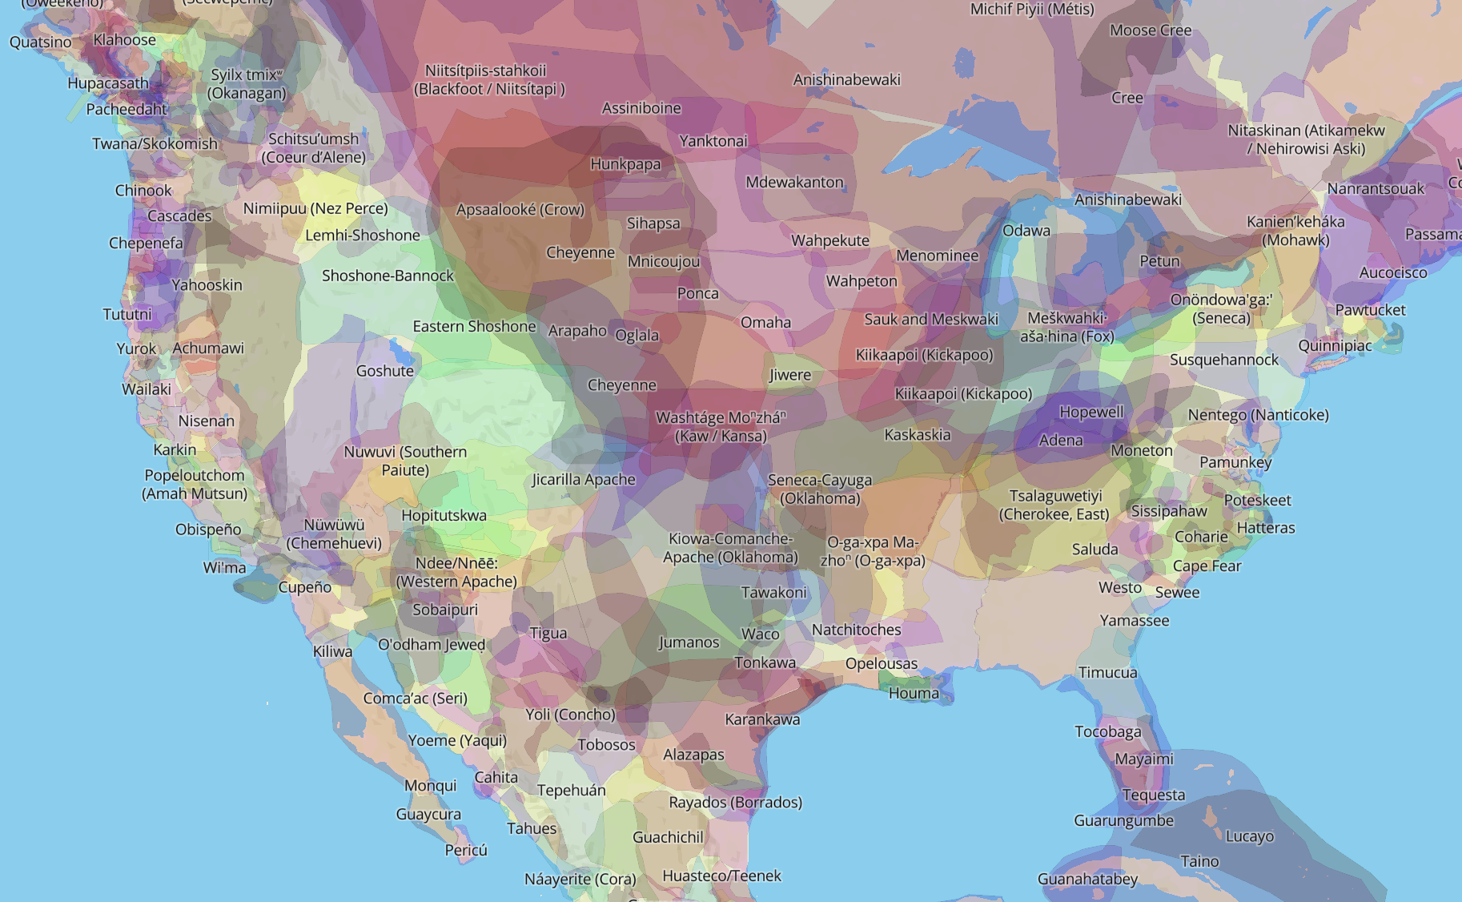
The Cosmic Explorer team recognizes the inherent connections between the lands, waters, sky, and people. We are committed to cultivating connections to place and partnerships with Indigenous communities who care for, have cared for, and will continue to care for these places. We acknowledge that we are responsible for the manner in which we do science and for the impacts it has on the land and its Peoples.
Map from native-lands.ca
Notes:
Such a large observatory is going to have a large footprint
Ancestral lands of indigenous peoples
Part of the site selection process is going to involve carefully creating partnerships with the local and indigenous communities that would be affected by the construction of these intrusments

Slide 15
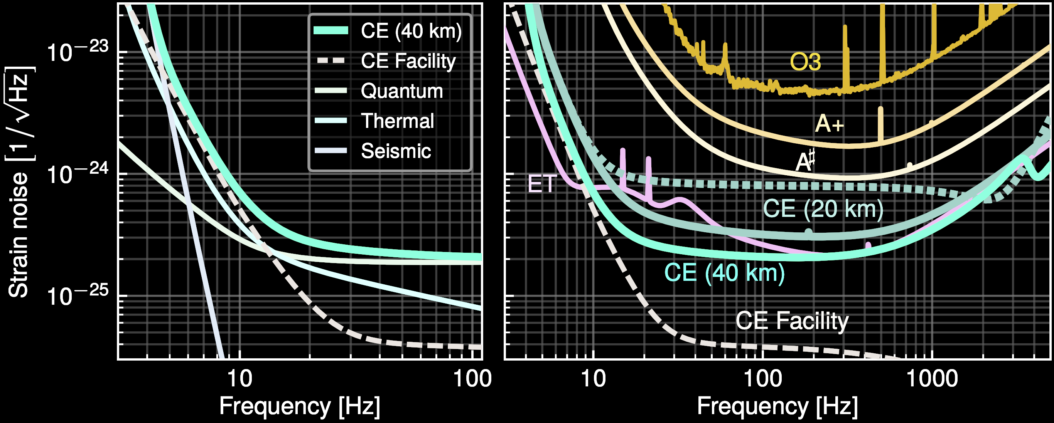
Order of magnitude improvement in strain sensitivity over current detectors
CE MPSAC ngGW White Paper
Evans + (inc SB) 2109.09882
  Equivalent to an order of magnitude increase in the diameter of a telescope
Notes:
CE design will provide an order of magnitude improvement over A+ at 100 Hz, increasing to 50 times at 20 Hz
For those folks that are electromagnetic observers

Slide 16
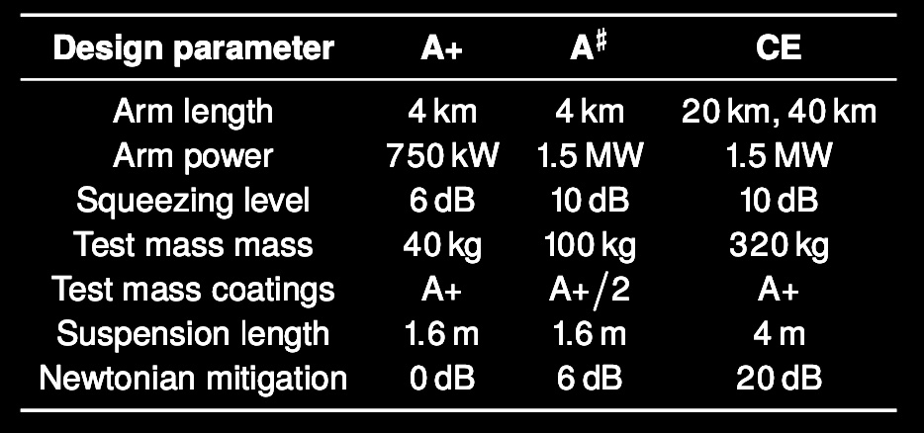
Design concept
Dual-recycled Fabry-Perot Michelson Interferometer
Order of magnitude longer arms
Quantum sensing
Improved low-frequency isolation
CE MPSAC ngGW White Paper
Evans + (inc SB) 2109.09882
Notes:
Arm length increase is relatively low risk
Dual recycling – power recycling mirror at input, signal recycling (bandwidth) at output
Increased laser power in the arms amplifies the effect of the phase shift induced by an arm length change, leading to a stronger detector response to a passing gravitational wave.
Low freqs -> radiation pressure (variation in the number of photos arriving) -> amplitude quadrature
High freqs -> shot noise (arrival rate of photos) -> phase quadrature
1 micrometer wavelength laser
thermal noise in the test mass optical coatings is reduced twenty-fold due to the larger optical beams and the longer arms
“Test mass coatings” refers to the thermal noise level of the test masses
most other displacement noise couplings are suppressed ten-fold
2× quantum noise reduction at the LIGO observatories suggests that the 3× quantum noise reduction assumed for CE is within reach
6 dB = factor of 4 improvement, 10 dB = OOM improvement
passive and active isolation systems scaled up from those in Advanced LIGO
Dedicated seismometer array to subtract Newtonian and gravity gradient noise
sum of infrastructure-specific noise sources that would be common to all future detectors utilizing the CE infrastructure

Slide 17
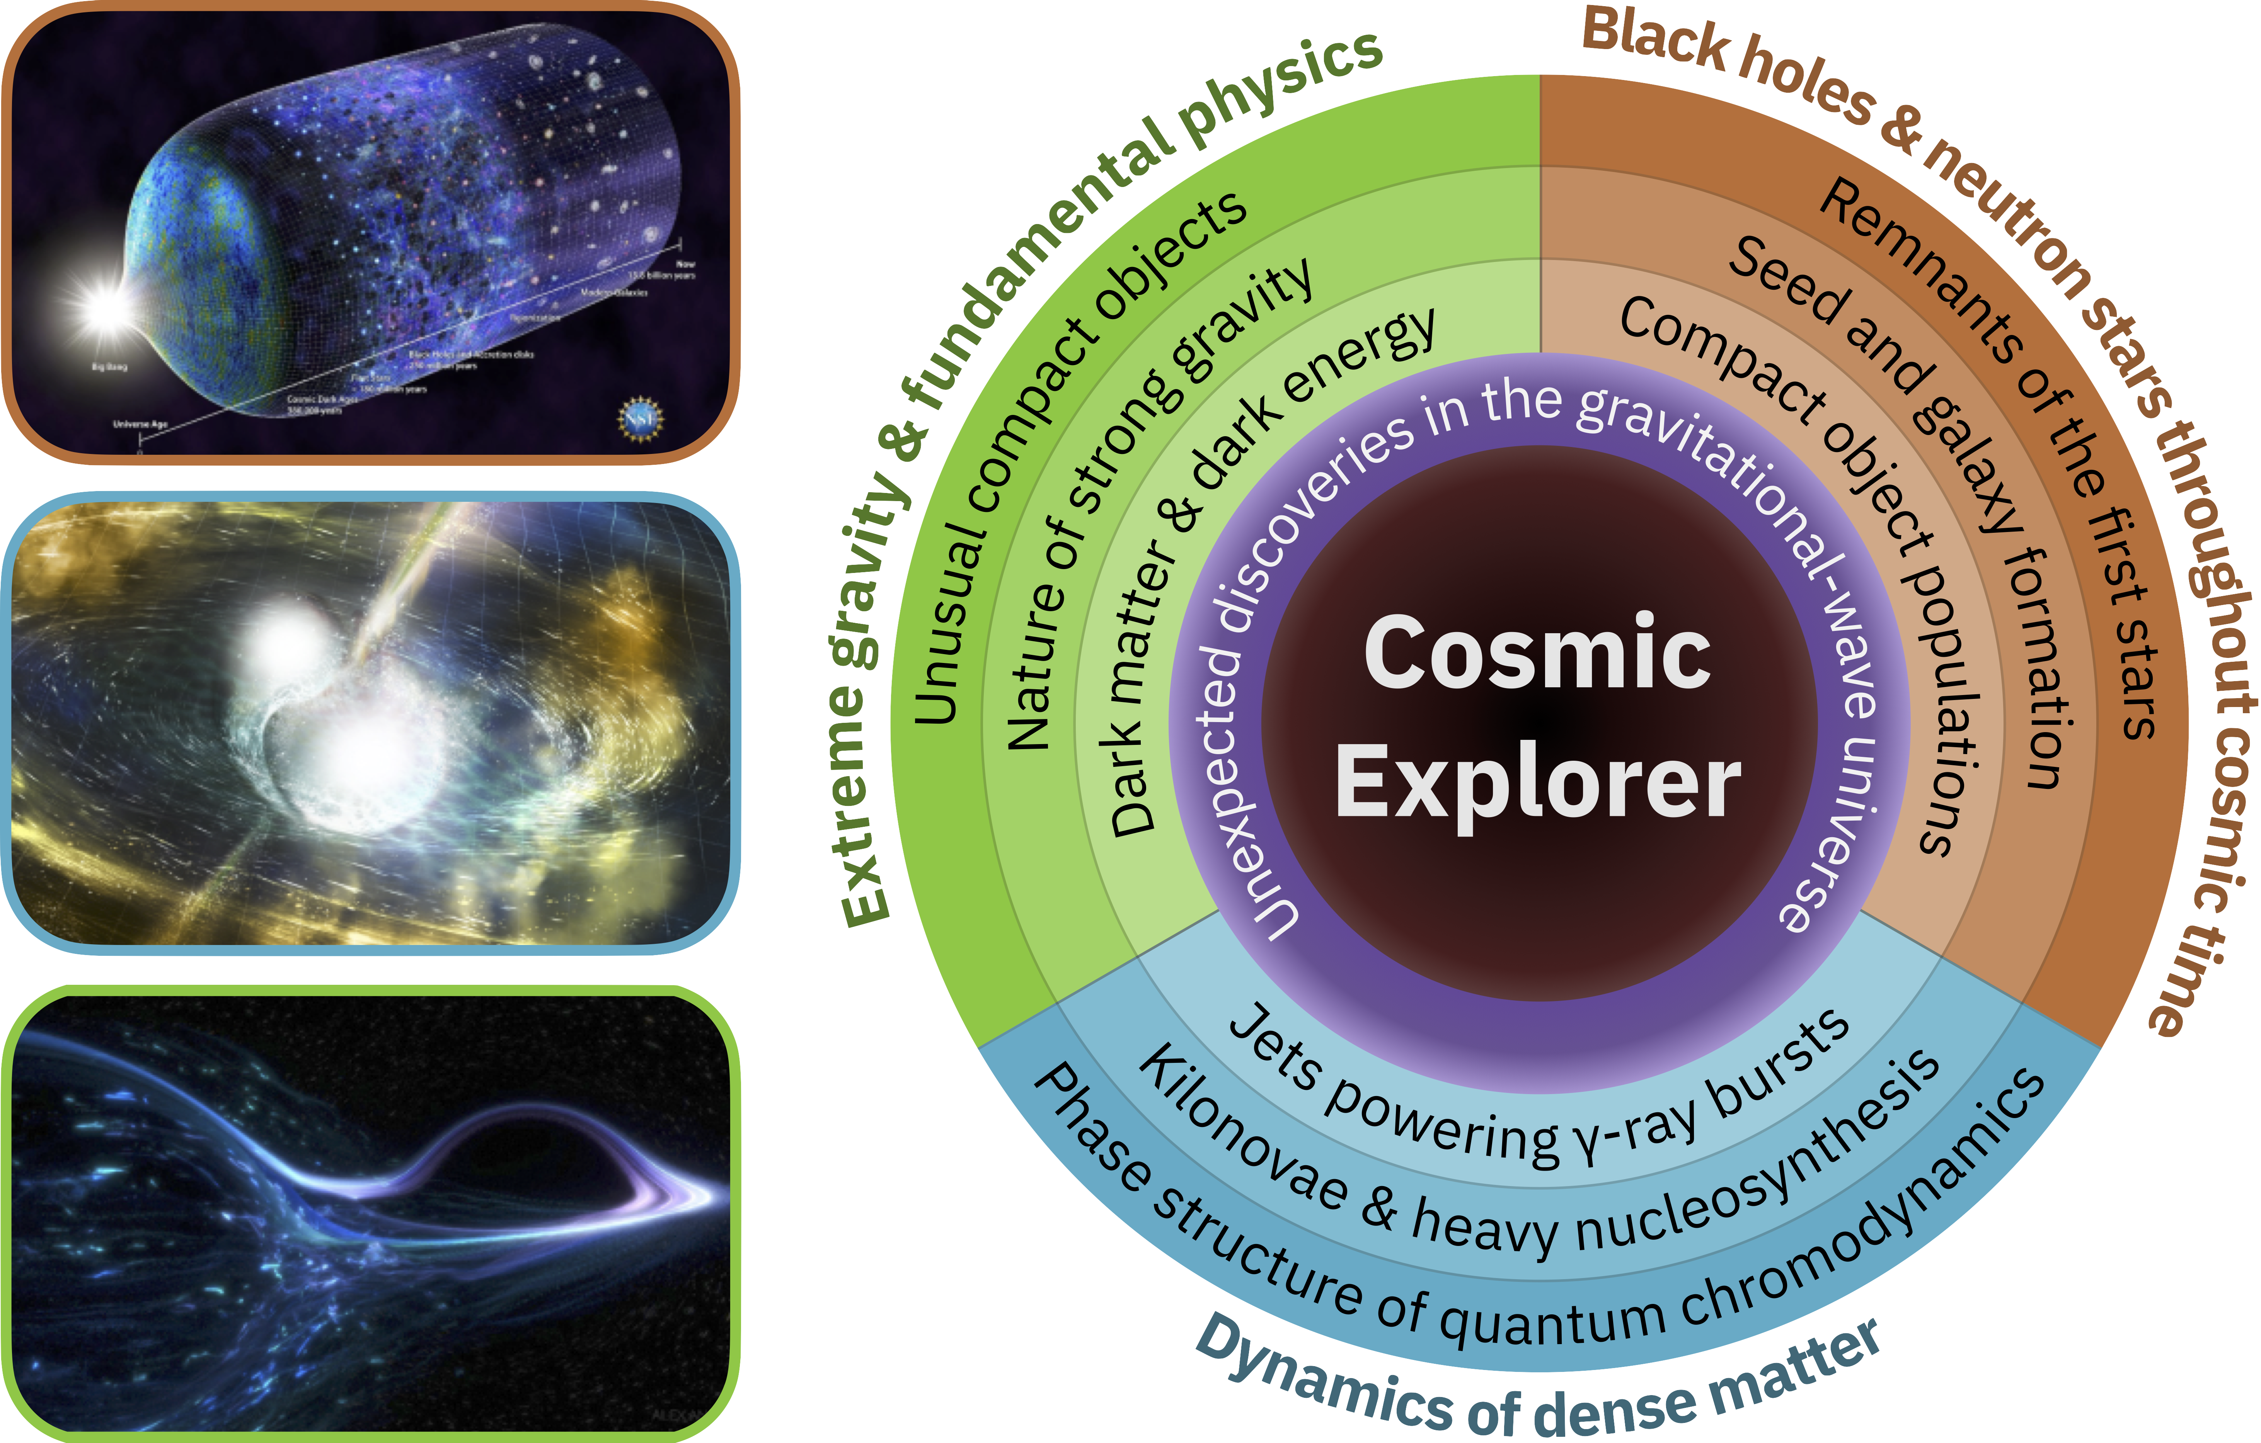
Key science objectives

Slide 18
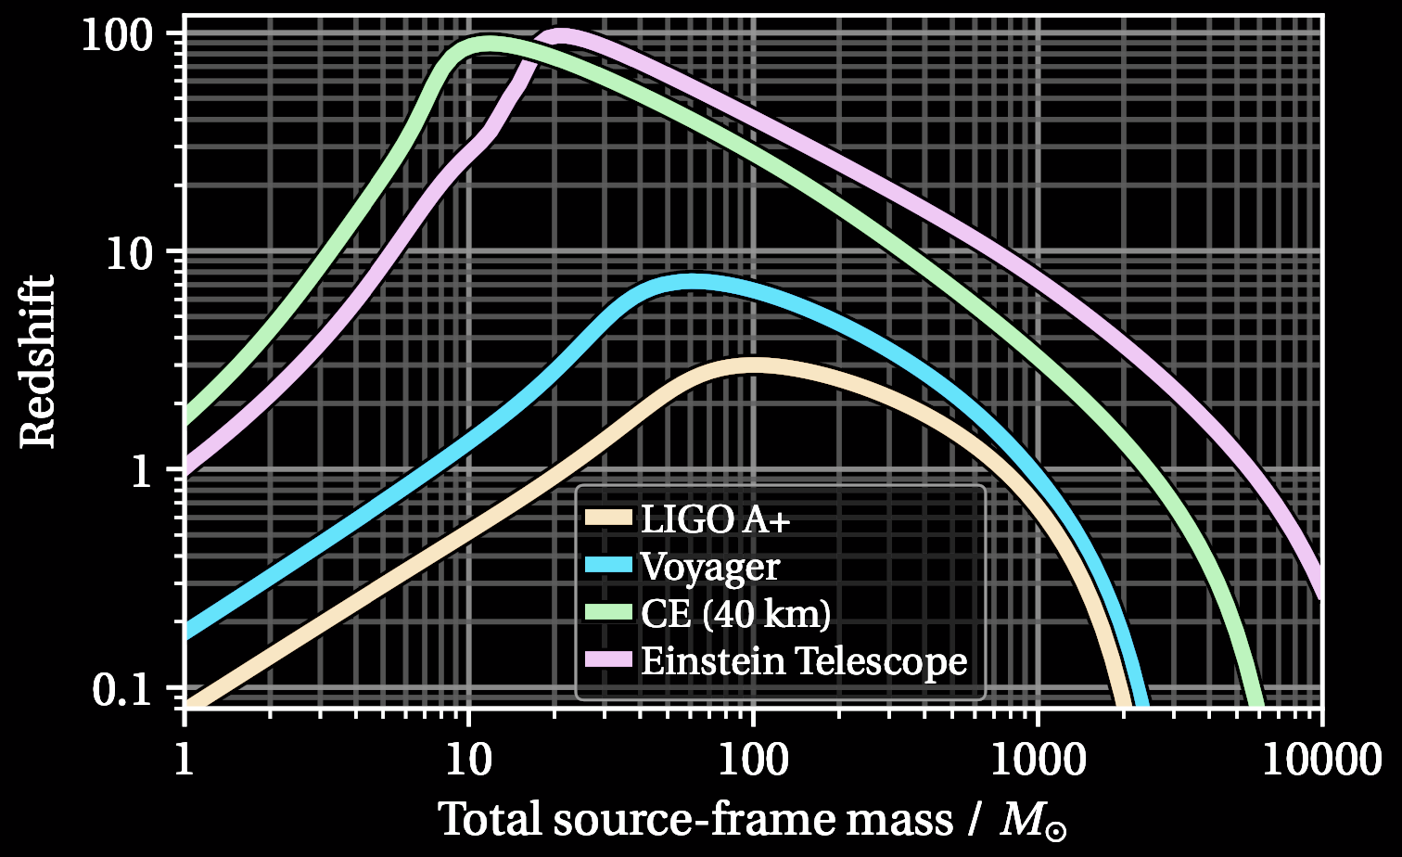
Black holes and neutron stars through cosmic time
Evolution of the merger rate as a function of redshift
Remnants of the first stars
Seeds of supermassive black holes, hierarchical growth
Smoking-gun distinction of primordial black holes
CE Horizon Study
Evans + (inc SB) 2109.09882
Notes:
Synergy with JWST which can observe galaxies composed of the first stars but not individual stars
At least one 40km CE → 100x higher BNS detection rate
Detection of PBH at z > 15 impossible with

Slide 19
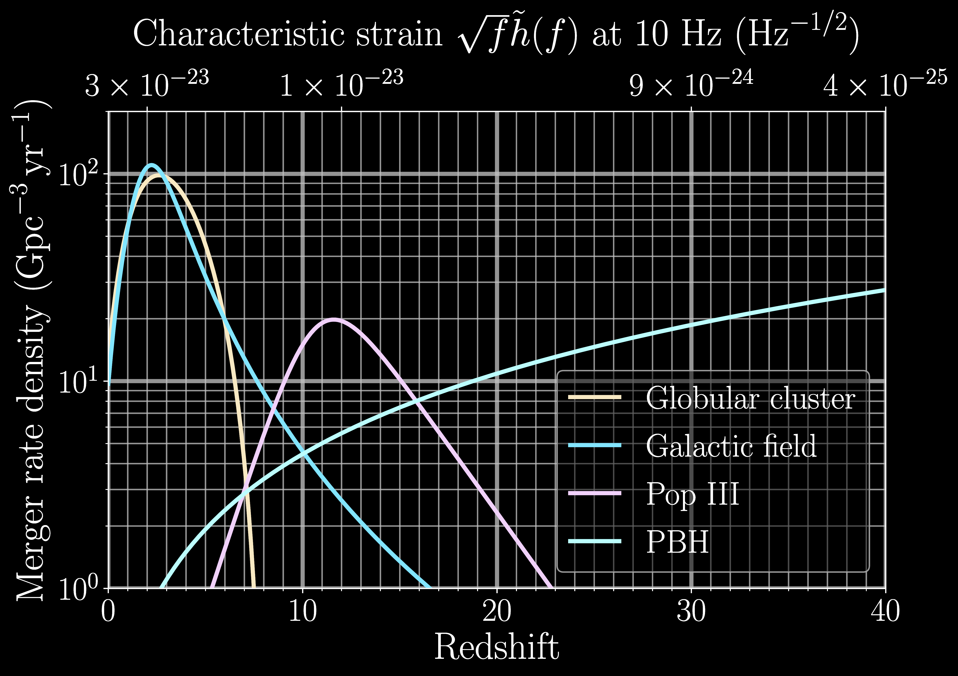
Black holes and neutron stars through cosmic time
Evolution of the merger rate as a function of redshift
Remnants of the first stars
Seeds of supermassive black holes, hierarchical growth
Smoking-gun distinction of primordial black holes
CE Horizon Study
Evans + (inc SB) 2109.09882
Notes:
Synergy with JWST which can observe galaxies composed of the first stars but not individual stars
At least one 40km CE → 100x higher BNS detection rate
Detection of PBH at z > 15 impossible with

Slide 20
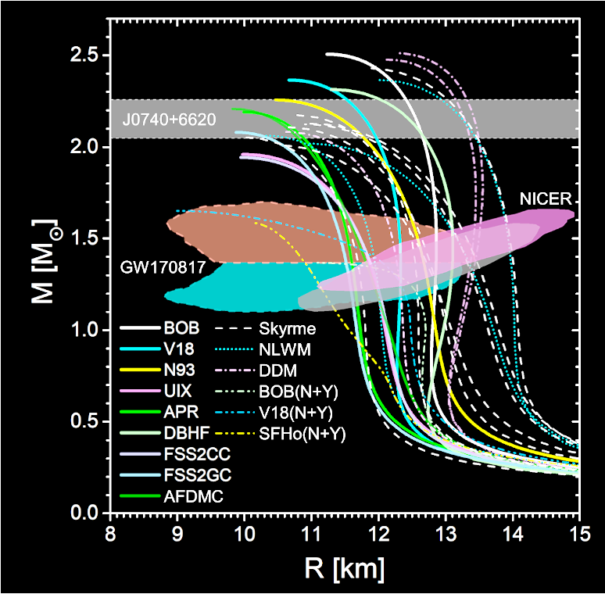
Dynamics of Dense Matter
Burgio+ PrPNP 120, 103879 (2021)
10m NS radius errors on the population level
Detection of BNS postmerger signal yearly
Detection of continuous GWs from known accreting NSs and millisecond pulsars
Detection of one supernova from within the Milky Way or its satellites over a 50-year lifetime
Notes:
NS radius constraint to better than 1% for hundreds of sources/year
Postmerger detection SNR > 5
Representative signal from CoRe simulation database (1.35 x2 NS with Sly EoS)
finite temperature, rapid rotation and strong magnetic fields
At least one 40km CE → 100x higher BNS detection rate
HLA not guaranteed detection of even Sco X-1 at the torque balance limit
Torque balance: spin-up torque from accretion = spin-down torque from GW emission
Known X-ray binaries with no observed pulsations (unknown GW frequency)
Some NSs spin faster than 700 Hz, f_GW = 2*f_spin
GW strain proportional to square root of X-ray flux
MSP spin down cutoff frequency-dependence is quadrupolar, minimum quadrupole 10^-9 (cosn

Slide 21
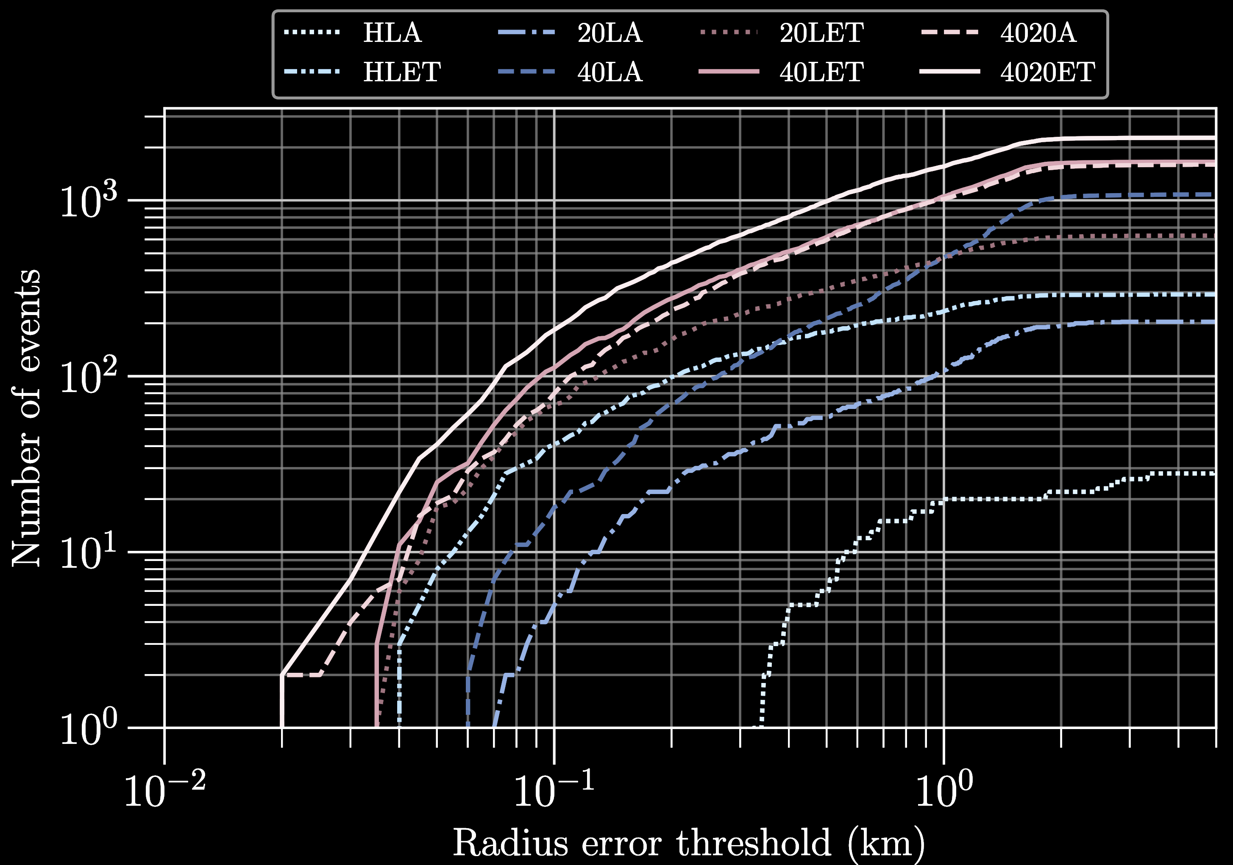
Dynamics of Dense Matter
10m NS radius errors on the population level
Detection of BNS postmerger signal yearly
Detection of continuous GWs from known accreting NSs and millisecond pulsars
Detection of one supernova from within the Milky Way or its satellites over a 50-year lifetime
CE Trade Study
Gupta+ (inc SB) 2307.10421
20km CE is critical!
Notes:
NS radius constraint to better than 1% for hundreds of sources/year
Postmerger detection SNR > 5
finite temperature, rapid rotation and strong magnetic fields
HLA not guaranteed detection of even Sco X-1 at the torque balance limit
Synergy with next-generation radio arrays that will expand the population of known MSPs
Supernova detection would be concordant with detection of neutrinos
Torque balance: spin-up torque from accretion = spin-down torque from GW emission
Known X-ray binaries with no observed pulsations (unknown GW frequency)
Some NSs spin faster than 700 Hz, f_GW = 2*f_spin
GW strain proportional to square root of X-ray flux
MSP spin down cutoff frequency-dependence is quadrupolar, minimum quadrupole 10^-9 (cosn
Representative signal from CoRe simulation database (1.35 x2 NS with Sly EoS)

Slide 22

Multimessenger Astrophysics
At least one 40km CE → 100x higher BNS detection rate
BNS redshift reach of $z≈2$
  Map the progenitors of short gamma-ray bursts
  Measure time delays
With at least 2 XG detectors:
  Tens of signals localized to < 1 deg²
  Thousands to < 10 deg²
  Few – tens < 10 deg² 5 mins before merger
Figure: Stephen Fairhurst

Slide 23
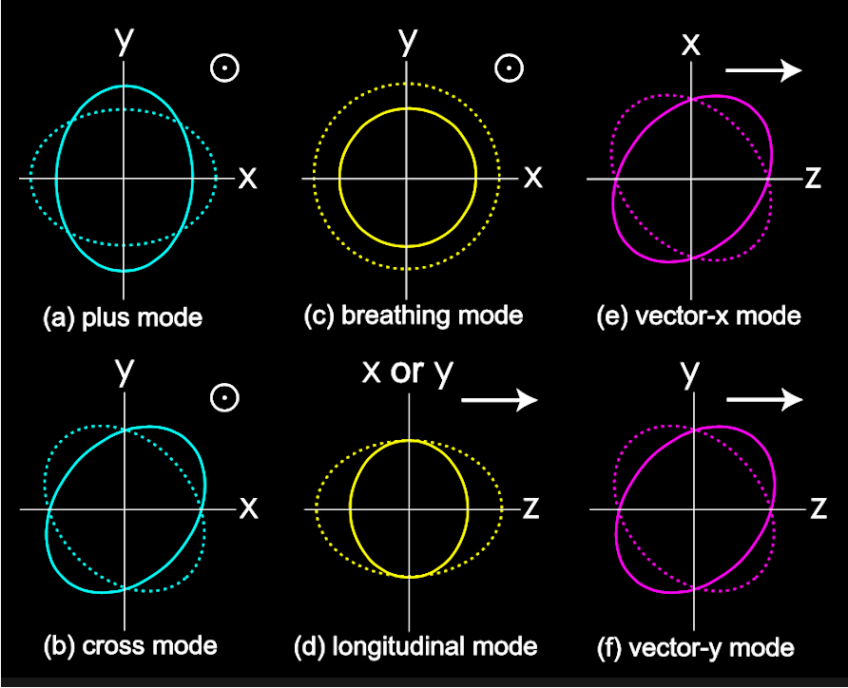
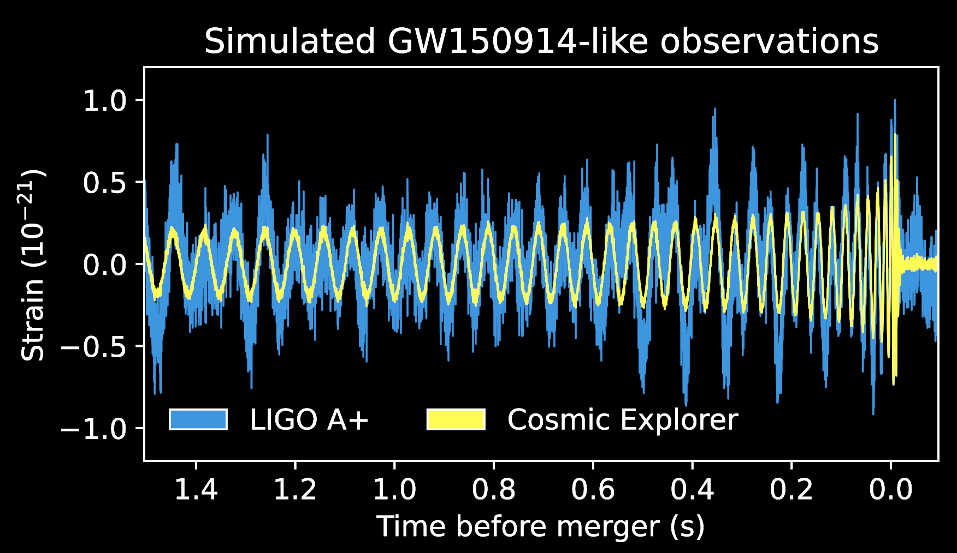

Extreme Gravity and Fundamental Physics
Tests of General Relativity
  Parameterized deviations
  Ringdown tests of no-hair theorem
  Memory effect
  Beyond-GR polarizations
  Graviton mass
Cosmology
  Expansion rate of the universe using standard sirens
  Constraints on $Λ$CDM and dark energy EoS using NS EoS
CE Horizon Study
Evans + (inc SB) 2109.09882
Notes:
3 yrs of operation including at least one 40km CE -> ~10 BBH with SNR > 1000
Precision tests using single sources with SNR > 1000 and ensemble of 10⁵ black holes/yr
Improve constraints on theory-agnostic tests of GR by 100x
Ringdown tests of the no-hair theorem with 100s of sources with post-inspiral SNR > 100
40km CE can uniquely distinguish between two scalar non-GR modes
BNS + counterpart at $z\sim 5$ → 1000x improved constraint on graviton mass
Detection of memory effect rules out > 4 propagation dimensions

Slide 24
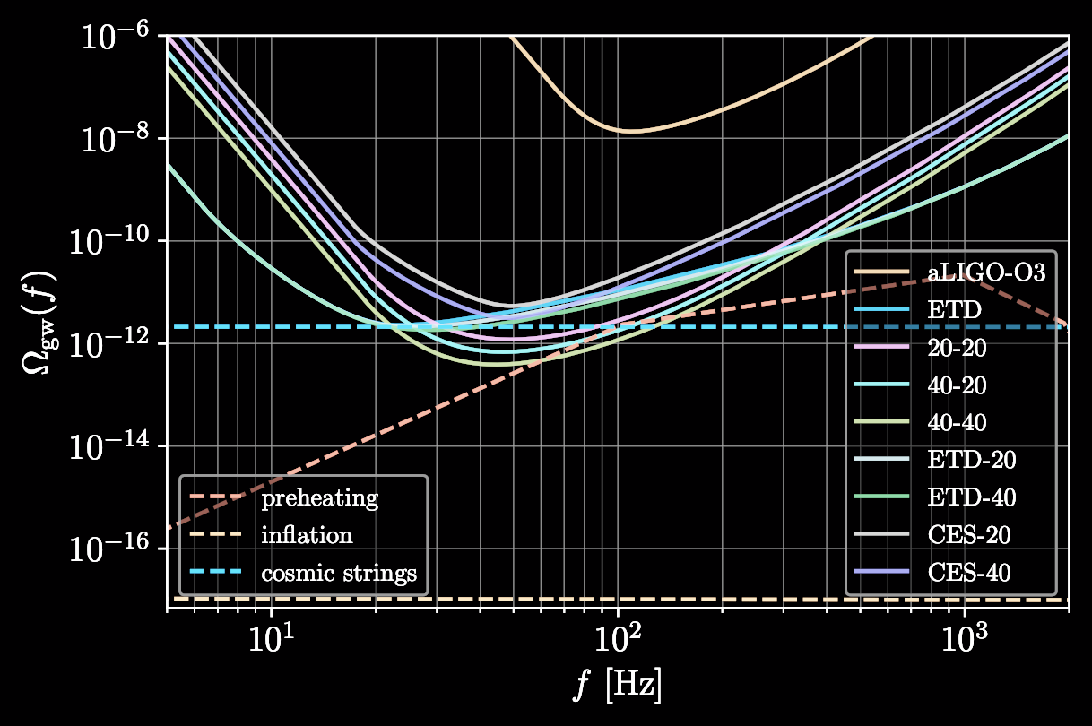
Beyond the Standard Model
Exotic compact objects
  Black hole mimickers
  Boson clouds around black holes
  Neutron stars with dark matter interiors
Primordial stochastic gravitational-wave backgrounds
  Cosmic strings
  First-order phase transitions
  Explosive particle production via preheating
CE Horizon Study
Evans + (inc SB, plot) 2109.09882
Notes:
Gravitational atom
ultra-light boson (axion) with mass in the range ∼ 10−13 to 10−12 eV
Superradiance process
emit quasi- monochromatic, persistent, GWs via boson-boson annihilation

Slide 25
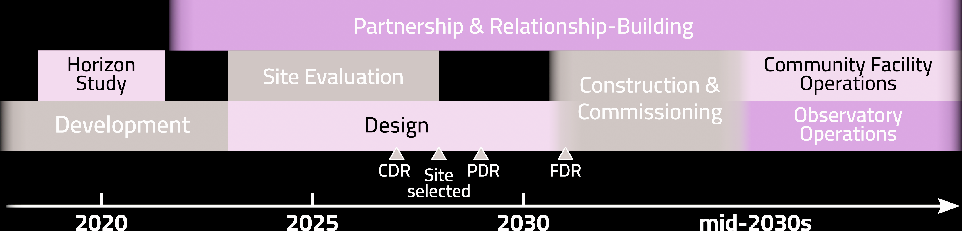
Cosmic Explorer timeline
NSF MPS ngGW subcommittee report emphasized the extraordinary discovery potential of a Cosmic Explorer 40km detector while at the same time carrying the lowest technical risk
  See session S10.00002 on Saturday afternoon
Notes:
Aggressive funding model hopefully enabled by the favorable report of the MPSAC
conceptual design review (CDR), preliminary design review (PDR, budget is final), final design review (FDR)

Slide 26
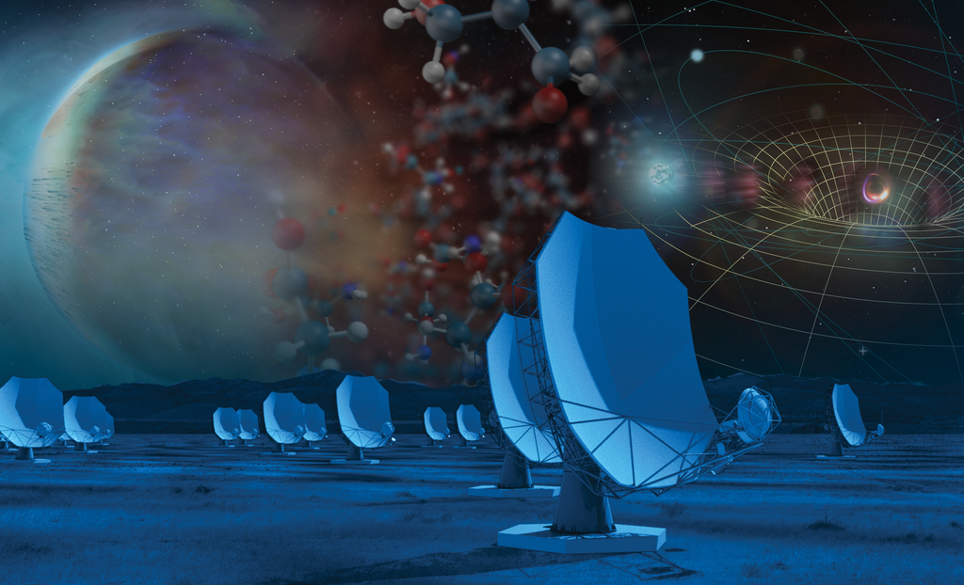
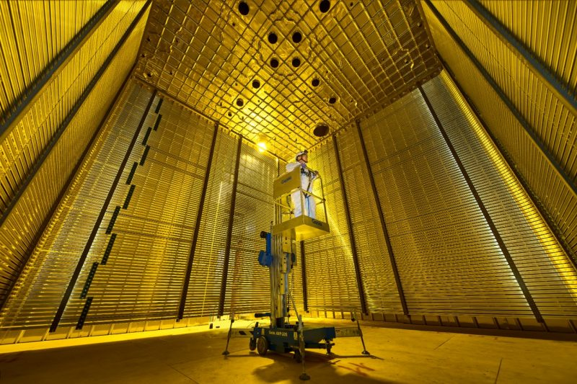
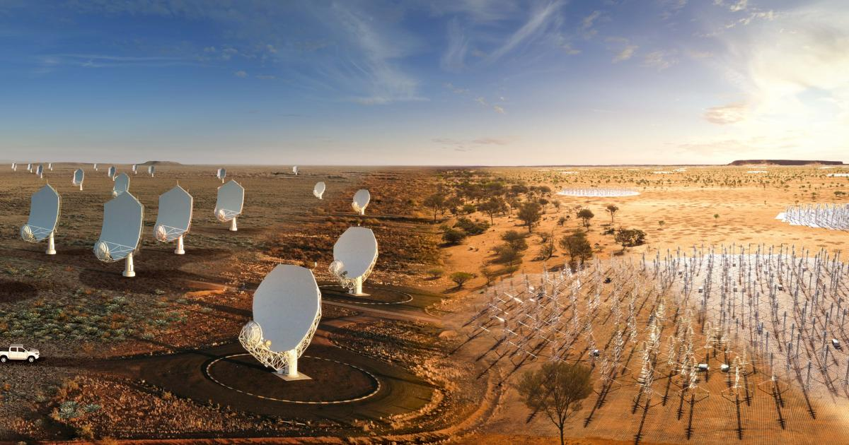
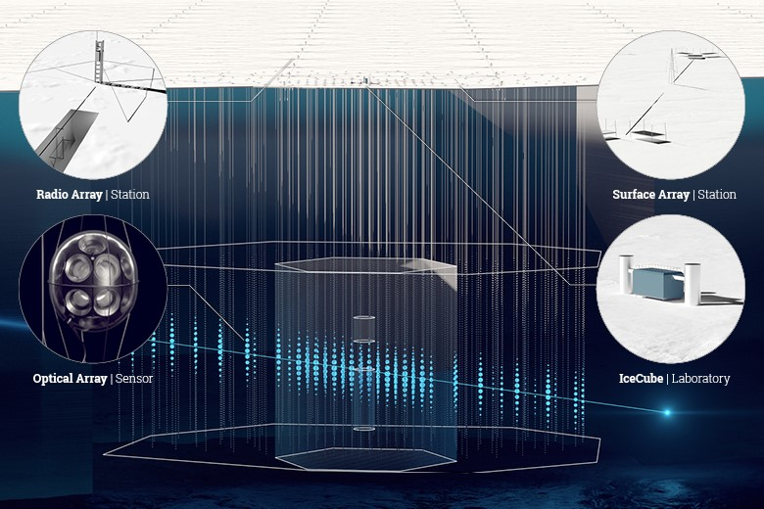
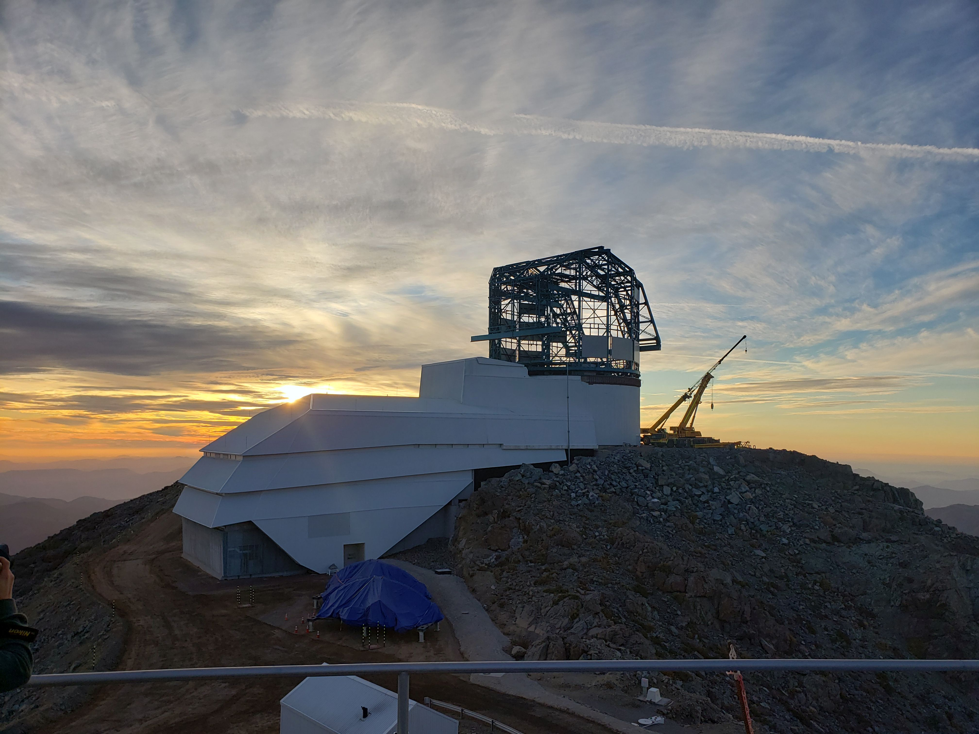
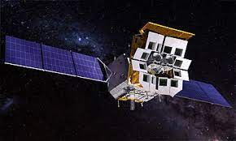
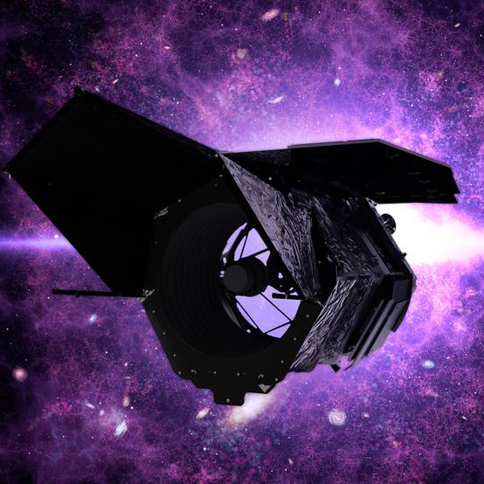
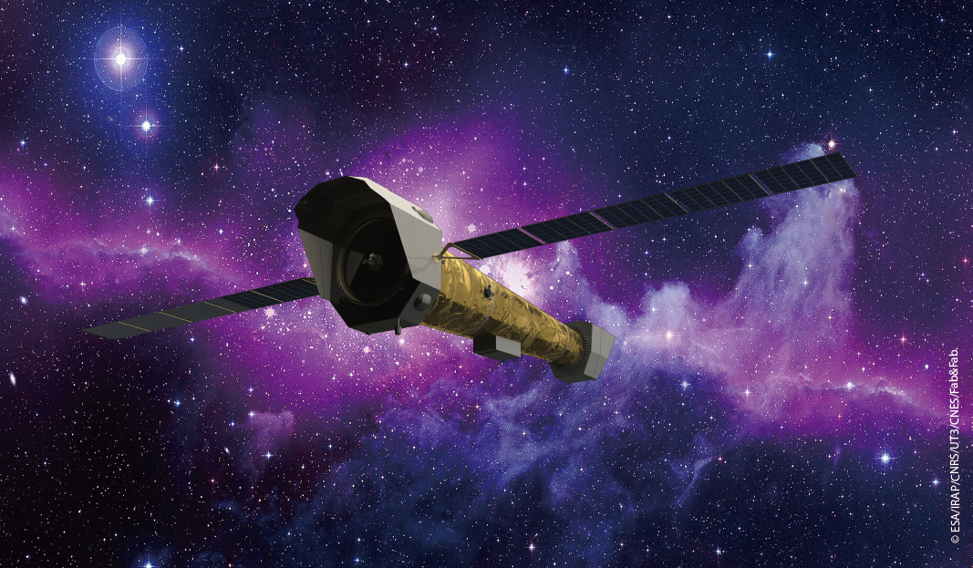
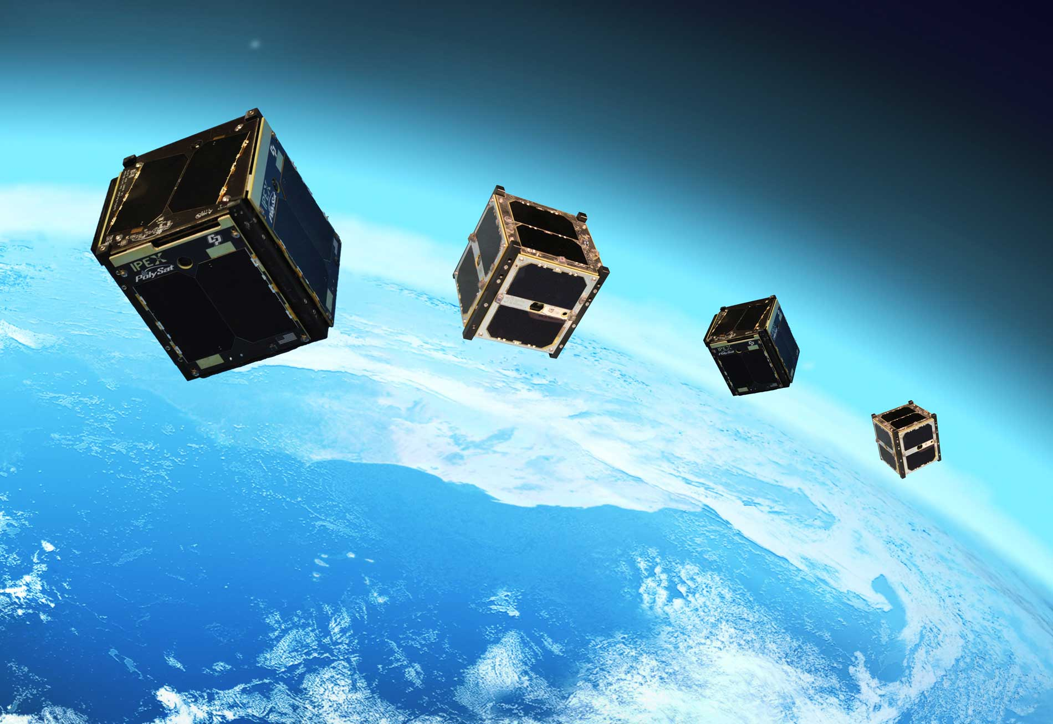
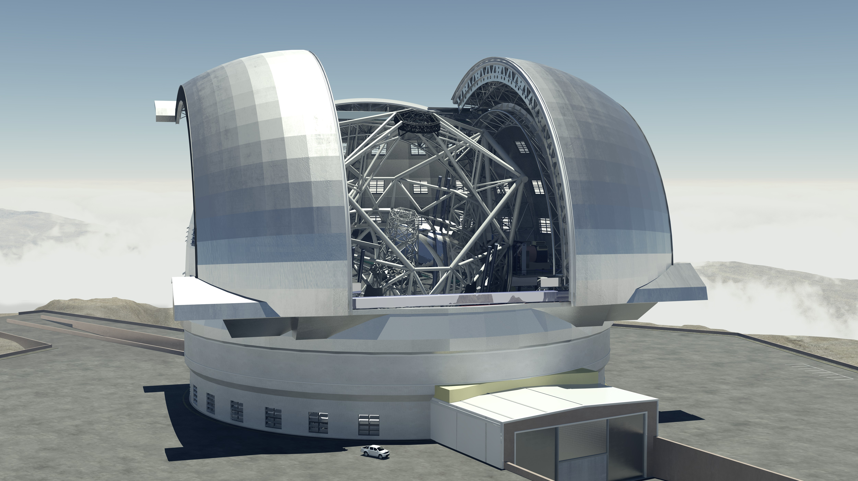
Multimessenger synergies
Neutrino:
DUNE, NKM3Net, IceCube Gen2
Radio:
ng VLA, SKA
X-ray/Gamma-ray:
Einstein Probe, Athena, THESEUS, HERMES
Optical/IR:
Nancy Grace Roman, ELTs, VRO LSST

Slide 27
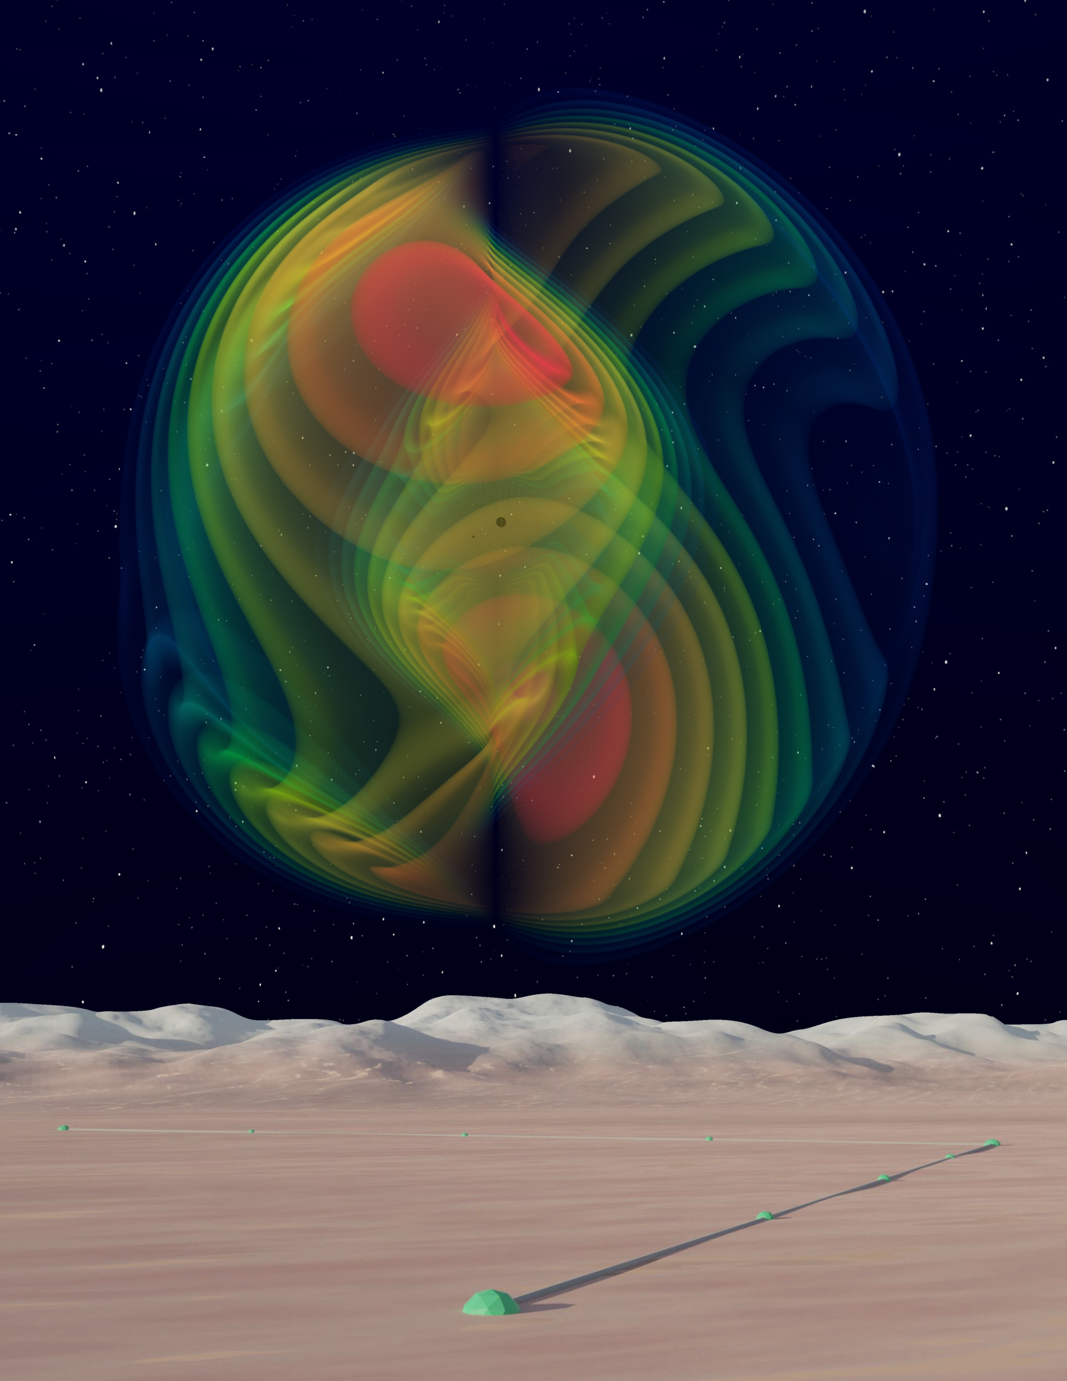
Conclusion
Deeper, wider, sharper
  Black holes and neutron stars through cosmic time
  Dynamics of Dense Matter and Multimessenger Astrophysics
  Extreme Gravity and Fundamental Physics
  Discovery potential
Image: Evan Hall (MIT), Nils Fischer, Harald Pfeiffer, Alessandra Buonanno (Max Planck Institute for Gravitational Physics), SXS Collaboration
Notes:
deeper sensitivity, new bands of observation and higher precision.

Slide 28
Backup

Slide 29
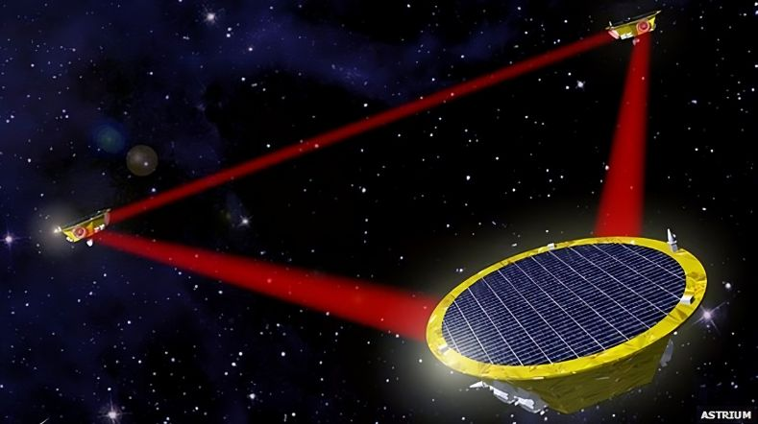
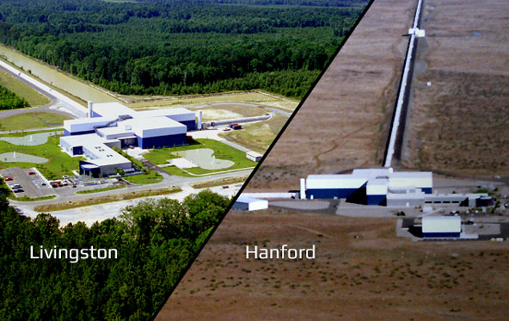
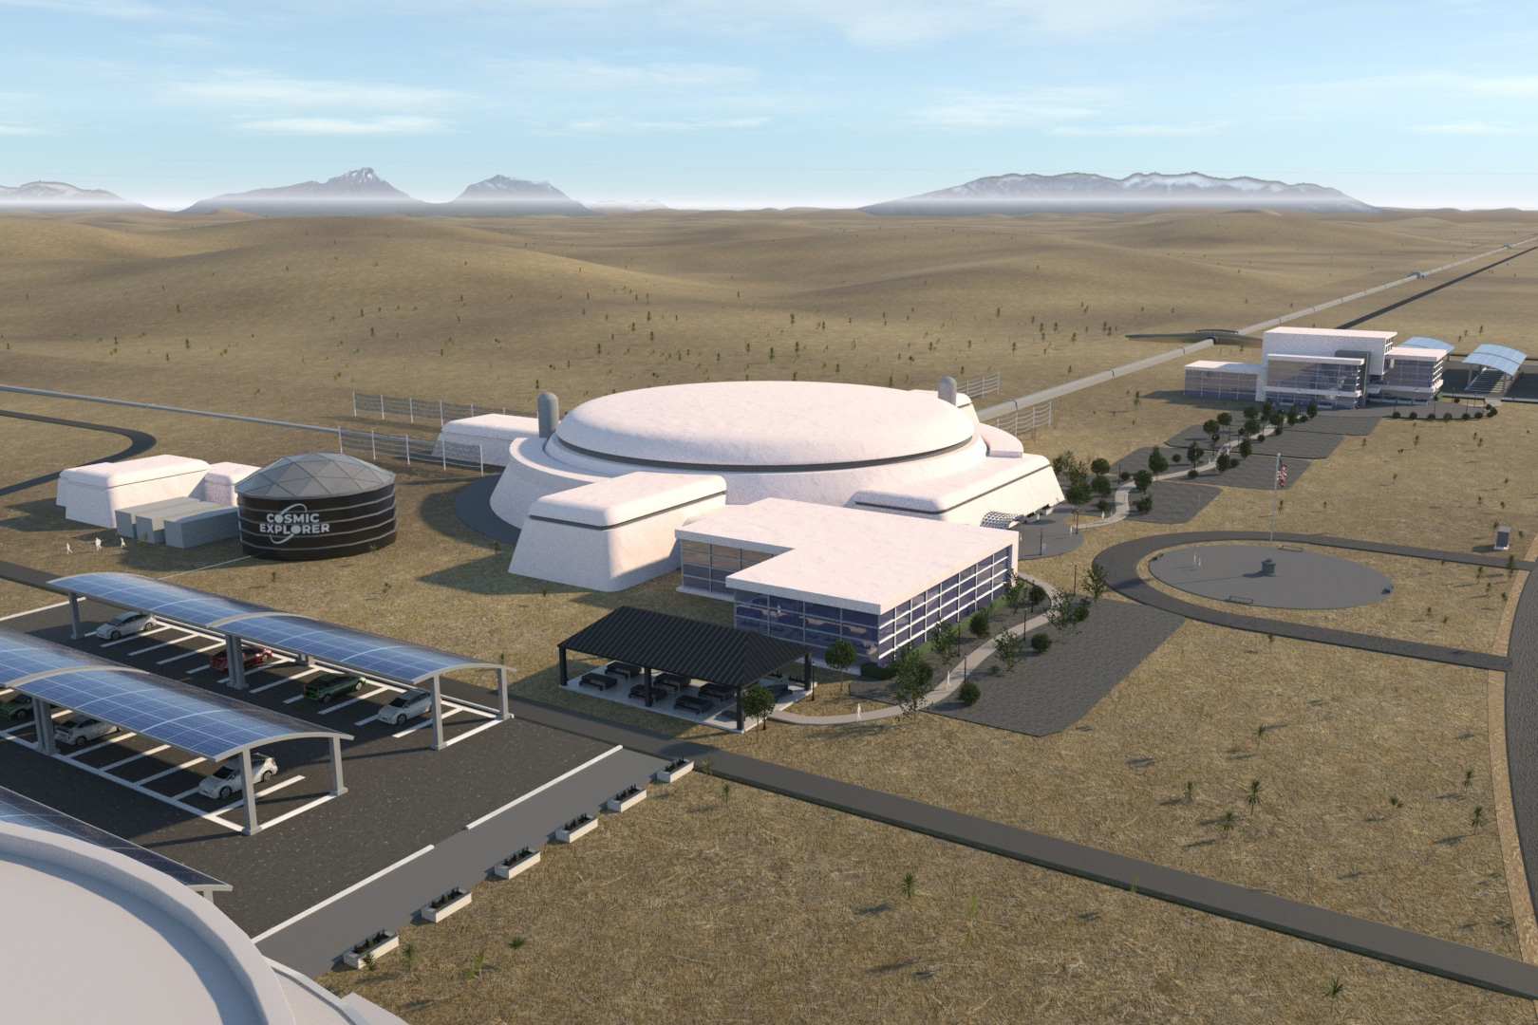
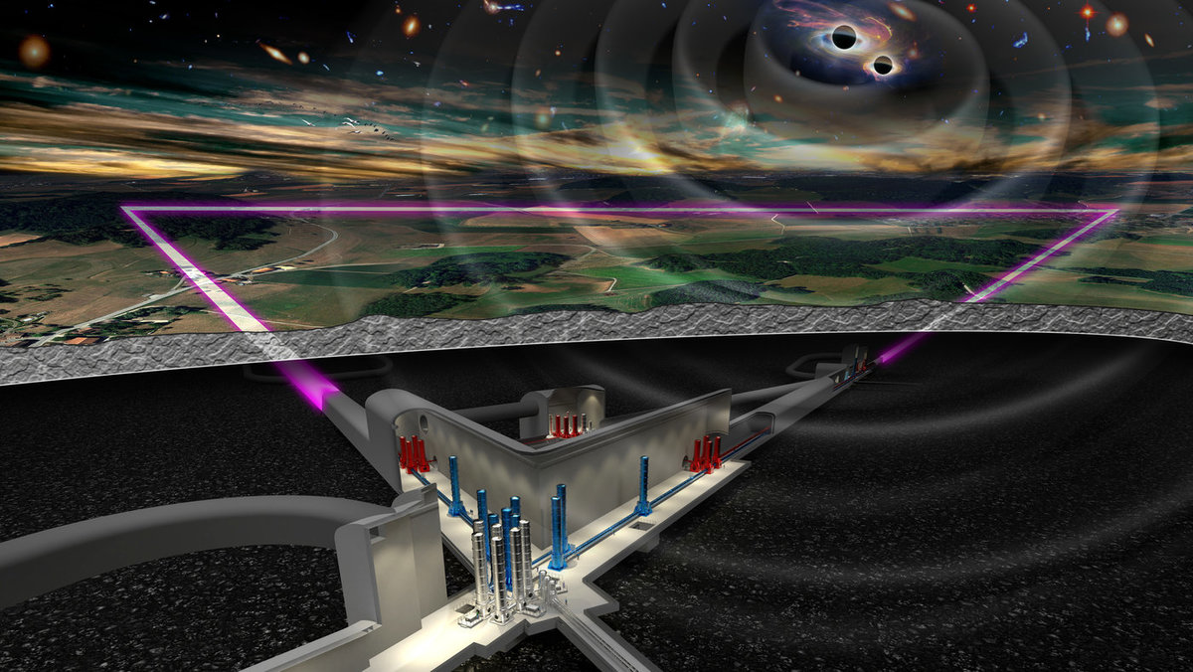
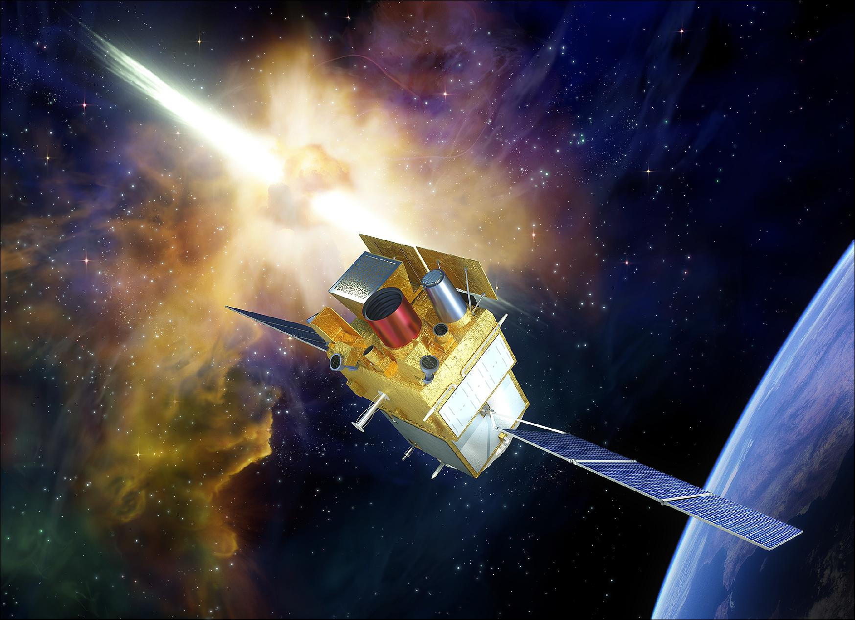
LVK O4
LVK O5
LIGO A#/Voyager
Virgo nEXT
LISA
Cosmic Explorer
Einstein Telescope
SVOM
VRO - LSST
Roman
2023
2026
2029
2032
2035
2038
Notes:
Reframe “methods development” to indicate that it doesn’t depend critically on observations, stress that projects will all include application to data
Put the three main thrusts of my research into the context of the observational landscape of the next decade and beyond
LISA, on which I’ve also worked though I didn’t get a chance to talk about
O4: ending Jan 2025, LHO 130 Mpc, LLO 170 Mpc, Virgo to enter at 45 Mpc, KAGRA delayed due to mag 7.6 earthquake in Japan, 2-detector sky areas 50% 300-1000 deg2
O5: starting 2026-2027 for two years, planned sensitivity around 250-350 Mpc, pessimistic ~50 BNS per year
A# aim for 600 Mpc range, pessimistic ~250 BNS per year, Virgo_nEXT facility limit 250-500 Mpc

Slide 30
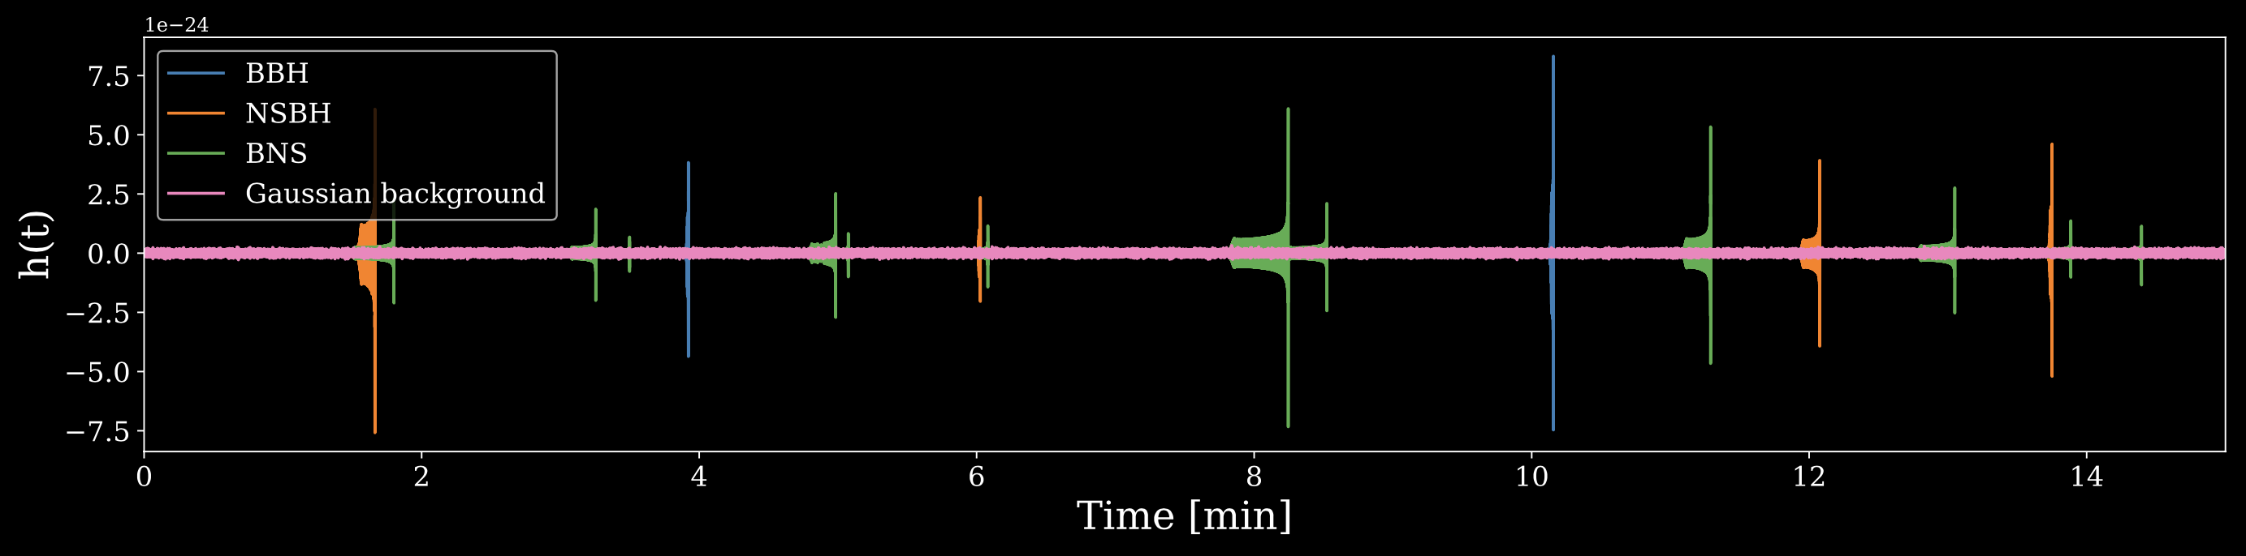
Next-generation data analysis
Bias in inferred binary parameters from overlapping signals?
Scalability of population inference techniques to thousands of events?
Separation of astrophysical foreground and cosmological background?
Notes:
Totals: BBH 2 NSBH 4 BNS 12

Slide 31
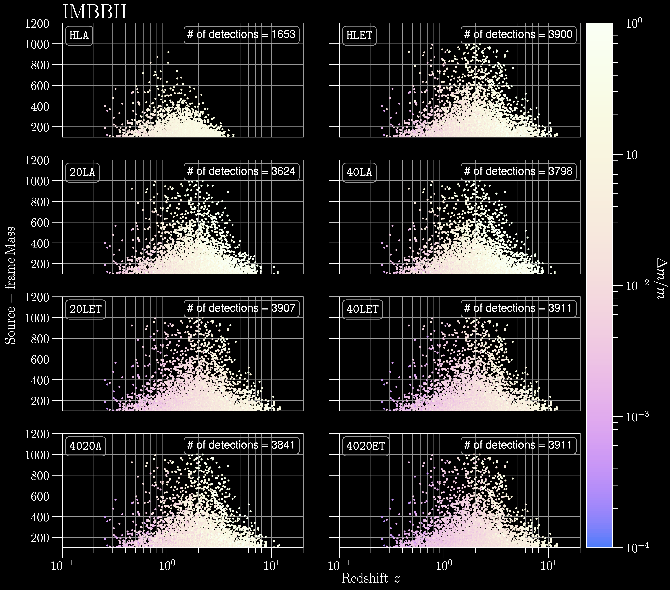

Slide 32


Slide 33


Slide 34

Boson cloud reach

