Slide 1
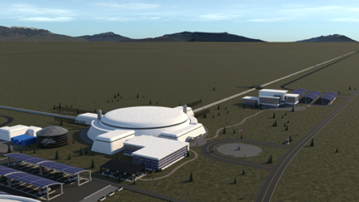
Compact binaries throughout cosmic history
Salvatore Vitale
Gravitational Waves Beyond the Boxes II
Perimeter institute
April 7 2022

Slide 2
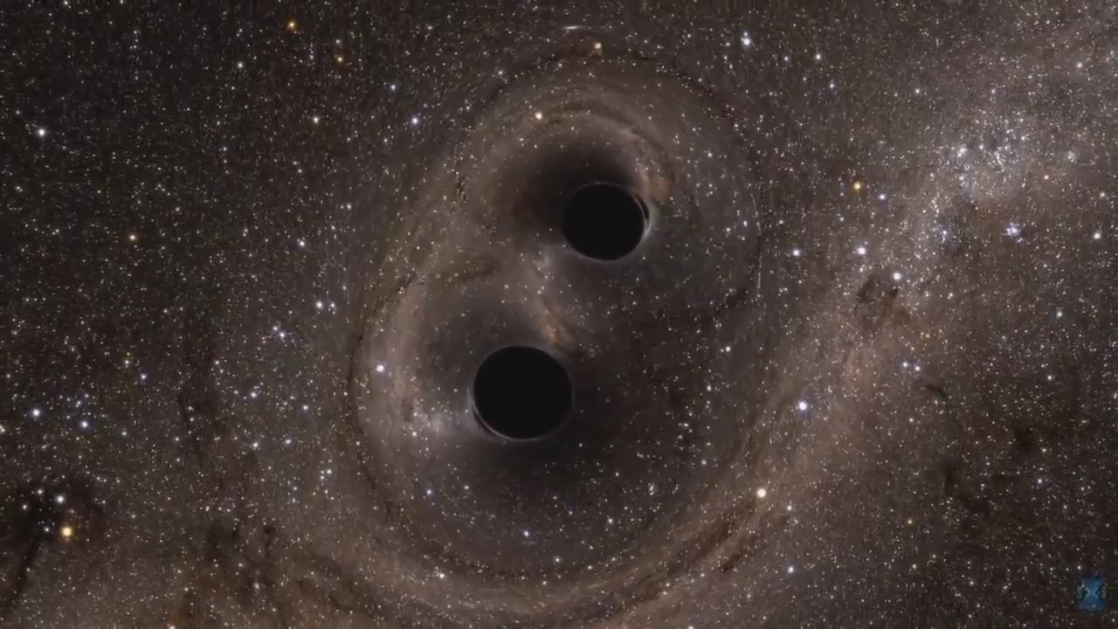
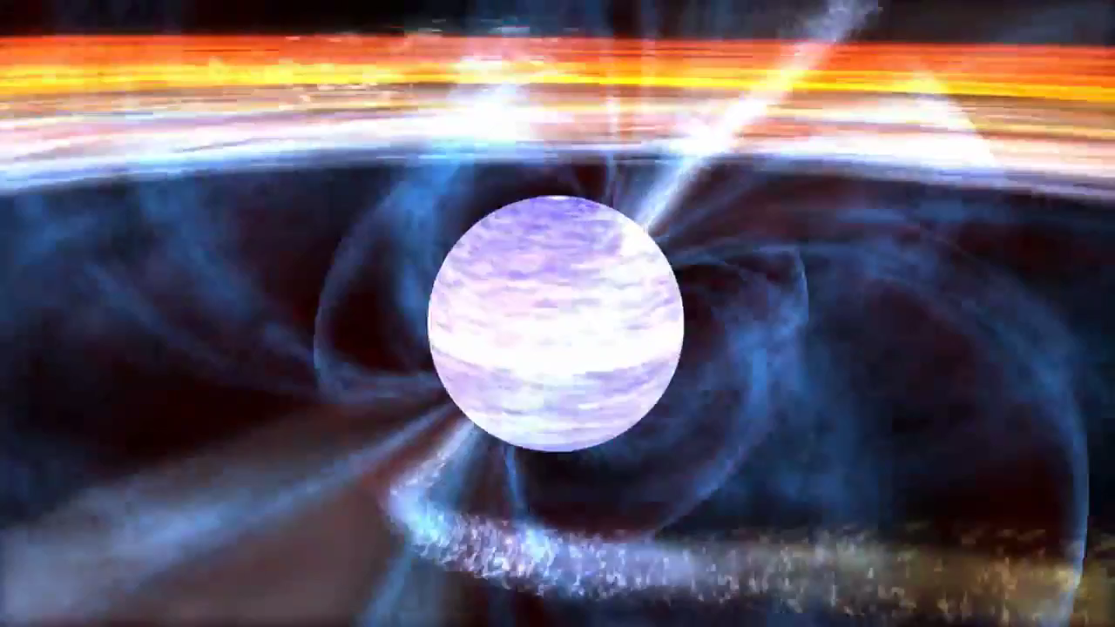
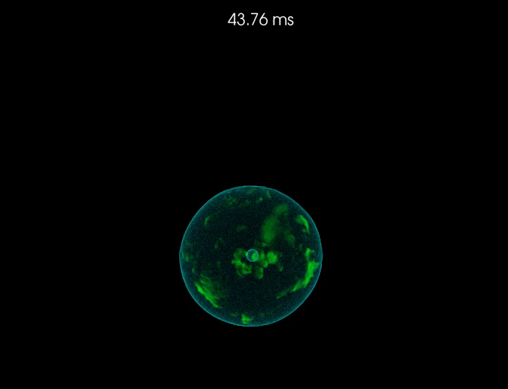
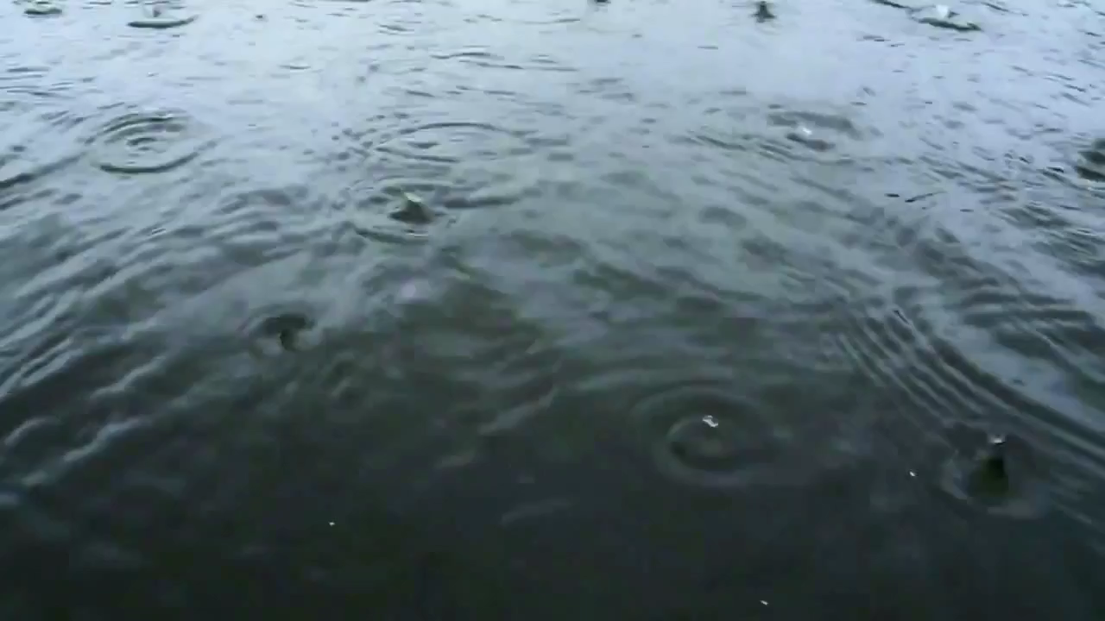
What can we detect?
TRANSIENT
PERSISTENT
Credits:
SXS collaboration
MATCH FILTER
ASYMMETRIC
NEUTRON STAR
COMPACT BINARIES (CBC)
UNMODELED
BURSTS
Core collapse Supernovae
STOCHASTIC BACKGROUND

Slide 3
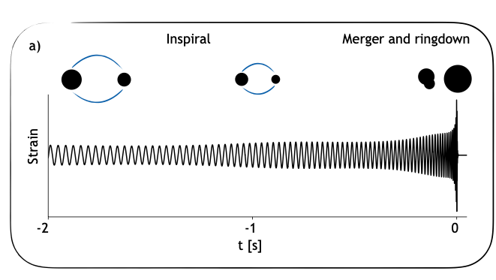
Compact binary anatomy
Duration/Merger frequency: total mass, spins
Phasing: chirp mass, mass ratio, spins
Overall amplitude: distance, orbital inclination
Amplitude modulation: spins angles
Merger-ringdown: nature of the compact objects
Amplitude (Arb)
Vitale, Science 372, 6546
Notes:
F_isco ~ 2.2KHz/mtot_in_msun

Slide 4
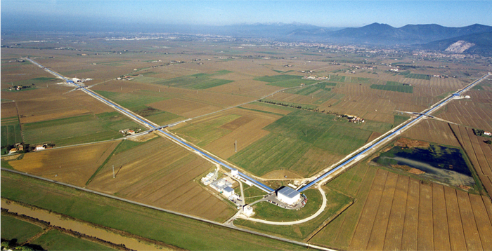
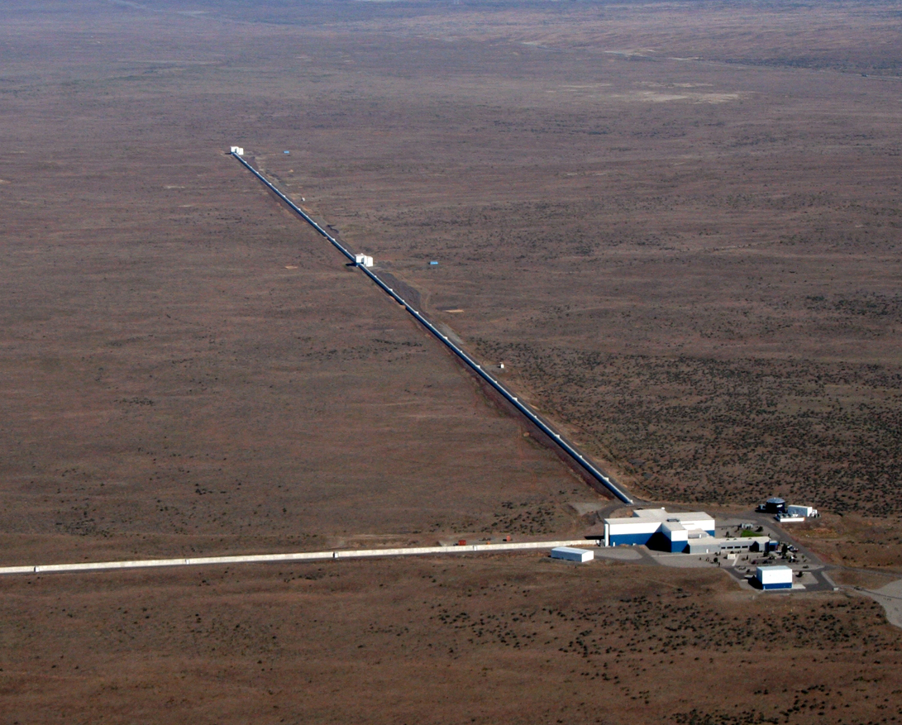
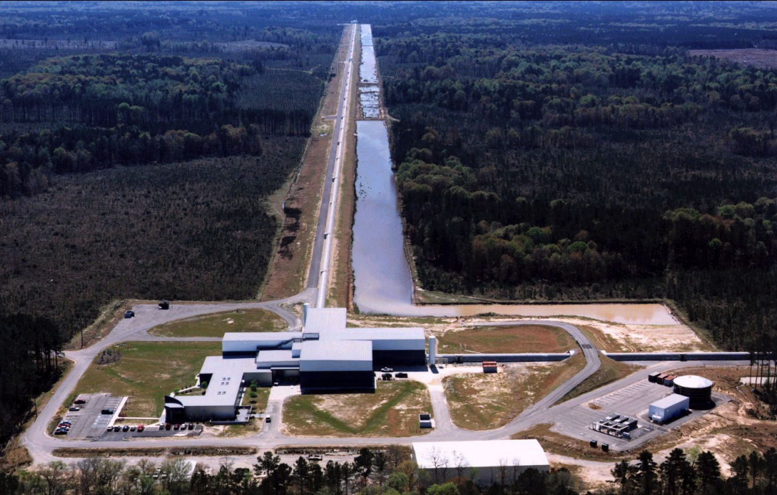
Ground based gravitational-wave detectors
LIGO Hanford Observatory
LIGO Livingston Observatory
Virgo Observatory

Slide 5
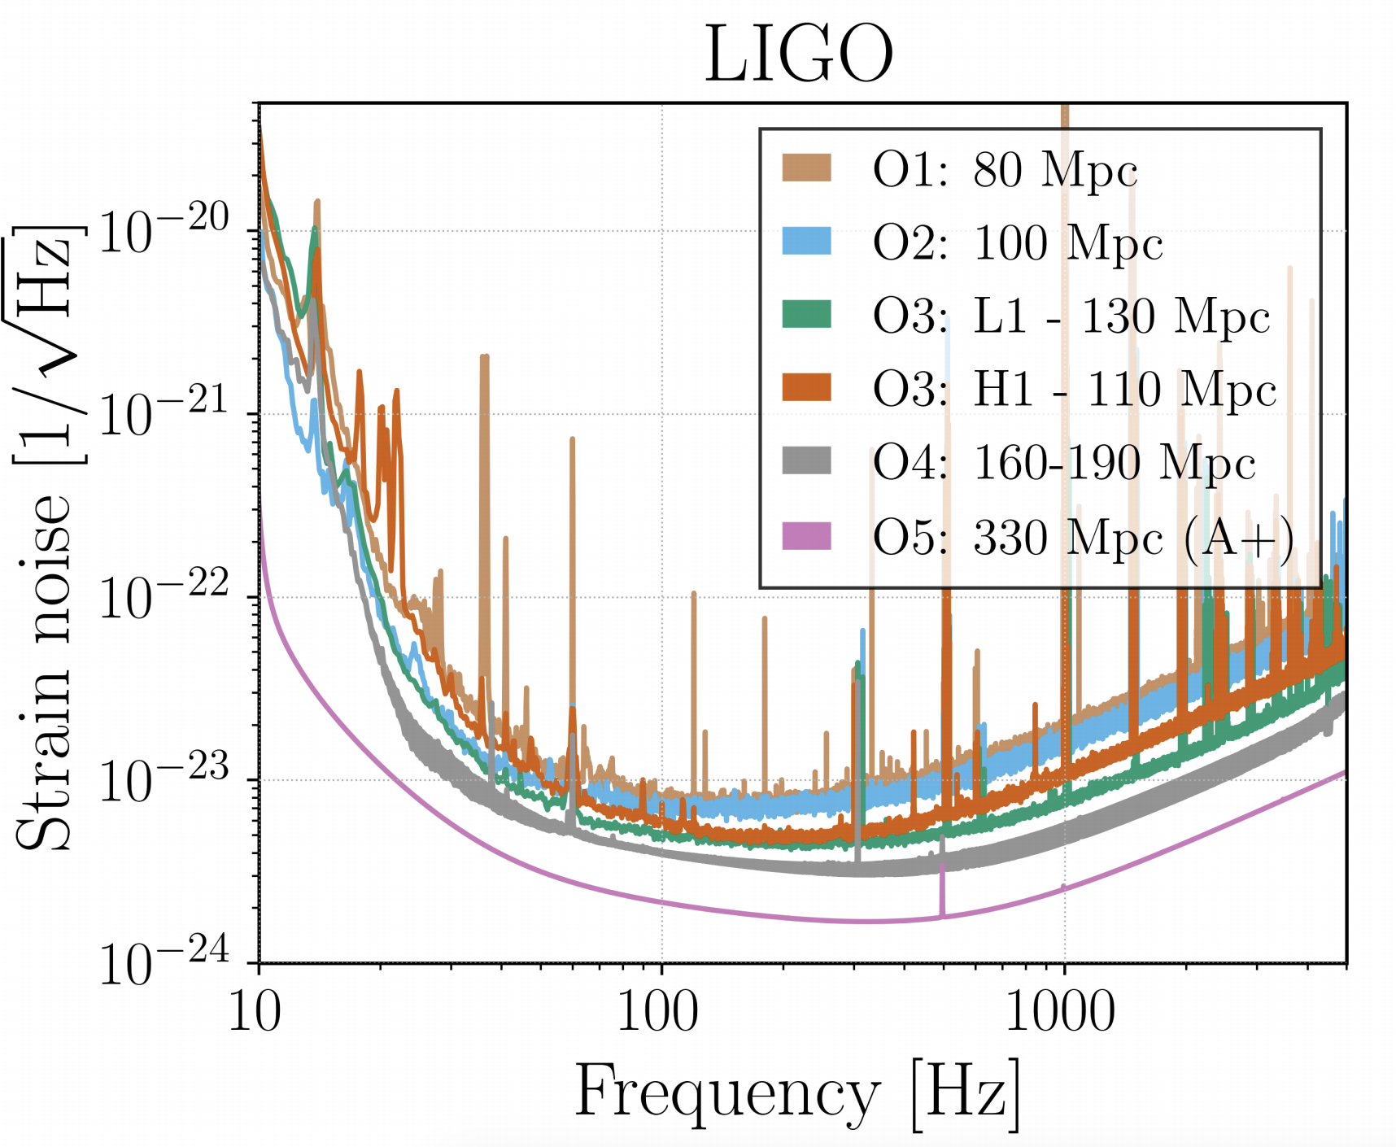
Where are we?
Advanced LIGO detectors have run since 2015 (with Virgo since 2017)
Three observing runs
The third observing run lasted roughly one year
Worse
Better
LVC LRR 21 3

Slide 6
S. Vitale, public DCC G1900660 2019
More detectors
The unexpected
Early-warning localization
CW Axions from 30M BH remnant
Stochastic
Sky localization BNS
IMBH
or high-z
BBH
Source-frame masses
Tests of General relativity
Distance/
Cosmology
Inclination/
EM modeling
NS post-merger
Supernovae and other unmodeled transients
Memory
Continuous waves
Precessing BH spins
Aligned BH spins
Eccentricity
mass ratio
Ringdown
NS Equation of state
Better low-frequency
Better bucket
Better high-frequency

Slide 7
Where are we?
Advanced LIGO detectors have run since 2015 (with Virgo since 2017)
Three observing runs
The third observing run lasted roughly one year
  56 candidate events made public (one per week!)
  Two neutron star black hole mergers (LVK 2106.15163)
  Tens of binary black holes!
  LVC catalogs paper online: 2010.14527, 2010.14529, 2010.14533
SV, Science 372, 6546, adapted from LVC public document G1901322

Slide 8
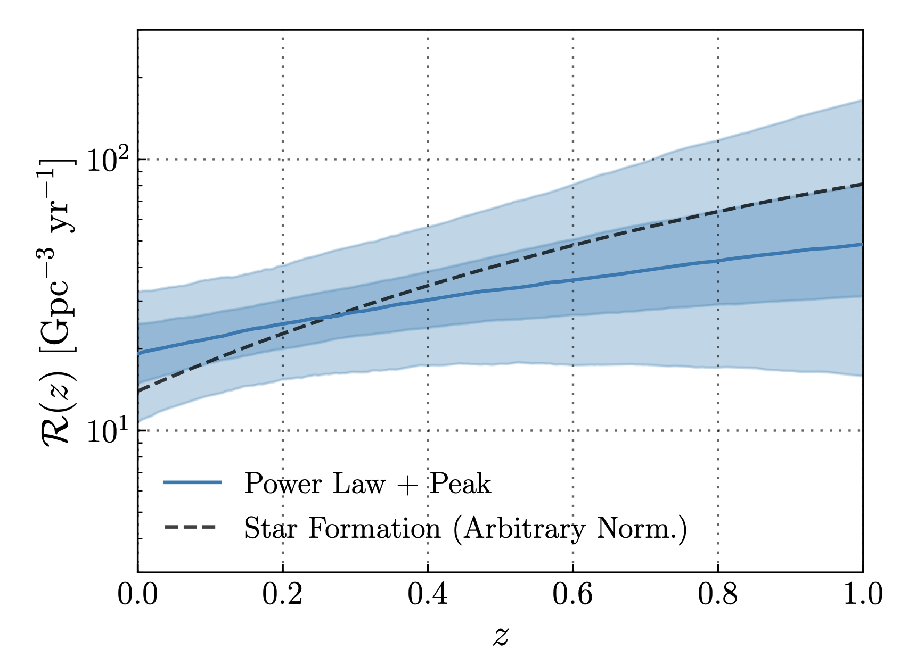
Where are we?
Even at design sensitivity, current detectors will be limited to
  Local universe
  ~100-200 sources (mostly BBH) per year
  Low to moderate signal-to-noise ratio
  Limited number of sources with EM counterparts
LVK ApJL 913 L7

Slide 9
Next-generation (NG) detectors
To gain access to sources across the universe new facilities are required
NG detectors
  Strain sensitivity 10x better than advanced detectors
  Detect black hole binaries at large redshifts
  High signal-to-noise ratios
  Many 100K sources per year
Targeting operation in the second half of 2030s

Slide 10
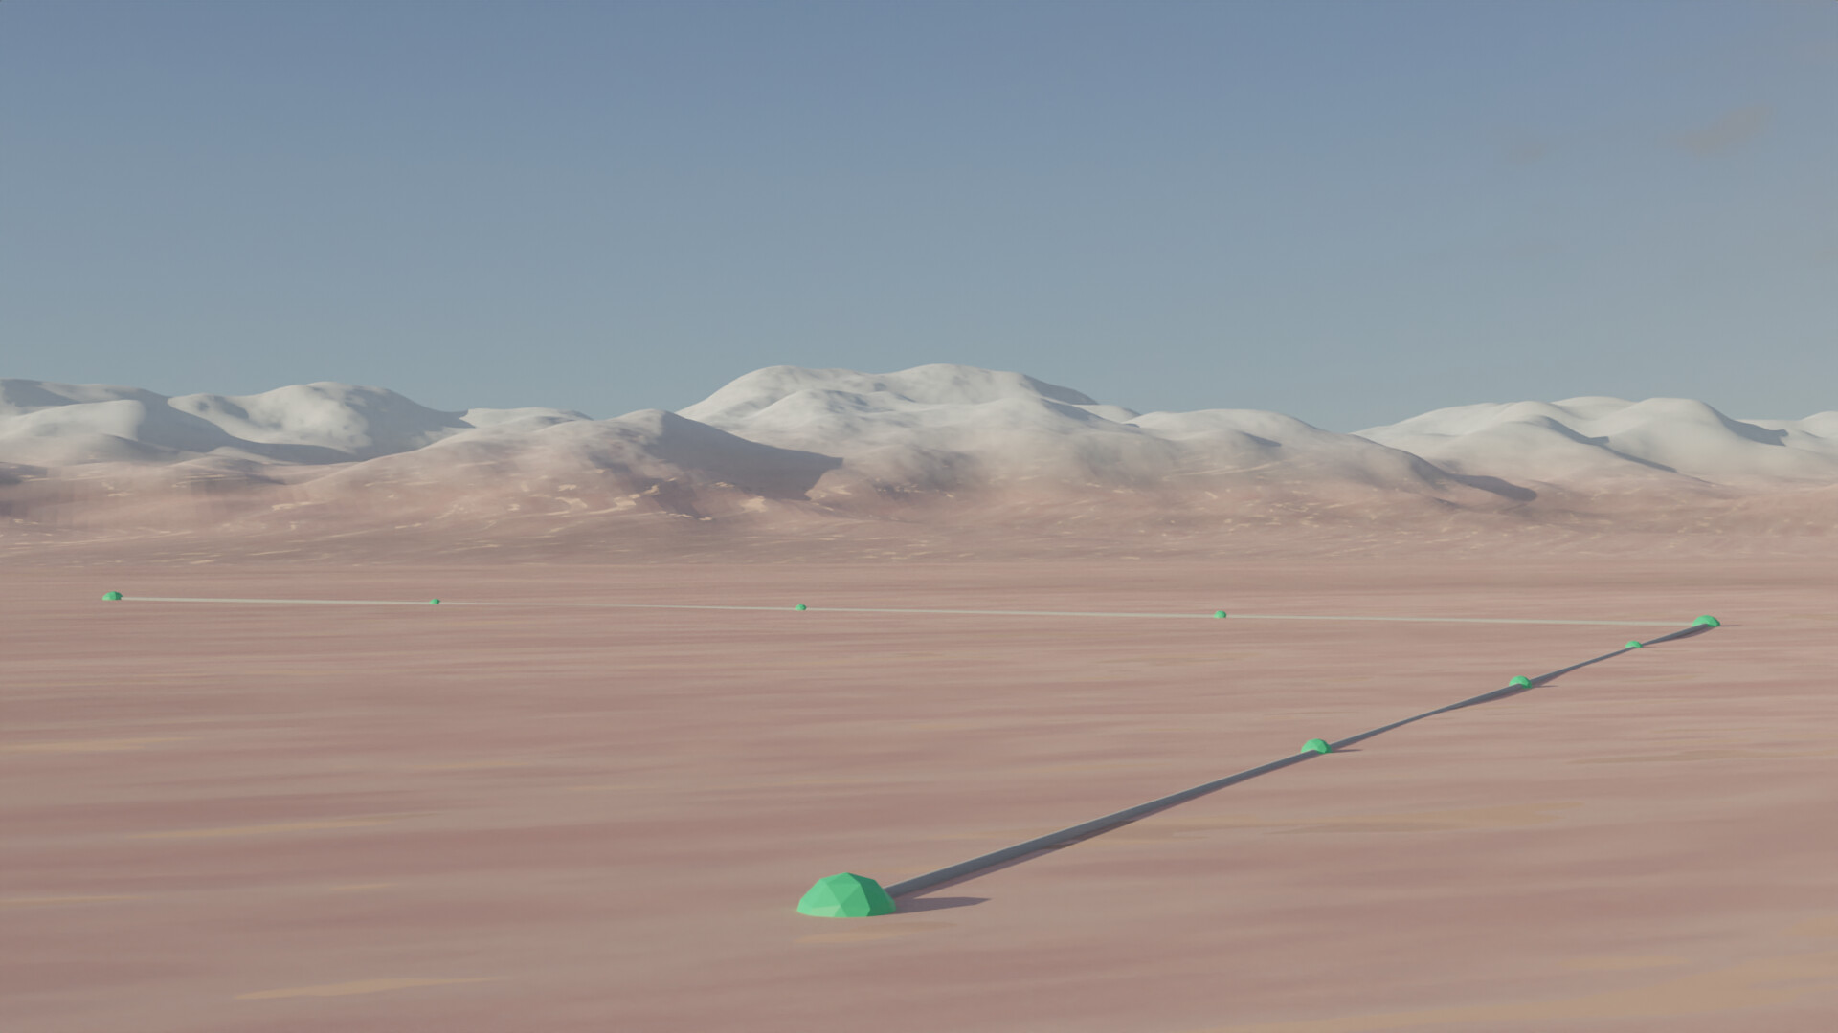
Cosmic Explorer
Next Generation gravitational-wave observatories
  based on current LIGO concepts: 10x longer, 10x more sensitive
Two L-shaped sites, one 20km on-a-side, other 40km
  Significant impact on Indigenous lands; consideration of this central to our planning
Observatories with ~50-year lifetime housing a progression of detectors
Likely to fully explore GW observation capability in this band
~$2B
~2035

Slide 11
Who is CE currently?
CEHS team (NSF funded 2019-2021, ~$3M)
  Institutions (and faculty PIs):
    MIT (M. Evans (overall PI), S. Vitale)
    Cal State Fullerton (G. Lovelace, J. Read, J. Smith)
    Penn State (B.S. Sathyaprakash)
    Syracuse University (S. Ballmer, D. Brown)
    Caltech (Y. Chen, R. Adhikari)
  Postdocs, students
    ~5 postdocs, ~10 students
  Professional scientists/engineers
    Matrixed from LIGO Lab + consultants for civil and vacuum engineering
Organization: Pivoting from collaborative effort to project structure
  Currently populating with volunteers, seeking funding for Conceptual Design phase (MREFC)
  External to project: CE Consortium with ~378 scientists

Slide 12
Toward a CE project

Slide 13
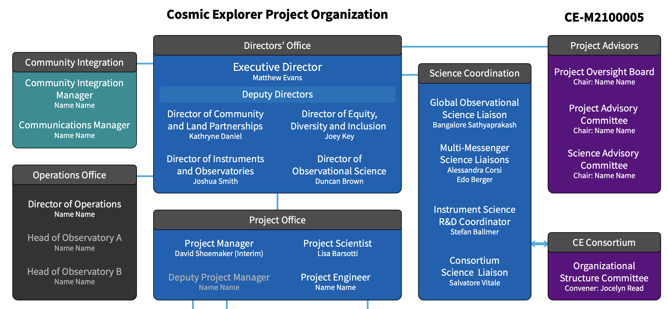
Toward a CE project

Slide 14
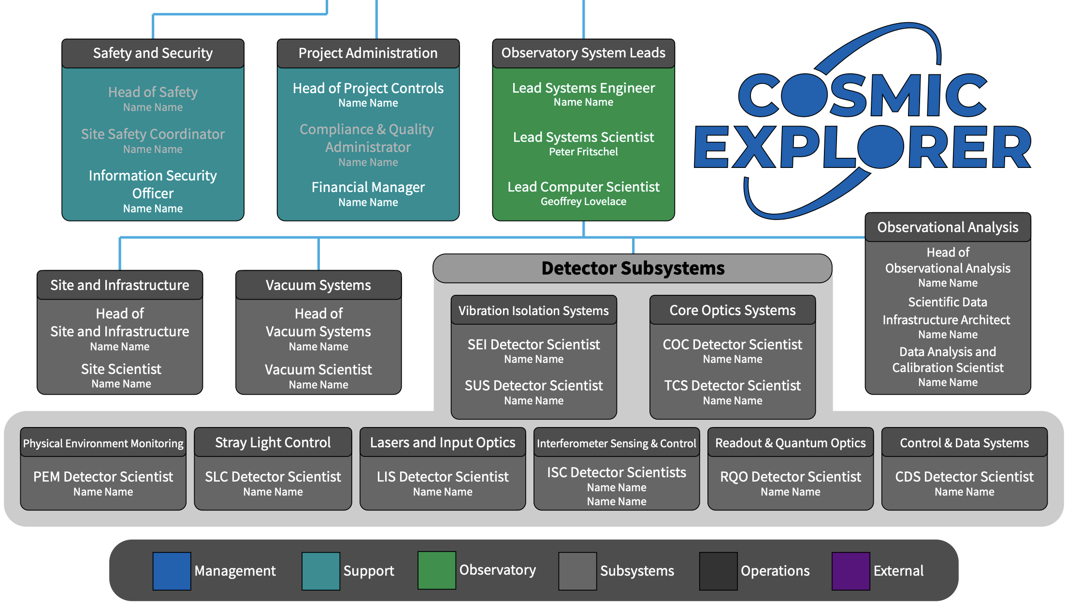
Toward a CE project

Slide 15

CE Science calls
We are holding monthly calls where you can present your NG-related work
https://cosmicexplorer.org/sciencecalls.html

Slide 16

Cosmic Explorer Horizon Study
NSF funded an Horizon Study (CEHS) to explore design options and scientific potential of ground-based next-generation detectors in the US
The final draft can be read at https://cosmicexplorer.org/
CEHS 2021

Slide 17

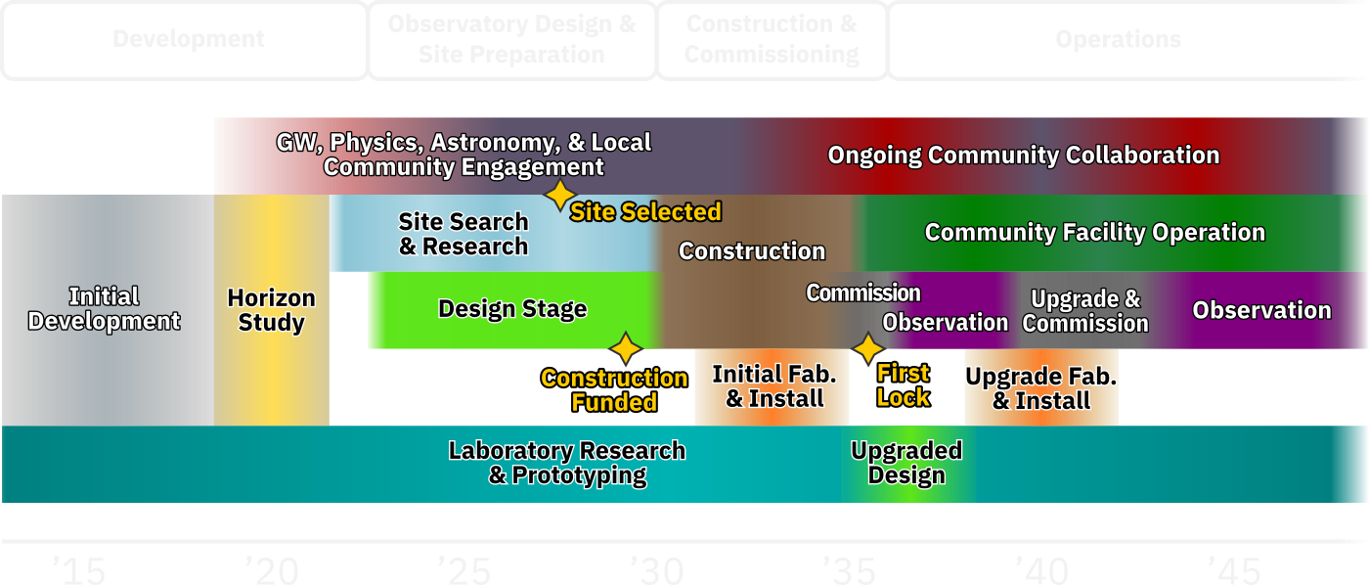
Cosmic Explorer Notional Timeline (see CEHS)
E. Hall, M. Evans, MIT
Notes:
A top-down success-oriented timeline that appears technically feasible.

Slide 18

Cosmic Explorer Notional Timeline (see CEHS)
E. Hall, M. Evans, MIT
Notes:
A top-down success-oriented timeline that appears technically feasible.

Slide 19
Cosmic Explorer Notional Timeline (see CEHS)
E. Hall, M. Evans, MIT
Notes:
A top-down success-oriented timeline that appears technically feasible.

Slide 20
CE Milestones, past and planned future
2010-2015 LIGO Scientific Collaboration R&D musing
2015 Solidification of
  Scientific Motivation for a future observatory
  Focus on a low-risk approach of a longer instrument
2018-2021 Horizon Study
  3-year NSF funded Collaborative proposal, $2.2M
  Produced the Cosmic Explorer Horizon Study
  Decadal White papers; NSF physics request to
  consider but not ranked in Decadal
  Dawn Community Report (GW Roadmapping)
2022-2025 Conceptual Design
  Currently Writing proposal to NSF for support to
  undertake CD;
  Placement by Chief Officer for Research Facilities
  (CORF, Linnea Avallone) on the list of NSF research projects
2025-2028 Preliminary Design, ending with NSB authorization (cost, plans, …)
Notes:
National science board = NSB

Slide 21
Currently seeking support for Conceptual Design
Conceptual Design scale: 3 years
  Principal cost elements: preparing PEP (professional project staff), Engineering studies (vacuum systems, civil construction), Site identification and acquisition planning
  Detector R&D but intention that this be pursued by small proposals to NSF
Preliminary and Final Design scale: 4 years
  Currently preparing unsolicited proposal to fund the Conceptual Design
  NSF program officer not yet seeking a centralized project proposal, but clearly on-board with the idea of CE and in the process of learning how major facilities are funded at NSF
Private funds
  In discussion with institutions; anticipate leadership at MIT
  Working to grow our institutional connections and support network

Slide 22
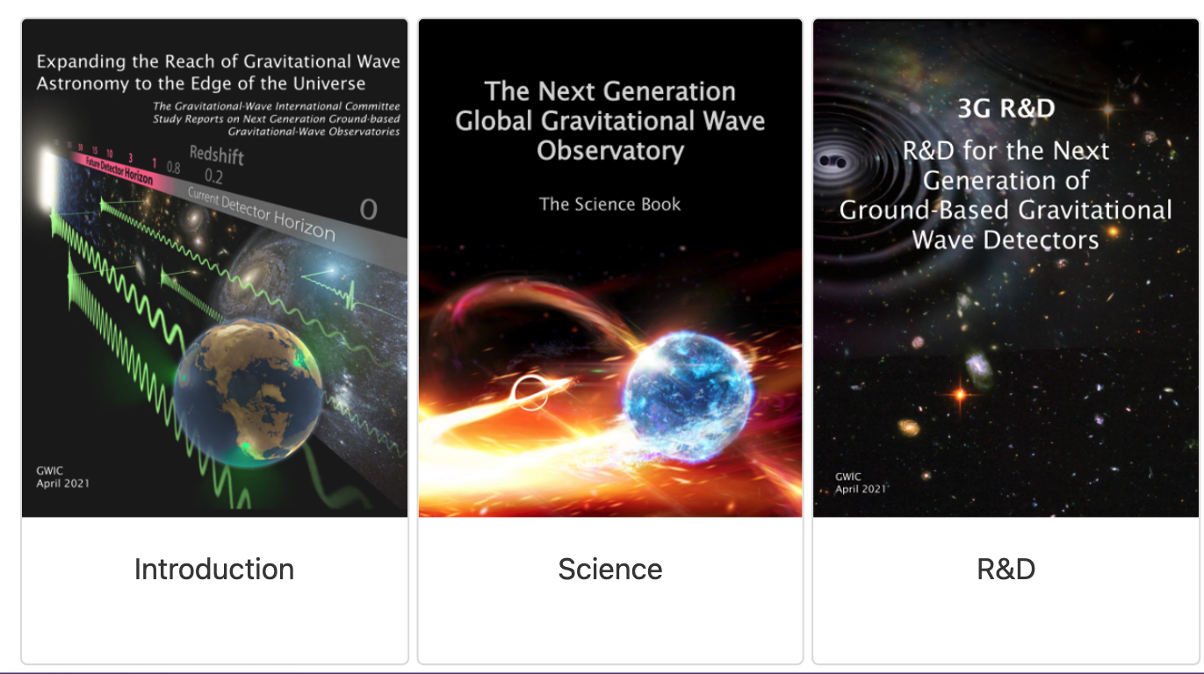
The Gravitational Wave International Committees and NG
To get the most out of NG detectors, a network is required
The GWIC has formed a committees focusing on NG R&D, science, and global coordination
Read more here: gwic.ligo.org/3Gsubcomm/
Dozens of useful documents and links (includes Cosmic Explorer Horizon Study, Einstein Telescope Design report)

Slide 23
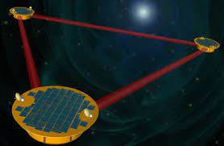
CE in the International Context
Laser Interferometer Space Antenna (LISA)
  An ESA-led space observatory with a small NASA contribution
  Expected to be launched in 2034 and take data concurrently with CE and ET
  Similar efforts also in China (two space observatories)
Neutron-star Extreme Matter Observatory (NEMO)
  An Australian observatory but a smaller observatory focussed on specific science
  Aspire to build a 20km CE-like detector in the future

Slide 24
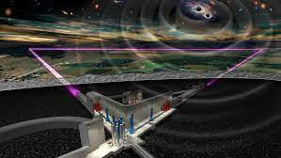
Einstein Telescope
A proposed next-generation ground-based gravitational-wave detector
Triangular-shaped, 10 Km arms
Underground to access low (~Hz) frequency
Mature design, design report published in 2011
  Technically challenging (underground cryogenic multiple interferometers)
Recently included in the European Strategic Forum for Research Infrastructures (ESFRI) roadmap!
Credit: NIKHEF

Slide 25
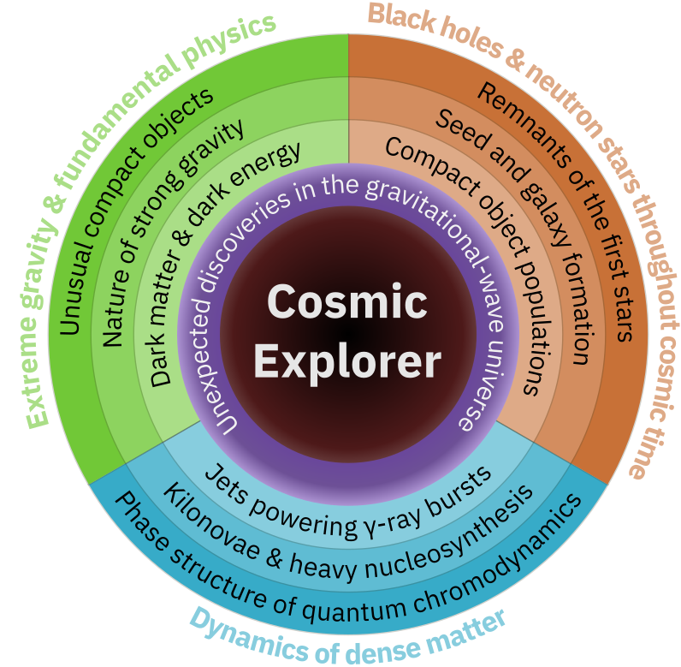
Cosmic Explorer Horizon Study
The CE HS identifies key science outcomes that can be reached with NG detectors
  Black holes and neutron stars throughough cosmic time
  Dynamics of dense matter & extreme environments
  Extreme gravity & Fundamental Physics
CEHS 2021

Slide 26
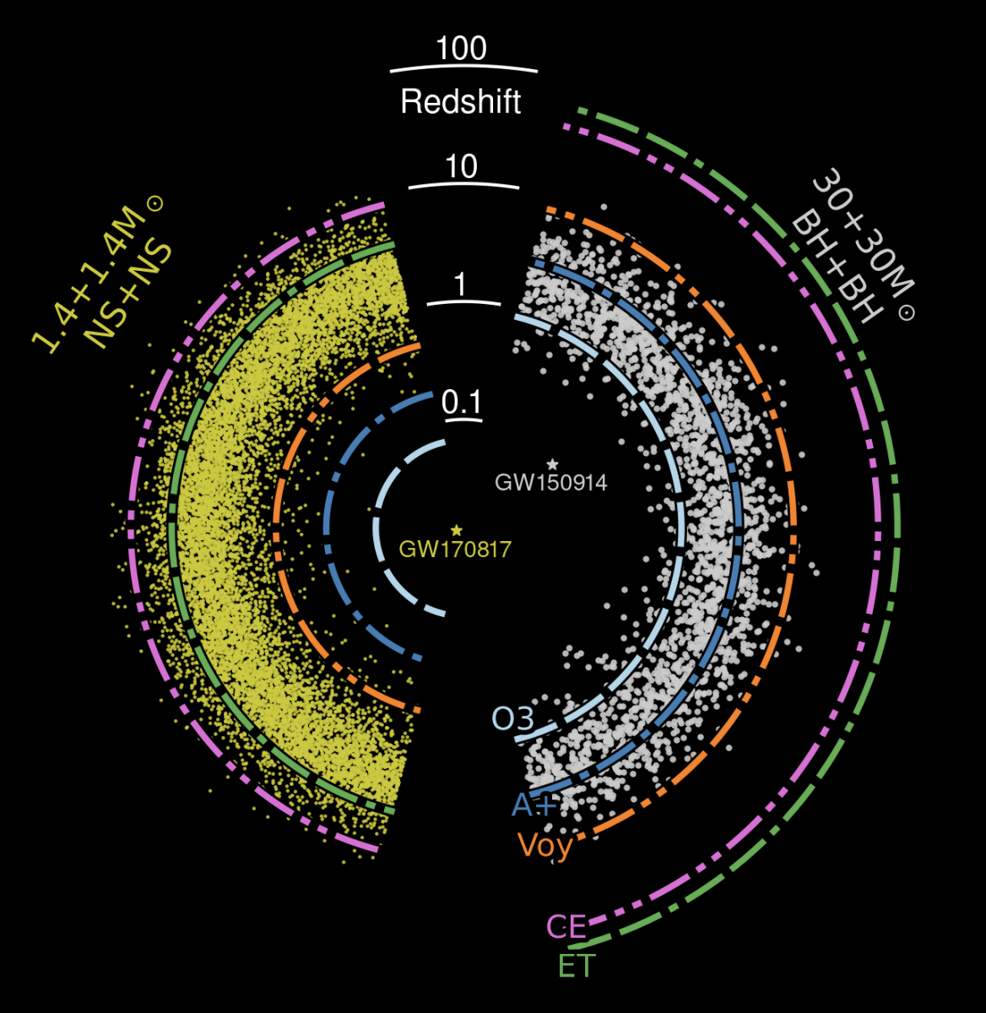
Cosmic Explorer Horizon Study
The CE HS identifies key science outcomes that can be reached with NG detectors
  Black holes and neutron stars throughough cosmic time
  Dynamics of dense matter & extreme environments
  Extreme gravity & Fundamental Physics
CEHS 2021

Slide 27
Detector sensitivity
CEHS 2021

Slide 28
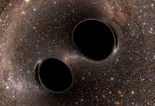
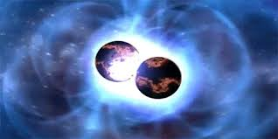
Listening to the Universe
CEHS 2021

Slide 29
Astrophysical populations of binaries
Can detect black holes from astrophysical populations which are currently unaccessible
It is important to have a network, to measure distance well, and hence source-frame mass
Ng+ ApJL 913 L5

Slide 30
Primordial black holes
If they exist, primordial black holes (PBHs) are expected to have had a higher merger rate in the past
Redshifts of tens
Detecting PBHs would be extremely consequential
CEHS 2021
Notes:
Merger rate goes like t(z)^{-34/37}

Slide 31
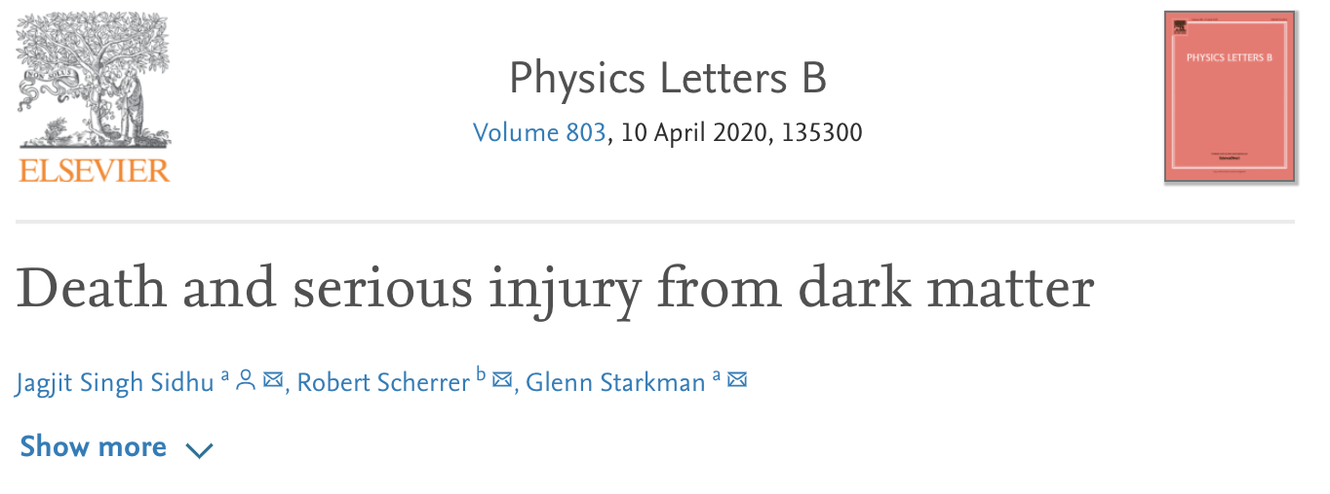
Primordial black holes
If they exist, primordial black holes (PBHs) are expected to have had a higher merger rate in the past
Redshifts of tens
Detecting PBHs would be extremely consequential
  Dark matter?
Notes:
Merger rate goes like t(z)^{-34/37}

Slide 32
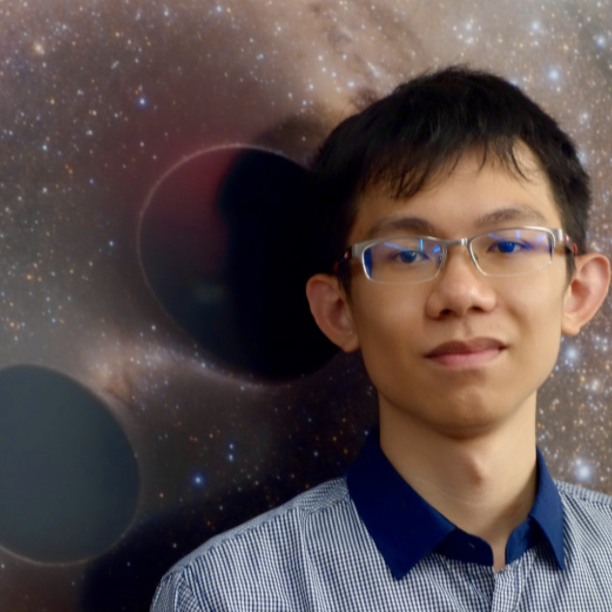
Primordial black holes
If they exist, primordial black holes (PBHs) are expected to have had a higher merger rate in the past
Redshifts of tens
Detecting PBHs would be extremely consequential
A lof of what I will report on is work of MIT student Ken Ng
CEHS 2021
Notes:
Merger rate goes like t(z)^{-34/37}

Slide 33
Astrophysical Black holes

Slide 34
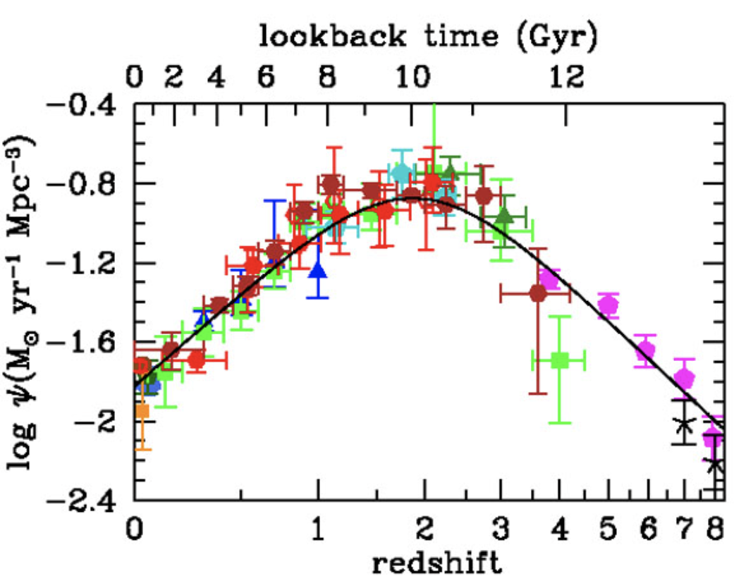
Star formation rate
We can reasonably expect that the formation rate of astrophysical black holes follows the star formation rate (SFR)
And we know the SFR!
Madau Dickinson 1403.0007

Slide 35
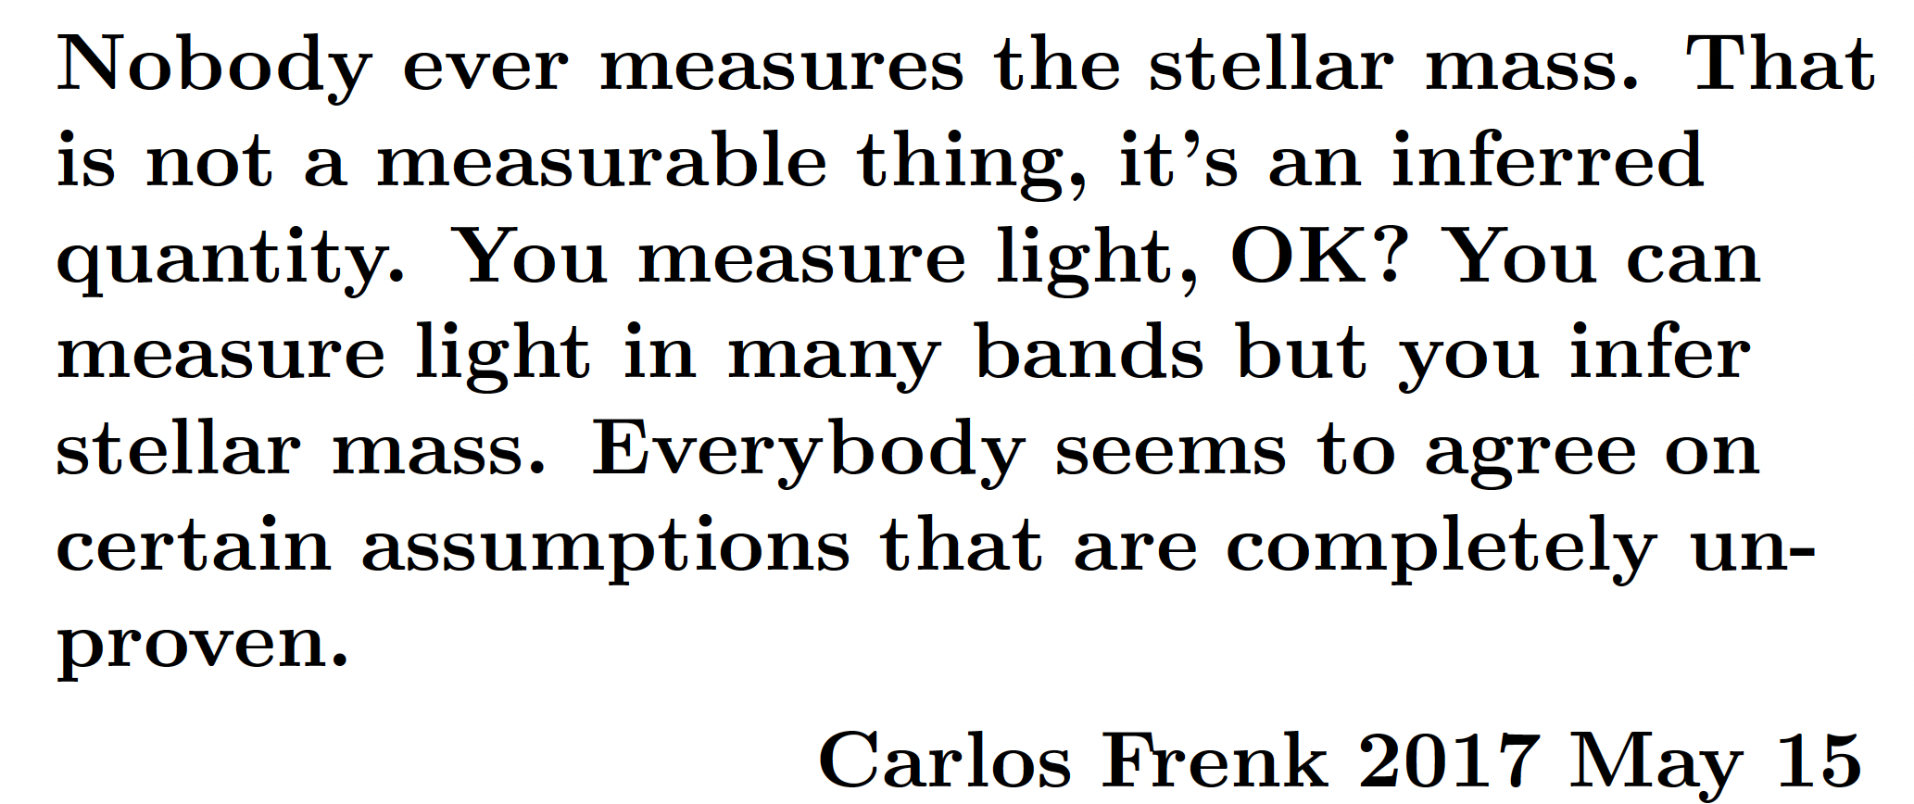
Star formation rate
We can reasonably expect that the formation rate of astrophysical black holes follows the star formation rate (SFR)
Or do we

Slide 36
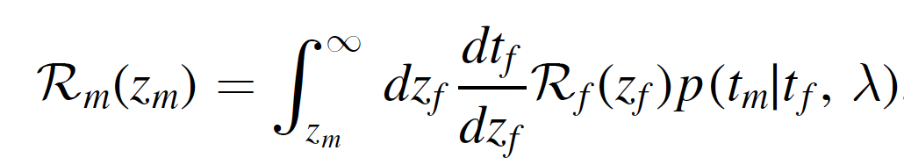
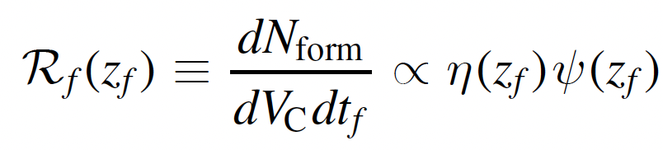
SFR and all that
Assume that the BBH merger rate is only affected by a (metallicity dependent) SFR and a time delay distribution (TDD)
In reality, things are more complicated and the merger rate might also depend on intrinsic properties (e.g. masses); various channels will contribute, etc
  Straightfoward to extend analysis to account for this
Can we use detected BBHs to measure SFR and TDD?

Slide 37
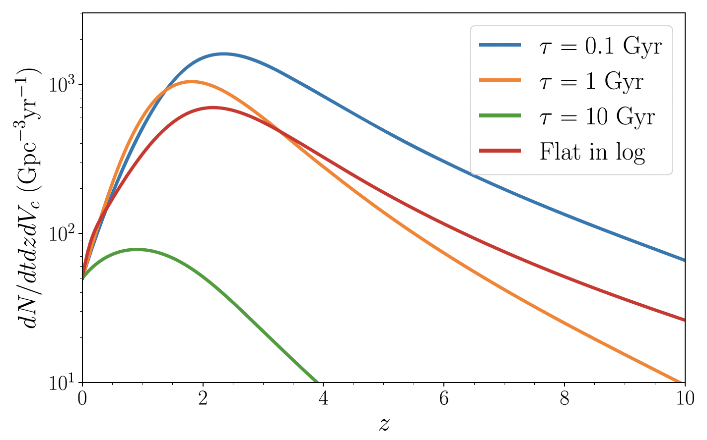
From SFR to merger rate
For a given formation rate, the true merger rate will depend on the time delay distribution
Madau Dickinson 1403.0007
Vitale+ 1808.00901

Slide 38
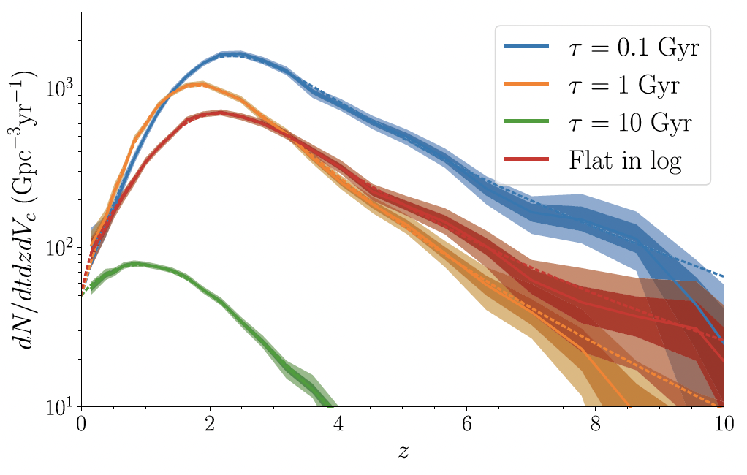
Unmodeled inference
With an unmodeled approach, one can measure the total merger rate and see where it peaks
For a given formation rate, the true merger rate will depend on the time delay distribution
Notes:
30k detections, weeks to 1y depending on TDD
2CE + ET

Slide 39
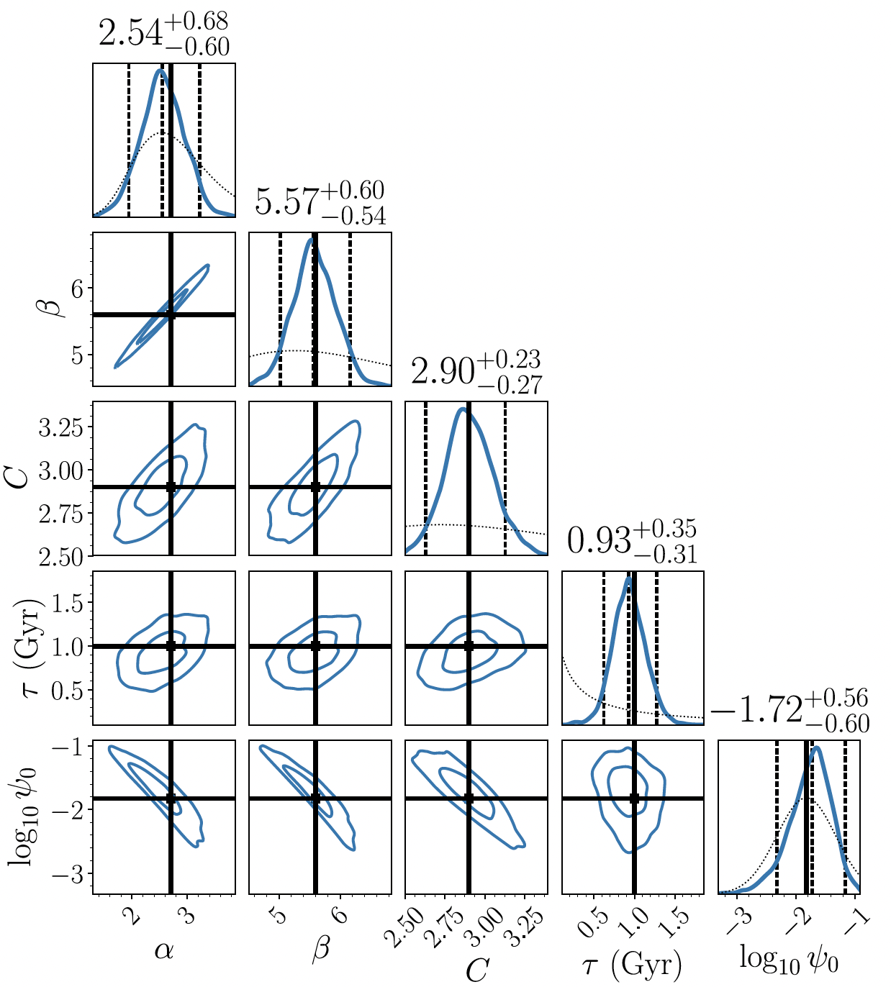
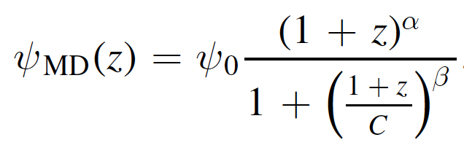
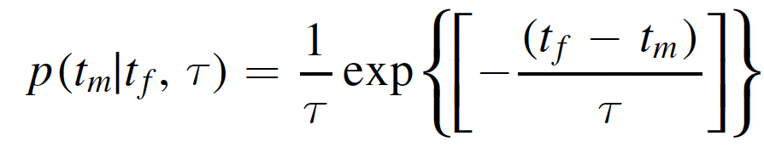
Measuring SFR and TDD
With a model for the SFR and the TDT, once can measure their parameters
Caveats: results as good as your model!
Notes:
30k detections

Slide 40
Allowing for multiple populations
In Ng+ 2012.09876 we allowed for multiple astrophysical populations
  “Local” field and dynamical channels
  High-z mergers from Pop III leftovers
Assumed two months worth of detections
2 CE + 1 ET
Ng+ ApJL 913 L5

Slide 41
Immediate questions
Can we measure the properties of each channel separately?
Can we measure the branching ratios between channels?
Can we show that Pop III BHs exist and when their rate peaked?

Slide 42
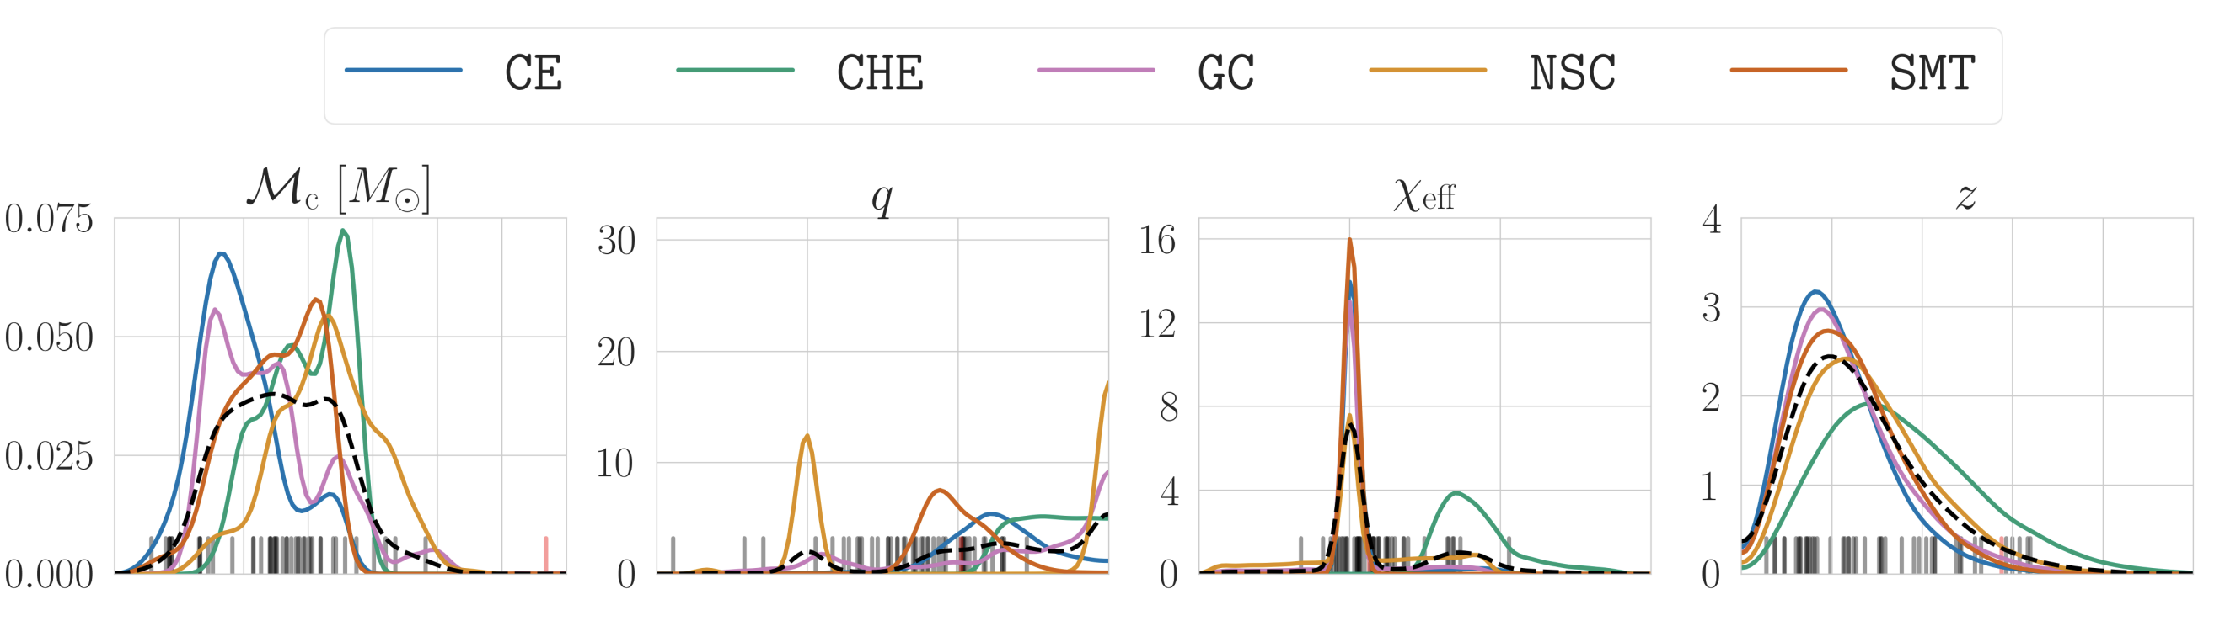
Models, models, models!
To characterize individual channels we need a way of labeling black holes
The ideal world scenario:
  Population synthesis gives us predictions we trust for the mass and spin and eccentricity and redshift of each channel as a function of redshift
Zevin+,2011.10057

Slide 43
Models, models, models!
To characterize individual channels we need a way of labeling black holes
The world were we live:
  Population synthesis gives us predictions which are highly uncertain locally, and even more so for Pop III
Use as little modeling as possible
  Redshifts!
Zevin+,2011.10057

Slide 44
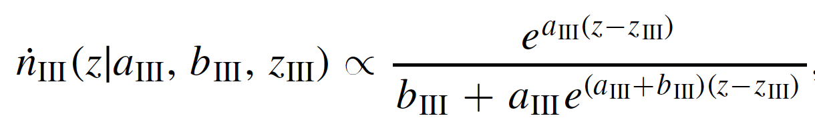
Modeled inference
Take predictions on redshift evolution of various channels, and use them as a parametrized template
E.g. for Pop III

Slide 45
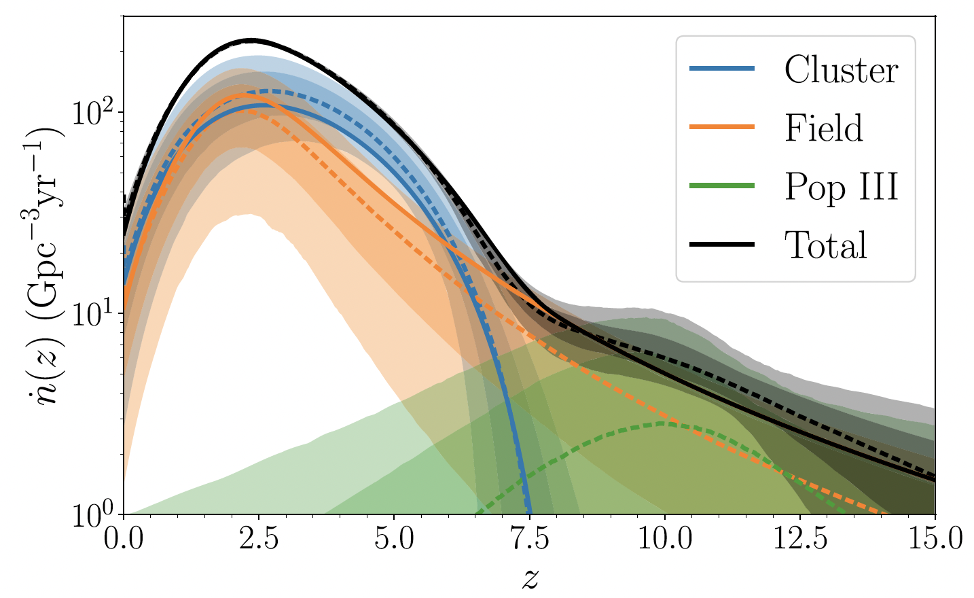
Modeled inference
Take predictions on redshift evolution of various channels, and use them as a parametrized template
E.g. for Pop III
f_III = 0

Slide 46
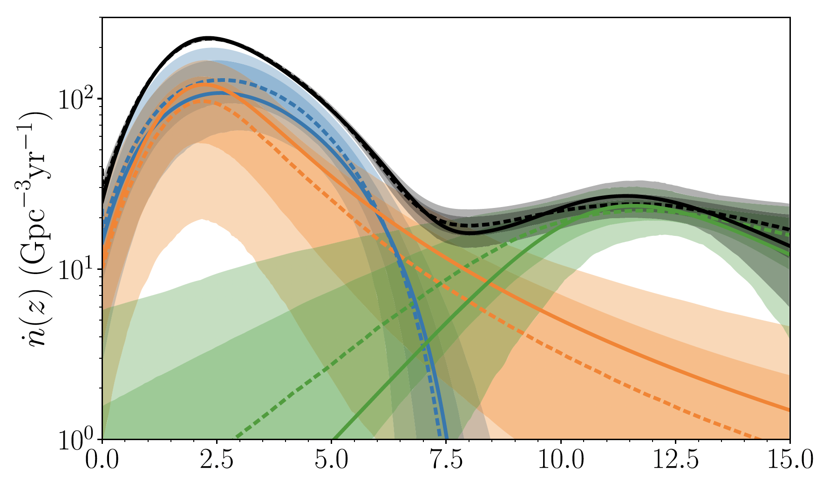
Modeled inference
Take predictions on redshift evolution of various channels, and use them as a parametrized template
E.g. for Pop III
f_III = 2.4%
Notes:
2.4% from Belc paper, fixes ratios of peak at around 1/10

Slide 47
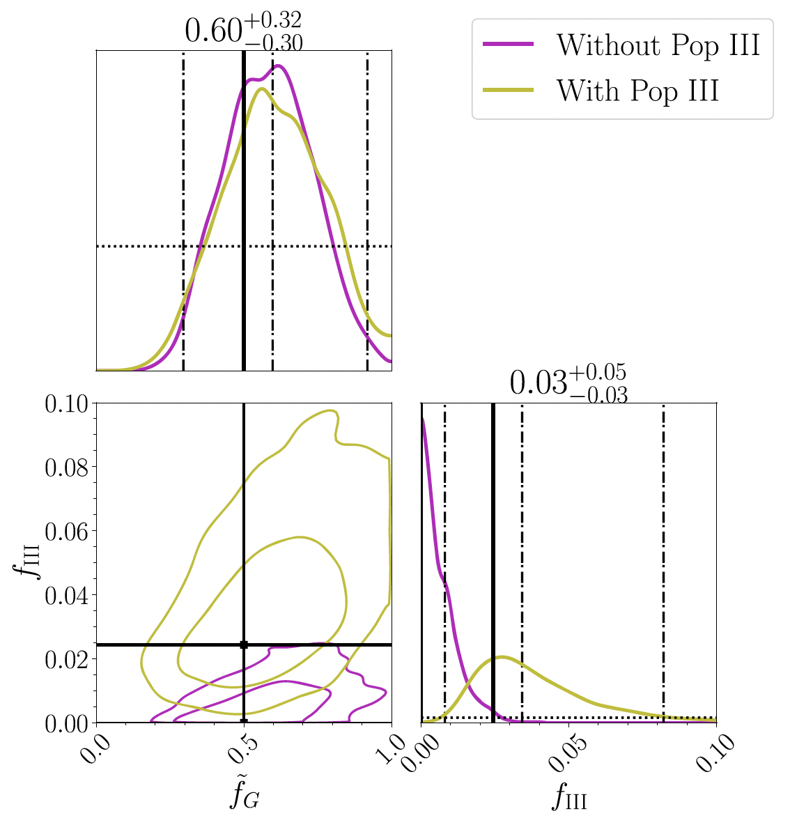
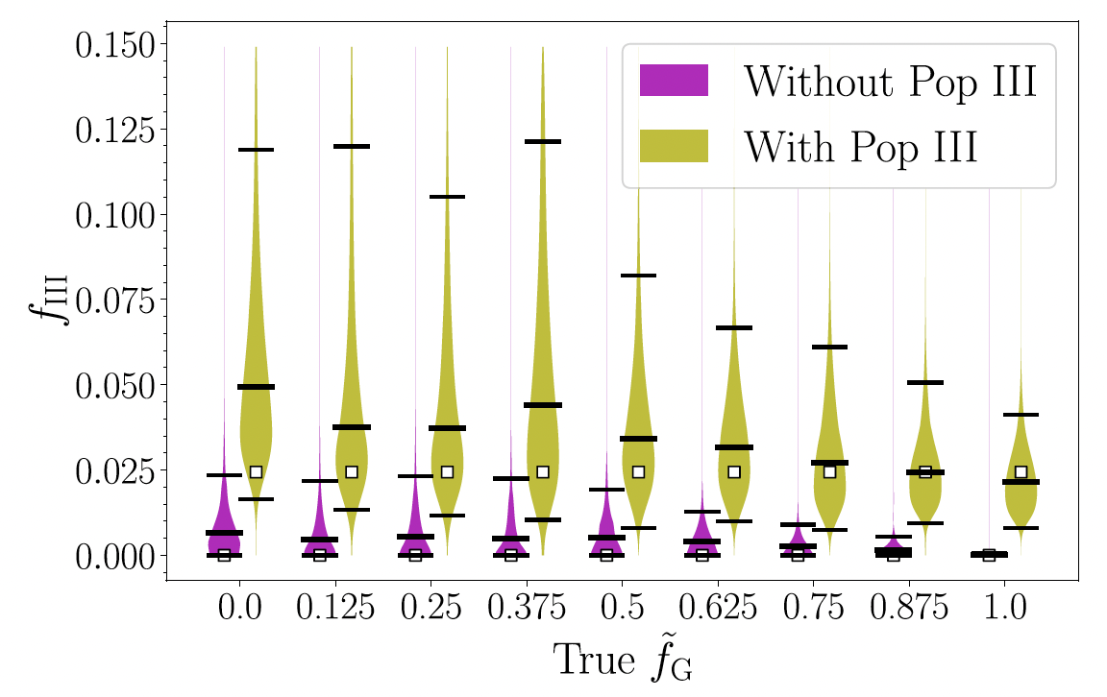
Are there Pop III mergers?
Assumes cluster and field have same rate

Slide 48
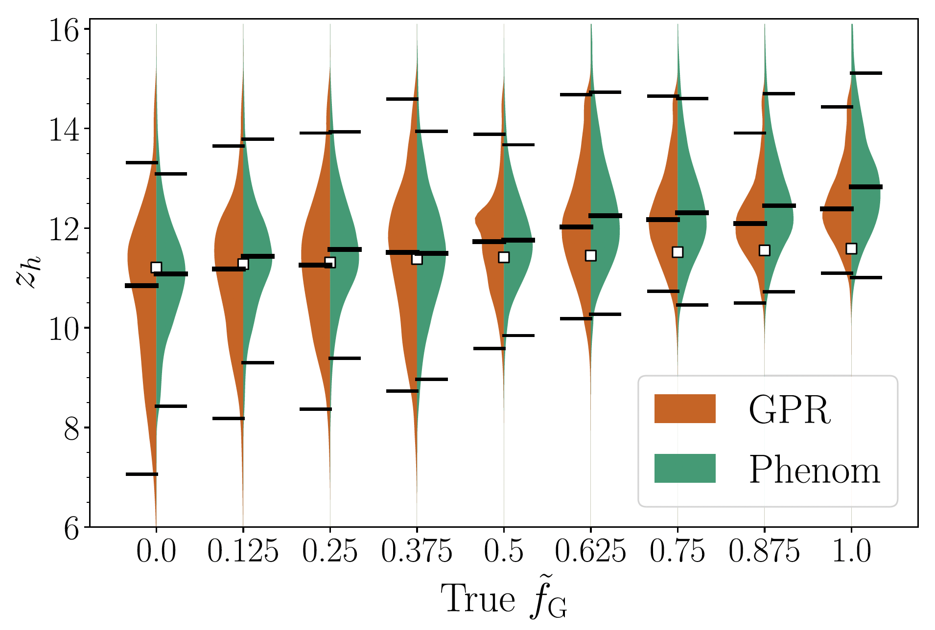
O Brother, Where Art Thou?
We can measure the peak of the Pop III mergers easily as one of the model parameters

Slide 49
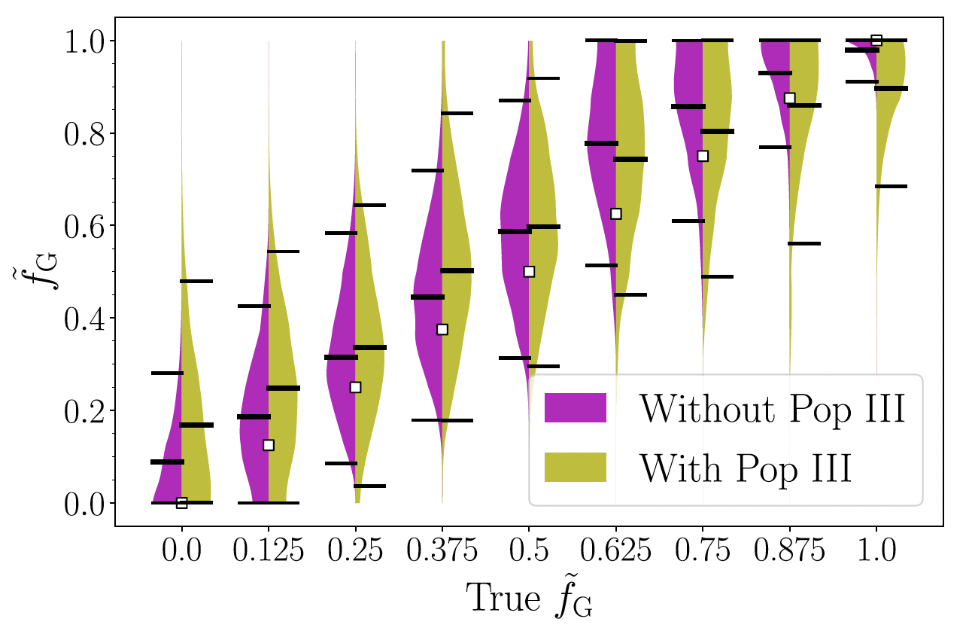
Branching ratios
The ratio between the two local channels can be measured with an uncertainty of ~0.4
This is with two months of data, uncertainty reduced with more time and more sophisticated population modeling
Results based on IMRp_v2, HM will help a lot (more on this later)

Slide 50
An unmodeled approach
What can be done if we really don’t trust any information coming from theory or population synthesis?
Just measure the total merger rate, without trying to label the black holes
Notes:
2 CEs and 1 ET

Slide 51
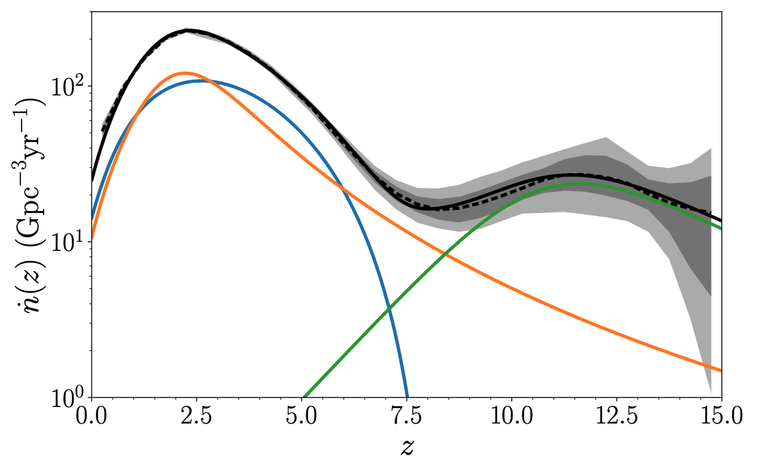
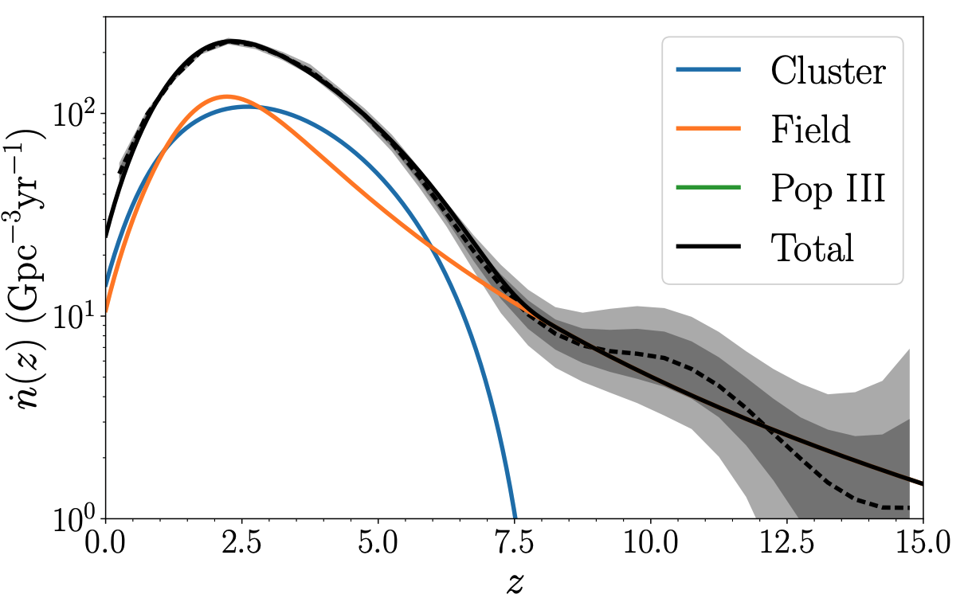
An unmodeled approach
What can be done if we really don’t trust any information coming from theory or population synthesis?
Just measure the total merger rate, without trying to label the black holes
Use gaussian process to infer the total merger rate
Notes:
2 CEs and 1 ET

Slide 52
An unmodeled approach
Use a simple algorithm to find stationary points of the total merger rate
Notes:
2 CEs and 1 ET

Slide 53
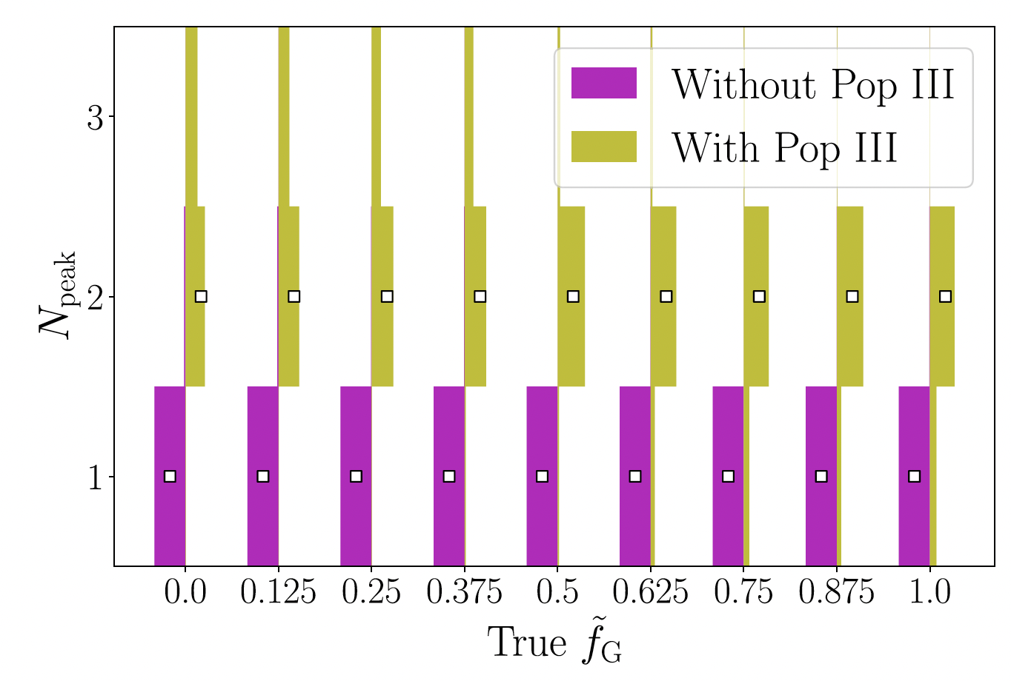
How many peaks
Can we find out that there is an high-redshift peak?
Yes!

Slide 54
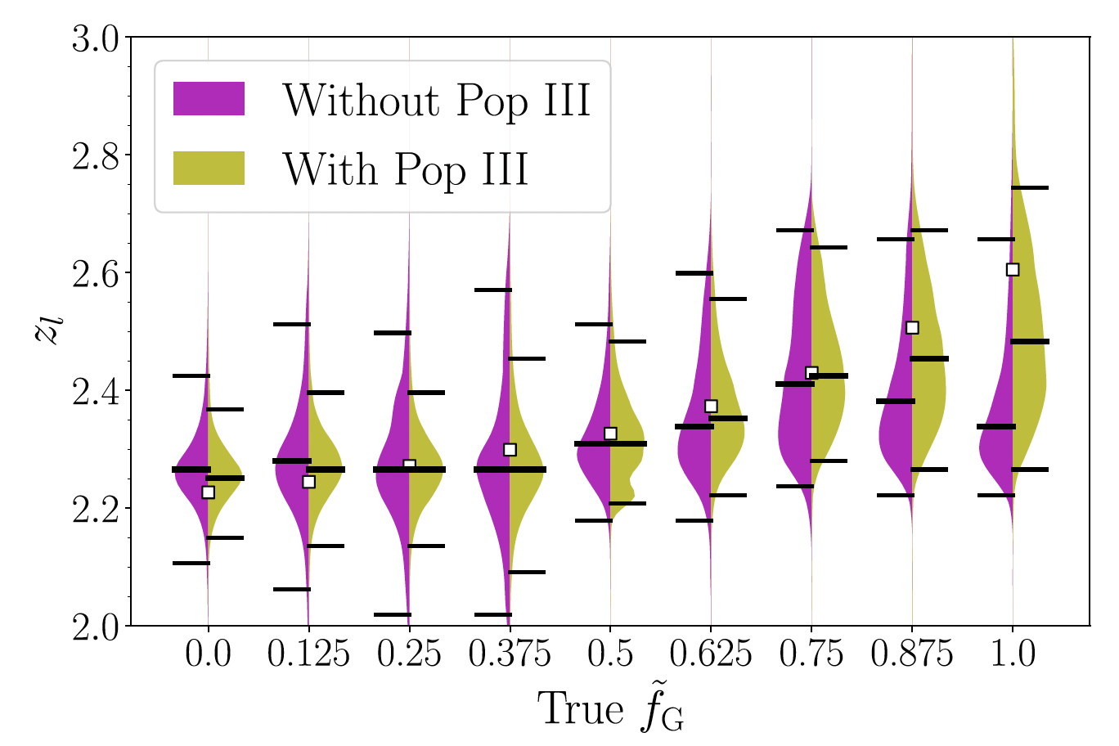
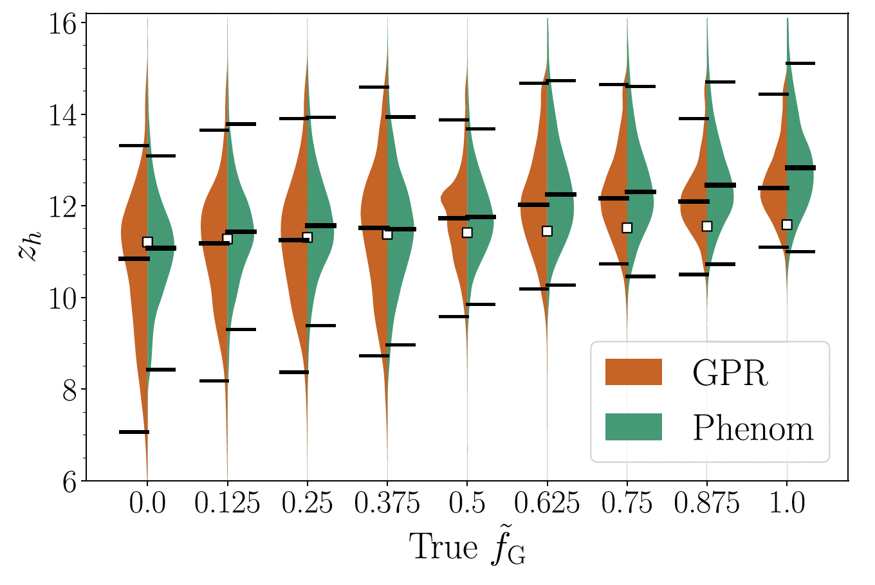
O Brother, Where Art Thou?
Can also measure the redshift of the nearby and far away redshift

Slide 55
Primordial black holes

Slide 56
Detecting PBHs mergers
Primordial black holes mergers might be recognizable because of
  Mass and spins spectrum
  Eccentricity at merger
  Extemely high redshift
Of these, the high redshift seems like the most uncontroversial tracer
CEHS 2021
Notes:
30-30M face-on candle
PBH:
V. De Luca et al., “Bayesian Evidence for Both Astrophysical and Primordial Black Holes:Mapping
the GWTC-2 Catalog to Third-Generation Detectors”, arXiv:2102.03809 (cit. on p. 36).
M. Raidal et al., “Formation and evolution of primordial black hole binaries in the early universe”,
J. Cosmology Astropart. Phys. 2019, 018 (2019) (cit. on p. 36).
Pop III
K. Belczynski et al., “On the likelihood of detecting gravitational waves fromPopulation III compact
object binaries”, MNRAS 471, 4702–4721 (2017) (cit. on p. 36).
Field
K. Belczynski et al., “The first gravitational-wave source from the isolated evolution of two stars in
the 40-100 solar mass range”, Nature 534, 512–515 (2016) (cit. on p. 36).
GC
321. C. L. Rodriguez and A. Loeb, “Redshift Evolution of the Black Hole Merger Rate from Globular
Clusters”, ApJ 866, L5 (2018)

Slide 57
The smoking gun
If NG detectors can observe a BBHs at redshift larger than say 30, the it’s going to be made of PBHs!

Slide 58
Listening to the Universe
CEHS 2021

Slide 59
The smoking gun
If NG detectors can observe a BBHs at redshift larger than say 30, the it’s going to be made of PBHs!
But being able to detect something at z >30 does not imply being able to measure its redshift to be that large
We don’t measure distance/redshift that well!
Notes:
PBHs become gravitationally bound to each other roughly when their local density becomes equal to the density of surrounding radiation, which generically happens after matter-radiation equality.

Slide 60
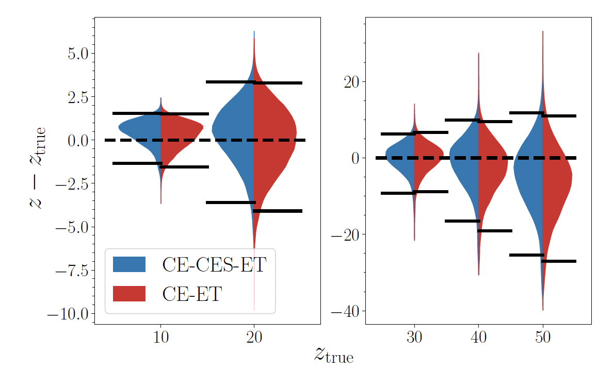
Pinning down a single PBBH
Can NG networks prove with certainty that a merger happened above some z_critical?
Not really. The best system we found for z_crit=30 has M_tot=40Msun, q=1, iota=pi/3 and ``only” 97% of the posterior lies at z>30
Ng+, 2108.07276
Notes:
Mtot=40, q=1 iota =30

Slide 61
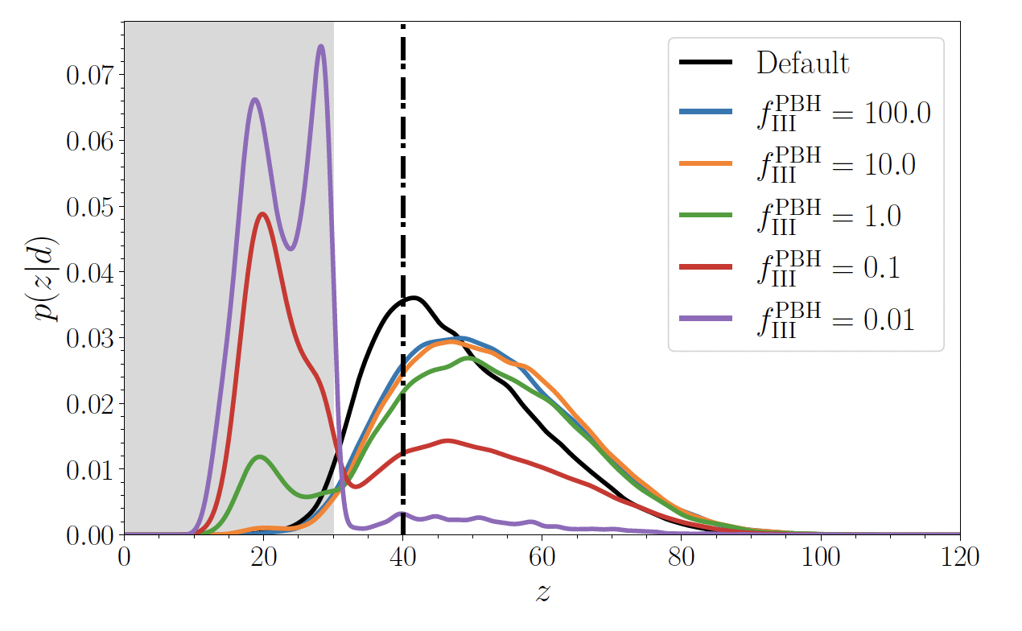
But which prior?
We also found that priors play a decisive role
The result in the previous slide used a uniform in comoving volume/time prior
But one should also use prior information about the relative aboundance of Pop III and PBH mergers
How much you believe this BBH is primordial strongly depends on how many BBHs you believe are primordial
Ng+, 2108.07276

Slide 62
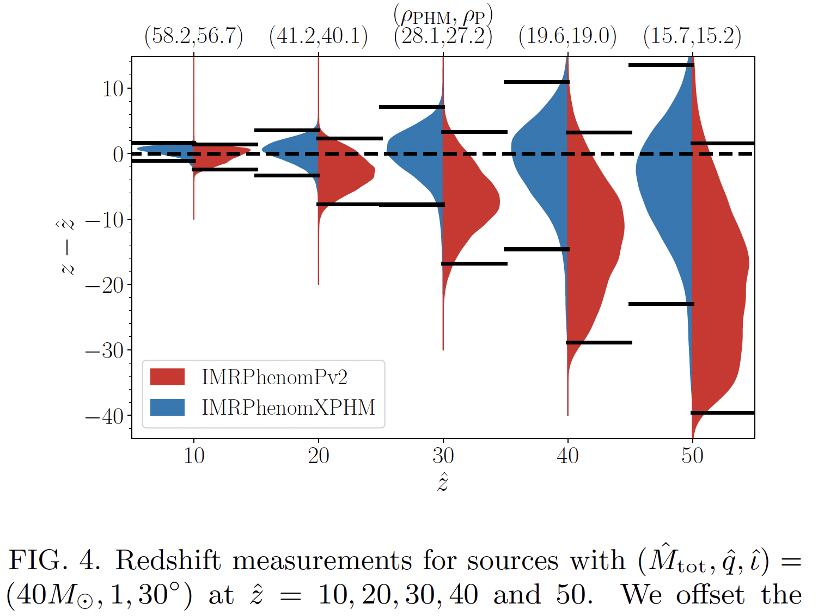
What about the other parameters?
Currently wrapping up extensive parameter estimation study for BBHs at large redshift
Focus on impact of higher order modes and their relation with other parameters
Red posterior offsets in figure not due to waveform systematics
HOMs buy up to a factor of ~2 in redshift estimation
Ng+, imminent
Notes:
Redshift prior goes as (1+z)^(-5/2) at z>>1

Slide 63
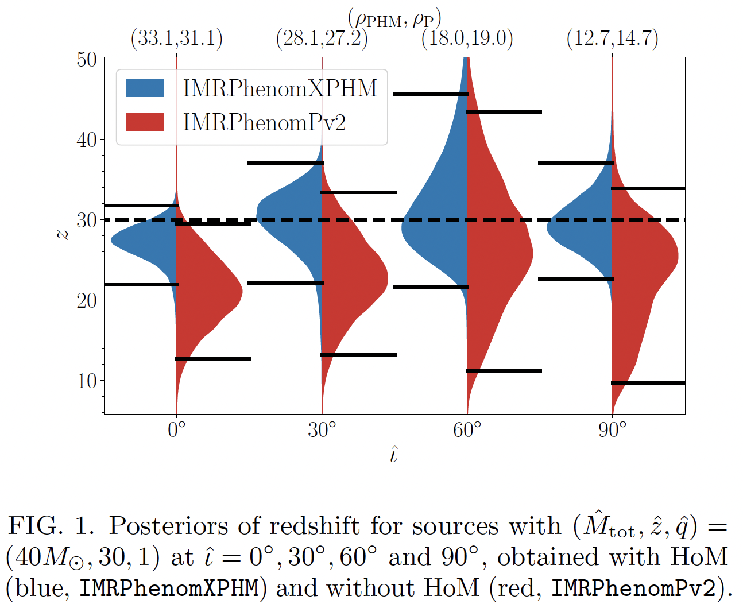
What about the other parameters?
Inclination significanty impacts amout of HOMs
Non linear trend
  First one wins because more HOMs break redshift/inclination degeneracy
  Then one loses because SNR is decreasing
Notes:
Redshift prior goes as (1+z)^(-5/2) at z>>1

Slide 64

What about the other parameters?
Mass ratio also impact the amount of HOMs
Non linear trend
  First one wins because more HOMs break redshift/inclination degeneracy
  Then one loses because SNR is decreasing

Slide 65

New correlations
The fact that the mass ratio enters in different ways in different harmonics creates an interesting q/iota correlation
M=40Msun

Slide 66

Can we show PBHs have zero spin?
PBHs are expected to be created with zero spin
Possibly acquire some spin by accretion as smaller redshifts
For redshifts above 30, 90% credible intervals are broad

Slide 67

Gotta catch 'em all
Put away the “exceptional event paper” and go after the population
Can we find evidence of something past the peak of mergers from Pop III?
Looking into Ng+ in prep
Ng+, imminent
Notes:
Lognormal PBH mass distribution, 30M sigma 0.3

Slide 68

Gotta catch 'em all
Put away the “exceptional event paper” and go after the population
Can we find evidence of something past the peak of mergers from Pop III?
Looking into Ng+ in prep
Ng+, imminent
Notes:
Lognormal PBH mass distribution, 30M sigma 0.3

Slide 69
Conclusions
Advanced detectors will explore the local universe (z ~ 1)
A new generation is required to detect sources everywhere in the universe
  Characterization of BH masses and spins, formation channels, evolution,…
  Thousands of neutron stars, EOS, cosmology,...
  Precise tests of general relativity
  Access to sources throughout cosmic history
Get involved! Numerous opportunities to play role in CE and ET

Slide 71

Multibanding
LISA can observe heavy BBH and intermediate-mass BBH
Some of those signals will also be visible from the ground (years later)
Complementary information! (Sesana PRL 116, 231102; Vitale PRL 117, 051102; Barausse+ PRL 116, 241104)
For nearby IMBH, LISA might provide Mchirp info, but not for z>~0.3
Cutler+, 1903.04069
LISA SNR =5
3G SNR ~ 1000
[Msun]
[Msun]

Slide 72

Multibanding
Ng+ PRD 102, 083020
Black holes will form clouds of ultralight bosons (if such particles exist)
  The bosons cloud emits nearly monochromatic GWs
LISA could detect the GWs from the inspiral while 3G detectors could simultaneously detect the GWs from the axion clouds

Slide 73


BBH orbital orientations
Their inclination angle distribution will be
isotropic
  Better ringdown tests, memory effect, spin precession, distance estimation [Refs4]
Schutz, CQG 28, 125023 , Vitale, PRD(R) 94 121501
Vitale+, PRL 112 251101, PRD 95 064053
Probability
Primary spin uncertainty
Orbital inclination
Orbital inclination [rads]

Slide 74
Black hole masses and spins
Source-frame component masses
  Uncertainties of [few-10]% for z<3
  Factor 1.5-2 better with 4 detectors w.r.t. 2 detectors
Component spins
  Due to larger SNR and isotropic orbital orientation, 3G will get much better spin estimation than current detectors
  Typical uncertainty on spin magnitude of primary ~0.5 (instead of ~unmeasurable)
  See Vitale & Evans, PRD 95 064052 for details.

Slide 75



Spins
Due to larger SNR and isotropic orbital orientation, 3G will get much better spin estimation than 2G
2G
3G
Vitale+, PRD 95 064053
Vitale+, PRD 95 064052

Slide 76
BBH Extrinsic parameters
Precise distance and sky position:
  EM (if luminous), isotropy, cosmology
Sky location
Luminosity Distance
Vitale & Evans, PRD 95 064052

Slide 77
BBH Extrinsic parameters
Precise distance and sky position:
  EM (if luminous), isotropy, cosmology
Even with 2 detectors, many sources localized better than 1deg2
Sky location
Luminosity Distance
Vitale & Evans, PRD 95 064052

Slide 78

Searching for ultralight bosons
Black hole spin measurements can be used to search for ultralight bosons $μ_{s}≲ 1×{10}^{−11}eV$
  QCD axion could solve strong CP problem
  Naturally arise in string theory
  Potential dark matter candidate
Can be scalar, vector, tensor
  Will focus on scalar today and neglect self-interaction (Baryakhtar+ 2011.11646)
Notes:
For LIGO BBHs, DECAY CONSTANT $f_{a}>{10}^{15}GeV$ is relevant
QCD axion has negligible self-interaction since $f_{a}\sim {10}^{20}GeV$
Baryakhtar+ 2011.11646
QCD axion potential ~ f_a^2 mu^2 (1-cos(phi/f_a)) -> non-linear self-itneractio for small f_a

Slide 79

Black hole superradiance
It is possible to extract energy from a rotating black hole
  Penrose process
  For waves, amplitude is amplified
If the particle/wave is not going to infinity, this can happen over and over
  Superradiance
The mass of the boson provides a ”mirror” that prevents it from leaving
  Exponential growth
Very exhaustive reviews, Hui 2101.11735, Brito+ 1501.06570, Barykhtar+ 2011.11646

Slide 80

Black hole superradiance
Can happen as long as the angular momentum of the wave is smaller than that of the BH
Formation of extended boson clouds (r >>1 Schwarzing radius)
Klein-Gordon equation in Kerr background
  ~Hydrogen atom-like cloud structure
Credit: M. Baryakhtar; see also Arvanitaki+, PRD 83, 2011
Notes:
Lam Hui - Wave Dark Matter 2101.11735
Brito+ Superradiance -- the 2020 Edition

Slide 81

Conditions for superradiance
Compton wavelength of boson must be comparable to BH size
$α_{G}=\frac{r_{BH}}{λ_{μ_{s}}}=\frac{GMμ_{s}}{ℏc^{3}}≲1$
The spin of the BH must be larger than the wave angular momentum
$ω_{μ_{s}}<mΩ_{H}(M,χ)$
Extract BH’s energy & momentum until $ω_{μ_{s}}=mΩ_{H}$
Notes:
Cloud orbital verlocity ~ alpha/ell

Slide 82


Observational signature
The cloud itself emits gravitational waves, but not very strongly (Arvanitaki+ PRD 91 084011 , Sun+ PRD 101 063020, Zhu+ PRD 102 063020
A mode characterized by quantum numbers (l,m) would grow till the black hole spin is reduced to $χ_{nlm}^{∞}=\frac{4mα_{G}\left(M,μ_{s}\right)}{4α_{G}^{2}\left(M,μ_{s}\right)+m^{2}}$
The timescale depends on the quantum numbers, faster for small (l,m)
$$M=30 M_{⊙}$$ $$μ_{s}=10^{−12}eV$$ | $l=m=1$ | $l=m=2$ | $l=m=3$
$$τ_{nlm}^{inst}$$ | $$𝒪(≲yr)$$ | $$𝒪(≲kyr)$$ | $$𝒪(≲Myr)$$

Slide 83






Observational signature
If boson exist, black holes of appropriate mass must have small spins
  Boson cloud has removed spin (Arvanitaki+, PRD 95 043001 , 91 084011)
  Also a few % of mass loss
E.g., $45M_{⊙}$ can only reach $l=m=3$ mode if its age is 10 billion years
$$l=1$$
$$l=2$$
~ 1 kyr
$$l=3$$
$$μ_{s}={10}^{−12}eV$$
~100 Myr
83

Slide 84


Signature in the BH population
BH spins at formation $χ_{F}$
  E.g. uniform in mass and spin

Slide 85




Signature in the BH population
BH spins at formation $χ_{F}$
  E.g. uniform in mass and spin
Bosons carve an exclusion region in the mass/spin plane
  Depends on black hole mass and age
$$μ_{s}={10}^{−12}eV$$
$$T_{age}=10Myr$$

Slide 86


Signature in the BH population
BH spins at formation $χ_{F}$
  E.g. uniform in mass and spin
Bosons carve an exclusion region in the mass/spin plane
  Depends on black hole mass and age
Detected population should have small spins and follow critical curve
$$μ_{s}={10}^{−12}eV$$
$$T_{age}=10Myr$$

Slide 87

Astrophysical contraints
Astrophysical black holes cover a very wide range of boson masses
Precise spin measurement is necessary
Brito+ 1706.06311

Slide 88

Using gravitational waves
One can use LIGO/Virgo detections to measure the spin of many black holes!
Timescale to merger becomes important
  Limits the (l,m) of cloud that can be formed, if any
Ng+ 1908.02312

Slide 89
Using gravitational waves
Great! A lot of LIGO/Virgo black holes do have small spins!
Is that evidence for axions?
Not that simple!
What LIGO and Virgo measure are the spins of the black hole when they merge
Spins at merger can be small because axions exist or because they were small to start with!

Slide 90

Using gravitational waves
Ng+ 1908.02312 (in press PRD ) presented a hierarchial Bayesian approach
Simultaneously account for (a possible) boson mass and the astrophysical distribution of spins at formation
Assuming boson exist, measure its mass
Model selection between boson vs no-boson hypotheses
Simulated BBHs with mass function consistent with LVC’s
Prefers bosons
Prefers no bosons

Slide 91

Contrainsts using O3a LIGO/Virgo data
In Ng+ 2011.06010 (in press PRL) we applied the method to the latest LIGO/Virgo catalog
Two sources consistent with large primary spin
Ng+ 2011.06010

Slide 92


Contrainsts using O3a LIGO/Virgo data
In Ng+ 2011.06010 (in press PRL) we applied the method to the latest LIGO/Virgo catalog
Two sources consistent with large primary spin
Analysis yields $<0.1\%$ posterior support for boson in mass range
$μ_{s}∈\left[1.3, 2.7\right]×{10}^{−13}eV$
Statistically insignificant support for boson at $μ_{s}\sim 1×{10}^{−12}eV$
Ng+ 2011.06010
Notes:
Shrinks to 2.2-2.7 e-13 if using tau =1e5 yrs

