Slide 1
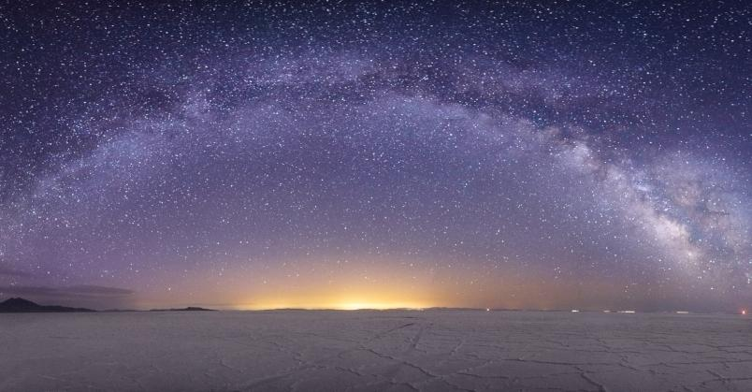


Cosmic Explorer
Progress and Plans
Matthew Evans, on behalf of the Cosmic Explorer Team

Slide 2
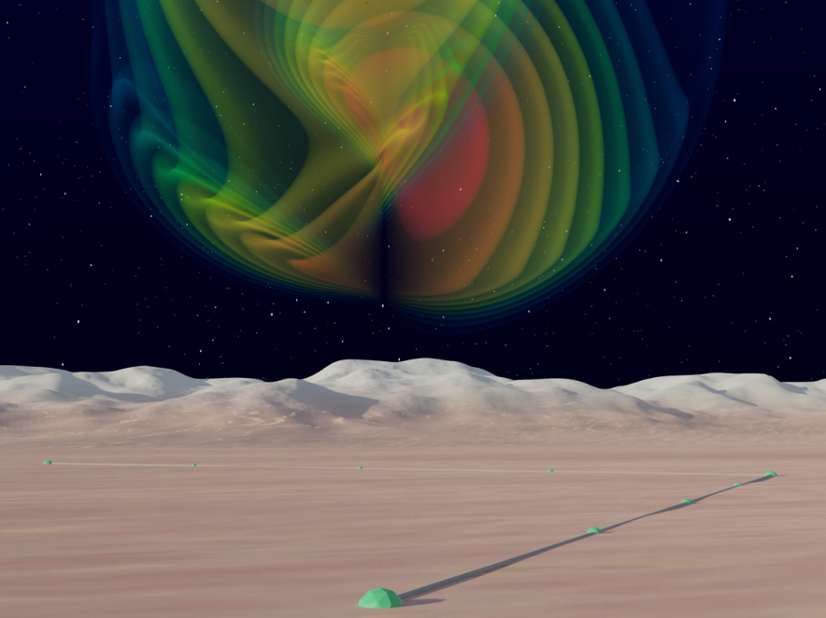
A Horizon Study for
Cosmic Explorer
Science, Observatories, and Community

Slide 3
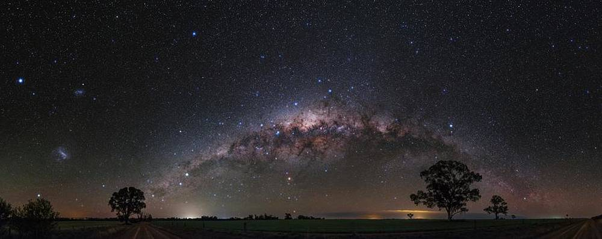
Getting Started
Your input and involvement is important to CE:
  CE Horizon Study available at cosmicexplorer.org
    dcc.cosmicexplorer.org/CE-P2100003/public
  And your feedback is much appreciated!
    cosmicexplorer.org/horizon-study-feedback
  CE will be built by this community.
  Please join the CE consortium
    cosmicexplorer.org/consortium.htm
EDI play a central role in our thinking about CE. I’ll start with a few words about one EDI aspect of the CE project…

Slide 4
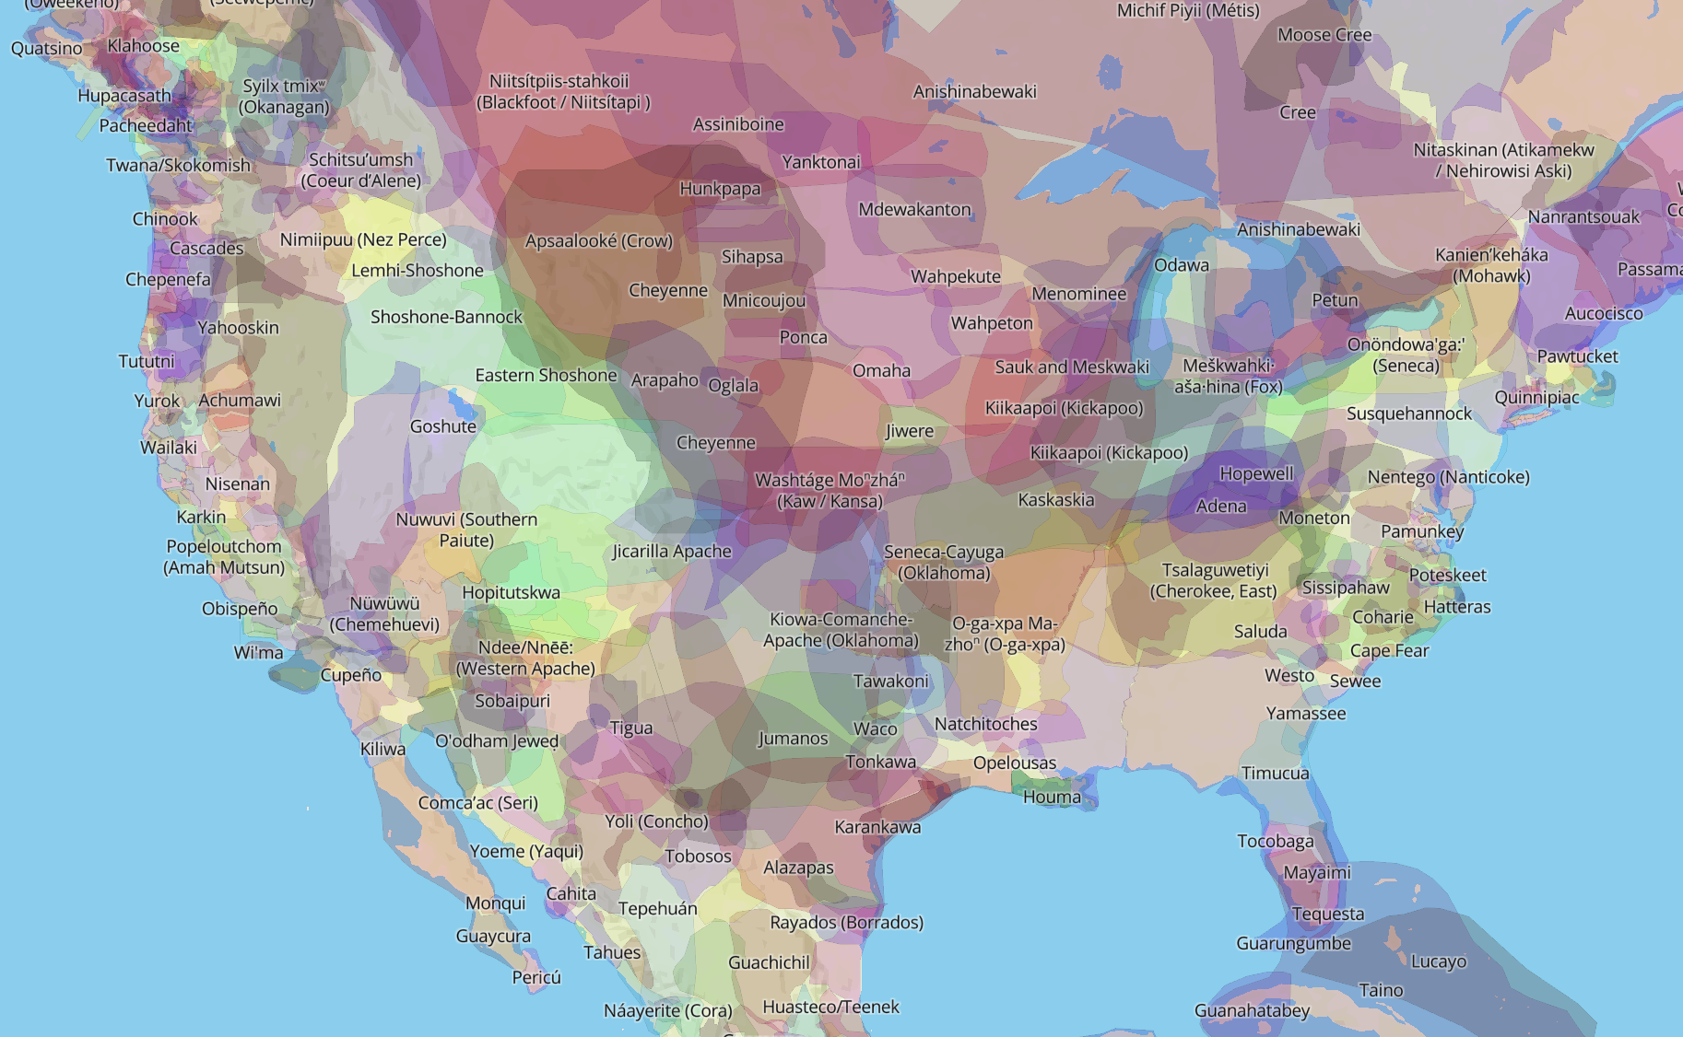
No matter where we build Cosmic Explorer, the history of the land will play a pivotal role in this project. We will have the opportunity, and obligation, to work with Indigenous Peoples to build synergistic relationships and to ensure that we respect their land, their culture and their sovereignty.
http://native-land.ca/
If you are not aware of issues surrounding TMT, please read arXiv:2001.00970 .

Slide 5
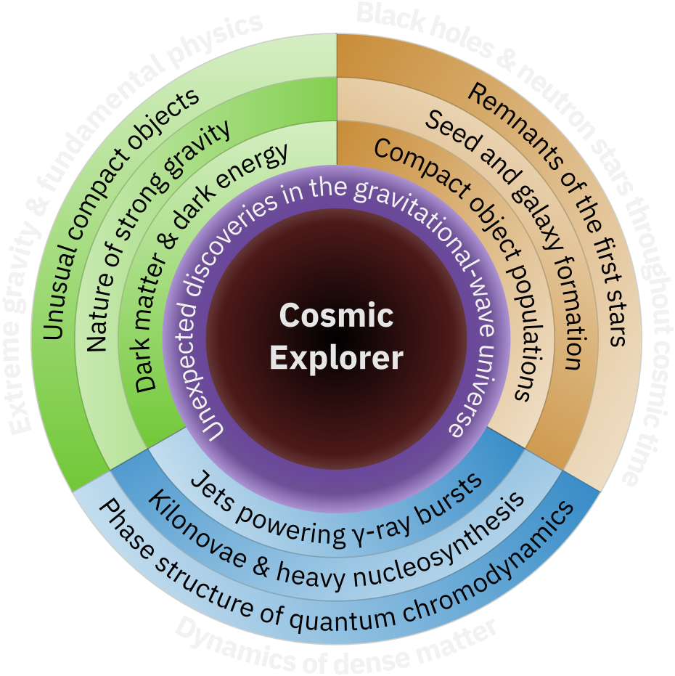

Slide 6
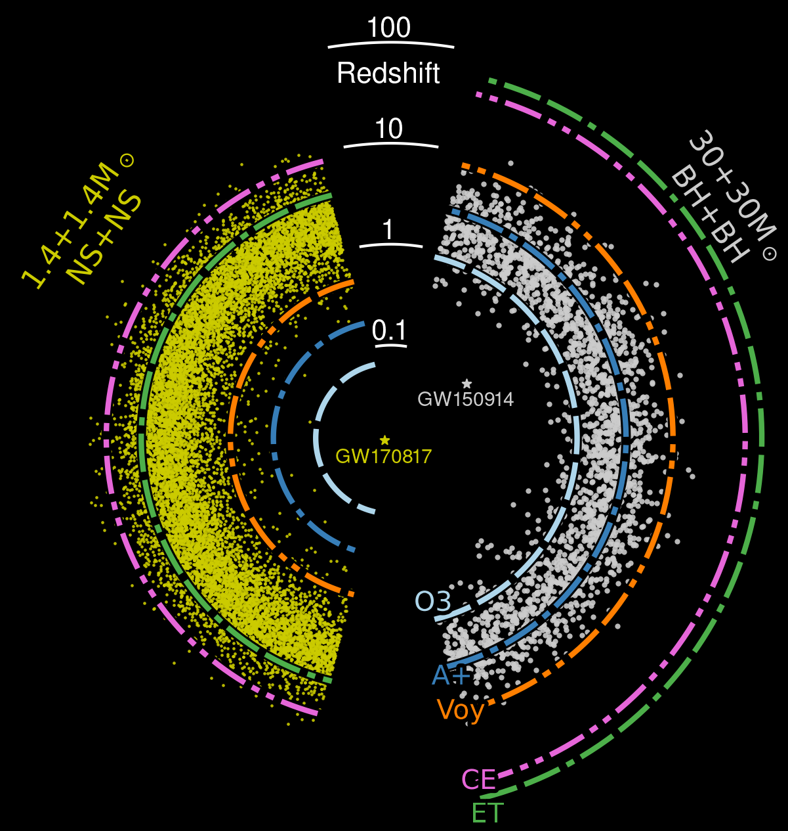
Black Holes & Neutron Stars Throughout Cosmic Time

Slide 7
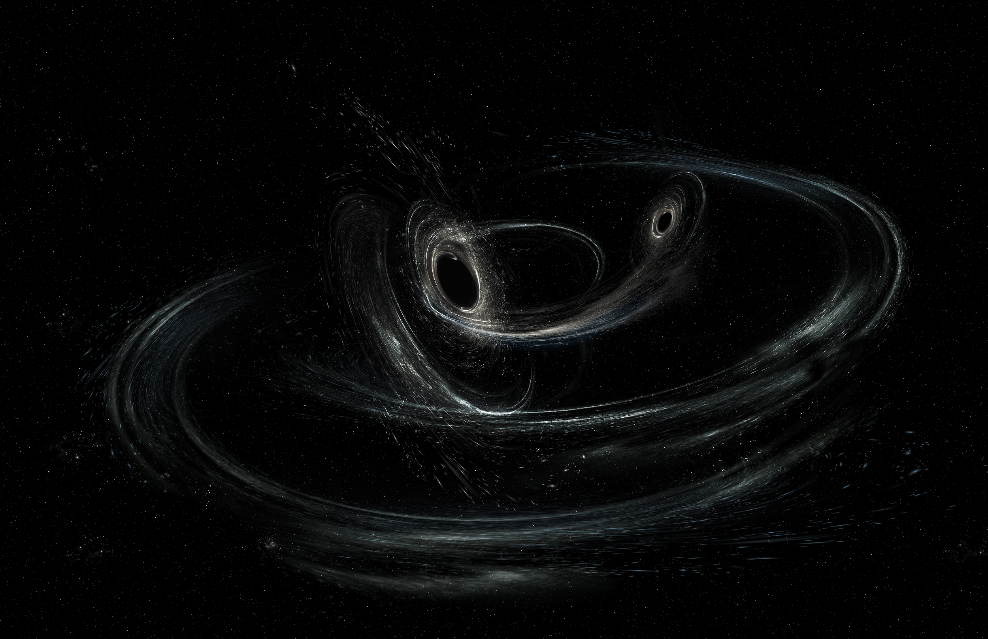
Precision tests will be enabled by black hole mergers like those seen now (~30 solar mass, at z ~ 0.3), which will have an SNR ~ 1000 in CE.
Extreme Gravity
& Fundamental Physics
With thousands of BBH events per day, we will be able to cherry pick the most telling events (high spins, large kicks, edge-on, high ellipticity, etc.).

Slide 8
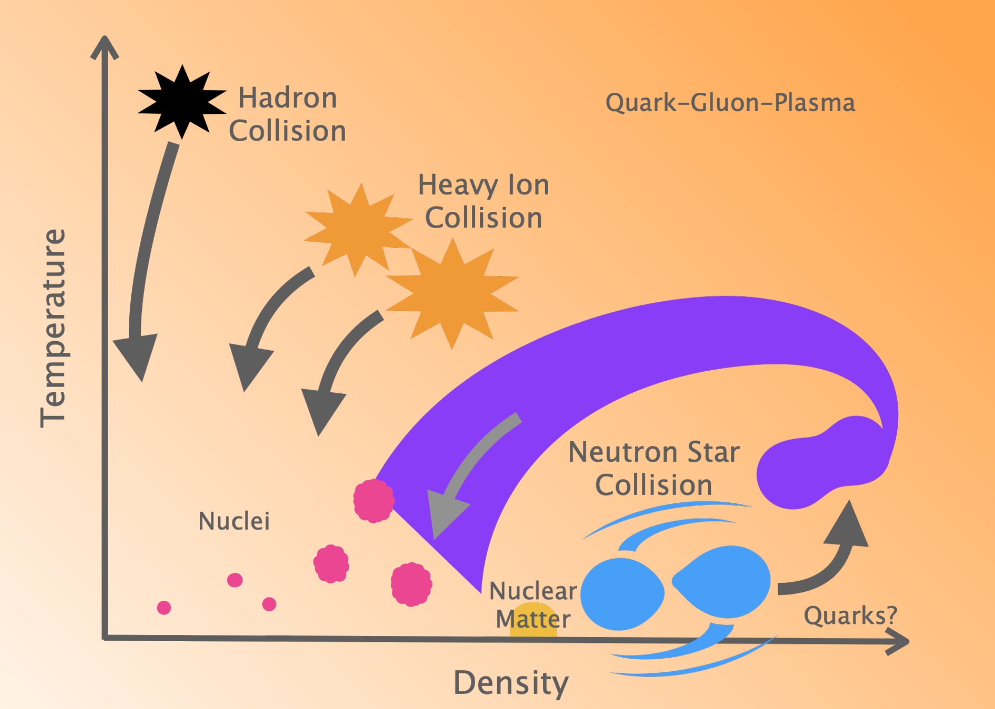
Dynamics of Dense Matter
& Extreme Environments

Slide 11
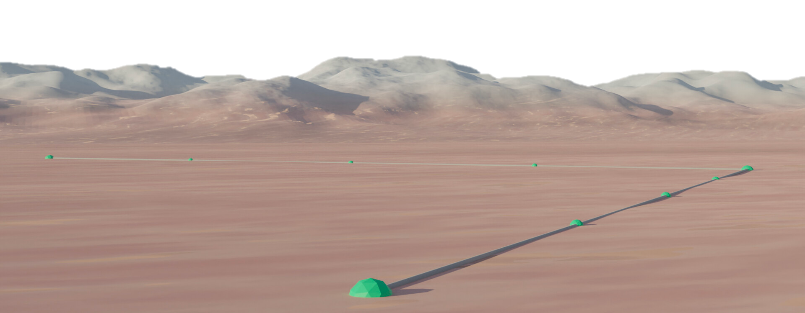
A Science-Driven Design for CE
In the Horizon Study we explore a variety of potential CE designs,
and address questions such as:
  Why is ground-based laser interferometry the best way
  to achieve our science goals?
  Why are we considering large L-shaped above-ground facilities?
  What are the advantages of 1 vs. 2 or more facilities?
The CE approach — seek to optimize detector length and design for maximum science while minimizing technical risk and complexity
We identify a combination of two observatories, one with 40 km long arms and the other with 20km long arms, as our “reference concept” for Cosmic Explorer.

Slide 12
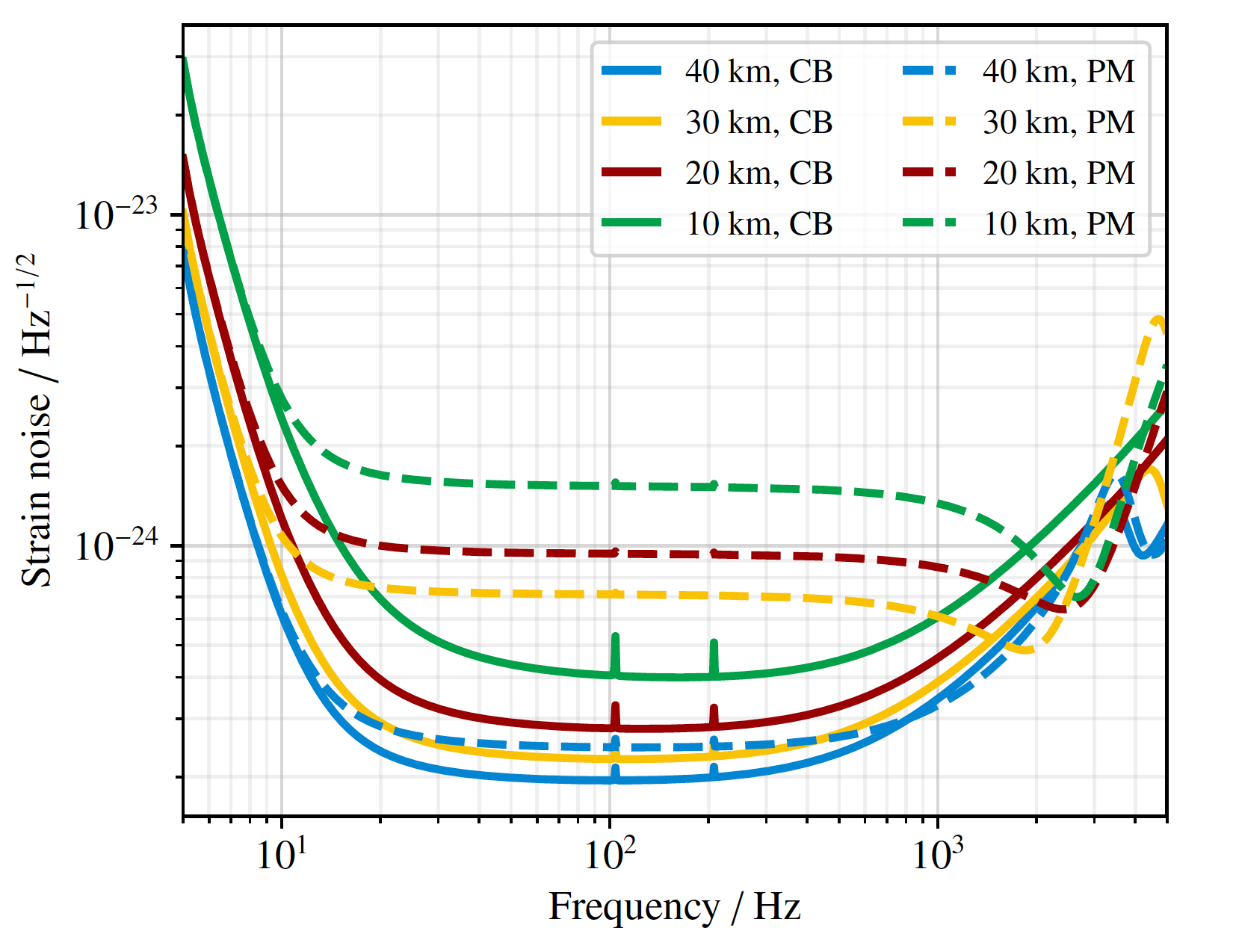
PM = post-merger optimized
CB = compact binary optimized
from CE Horizon Study
from CE Horizon Study

Slide 13
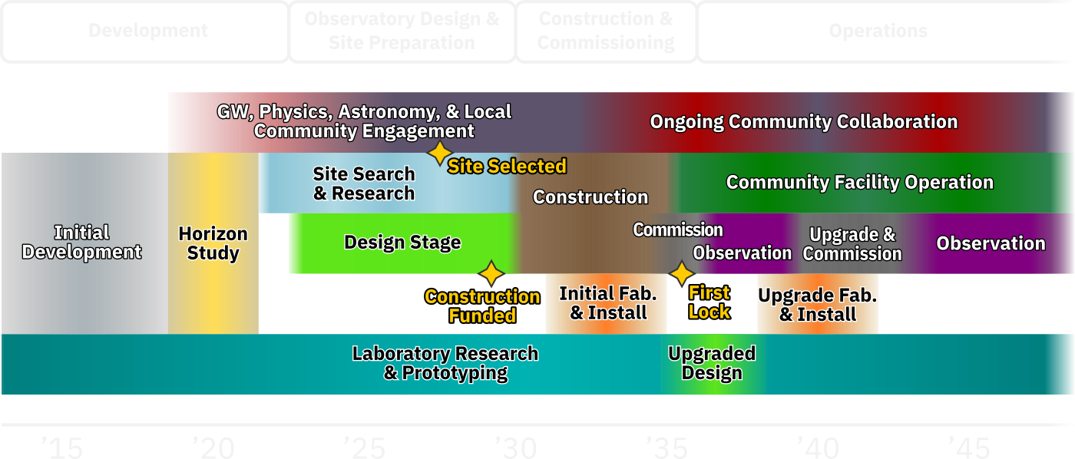
Cosmic Explorer Timeline

Slide 14
The Message
Next-Generation Observatories have great potential!
  Cosmic Explorer and ET are moving forward
  We are guided by researchers like you!
Your input and involvement is important to CE:
  CE Horizon Study available at cosmicexplorer.org
    cosmicexplorer.org/horizon-study-feedback
  CE will be built by this community.
cosmicexplorer.org/consortium.html

Slide 15
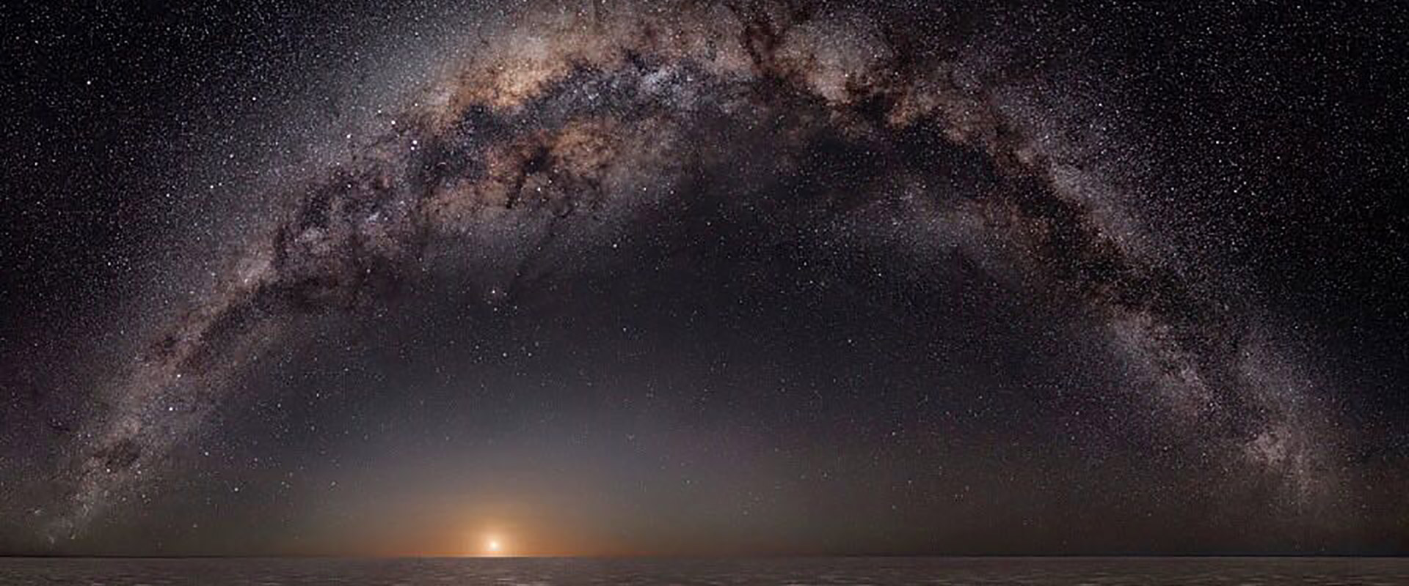
Extra material

Slide 16
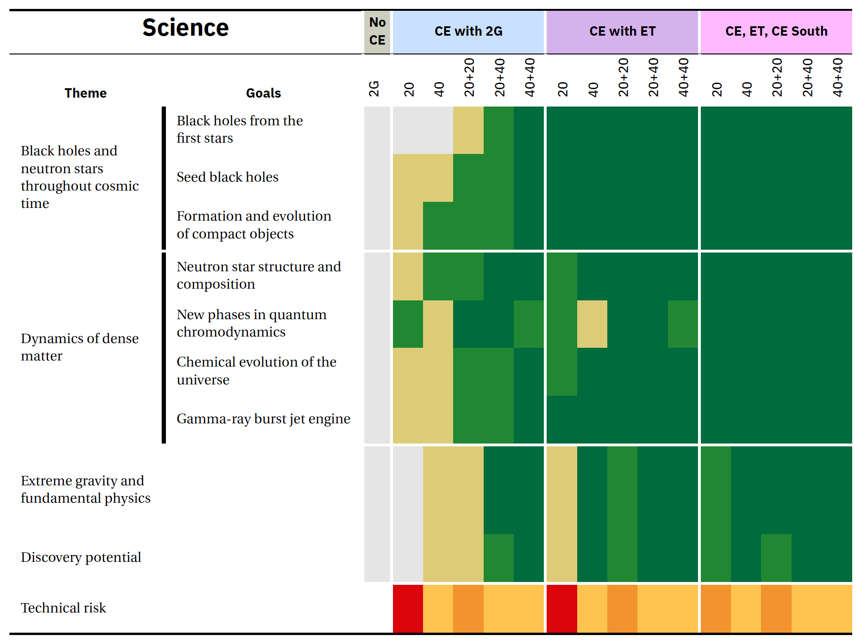
7) Optimizing Design Performance
A study of how design choices impact the key science goals,
in the context of a global network with ET and CE South

Slide 17
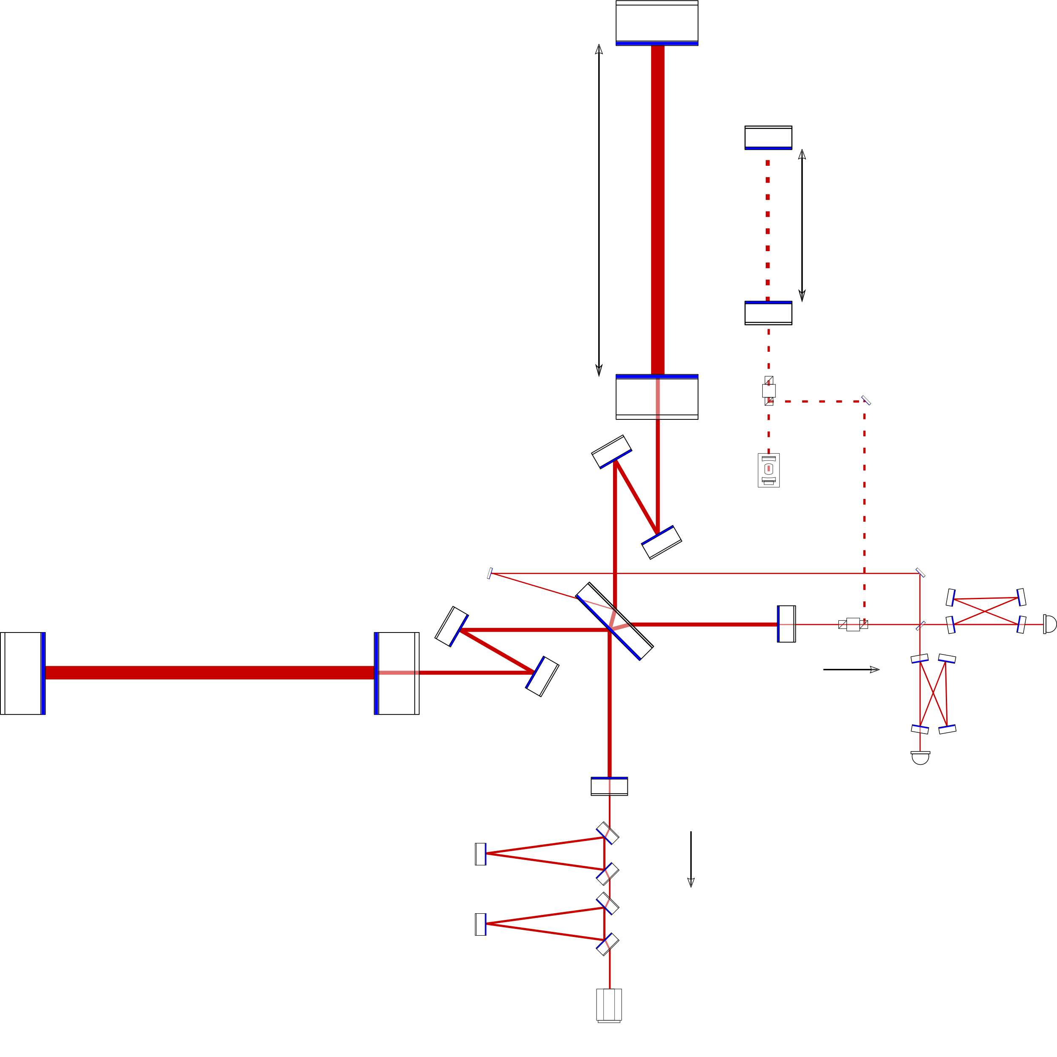
8) Technical Overview and Design Choices
This section provides a technical overview of the Cosmic Explorer Observatory including
  technical siting considerations (seismicity, infrasound, etc.)
  required infrastructure
  vacuum system requirements and design
It also outlines the key technologies that will require R&D
to enable the CE science goals.
Finally, other key considerations including
  Choice of site (esp. local stakeholders, environmental impacts,
  natural hazards, surrounding infrastructure)
  Cost vs. Arm length – not a linear scaling
  Beamtube material and diameter

Slide 18
9) Data Management, Analysis, and Computing
Here we present a vision for providing CE data to the scientific community
Describe plans for Open Data and dissemination of
  Production of clean, calibrated data set for science community
  Dissemination of alerts for multi-messenger science
Estimate the computing and human resources
needed to deliver these goals
Discuss needs for operations analysis and computing
Discuss areas where support is needed for
community's analysis and computing

Slide 19
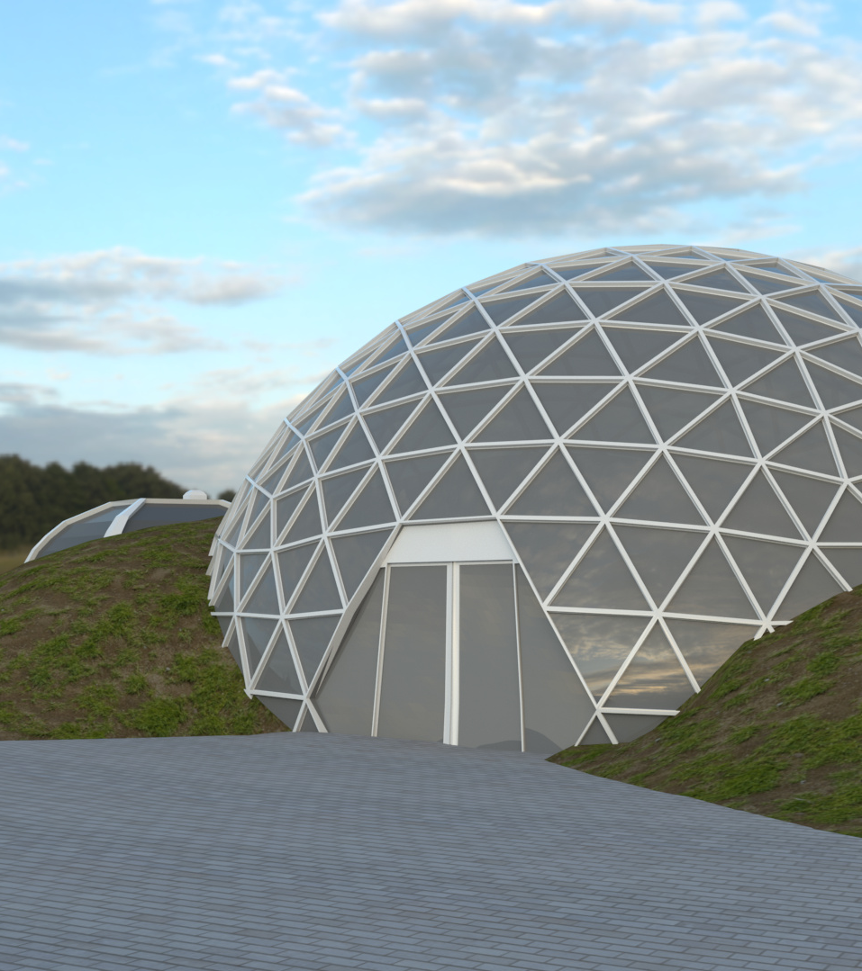
10) Cosmic Explorer at the Local and Global Scales
The Cosmic Explorer project will develop observatory designs with a multi-dimensional approach that creates synergy with its respective local, scientific, and global communities. This includes designing the physical and virtual infrastructure to serve Cosmic Explorer’s broad community integration and engagement goals, and developing interpersonal relationships among members of these communities. Early and ongoing engagement with communities connected with Cosmic Explorer, from local to global, will be crucial to the project’s success.

Slide 20
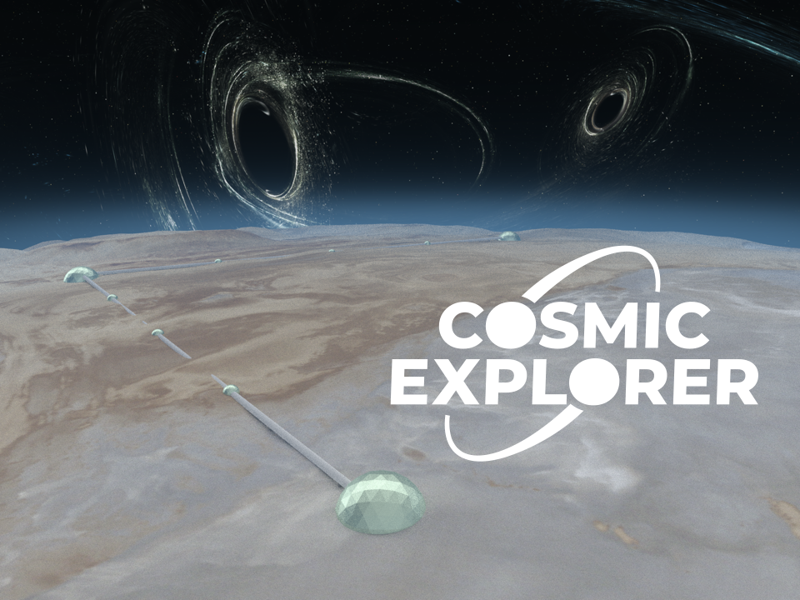
CE: 40 and 20km L, surface, 1 interferometer per observatory

