Slide 1
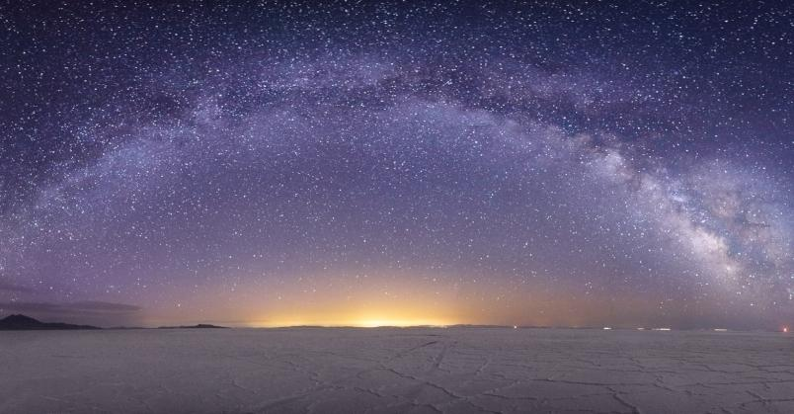


Cosmic Explorer
Horizon Study
Matthew Evans, on behalf of the Cosmic Explorer Team

Slide 2
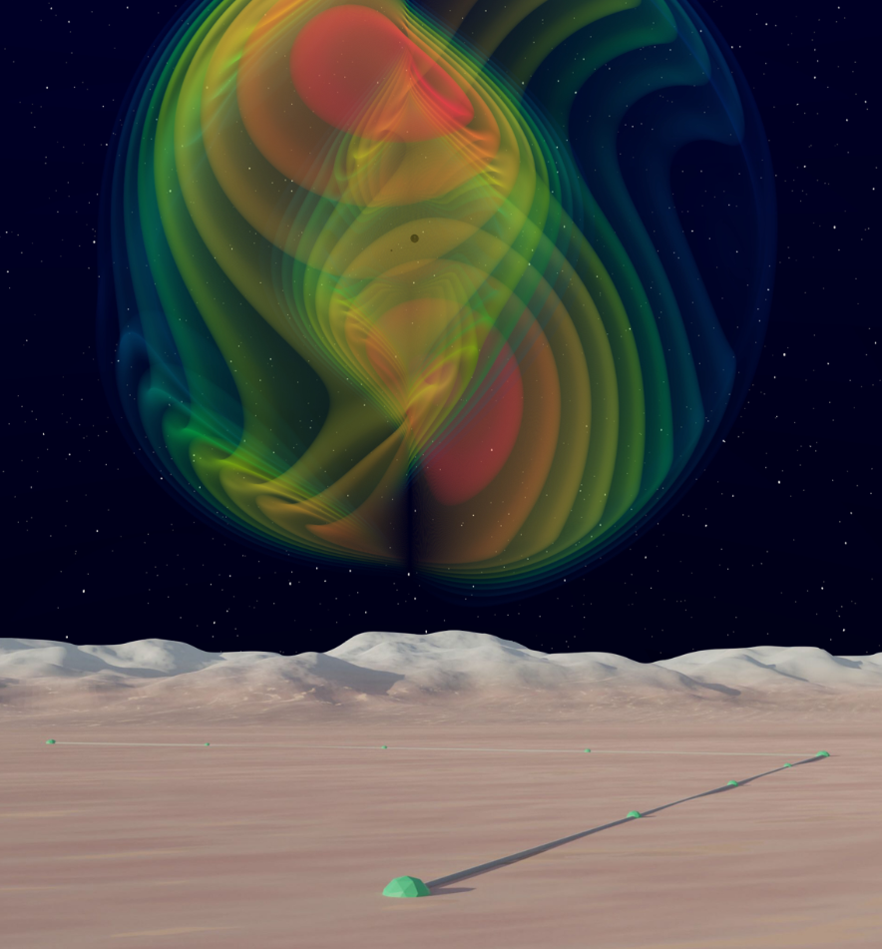
A Horizon Study for
Cosmic Explorer
Science, Observatories, and Community

Slide 3
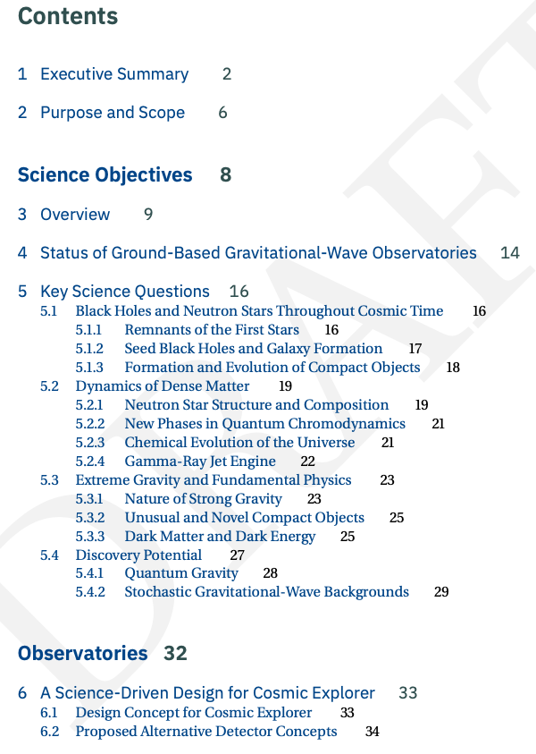
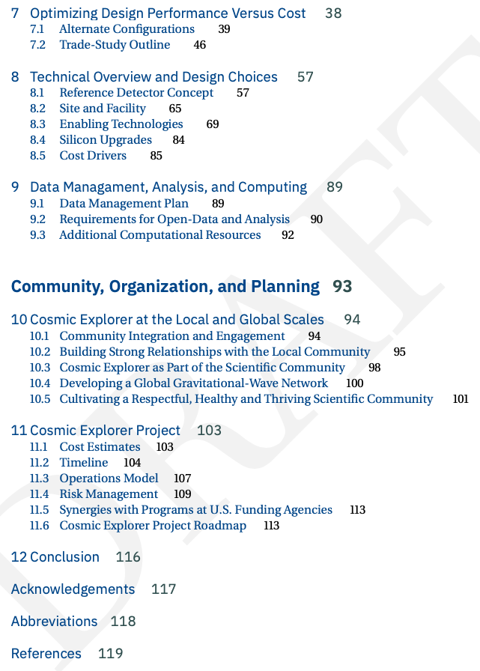
CEHS: the current draft

Slide 4
Timeline for finishing the CE Horizon Study
June 9: Draft ready for wide circulation (to CE Consortium, LVK, Astro/DGrav/DOE communities, others)
July 15-30: Incorporate input in final round of editing
Aug 1: Deliver polished draft to NSF
October 5-7: Present at DAWN meeting for community for input and endorsement

Slide 5
2) Purpose and Scope
The CE Horizon Study includes
  A vision of the science enabled by CE
  A reference design for the CE instrument and its evolution
  An analysis of design options and their impact on the scientific output of CE
  A parametric cost estimate for CE construction
It is intended to inform the scientific community, and the agencies which fund that community, with the goal of providing a foundation for further development of CE in those communities while spurring action toward CE’s construction.

Slide 6
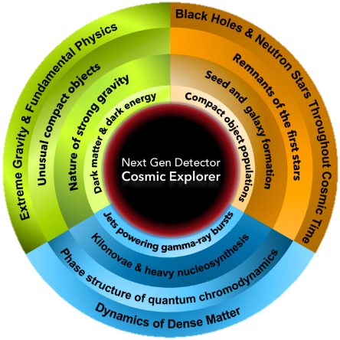
5) Key Science Questions
3 main categories of science goals
Discussed in terms of what CE can do as a function number of observatories and global GW network

Slide 7
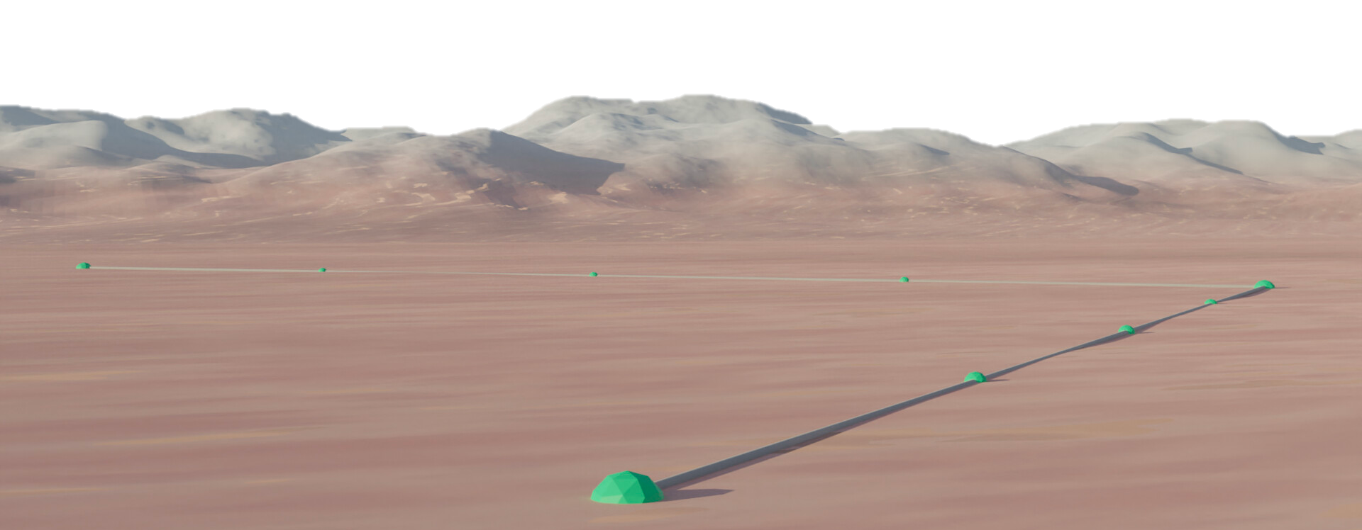
6) A Science-Driven Design for CE
This section provides a high-level discussion of the design concept for CE
  Why is ground-based laser interferometry the best way
  to achieve our science goals?
  Why are we considering large L-shaped above-ground facilities?
    What are the fundamental drivers behind arm length?
    What are the advantages of 1 vs. 2 or more facilities?

Slide 8
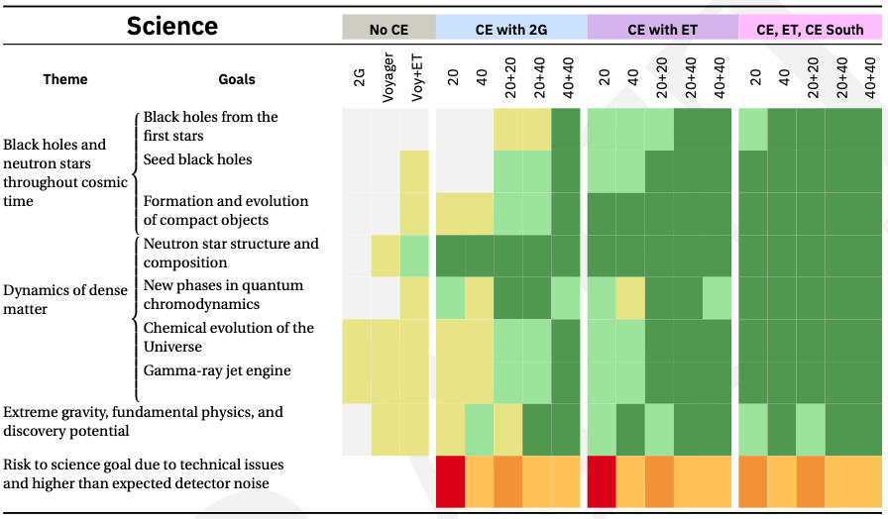
7) Optimizing Design Performance
A study of how design choices impact the key science goals,
in the context of a global network with ET and CE South

Slide 9
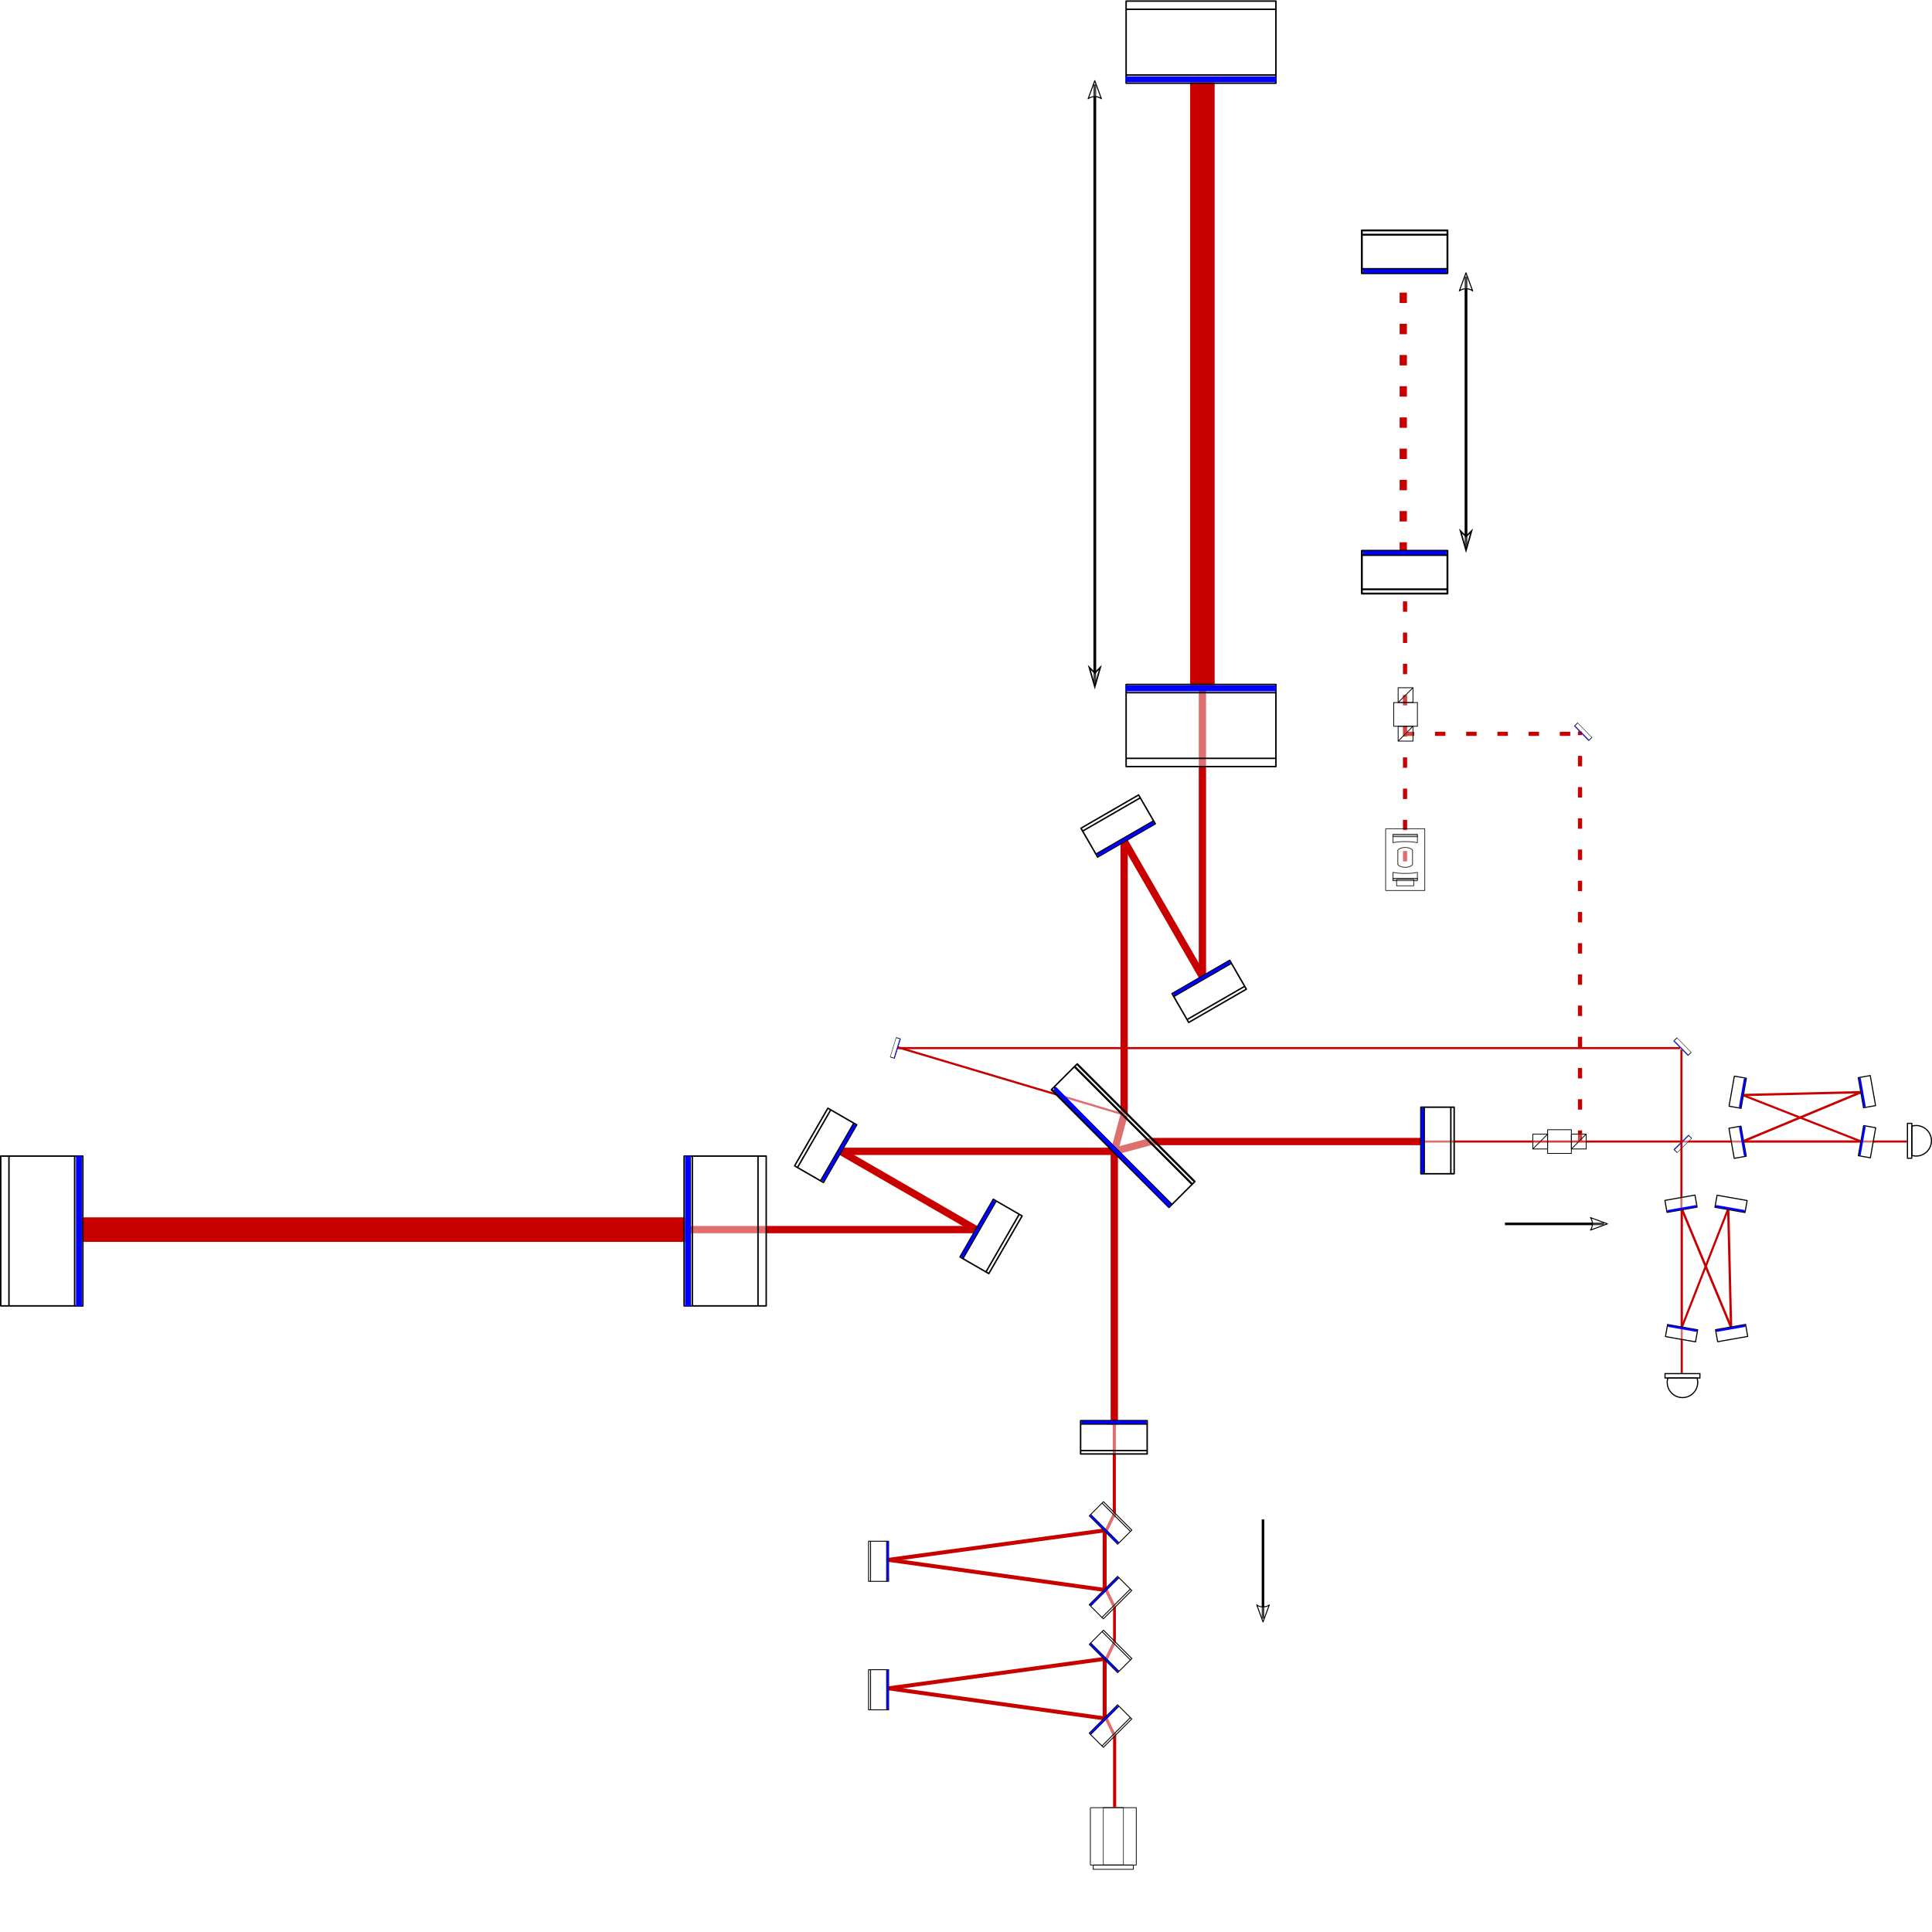
8) Technical Overview and Design Choices
This section provides a technical overview of the Cosmic Explorer Observatory including
  technical siting considerations (seismicity, infrasound, etc.)
  required infrastructure
  vacuum system requirements and design
It also outlines the key technologies that will require R&D
to enable the CE science goals.
Finally, other key considerations including
  Choice of site (esp. local stakeholders, environmental impacts,
  natural hazards, surrounding infrastructure)
  Cost vs. Arm length – not a linear scaling
  Beamtube material and diameter

Slide 10
9) Data Management, Analysis, and Computing
Here we present a vision for providing CE data to the scientific community
Describe plans for Open Data and dissemination of
  Production of clean, calibrated data set for science community
  Dissemination of alerts for multi-messenger science
Estimate the computing and human resources
needed to deliver these goals
Discuss needs for operations analysis and computing
Discuss areas where support is needed for
community's analysis and computing

Slide 11
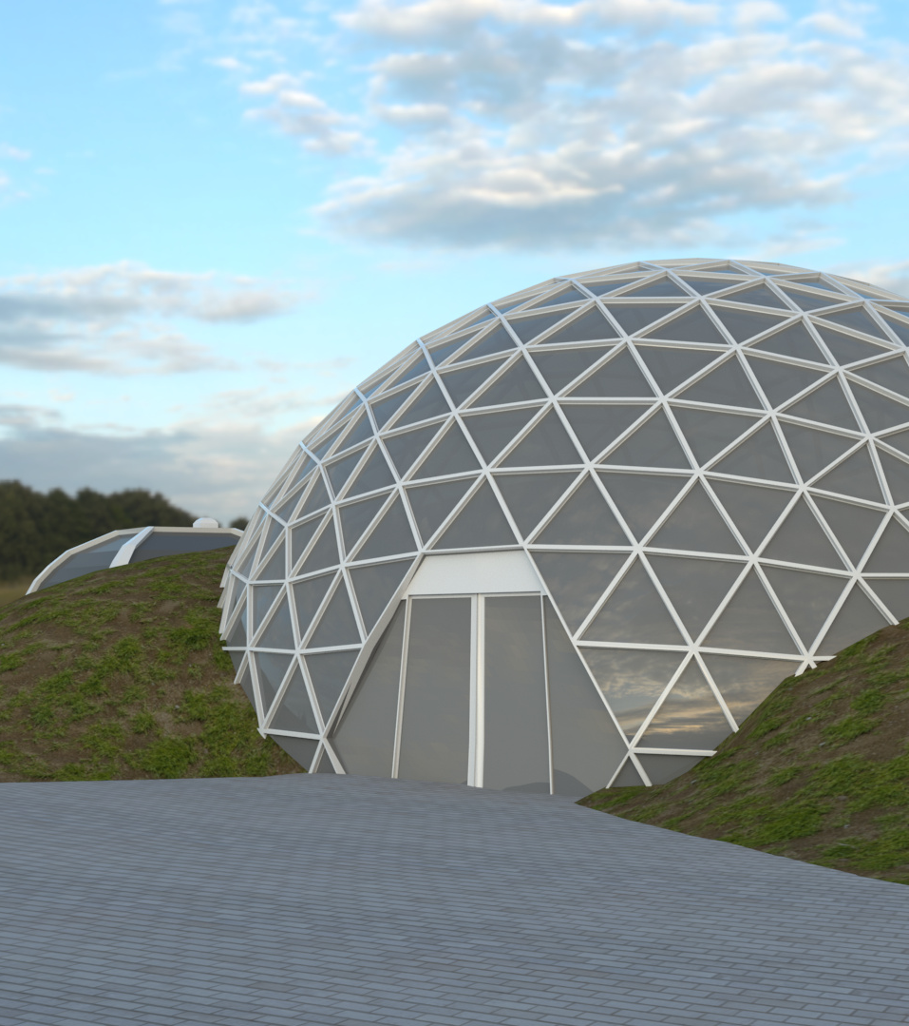
10) Cosmic Explorer at the Local and Global Scales
The Cosmic Explorer project will develop observatory designs with a multi-dimensional approach that creates synergy with its respective local, scientific, and global communities. This includes designing the physical and virtual infrastructure to serve Cosmic Explorer’s broad community integration and engagement goals, and developing interpersonal relationships among members of these communities. Early and ongoing engagement with communities connected with Cosmic Explorer, from local to global, will be crucial to the project’s success.

Slide 12
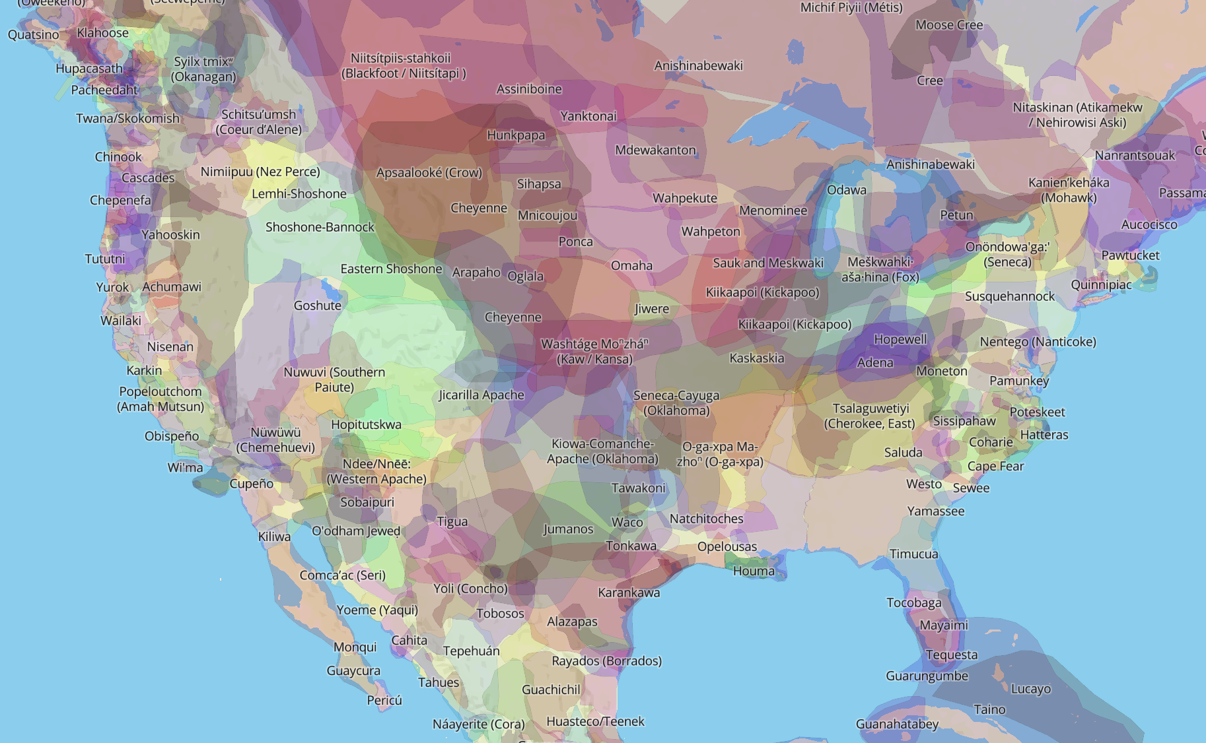
No matter where we build Cosmic Explorer, the history of the land will play a pivotal role in this project. We will have the opportunity, and obligation, to work with Indigenous Peoples to build synergistic relationships and to ensure that we respect their land, their culture and their sovereignty.
http://native-land.ca/
If you are not aware of issues surrounding TMT, please read arXiv:2001.00970 .

Slide 13
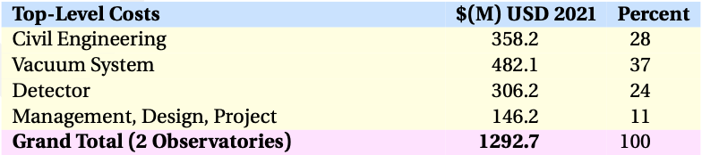
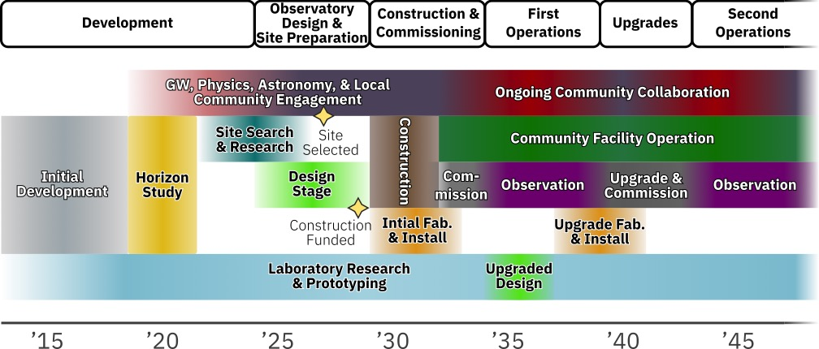
11) Cosmic Explorer Project
Project Organization
Project Planning
Cost and Schedule
Risk Management

Slide 14
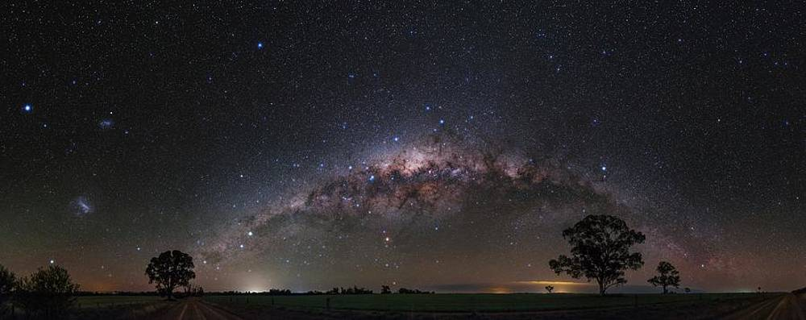
The Message
Over the next few months, we (i.e. including you!) will be
  setting the stage for future GW observatories in the US
  delivering the CE Horizon Study to the NSF
  following through by expanding the CE support base
We need you to be involved!
  google form for feed-back: tinyurl.com/CEHSform
  CE will be built by this community.
cosmicexplorer.org/consortium.html

Slide 15
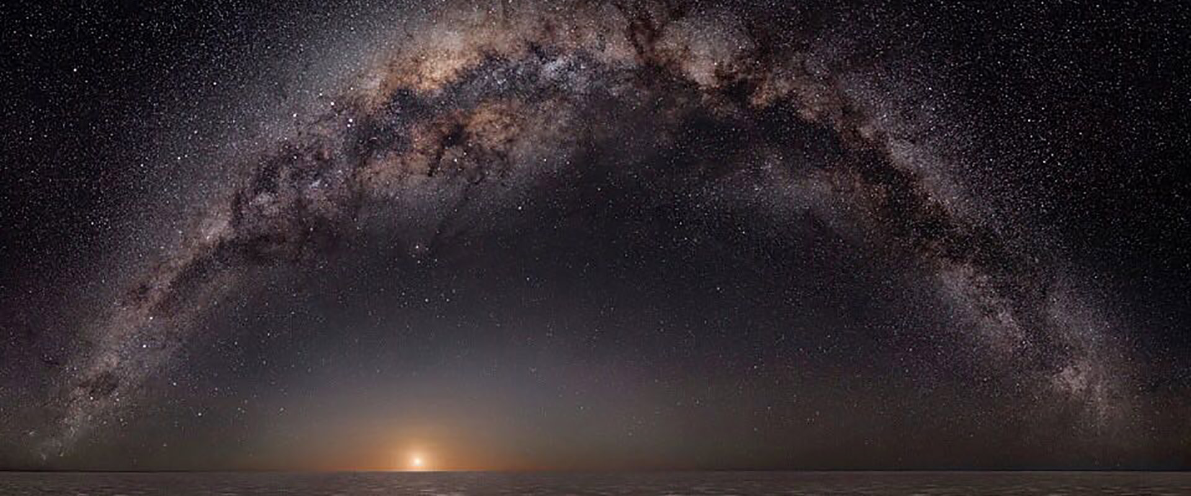
Extra material

Slide 17
Black Holes & Neutron Stars Throughout Cosmic Time
CE-G2000035 - Evan Hall

Slide 18
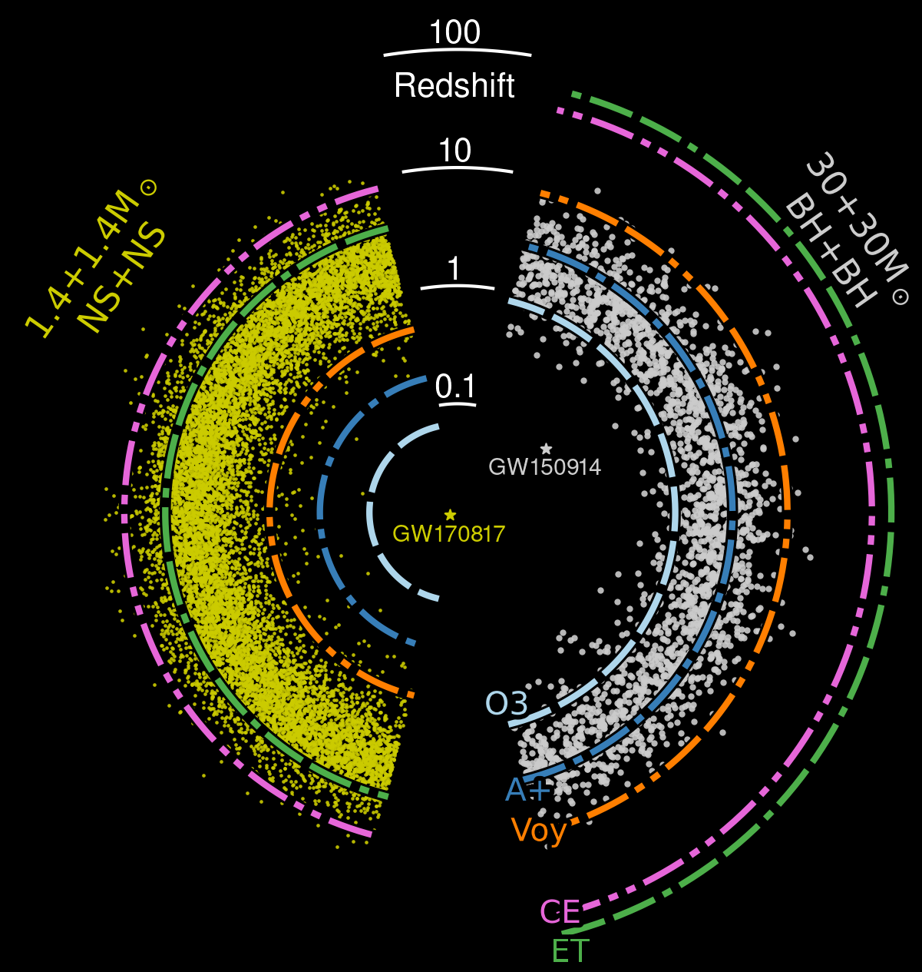
Black Holes & Neutron Stars Throughout Cosmic Time
CE-G2000037 - Evan Hall

Slide 19
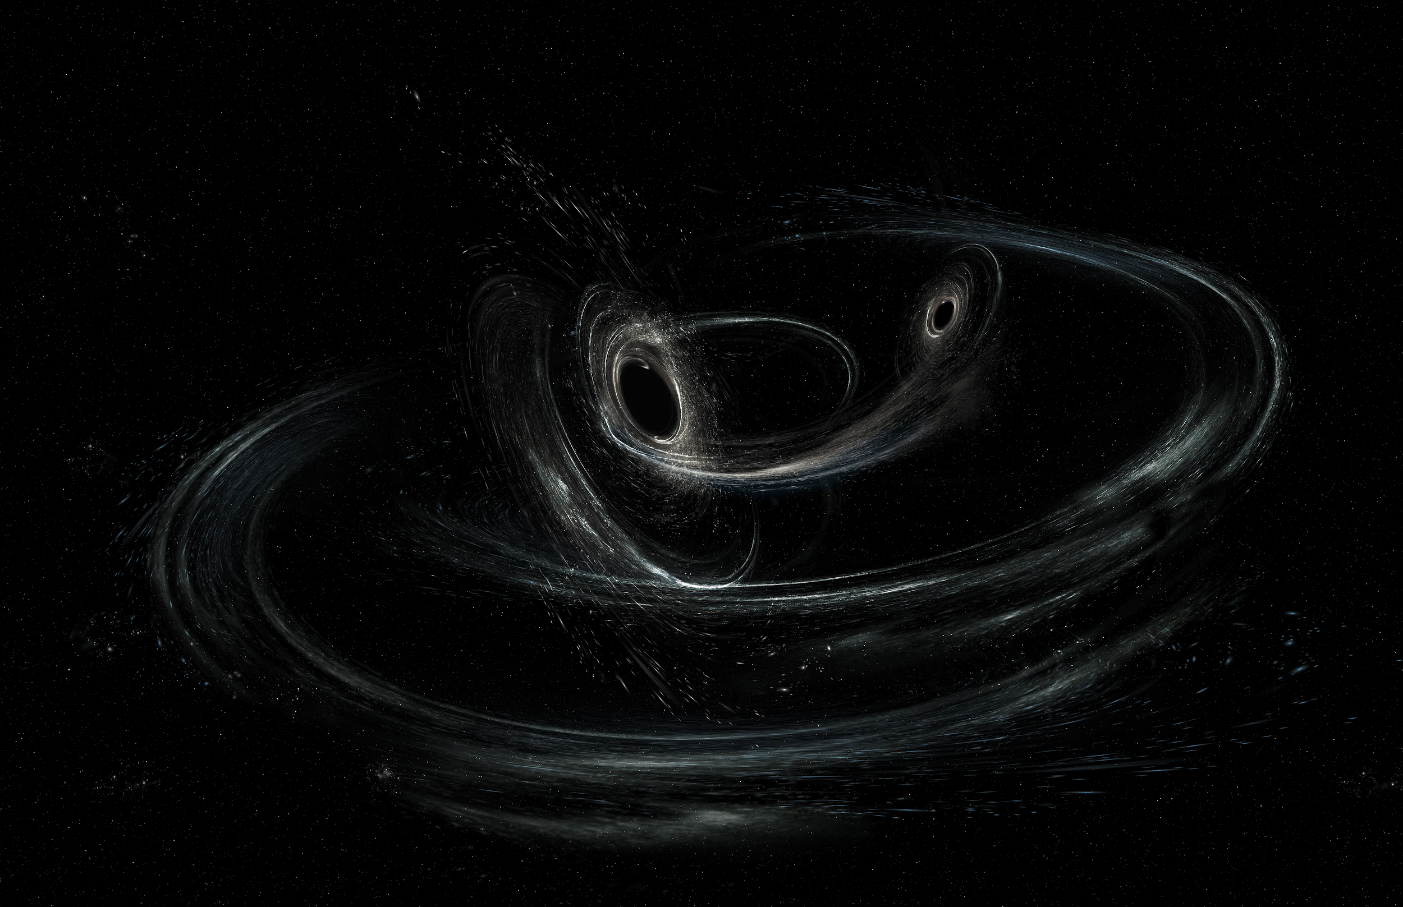
Precision tests will be enabled by black hole mergers like those seen now (~30 solar mass, at z ~ 0.3), which will have an SNR ~ 1000 in CE.
Extreme Gravity
& Fundamental Physics
With thousands of BBH events per day, we will be able to cherry pick the most telling events (high spins, large kicks, edge-on, high ellipticity, etc.).

Slide 20
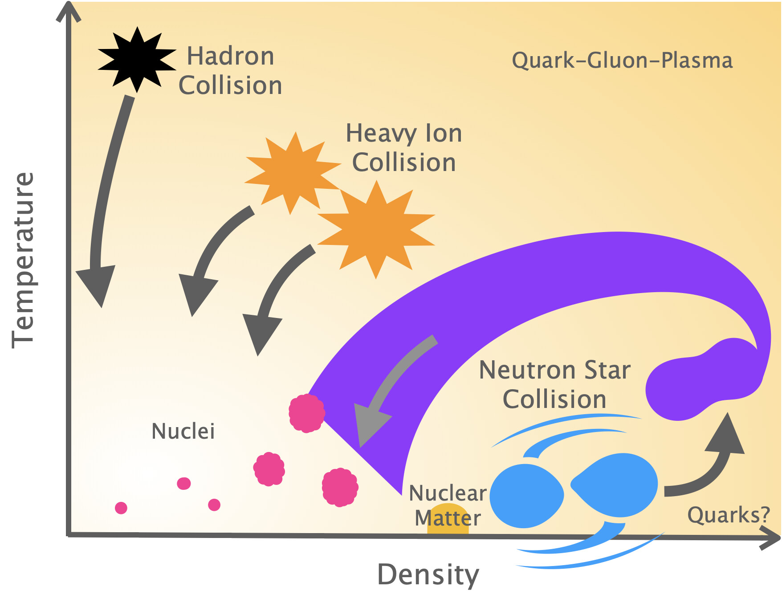
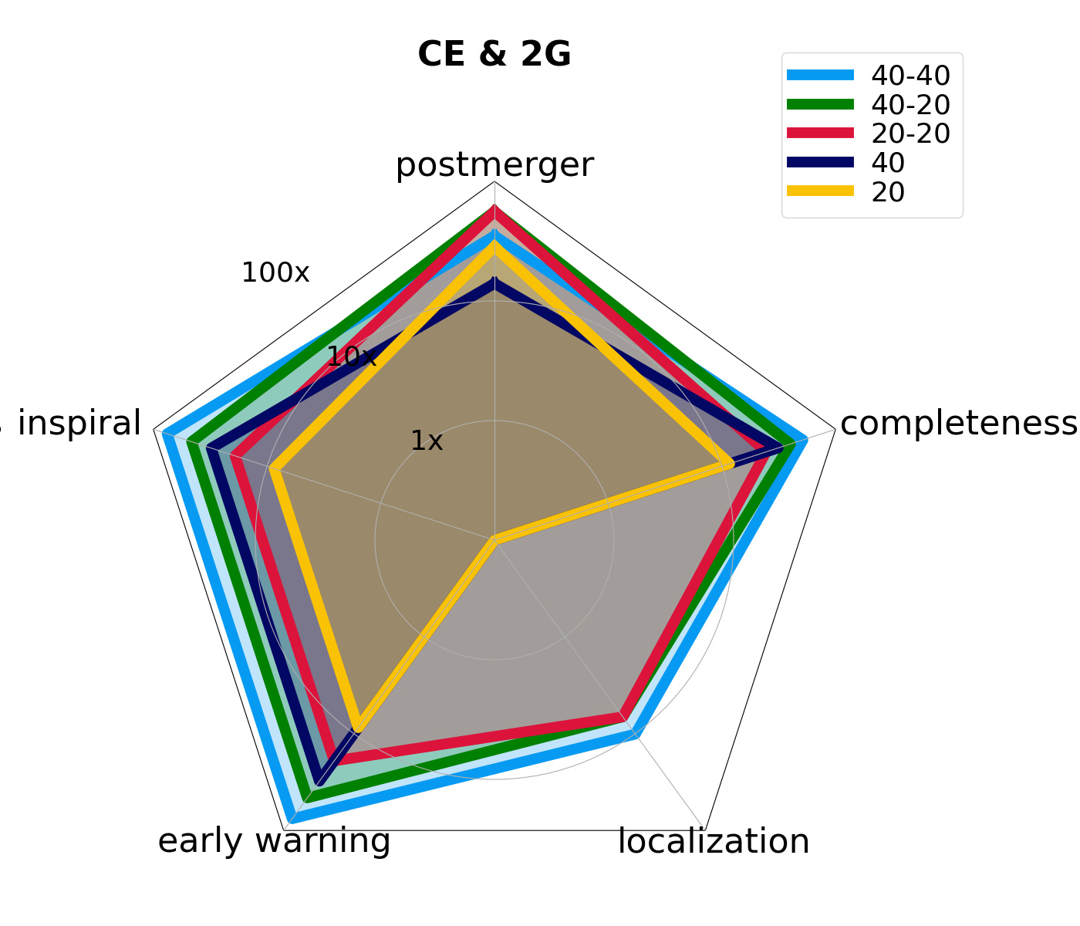
Dynamics of Dense Matter
& Extreme Environments

Slide 21
Cosmic Explorer Update
Incremental improvements on current technology maybe another path to the target CE sensitivity (formerly CE2)
Extreme Gravity
& Fundamental Physics
Black Holes & Neutron Stars Throughout Cosmic Time
arXiv:2012.03608

Slide 23
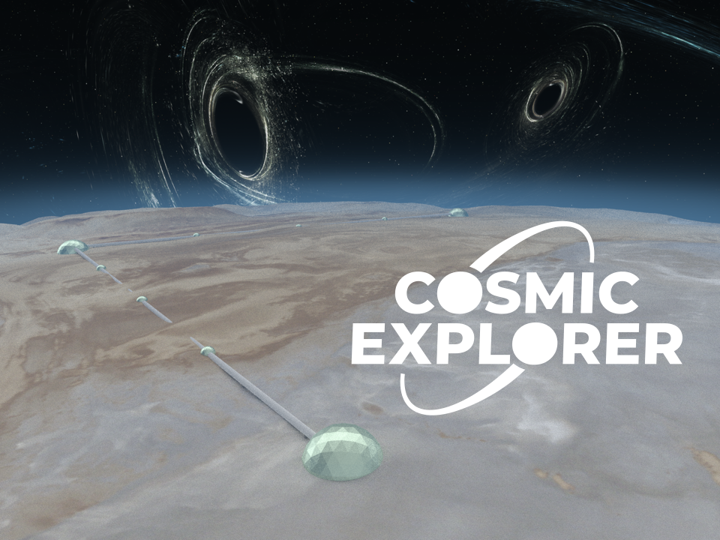
CE: 40 and 20km L, surface, 1 interferometer per observatory

