Slide 1


Astrophysics with the next generation of ground-based gravitational-wave detectors
Salvatore Vitale
MIT
April APS 2018

Slide 2
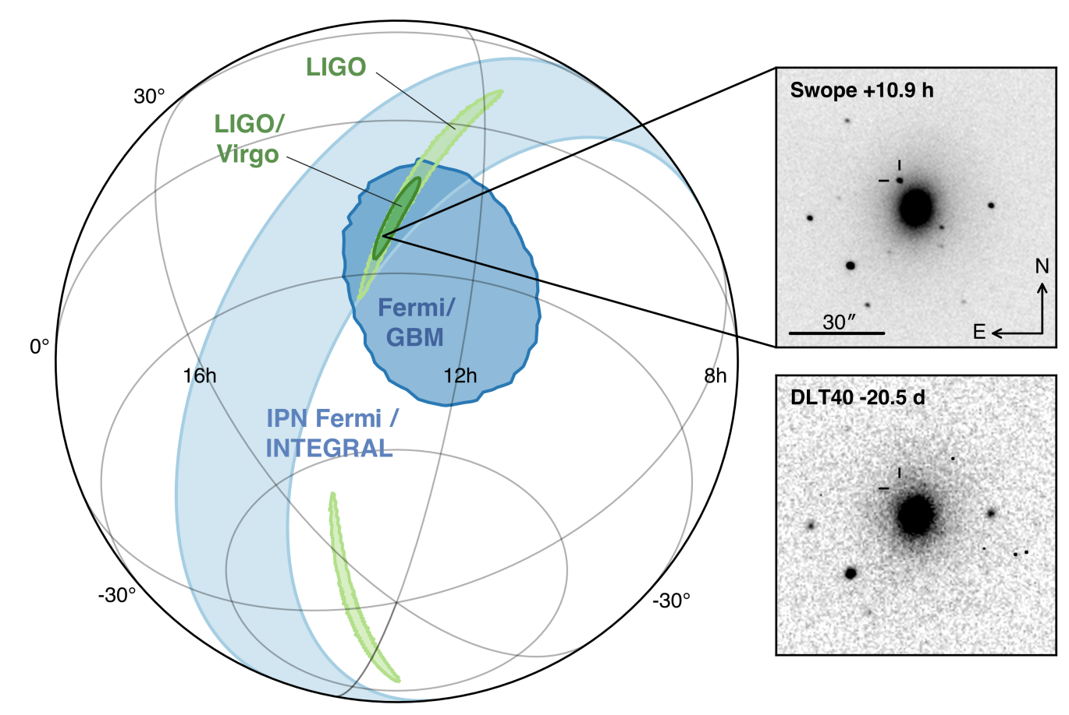
Where are we?
Advanced detectors (second generation, 2G) have detected 6 binary black holes (BBH)
  Component masses measured at few x 10% level
  Spins very hard to measure
  Oriented face-on/off
  Up to redshift of ~0.2
  See LVC, PRL 118 221101, PRX 6 041015, https://www.ligo.org/detections.php
And one binary neutron star (BNS), LVC PRL 119, 161101
  First GW bounds on the equation of state (EOS) of nuclear matter
  Joint EM-GW detection
LVC and friends, ApJL, 848:L12, 2017

Slide 3

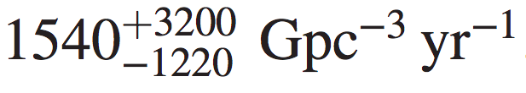
Where are we?
We have estimated the merger rate of BBH and BNS to be in the range
Will advance the exploration of extremes of astrophysics and gravity
solve open questions in fundamental physics and astronomy
provide insights into most powerful events in the Universe
boost the impact of multi-messenger astronomy
likely to reveal new objects and phenomena
LVC, PRL 118 221101
LVC, PRL 119 161101

Slide 4
Where are we?
You are here!

Slide 5
Where do we go from here?
With 2G at design, we’ll go up to z ~ 1 for BBH and ~0.1 for BNS
If we want to detect sources at high redshift, we need something else
Proposed third—generation (3G) ground based detectors will
  Be a factor of ~>10 more sensitive that 2G-design
  Detect BBH from redshifts >10
  Detect a lot of sources, with very large signal-to-noise ratio (SNR)

Slide 6
A science case for next-generation detectors
LIGO and Virgo both have facility-imposed limits on sensitivity
  a compelling case to build detectors that can observe deeper into cosmos
to fully exploit the GW window we will require new facilities
Gravitational Wave International Committee (GWIC) formed a subcommittee to develop a vision for the next generation of ground-based detectors
one of the charges to the GWIC subcommittee is:
  “commission a study of ground-based gravitational wave science from the global scientific community, investigating potential science vs. architecture vs. network configuration vs. cost trade-offs, …”
  GWIC subcommittee has constituted five 3G subcommittees:
    (1) Science Case Team (3G-SCT), (2) R&D Coordination, (3) Governance, (4) Agency Interfacing, (5) Community Networking
Science Case will be developed by an international consortium of scientists under the leadership of the 3G-SCT (18 members)

Slide 7
Science Case: Goals, Timeline
develop a robust science case unique to GW observations for the next generation of ground-based detectors
  help with position papers for national and international studies and surveys
    APPEC and ESFRI roadmaps in Europe, US decadal survey, …
science case document to be delivered by Dec. 2018
  study supported by eight working groups
  ~ 150 researchers from around the world have joined the 3G-SCT consortium

Slide 8
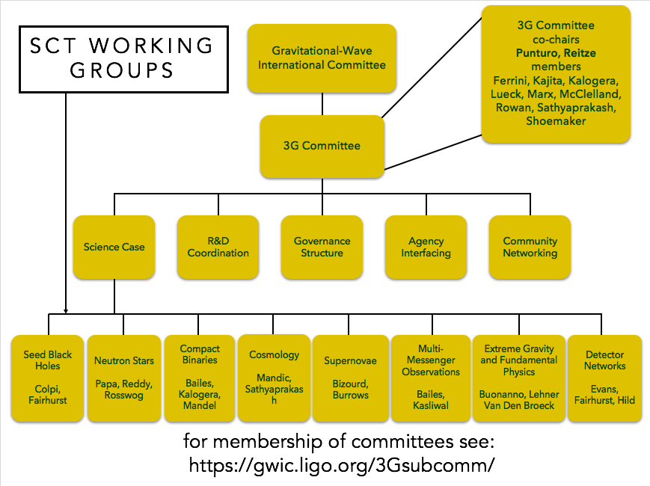
Interested in contributing? Email Vicky Kalogera and Bangalore Sathyaprakash!

Slide 9
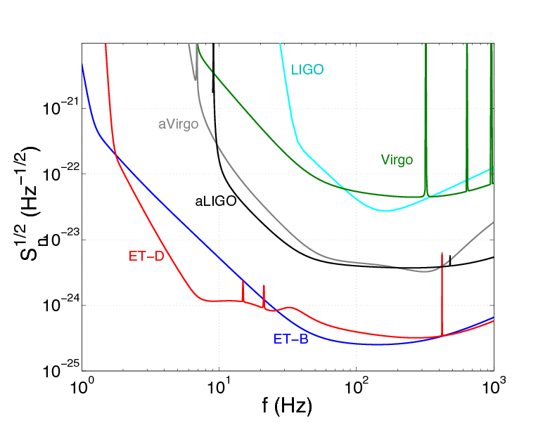
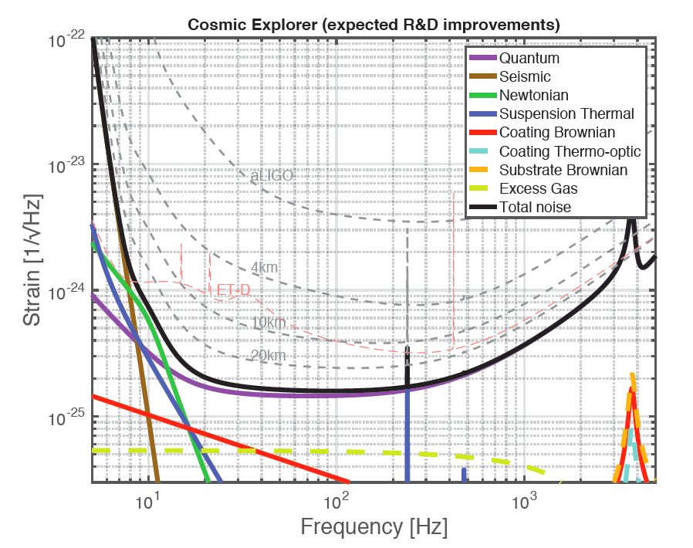
Proposed 3G detectors
Einstein Telescope
  10 Km long arms
  Triangular shape
  Underground
  Sensitivity down to few Hz
Cosmic Explorer
  40 Km long arms
  L shaped
  Over ground
  Sensitivity down to ~8Hz
Regimbau+, PRD 86 122001
LVC, 1607.08697

Slide 10
Where do we go from here?
Reionization
You are here!
Peak of merger rate from Gclobular clusters
Peak of SFR
Primordial BHs?
aLIGO
BHs from POPIII stars merge?

Slide 11
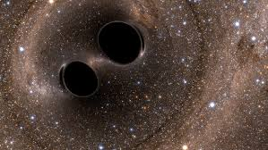
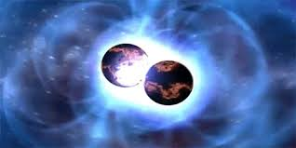
Where do we go from here?
credit E. Hall, J. Miller

Slide 12
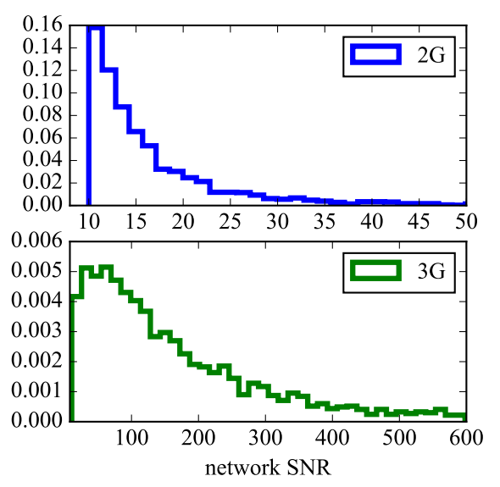
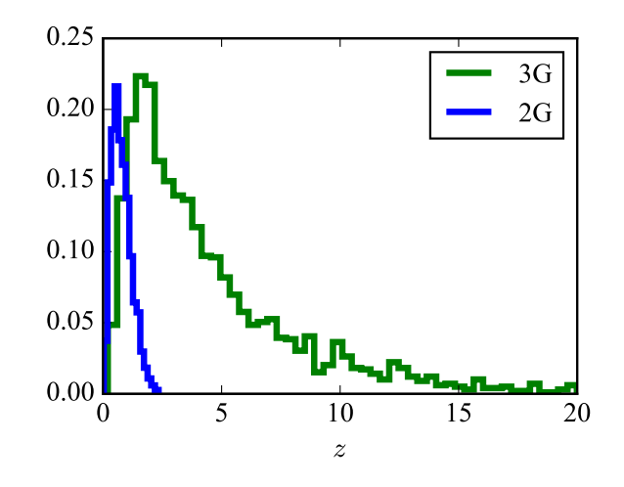
Loud and clear
BBH detected by 3G detectors will typically be loud
Most events from redshift of a few
BBH with component masses in range [6,100]M
Vitale, PRD(R) 94 121501

Slide 13
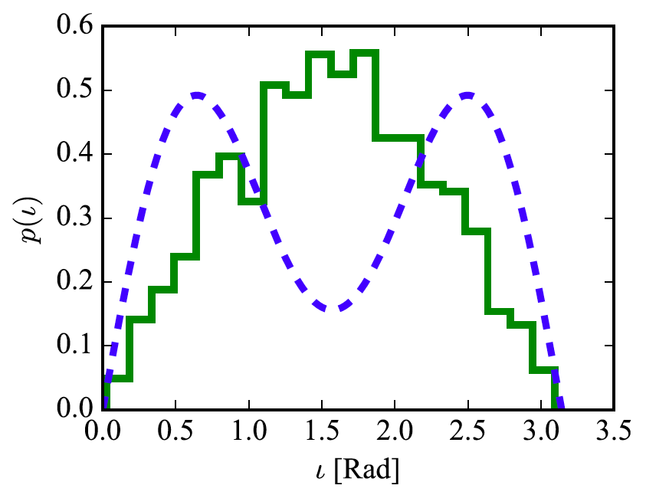
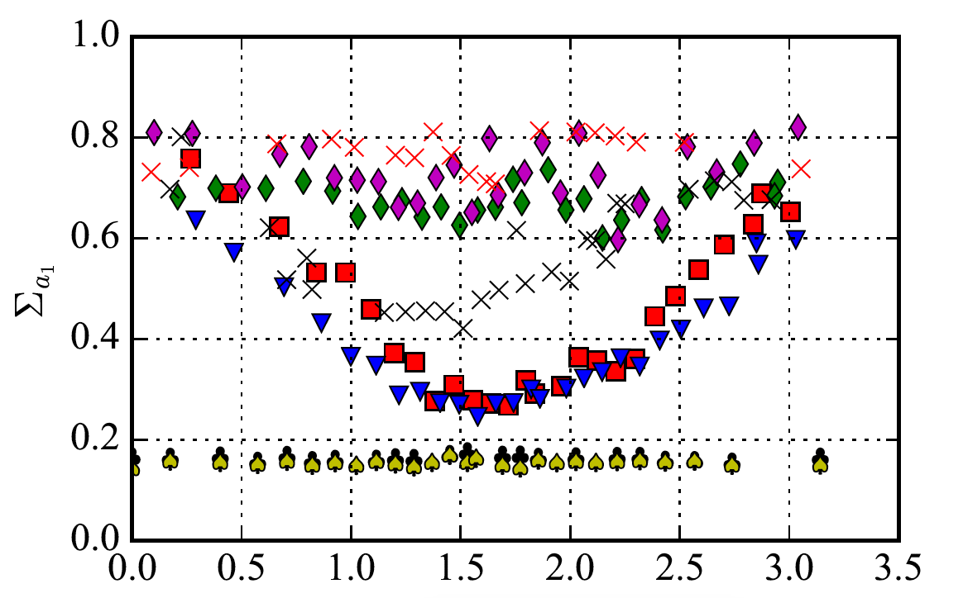
… and well oriented
Their inclination angle distribution will be
isotropic
  Better ringdown tests, memory effect, spin precession, distance estimation
Vitale, PRD(R) 94 121501
Vitale+, PRL 112 251101, PRD 95 064053

Slide 14
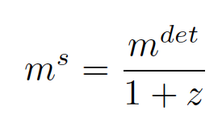
Why a network?
For advanced detectors
  Sky localization, distance estimation
  Glitch rejection
  Increase network duty cycle
For more sensitive detectors
  All of the abovementioned
  Mass estimation!! (Through luminosity distance and cosmology)

Slide 15
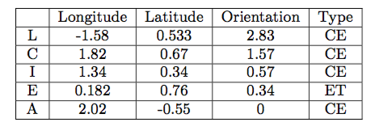
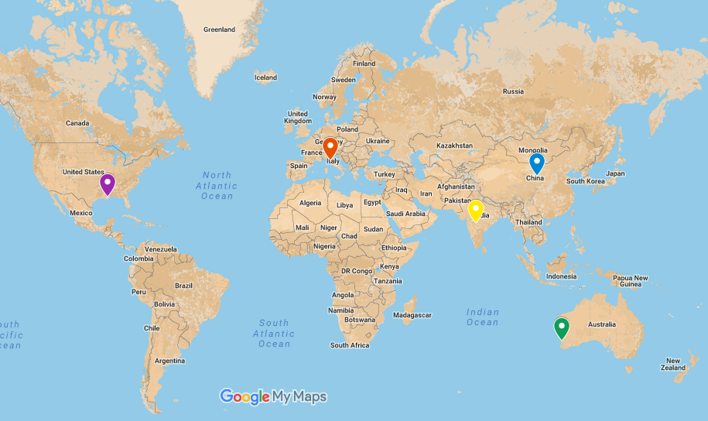
Locations
Vitale & Evans, PRD 95 064052

Slide 16
BBH Extrinsic parameters
Precise distance and sky position:
  EM (if luminous), isotropy, cosmology
Sky location
Luminosity Distance
Vitale & Evans, PRD 95 064052

Slide 17
BBH Extrinsic parameters
Precise distance and sky position:
  EM (if luminous), isotropy, cosmology
Even with 2 detectors, many sources localized better than 1deg2
Sky location
Luminosity Distance
Vitale & Evans, PRD 95 064052

Slide 18
BBH Source frame masses
Especially at large redshifts, having more than 2 sites is important to measure component masses
Uncertainties of [few-10]% for z<3
Factor 1.5-2 better with 4 IFOs w.r.t. 2 IFOs
Vitale & Evans, PRD 95 064052

Slide 19
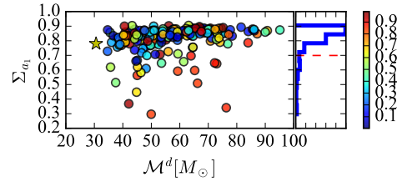
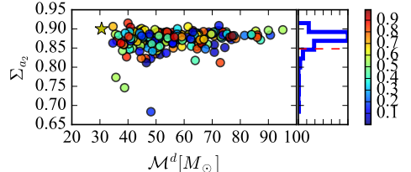
BBH Spins
Due to larger SNR and isotropic orbital orientation, 3G will get much better spin estimation than 2G
2G
3G
Vitale+, PRD 95 064053
Vitale & Evans PRD 95 064052

Slide 20
BBH Formation channels
Many methods have been proposed to study the formation channels of BBH (and compact binaries in general)
  Shown to work for 2G – local universe (Vitale+, Farr+, Talbot+, Stevenson+,more)
With 3G:
  Study how the fraction of CBC from each channels evolve with redshift
  Accessing thousands of BBH per year we can study the explosion mechanism of SNe (O'Shaughnessy+, PRL 119 011101 shows what can be learned with GW151226 alone)

Slide 21
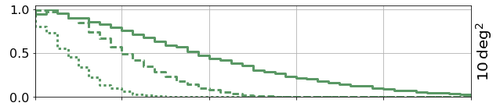
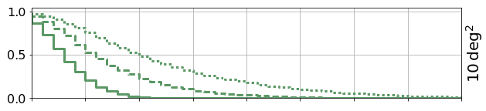
BNS Localization
Will detect BNS at large redshifts
A significant fraction of which can be localized to a few deg2
  H0, dark energy EOS (Sathyaprakash+ 0906.4151; Del Pozzo+ 1506.06590; many more)
Mills+ 1708.00806
3 ET
3 Vy
3 Vy -ET
Fraction of events
3 CE
3 ET
ET-2CE

Slide 22
Equation of state and postmerger
Advanced detectors will start measuring the equation of state of neutron stars
  Most likely from the inspiral phase
  With a bit of luck, hints of postmerger physics
3G detectors will easily measure the EOS from both inspiral and post-inspiral
BNS at 100Mpc
Adapted from Read+ PRD 88, 044042

Slide 23
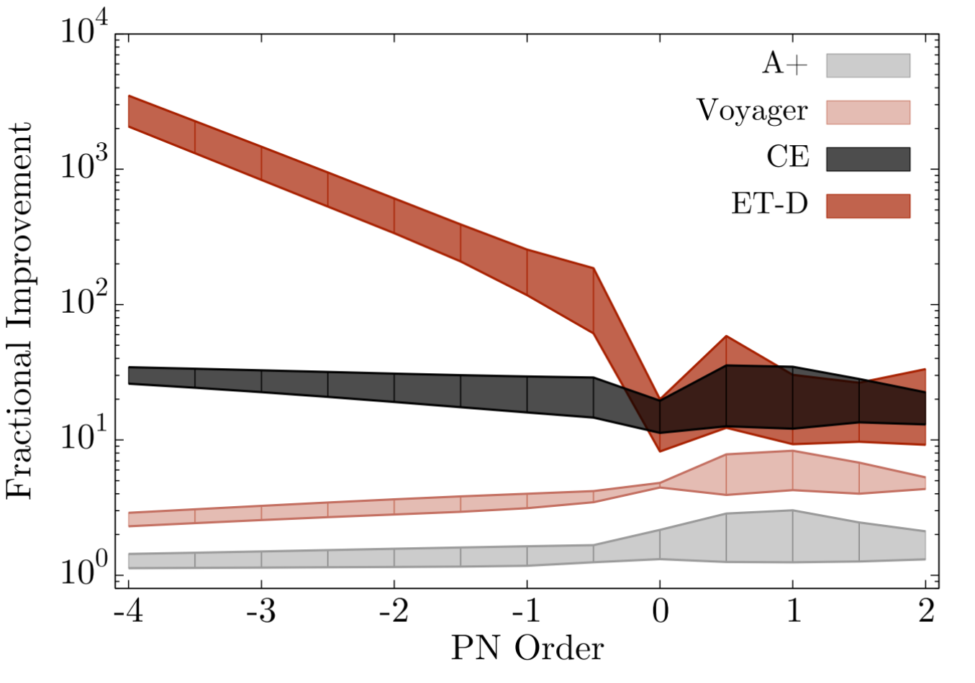
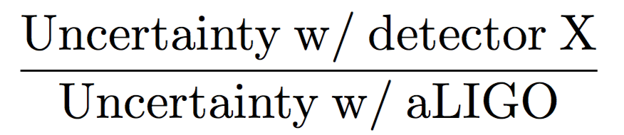
Tests of general relativity
Larger SNR and better low frequency will yield dramatic improvements
Also, precise ringdown tests, memory effect, propagation tests, more!
Chamberlain+, 1704.08268

Slide 24
How many events?
Using the rates calculated with O2 events and projecting…
3G detectors will detect
  ~ 10^5 BBH per year (Regimbau+, PRL 118, 151105)
  ~ 10^6 BNS per year (LVC, 1710.05837)

Slide 25
A few months worth of advanced detector time

Slide 26
1.5 hrs worth of 3G detections…

Slide 28
Merger rate density
We can calculate the BBH merger rate as a function of redshift
Generated 1, 6, 12 months worth of BBH detections by 3 3G detectors
  Assume Madau-Dickinson star formation rate (SFR)
  Tried several prescriptions for the time delay between merger and formation
  BBH formation rate proportional to SFR
For BNS see Van Den Broeck JPCS 484 012008

Slide 29
Merger rate density
Merger rate density can be reconstructed after only 1 month of detections
Unmodeled approach
Vitale and Farr W, in prep
Vitale, Farr, in prep
Salvatore Vitale

Slide 30
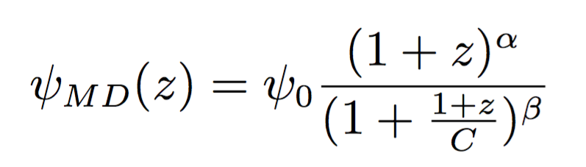
Star formation rate
If a model for SFR and time delay is assumed, can measure the time delay coefficient and well as the parameters of the SFR
Vitale and Farr W., in prep
SFR template:
Vitale, Farr, in prep

Slide 31
Formation channels
Depending on relative abundances, might be able to distinguish populations and calculate branching ratios
GCs
POPIII
`
`

Slide 32
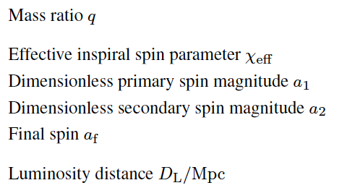
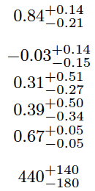
Going 3G
A GW150914-like event will have SNR~2000 in a cosmic explorer facility.
How well can we do?
Precision for a few key parameters for GW150914
LVC 1602.03840

Slide 33
Going 3G
A GW150914-like event will have SNR~2000 in a cosmic explorer facility.
How well can we do?
Vitale, Whittle, imminent

Slide 34
Conclusions
Advanced detectors will explore the local universe (z ~ 1) and characterize black holes
A new generation is required to detect BH everywhere in the universe
  Characterization of BH masses and spins, formation channels, evolution,…
  Thousands of neutron stars, EOS, cosmology,...
  Precise tests of general relativity
  Access to sources throughout cosmic history

Slide 35
Thanks

Slide 36
Challenges
3G detectors also come with important challenges
  Low frequency -> long waveforms -> need to keep runtime manageable
  Hundreds of events per day
  Computational challenges
  High SNR -> require extremely high WF faithfulness
  High SNR -> require extremely good instrument calibration

Slide 37
Backup

Slide 38
Heterogeneous networks

Slide 39
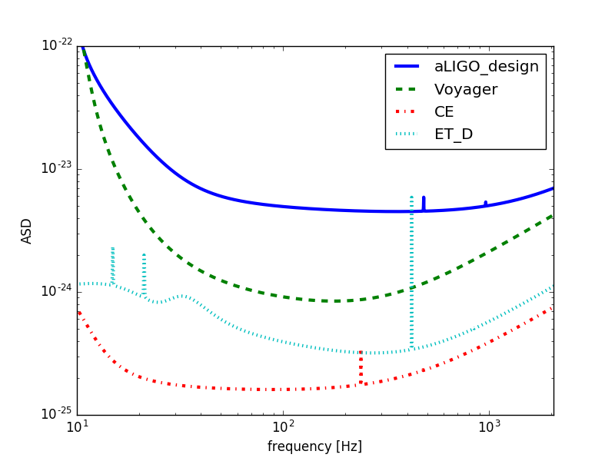
Motivation
Would like to have two (or more!) 3G detectors
Funding or timelines might in fact result in only 1 3G detector to be online, at least for a while
We might have
  1 3G
  1 or more detectors from previous generations

Slide 40
Heterogeneous networks
Does it make sense to keep old detectors running if a 3G is online?
Guesstimates:
  3G-2G. Factor >10 difference. 2G are of no help
  3G-A+. Factor ~>5 difference. A+ probably of no help
  3G-Voyager: Voyager might help for sky localization (not detection/range)

Slide 41
Observing most of the BBH in the universe
Considered population of BBH with component masses in the range [6,100] M
Uniform in com. vol.
As long as at least 1 ET detector is included, BBH are detected up to redshift of ~15
Adding Voyager won’t change much
Adding a CE pushes the typical detection farther away

Slide 42
Extrinsic parameters (2.5G+3G)
Adding a Voyager significantly improves sky localization - factor ~100
See Mills+ for BNS sky localization precision
However with only 1 3G will rarely have localizations better than 1deg2
Smaller improvement in distance estimation
Sky location
Luminosity Distance
Vitale in prep
Vitale, Whittle, imminent

Slide 43
Intrinsic parameters (2.5G+3G)
Adding a Voyager can improve the source frame mass estimation (since distance is needed to convert from detector frame)
No improvement for spin parameters
Source frame chirp mass
Effective spin
Vitale, Whittle, imminent

