Slide 1



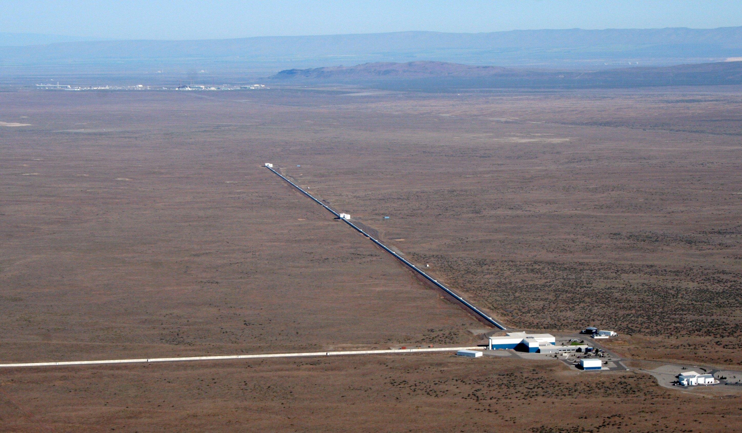
Present and Future Terrestrial GW Detectors
David Shoemaker
MIT Kavli
Slides from many ET, CE and LIGO Collaborators!
LISA Symposium
11 July 2024
CE-G2400052

Slide 2
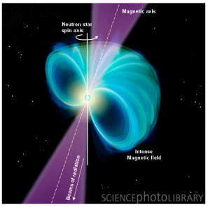
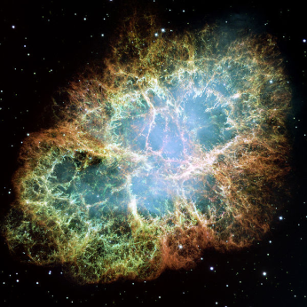
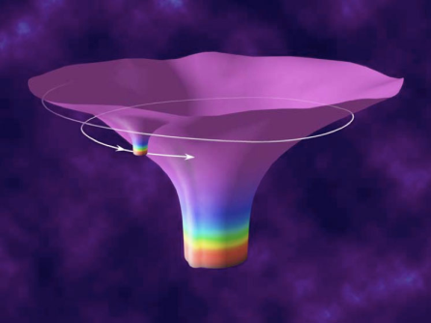
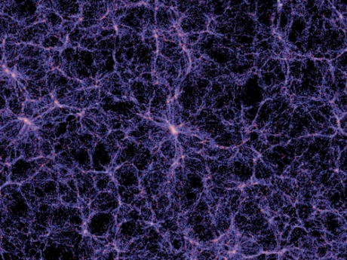
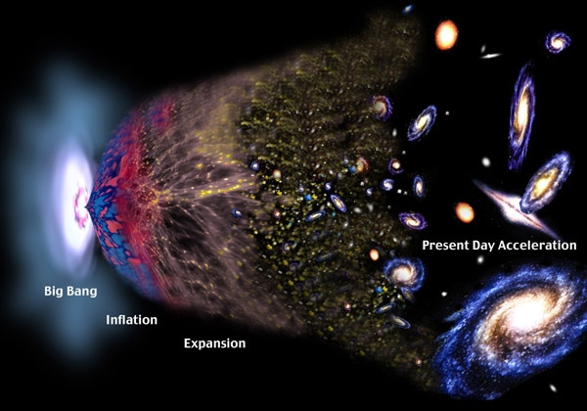
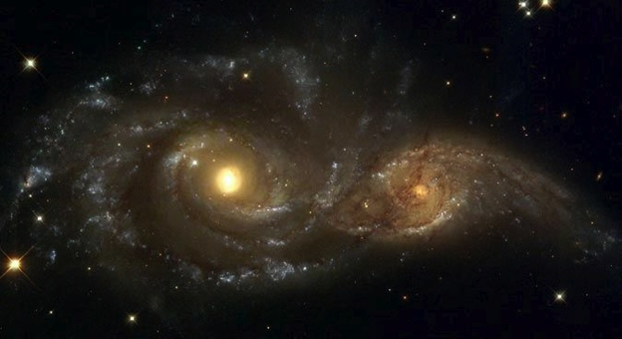
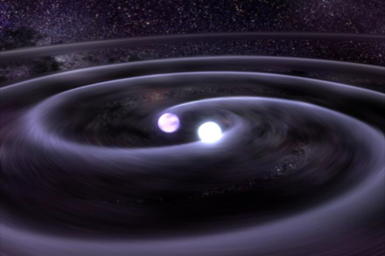
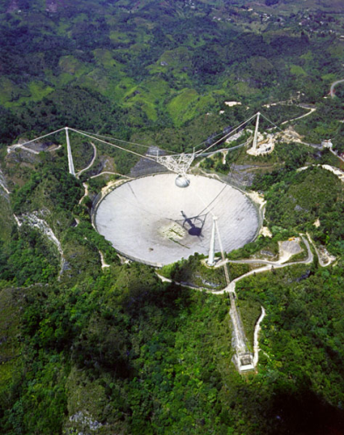
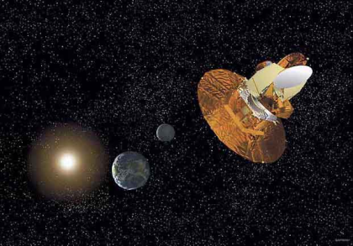
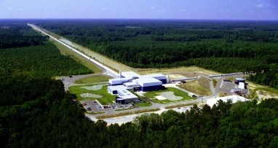
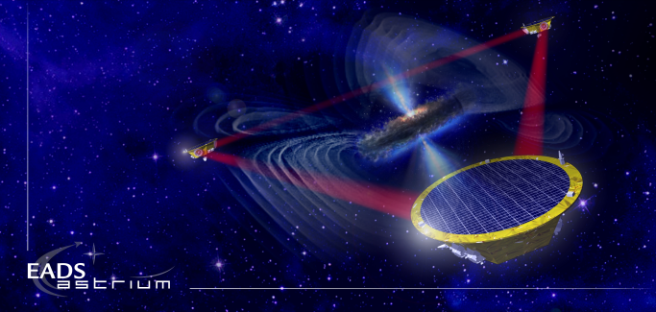
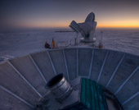
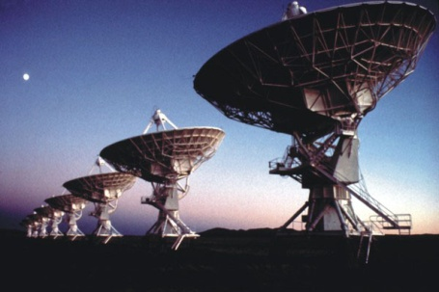
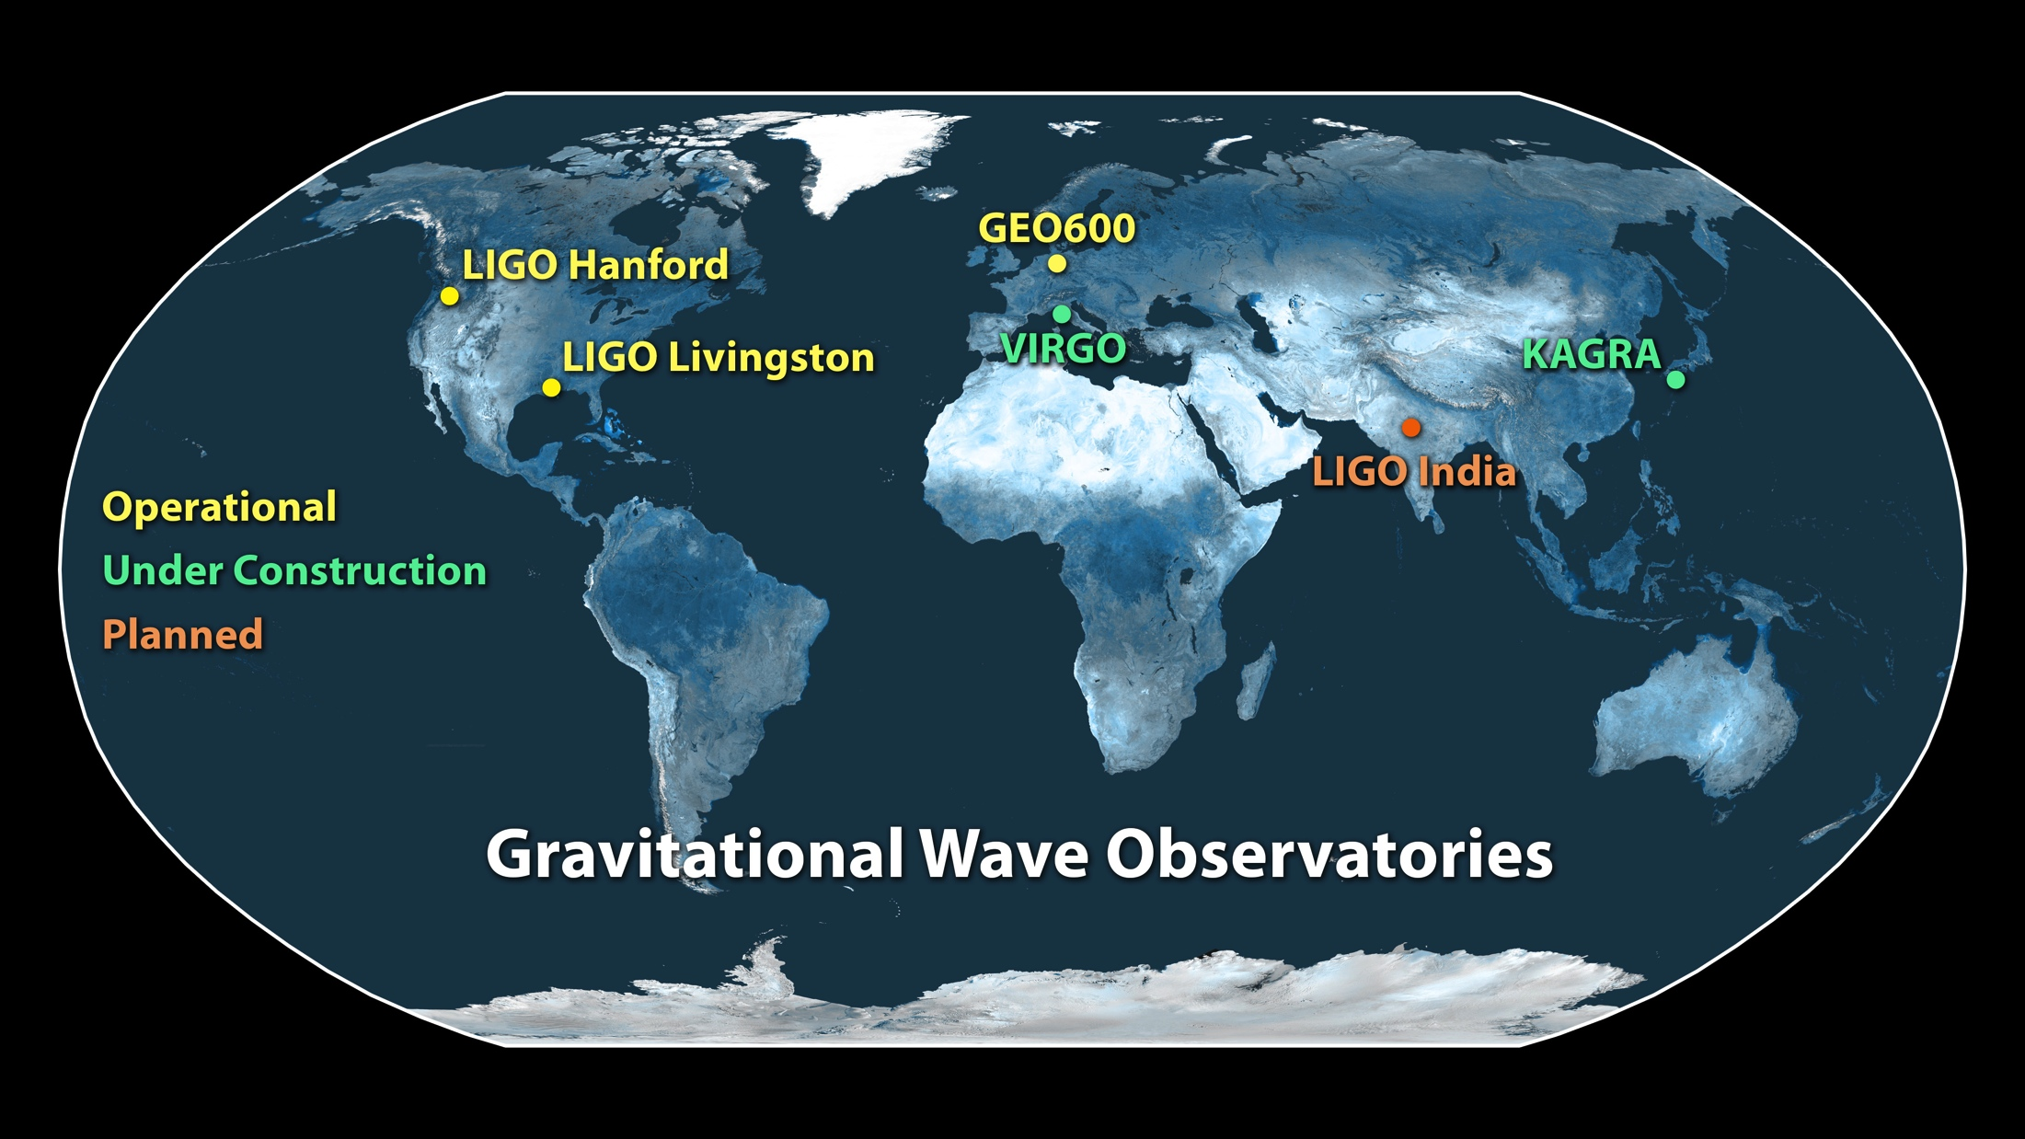
The Gravitational Wave Spectrum
Supernovae
Cosmic Strings
Relic radiation
Extreme Mass Ratio
Inspirals
Spinning NS
BH and NS Binaries
Supermassive BH Binaries
10⁻¹⁶ Hz
10⁻⁹ Hz
10⁻⁴ Hz
10⁰ Hz
10³ Hz
Pulsar timing
Space detectors
Terrestrial interferometers

Slide 3
The Gravitational Wave Spectrum
Supernovae
Cosmic Strings
Relic radiation
Extreme Mass Ratio
Inspirals
Spinning NS
BH and NS Binaries
Supermassive BH Binaries
10⁻¹⁶ Hz
10⁻⁹ Hz
10⁻⁴ Hz
10⁰ Hz
10³ Hz
Pulsar timing
Space detectors
Terrestrial interferometers

Slide 4
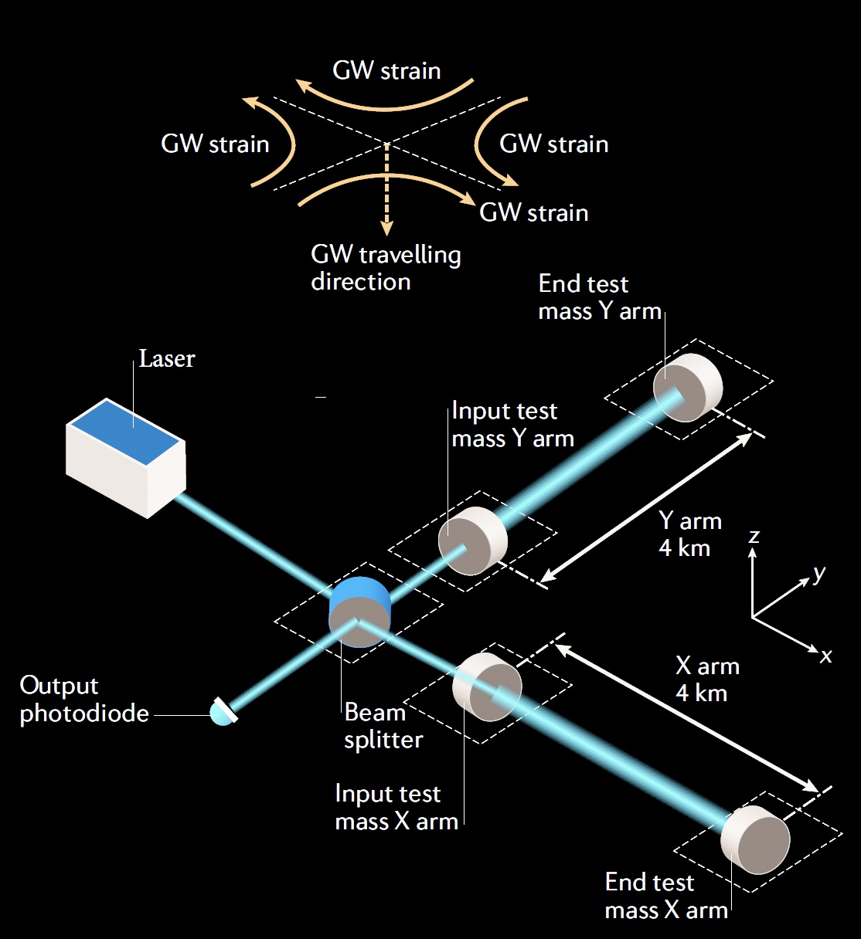
Why are terrestrial detectors limited to f > ~1 Hz?
Passing GW shortens the light path for one arm, lengthens for the other – and then vice-versa
ΔL = h_{GW} · L
Interference at the Beam splitter turns this into a light intensity variation, and a photodiode into an electrical signal
Resolution of the readout limited by quantum effects
Physical motion of the mirrors due to local forces masks the minuscule changes in light path due to GWs

Slide 5
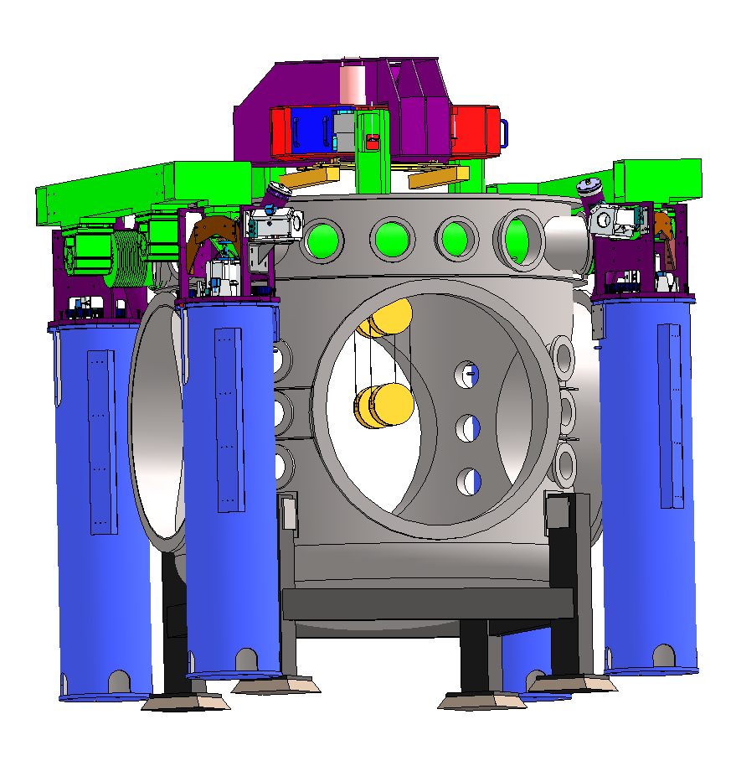
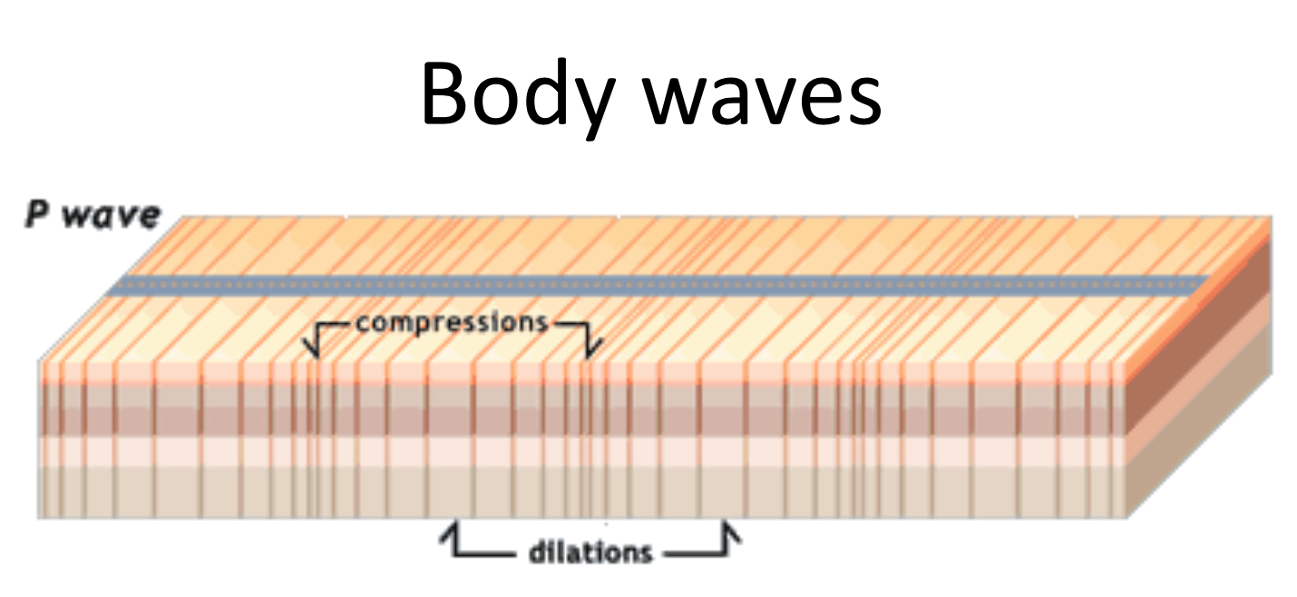
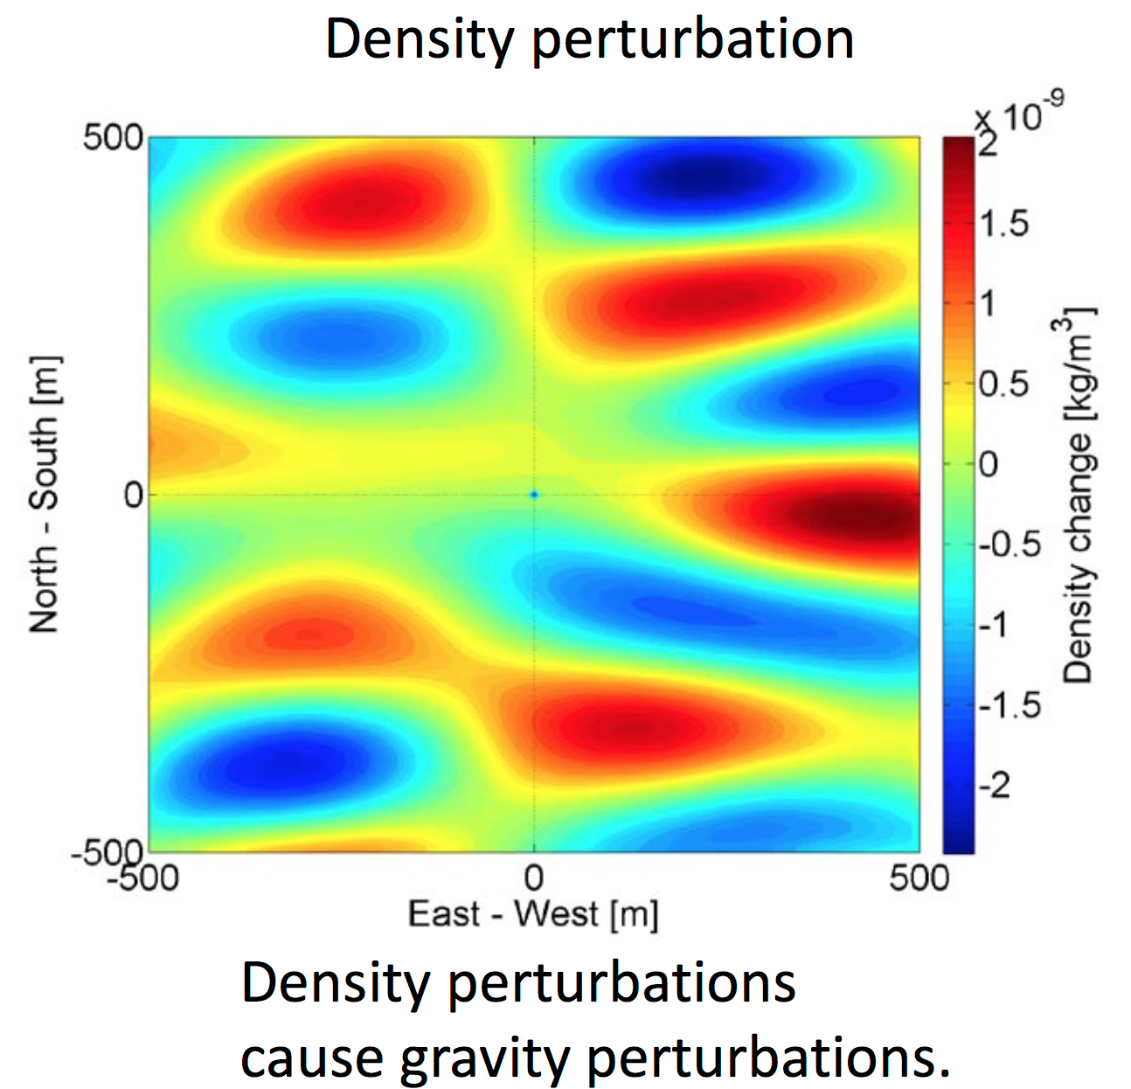
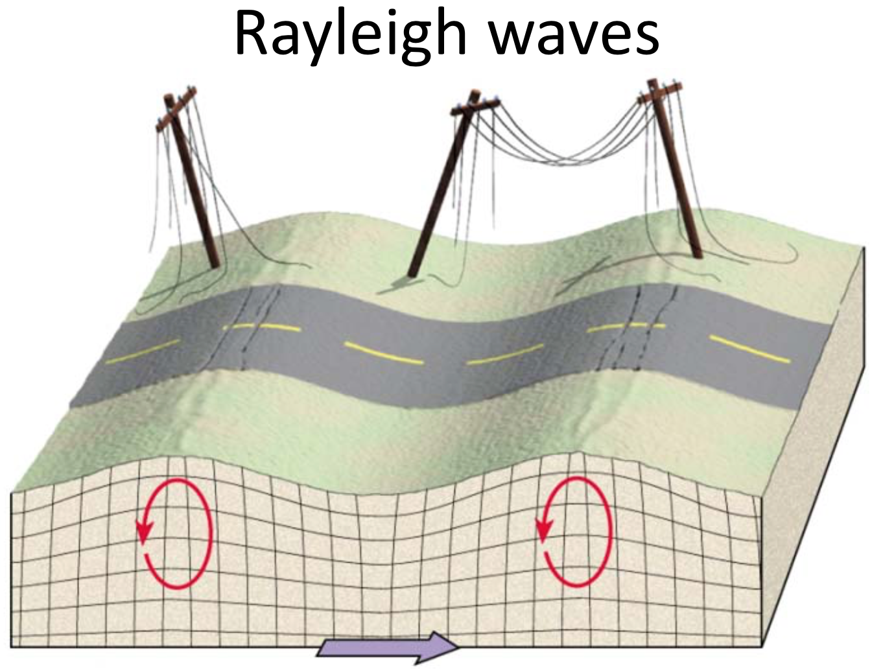
Newtonian background due to seismic environment
In principle, can eliminate all direct mechanical coupling
Can not shield against the wandering net gravity vector
Images: J. Harms
Images: J. Harms

Slide 6
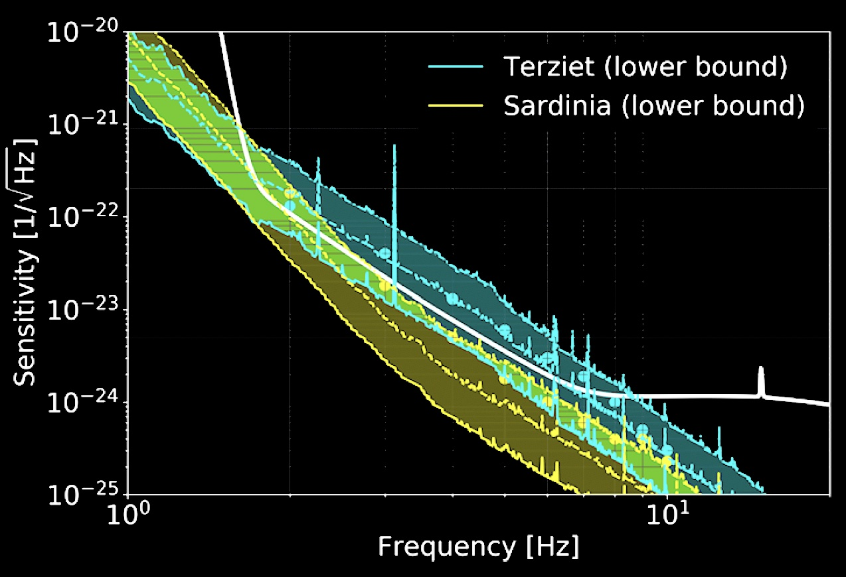
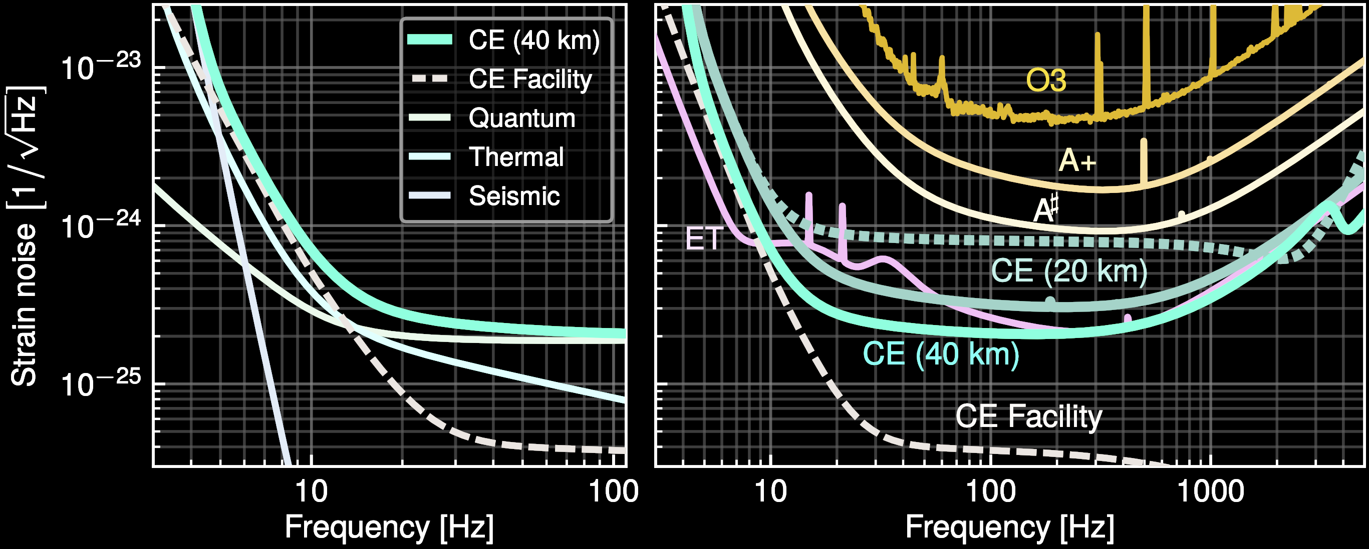
Newtonian background creates a wall at a few Hz
Harms et al. 2022
Newtonian Background falls as ~ 1/f ⁵
Can reduce somewhat by moving underground
  ET vs CE – more later on these two
Can reduce somewhat with arrays of seismometers and subtraction of effect
Forbiddingly large for ~3Hz and lower
Ultimate limit on the lowest frequency detectors on- or under-ground
And thus the largest BH masses detectable
Evans et al. 2023

Slide 7
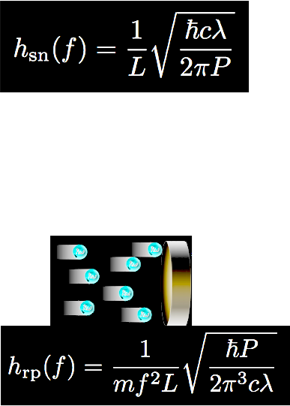
Practical limitations for Terrestrial Detectors
Arm length L – currently in short-antenna limit; path-length shift ΔL from a given strain grows with interferometer arm length. Maximize L !
  ΔL = h_{GW} · L
  LIGO 4km, Virgo and KAGRA 3km
Optical resolution – limited by photon
Poisson counting statistics; maximize laser power P
…but too much power, and the radiation pressure
causes mirror motion which masks the GW
Optimal power – naïve quantum limit
  Working with ~50-100 W

Slide 8
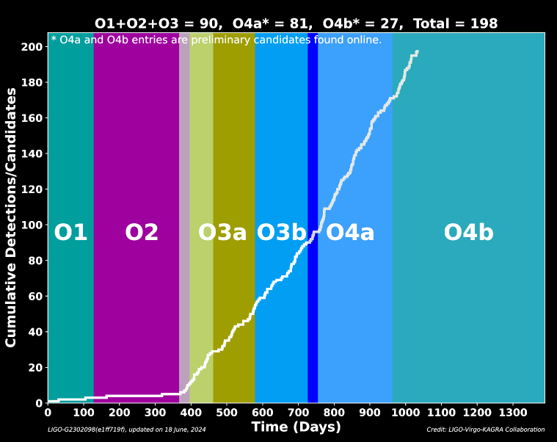

Sensitivity improvements boost signal rate
r_{reach} ∝ 1/h_{sensitivity}
Volume of space accessible –
and sources –grows as ~(sensitivity)³
There are gaps for the upgrades… but so far we make up for it

Slide 9
Sensitivity improvements boost signal rate
r_{reach} ∝ 1/h_{sensitivity}
Volume of space accessible –
and sources –grows as ~(sensitivity)³
There are gaps for the upgrades… but so far we make up for it

Slide 10
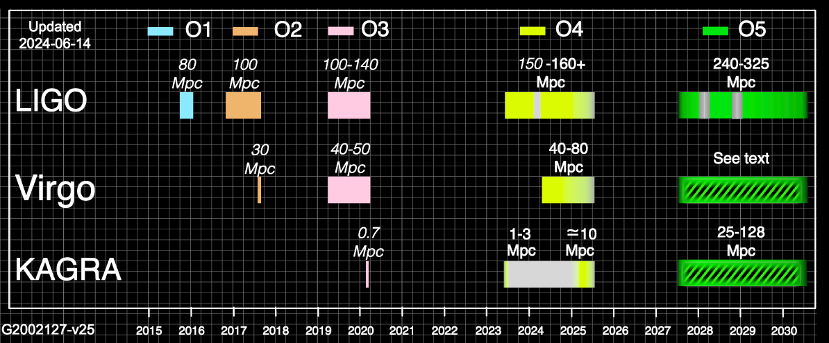
Observing with LIGO, Virgo, KAGRA
Continued interleaved improvements and observing foreseen
  Hope you saw Monica’s talk yesterday for results to date
LVK have concrete plans through early 2031
Will propose for final 3-4km baseline detectors, to operate in the 2030’s

Slide 11
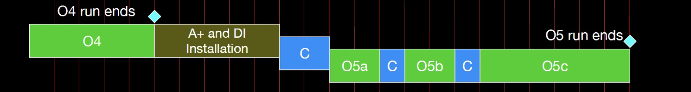
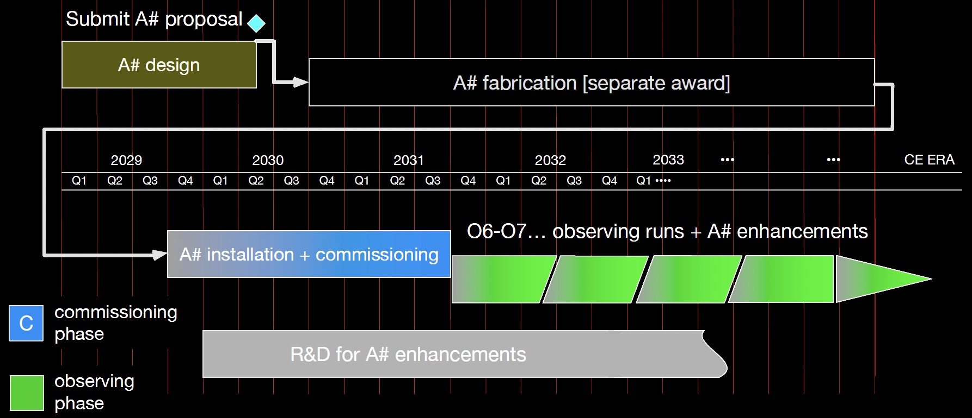
Notional Plans for the current 4km observatories –
2x improvements
~160 Mpc
~275 Mpc
Best guess for LIGO
evolution
Virgo similar
Gives improving performance and continuous operation to ~2040
~600 Mpc

Slide 12
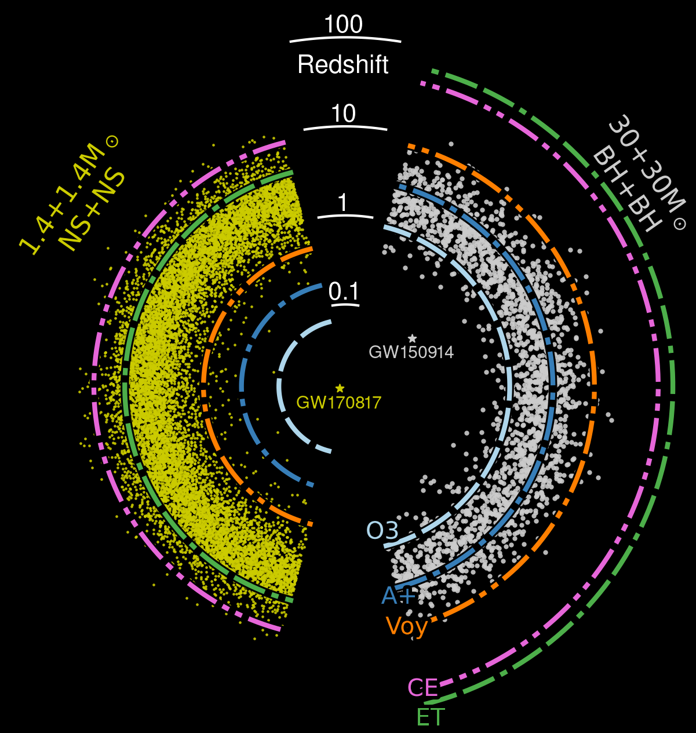
What could we do with 10x better GW detectors?
Greater sensitivity will enable a qualitative growth in the number of observed sources
(10x sensitivity →
few 10⁵ sources per year)
Improves localization for MMA
It also increases the resolution of waveforms, enabling more stringent tests of GR and more detailed models of the coalescences
Wider bandwidth can expose Neutron star coalescence and thus dynamics of dense matter
…See Samaya’s talk, up next, for more on the science

Slide 13
Even better detectors would deliver more science.
How to build a such a 10x better detector?
One Approach:
Make it 10x longer → 10x larger signal
ΔL = h_{GW} · L

Slide 14
Noise due to stochastic forces is independent of armlength
ΔL = h L
The Newtonian Background is the same for 4 or 40km, but the signal is 10x larger
Also unchanged:
  Direct seismic level and coupling
  Thermal noise motion (pendulum, substrate, coating)
  Magnetic and electrostatic dynamic forces
…Up to L = 1/2 λ_{GW} – giving an optimal length for a given signal
  40km already a bit long for NS-NS coalescence!

Slide 15
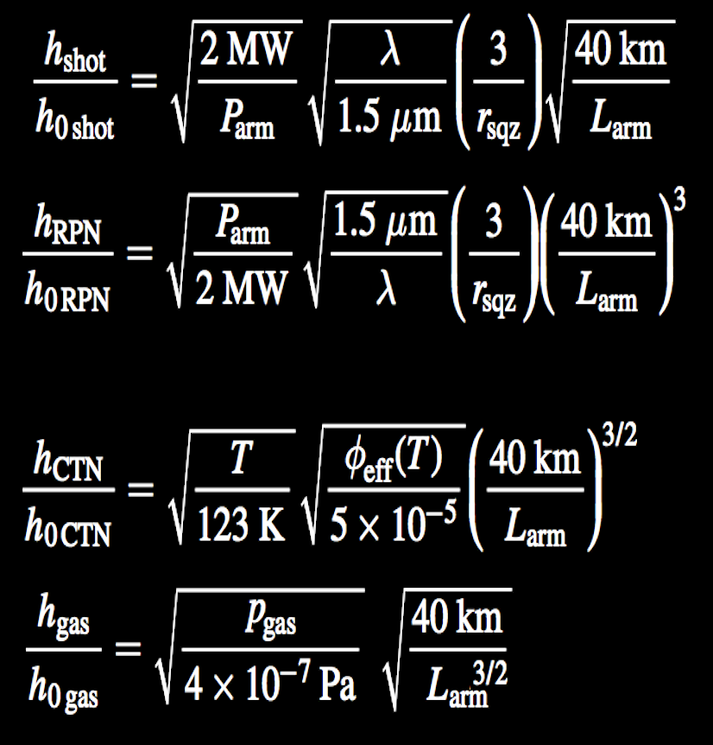
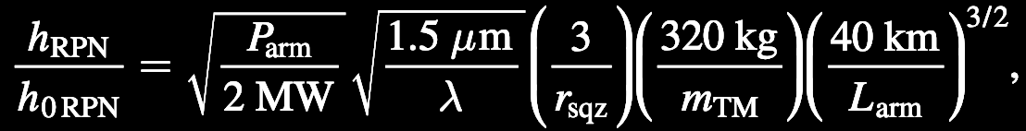
Sensing noises scale with arm length at various powers of 1/L – all get better
Shot Noise
while maintaining bandwidth
Radiation Pressure Noise
while maintaining bandwidth
Coating Thermal Noise
loss angle dependence
Residual Gas Noise
facility limit
15

Slide 16
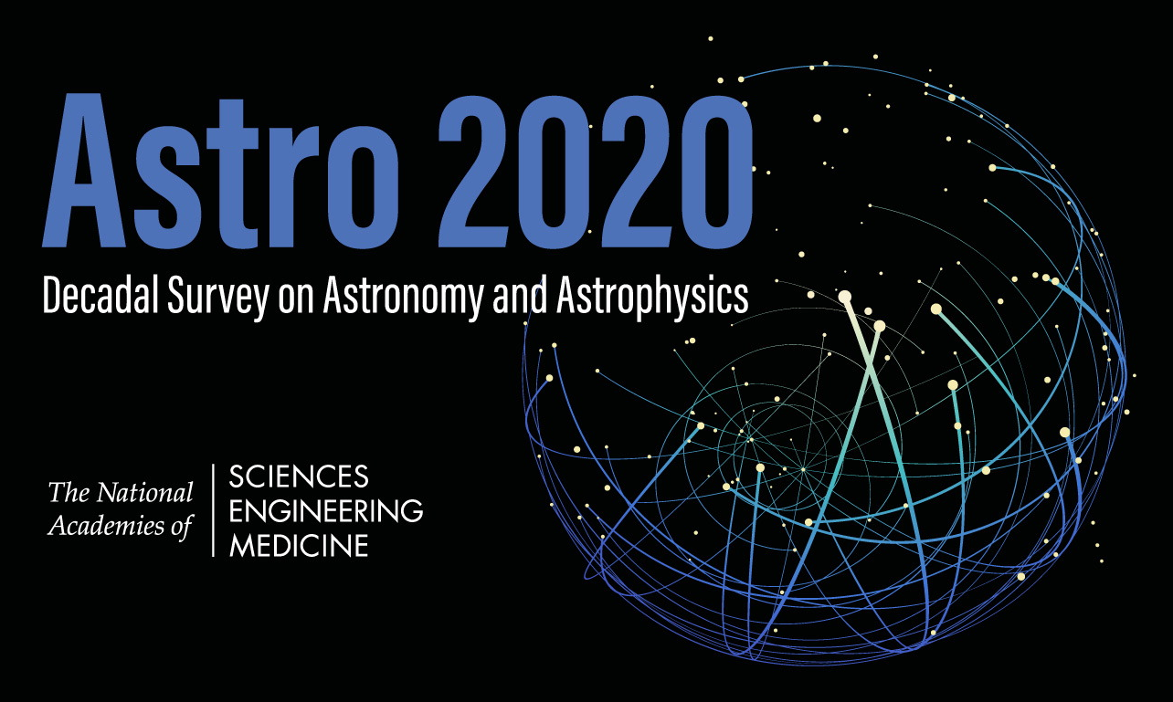

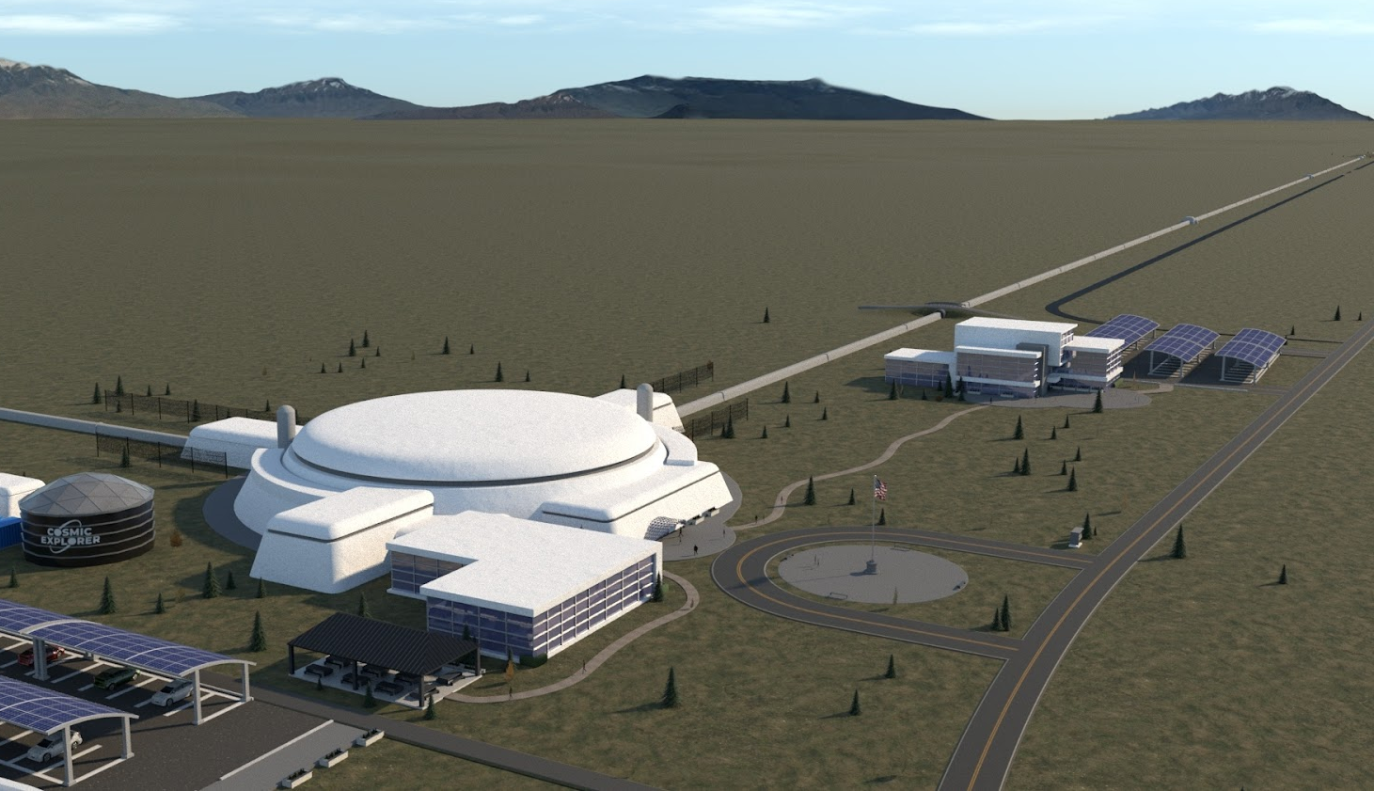
Image: Eddie Anaya (Cal State Fullerton)
cosmicexplorer.org
CE is planned to be a larger, and more technically advanced version of LIGO:
baseline of two widely separated observatories, 40km and 20km arms
LIGO-like concept for a single interferometer per site, on Earth’s surface
US contribution to the next-gen Network (with Einstein Telescope – European project)
Image: Eddie Anaya (Cal State Fullerton)
Image: Eddie Anaya (Cal State Fullerton)
Image: Eddie Anaya (Cal State Fullerton)
cosmicexplorer.org
Image: Eddie Anaya (Cal State Fullerton)

Slide 17
CE Status
Conceptual Design is now underway
No preferred sites – but very active process to find possible sites and host communities
  NSF will select sites with our data as input
CE Funding approved for this phase, next phase in discussion with NSF
  International contributions (in-kind) – UK, Canada, Australia, Germany
Big News in 2024: NSF ‘Blue Ribbon’ Panel recommends NSF pursue CE
  Recommended Networks:
    CE40, ET, LIGO-India
    CE40, ET
    CE40, CE20, LIGO-India
    CE40, CE20
Goal: observatories by mid-2030’s

Slide 18
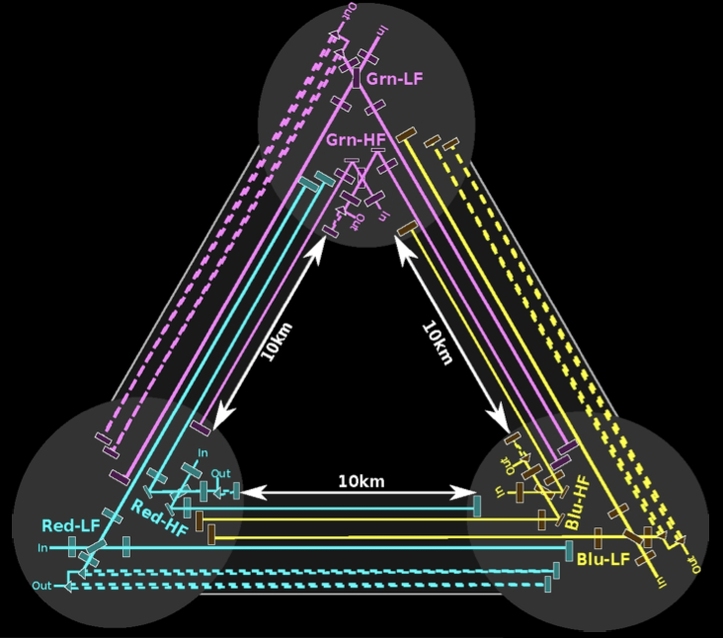
European Vision for the next generation:
Einstein Telescope
ET Design: underground, high frequency + low frequency ‘xylophone’ pairs; looking at 10km Triangle, or two 15km ‘L’
  Cryogenic test masses, longer wavelengths for low freqs
  Underground Infrastructure enabling future upgrades
Current envisioned timeframe:
  Construction to begin in 2026
  Science operations to begin in 2035
Status:
  ET is a fully recognized European Project on European Strategy Forum for Research Infrastructures (ESFRI) Roadmap → a key step in getting the project funding
  ET Project Organization and relevant Boards established
  Promise of order 10⁹ € from Dutch and Italian agencies
  Site evaluation well underway

Slide 19

ET candidate sites
Two sites officially candidate to host ET:
  EMR EUregio, border region between Nederland, Belgium and Germany
  Sardinia (Lula area, Barbagia)
A third potential site is located in Saxony (Lusatia), still not official
Overall site evaluation is a complex task depending on:
  Geophysical and environmental quality
  Financial and organization aspects
  Services, infrastructures

Slide 20
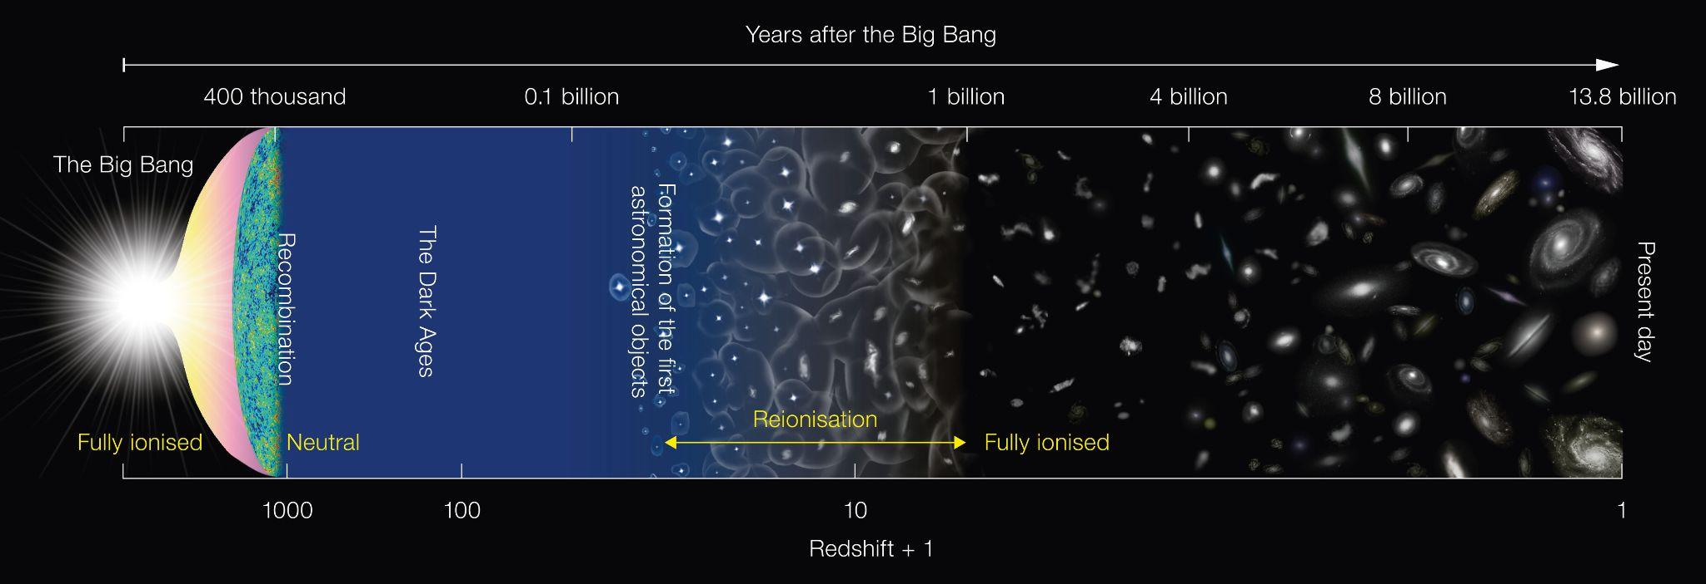
Reach of present and future instruments
Credit: ESO/NAOJ
Cosmic Explorer
Einstein Telescope
LISA
LIGO
~2033
LIGO
today
Slide: Kevin Kuns

Slide 21
The last page
Ground-based GW observation works, and LIGO, Virgo, and KAGRA observing together
There are lots of sources yet to be observed
Scaling laws show the technical feasibility of better detectors
The US Concept, Cosmic Explorer
  Two sites, one 40km, one 20km
  Surface construction, LIGO Technology
The European Concept, Einstein Telescope
  Underground multiple-interferometer approach
  Pushes detector technology with high power, low temperatures
Both eager to participate in Multi-Messenger Astrophysics
And… Looking forward to multi-band with LISA!

