Slide 1
Draft: Initial Conceptual Layout
Cosmic Explorer Corner Station
Matt Todd, Stefan Ballmer
Update 2024/07/15
CE-G2400048

Slide 2

Update: CE design call – July 15, 2024
“We couldn’t make everyone happy, so everyone’s going to be a little unhappy”
Parameter set we may be stuck with (? can change):

Slide 3
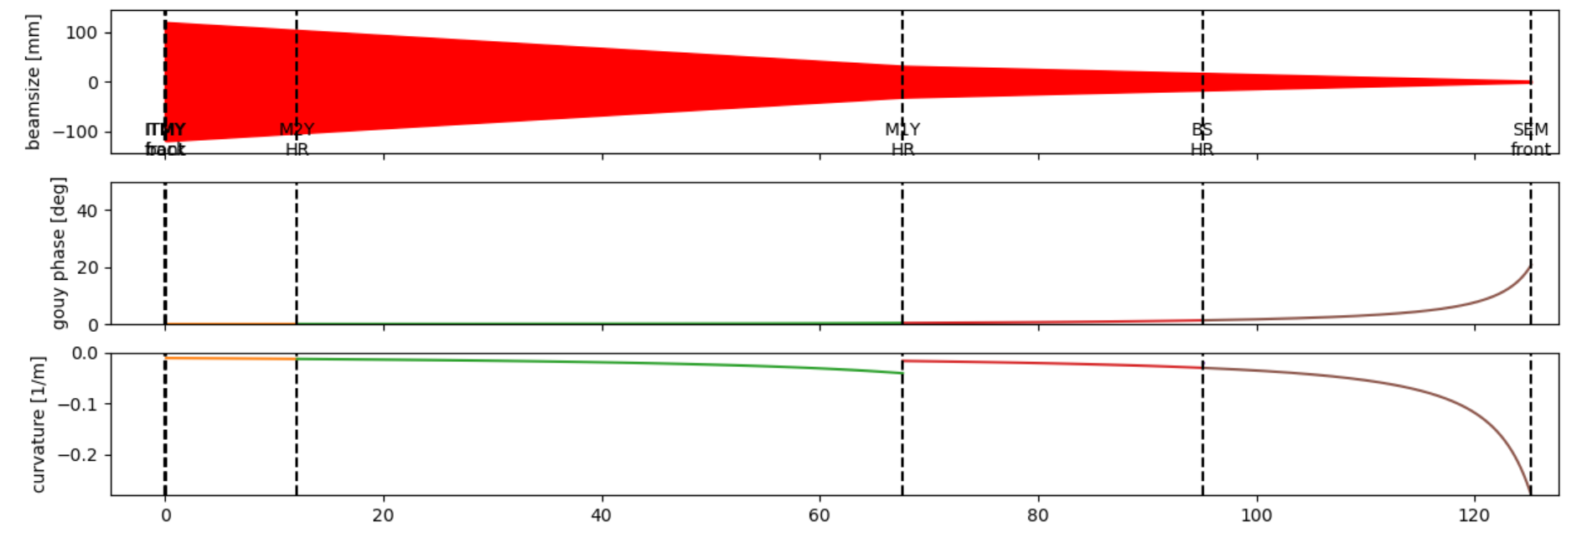
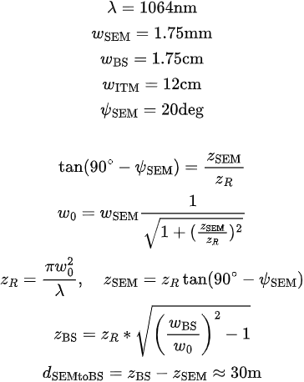

Rationale
≈
12
67.5
95
125
We cannot go much more to the left for M2 because the beamsize must be sufficiently small so that spread over the angle of incidence is not larger than the optic
We chose d(M1-BS) to be similar to d(SEM-BS) to preserve the AOI on M1. This can be shrunk, but we would need to make the AOI bigger.

Slide 4
Rationale in words
Gouy phase of O(20deg), most of it evolving just before the SEM
This sets the relative Gouy phase of the Gaussian beam segment between BS and SEM at the SEM to close to 70deg (0deg is at focus, 90deg far away)
With min. beam size constraints at SEM and BS this forces the SEM-BS distance around 30m, setting the “crab scale”
Also sets the the zR at BS around 1.2m
In principle BS-M1 could be shorter than SEM-BS, but that would increase the angle of incident on M1
This “crab scale” also sets the scale of the telescope, M1-M2
We used a minimal M2-ITM that allows M2 to be the same as ITM

Slide 5
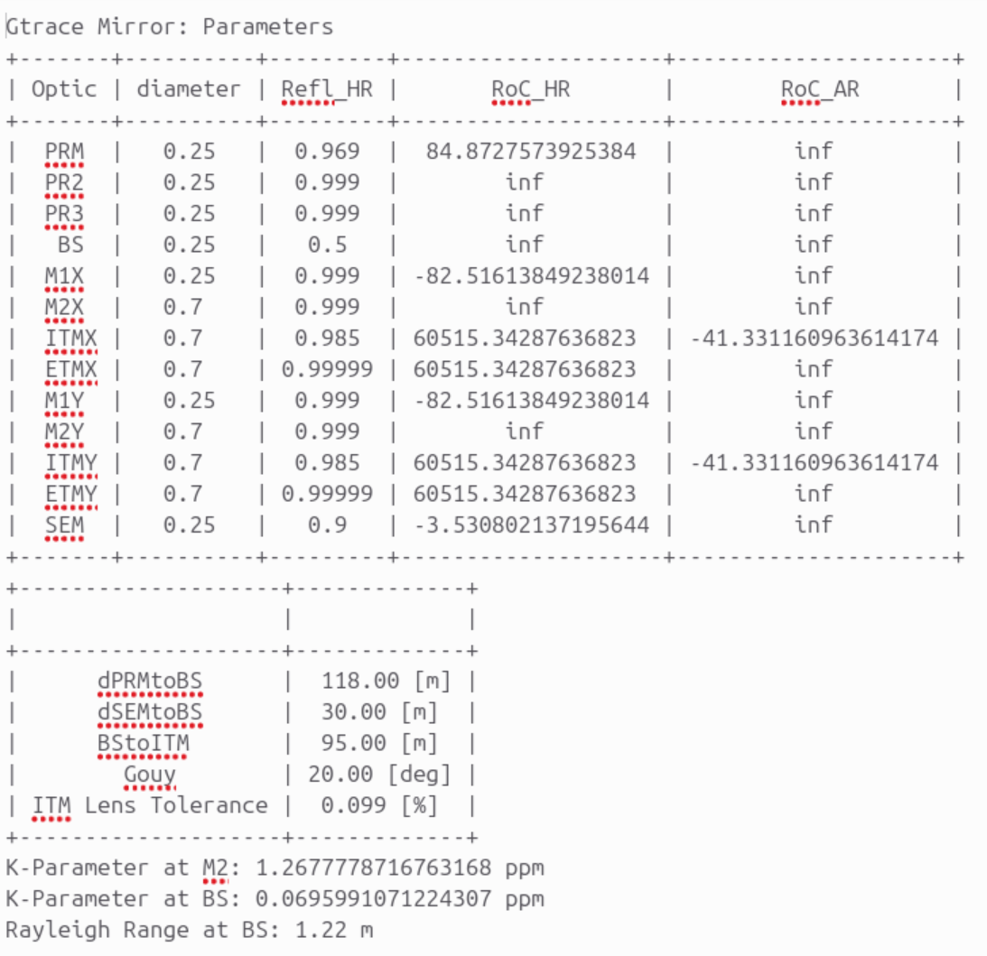
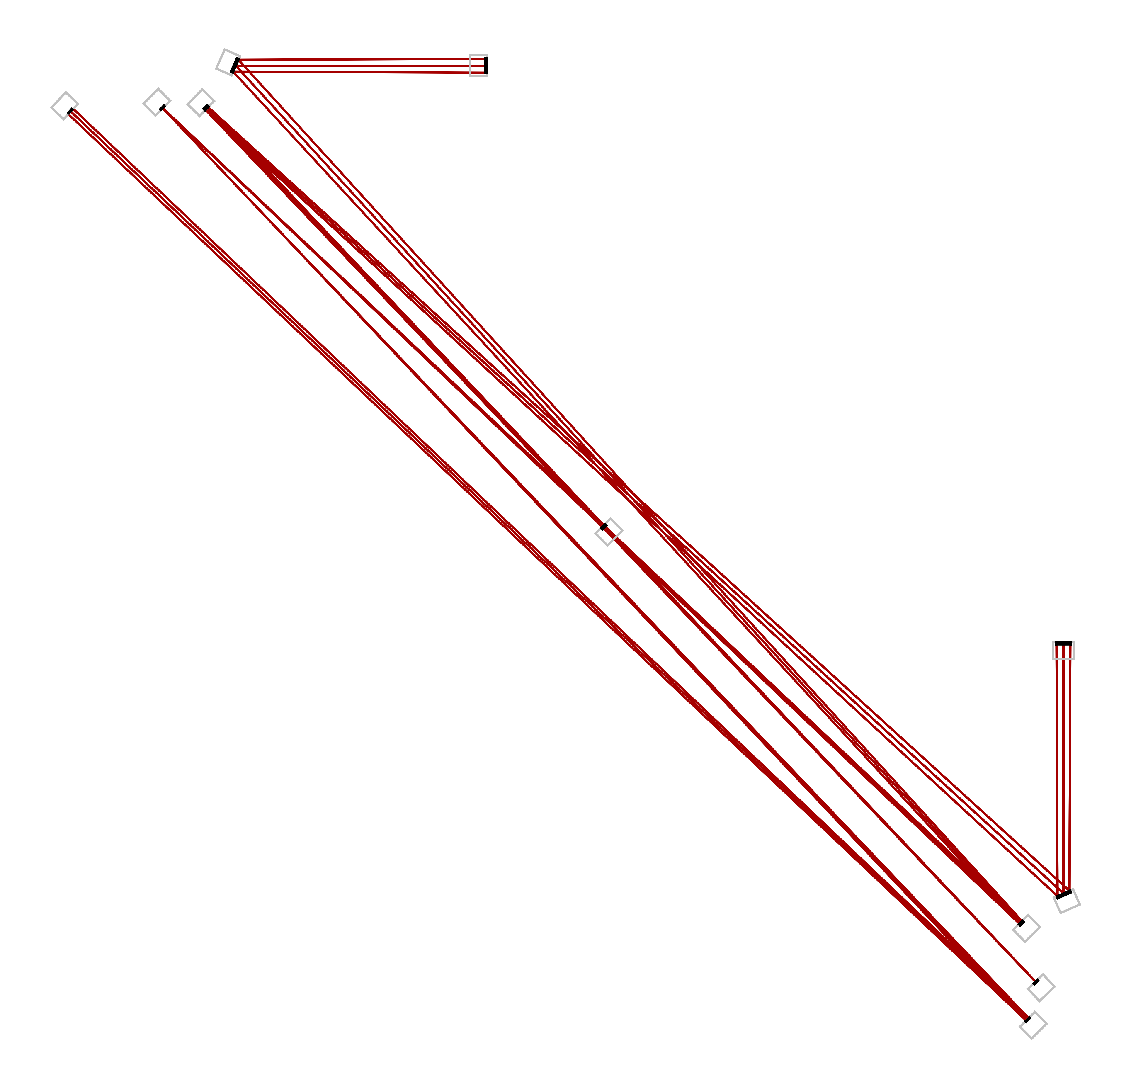
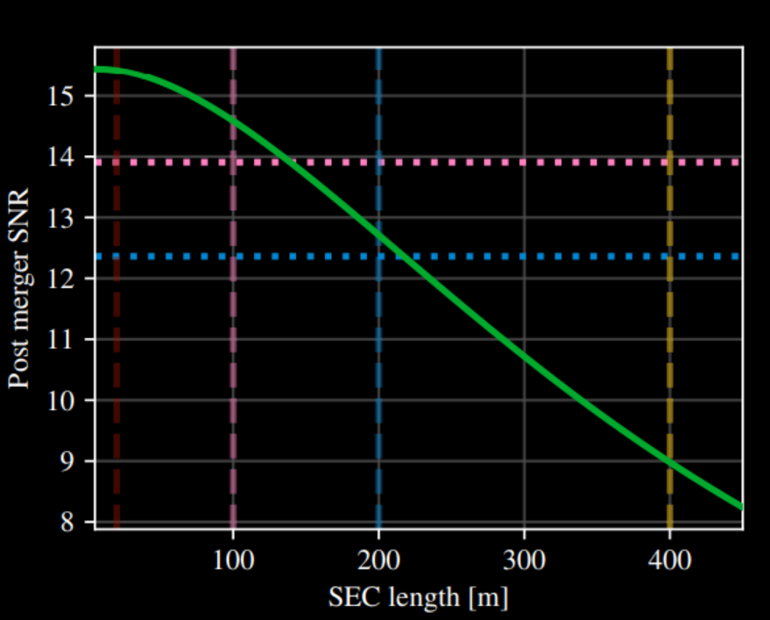
Have to cross in the arms unless we want to go up to at least 160m, which means we lose at least 10% PostMerger SNR
Kuns, G2300048-v2

Slide 6
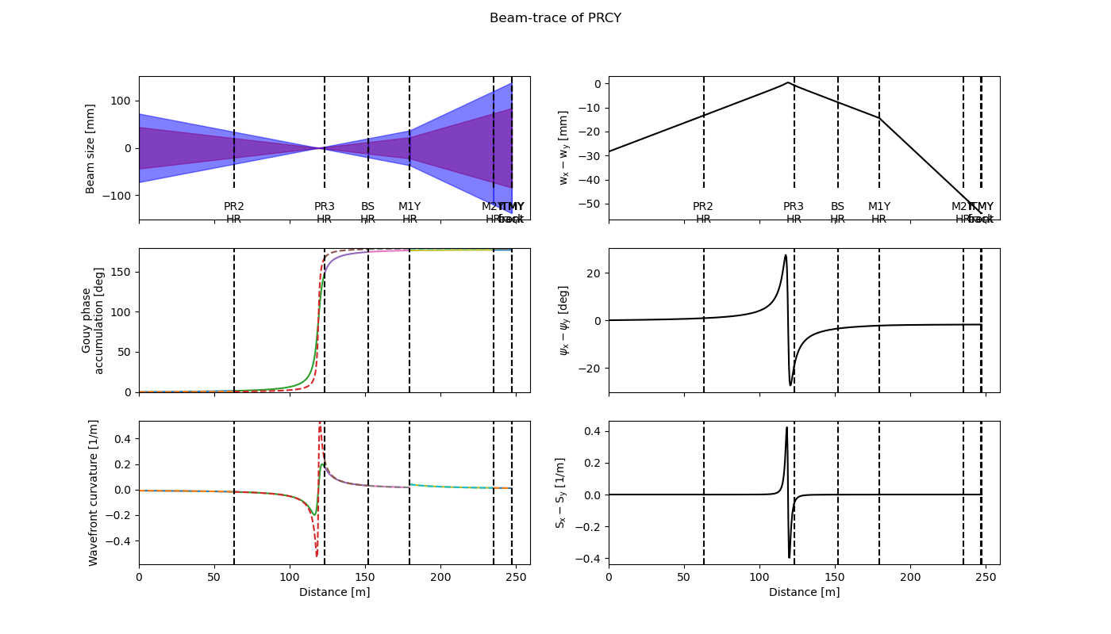
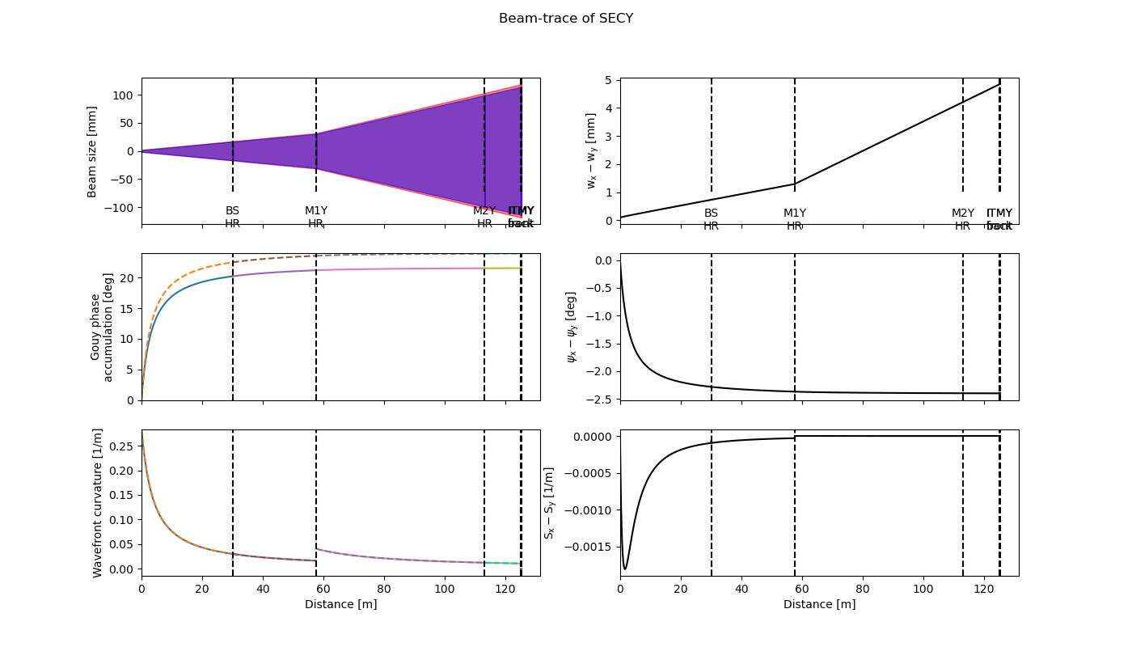

Slide 7
Draft: Initial Conceptual Layout
Cosmic Explorer Corner Station
Matt Todd, Stefan Ballmer
CE-G2400048

Slide 8
Cosmic Explorer Conceptual Vacuum Layout
For Long Crab
Iteration 1, to have some concrete proposal

Slide 9
Pre-Stabilized Laser
Input Optics
2nd IMC
IMB1
1st IMC
IFO IN
MX2
ITMX
IMA1
PRM
PR3
MY1
Newtonian Noise
Keep-out Zone
Newtonian Noise
Keep-out Zone
ITMY
BS
MY2
FC1
MX1
IFO I/O
SEM
IFO OUT
Readout Optics
PR2
HOM LO
SQZ Freq Ref
IMA2

Slide 10
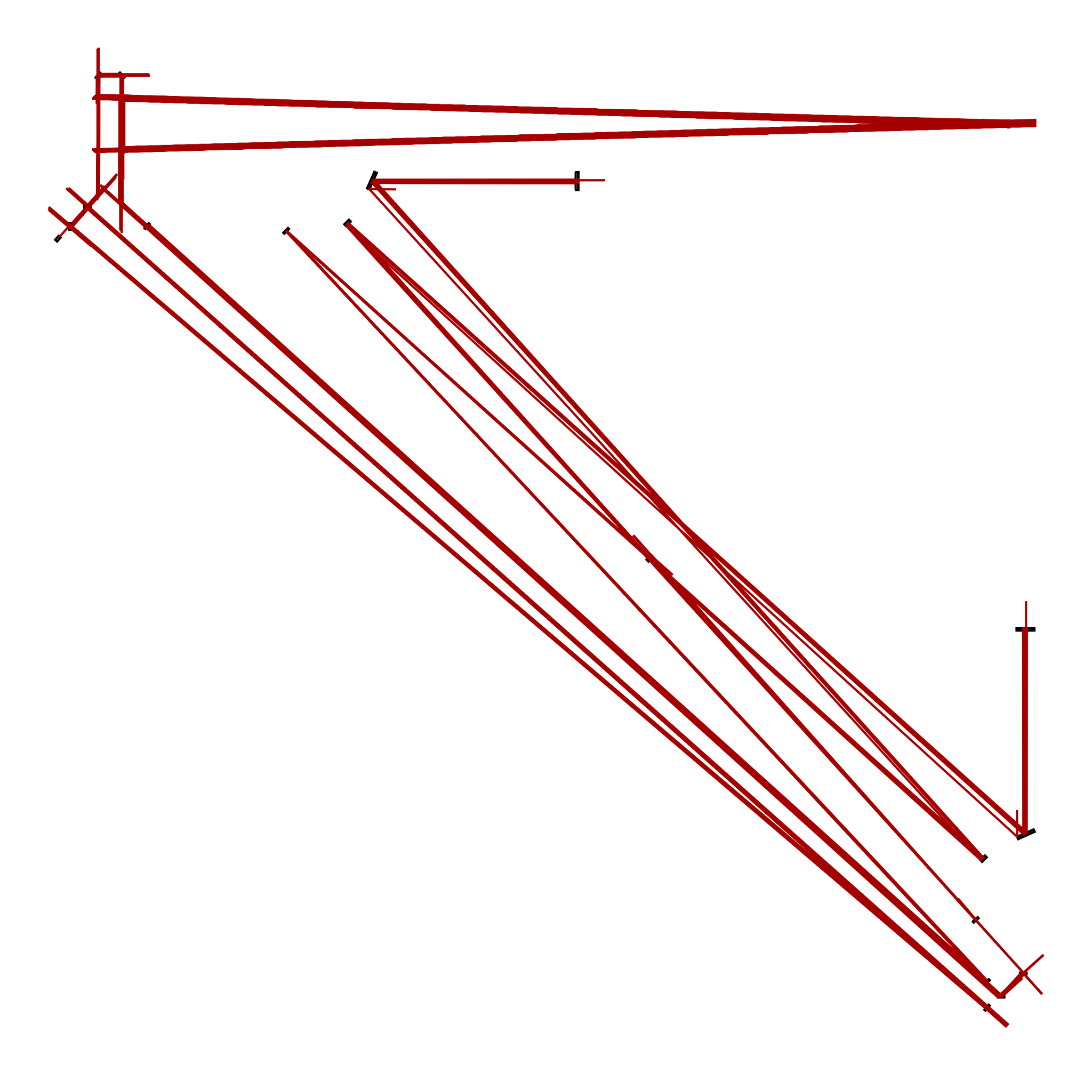
iIMCsteer2
iIMCsteer3
IMC2A
IMC2C
IMC2B
iIMCsteer1
IM1
M2X
ITMX
IMC1B
M1Y
IMC1A
PRM
PR3
BS
ITMY
M2Y
M1X
SEM
BHD
PR2
IMC1C
BHDsteer

Slide 11
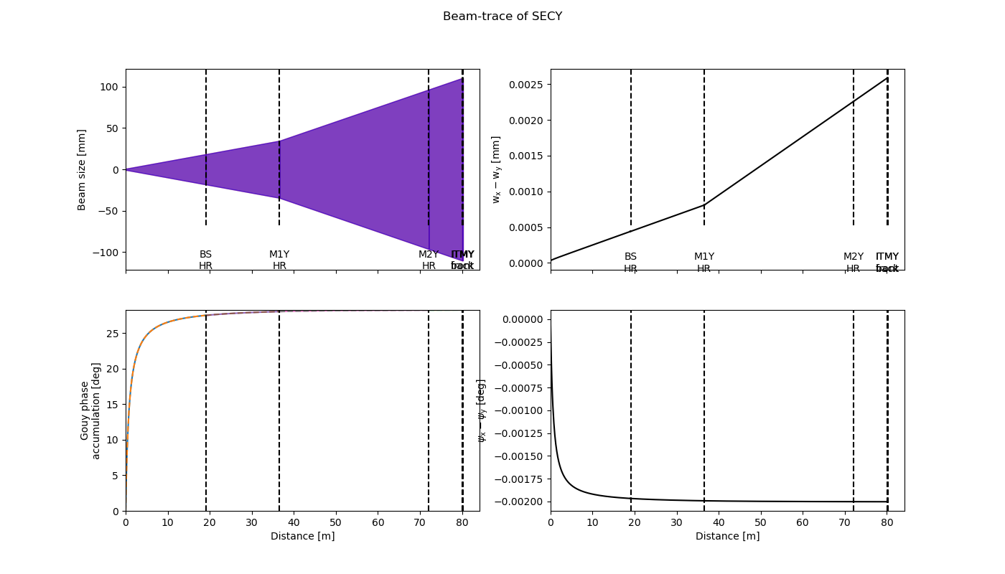

Slide 12
Pros, Cons
Pros:
  IFO OUT, HOM LO, SQZ Freq Ref, FC access all next to readout chamber
  FC along Y arm
  2nd IMC along X arm
  Relatively simple X / Y / diagonal vacuum system structure
Cons:
  BS access constraint by beams on both sides
    PRC could be routed differently, not following “shoelace” pattern
  BS should be closer to MX1/MY1 than to SRM
  Optics cluster together too much?
Working on to-scale version with FinTrace…
  IMC A and B designs likely to change

Slide 13
Next on the list…
Fundamental layout changes?
  IMCA location?
  PRC routing for BS clearance?
  Realistic Space Requirements for
    Input Optics Area
    Readout Optic Area
Flexibility for IMC length, ETC?
Define realistic keep-out zones
  ISI/ external isolator
Vacuum system components
    Types of chambers
    Types of pipe

