Slide 1
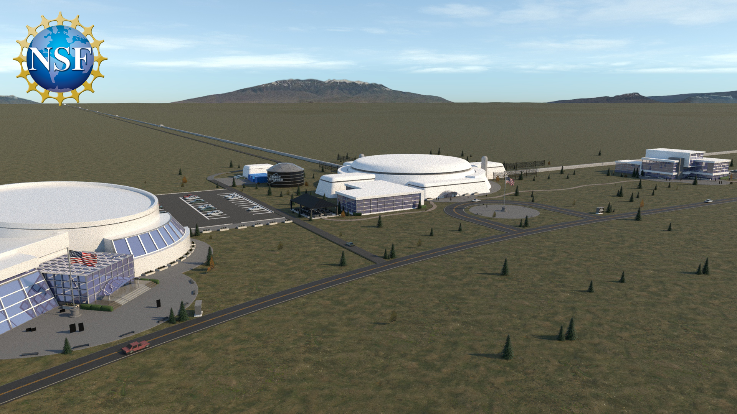
Update from Cosmic Explorer LIGO-Virgo-KAGRA Meeting, Spring 2022
CE-G2200019 LIGO-G2200542
On zoom, March 18, 2022
Stefan Ballmer
Artist: Eddie Anaya (Cal State Fullerton)

Slide 2
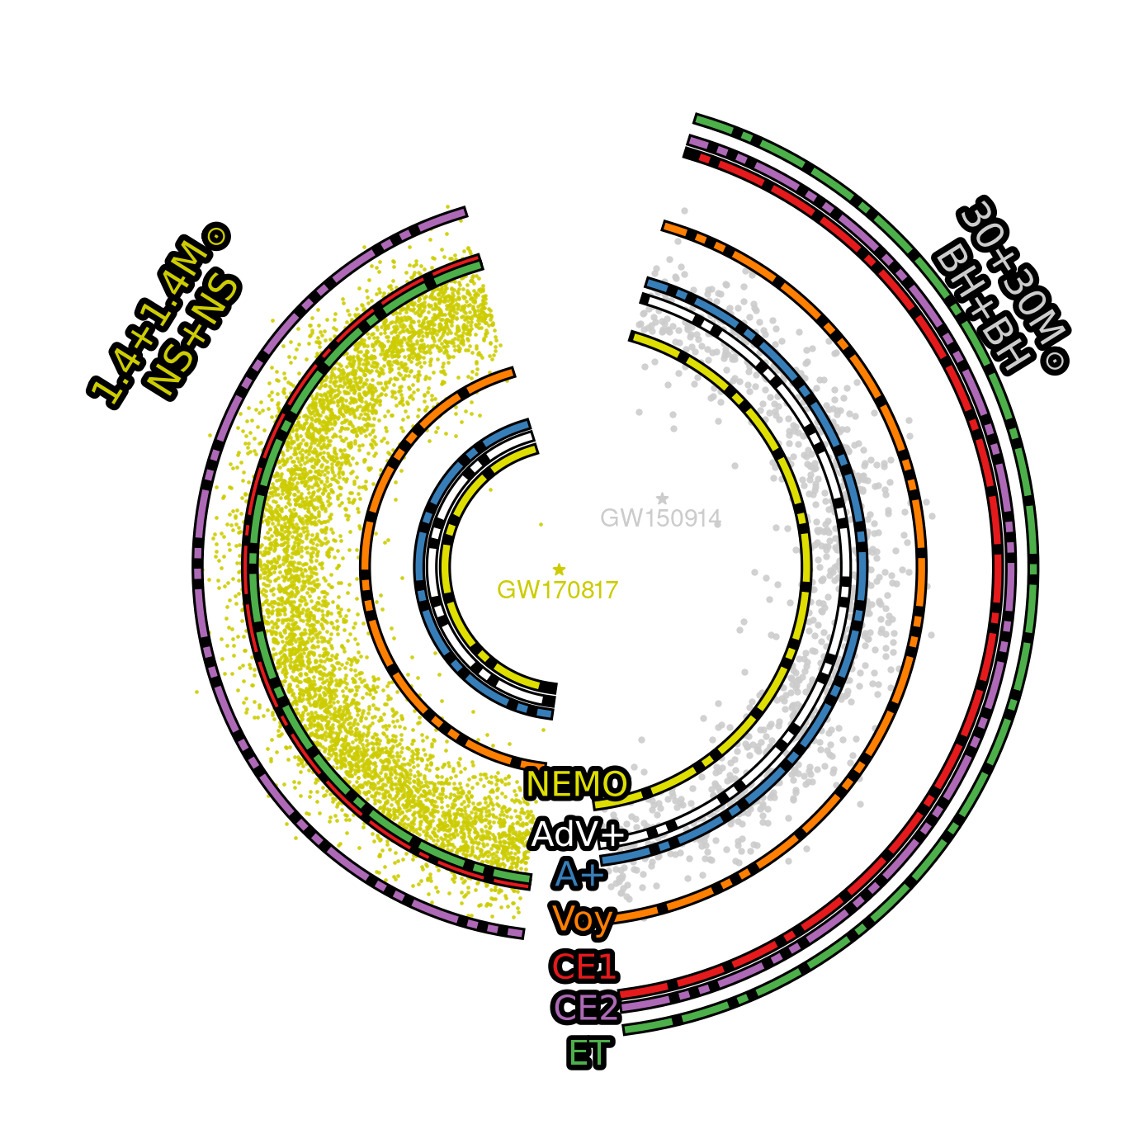
Cosmic Explorer The Vision for Gravitational-Wave Astrophysics and Astronomy
Third-Generation Gravitational-Wave Observatory
40 km and 20 km L-shaped surface observatories
10x sensitivity of today’s observatories (Advanced LIGO+)
Enables access to
Stellar to intermediate mass mergers throughout Cosmic Time
Dynamics of Dense Matter
Extreme Gravity
Envisioned as an open-data facility

Slide 3
News from last year
Cosmic Explorer Horizon Study
Connect science goals to design choices
Number of detectors and location
Detector length and configuration
Delivered to the NSF in Fall 2021
Available at
dcc.cosmicexplorer.org/CE-P2100003/public
arxiv.org/abs/2109.09882

Slide 4
News since last LVK meeting
Astro 2020 Decadal Survey: A Resounding Endorsement for Cosmic Explorer (Nov 2021)
”Gravitational wave astrophysics is one of the most exciting frontiers in science.”
“..and planning the next-generation observatory, such as Cosmic Explorer, is essential.”
“The survey committee strongly endorses gravitational wave observations as central to many crucial science objectives.”

Slide 5
News since last LVK meeting
DAWN VI workshop held Oct 5-7, 2021
Over 200 physicists and astronomers attended
Report available here: https://arxiv.org/pdf/2112.12718.pdf
A total of 205 researchers endorsed the report

Slide 6
News since last LVK meeting
DAWN VI Report Quotes:
On Cosmic Explorer specifically:
“There was a consensus that Cosmic Explorer is a concept that can deliver the promised science. A strong endorsement of Cosmic Explorer, as described in the CE Horizon Study, is a primary outcome of DAWN VI.”
"Guided by the experience with the LIGO and Virgo detector commissioning, the CE team came to the conclusion that while making the detector longer evidently increased the cost, it appeared to be the lowest risk path to better sensitivity.”
On 3G detectors in general:
”…the observational science value to having a network node in the southern hemisphere is significant. The community should continue to explore means to realize a next-generation observatory there."

Slide 7
Snowmass DPF Community Planning Exercise
” The Particle Physics Community Planning Exercise (a.k.a. “Snowmass”) is organized by the Division of Particles and Fields (DPF) of the American Physical Society. Snowmass is a scientific study. It provides an opportunity for the entire particle physics community to come together to identify and document a scientific vision for the future of particle physics in the U.S. and its international partners. Snowmass will define the most important questions for the field of particle physics and identify promising opportunities to address them. The P5, Particle Physics Project Prioritization Panel, will take the scientific input from Snowmass and develop a strategic plan for U.S. particle physics that can be executed over a 10 year timescale, in the context of a 20-year global vision for the field.”

Slide 8
Snowmass DPF Community Planning Exercise
GW participating this time
Numerous GW white paper contributions
One white paper focused on new GW facilities:
“Future Gravitational-Wave Detector Facilities” Snowmass 2021 white paper was submitted
Covers Cosmic Explorer +Voyager + MAGIS/AION Atom Interferometers + GLOC
Available at arxiv.org/abs/2203.08228
Looking for endorsements - email me if you want to endorse it: sballmer@syr.edu

Slide 9
NSF Research Infrastructure Guide
The new Research Infrastructure Guide
Guide for full life-cycle of all Major Facilities
Was published in December 2021
Replaces NSF Major Facilities Guide (MFG)
…has GW merger on front page….
Outlines the next steps for Cosmic Explorer
Conceptual Design
Preliminary Design
Final Design
Construction

Slide 10
NSF Proposal Our Plan, with Input from the NSF
One core Conceptual Design proposal (from multiple institutions)
Establish a project office, write initial Project Execution Plan (PEP), address governance and organization questions, etc.
In parallel, pursue (with CE Consortium and LSC) a variety of grants for design-focused R&D
CE Project to facilitate and coordinate R&D efforts, but the research will happen in the community, and will be funded through the usual NSF proposal process . We need participation!

Slide 11
Cosmic Explorer Project Formation
Cosmic Explorer Project
Initiated by PIs of Horizon Study to maintain momentum
Highest priority: Determine path to funding Conceptual Design Phase
Established project organizational chart
Call to consortium for project volunteers went out earlier this Month
Not too late to volunteer – contact Matt Evans: m3v4n5@mit.edu
CE Consortium provides venue for interested scientists to engage
Sign up at https://cosmicexplorer.org/consortium.html

Slide 12
Cosmic Explorer Project Organization
Intended to
Take Cosmic Explorer into the Conceptual Design Phase
Provide contact information to outside researchers and funding agencies
Currently staffed by volunteer effort

Slide 13
Cosmic Explorer Road Map
Lots happened for Cosmic Explorer since last LVK meeting:
Horizon Study delivered to NSF
Astro 2020
DAWN VI endorsement
Snowmass participation
Project formation and organization
More will happen this year:
Consortium research organization
Path to funding Conceptual Design

Slide 14
End

