Slide 1

CE-G2000044 / LIGO-G2001761
Stefan Ballmer
on behalf of the
Cosmic Explorer Team
Oct 7, 2020
Snowmass 2021

Slide 2
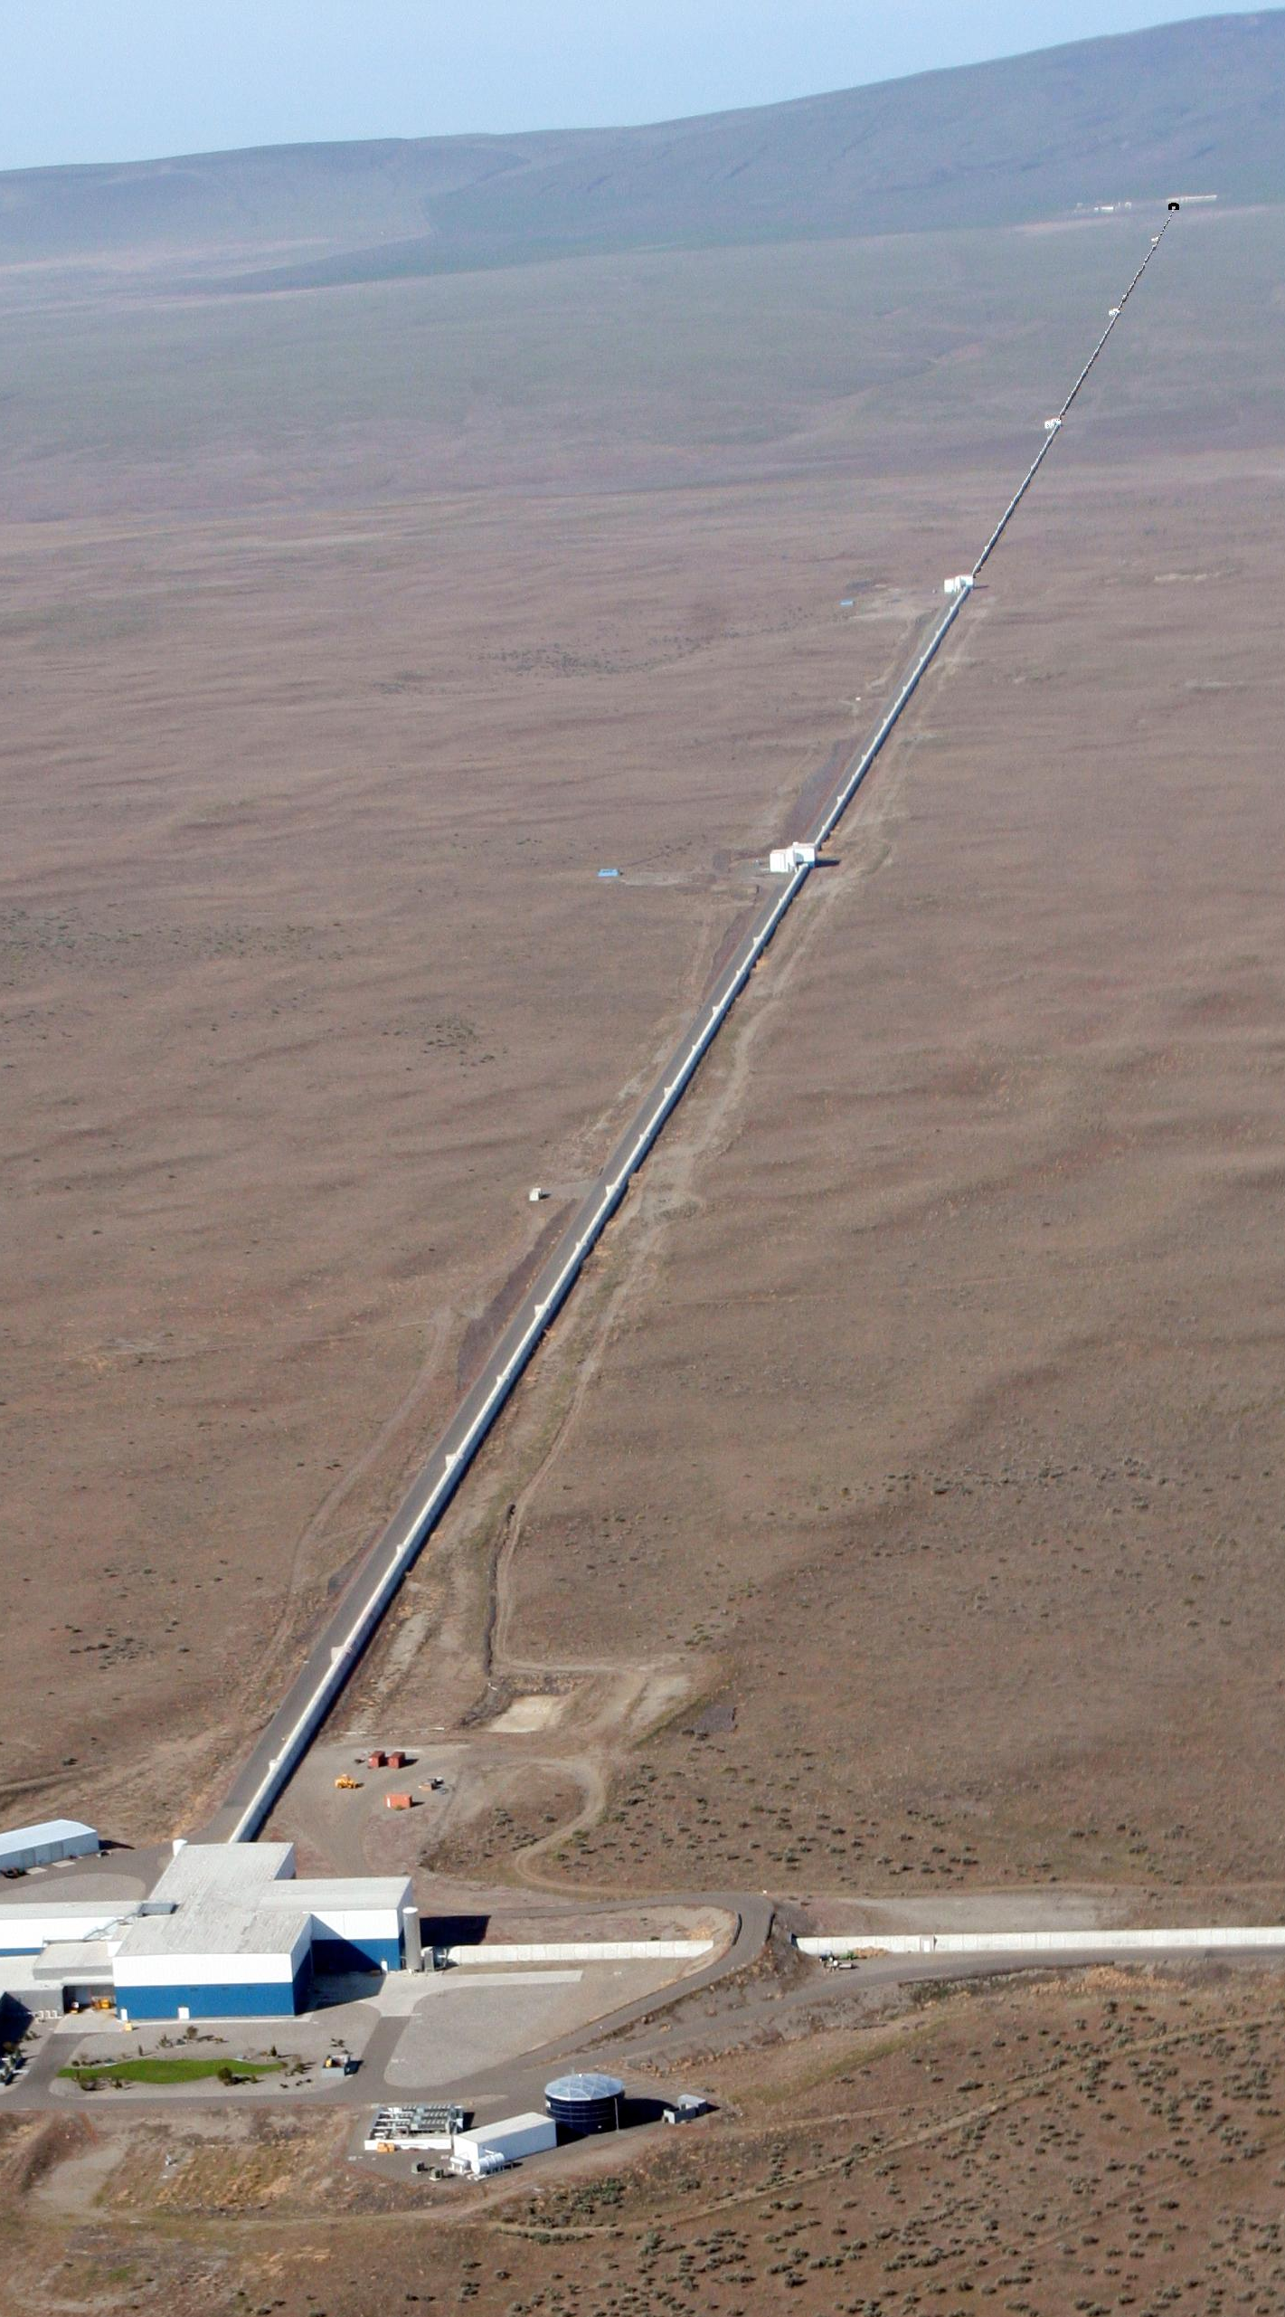
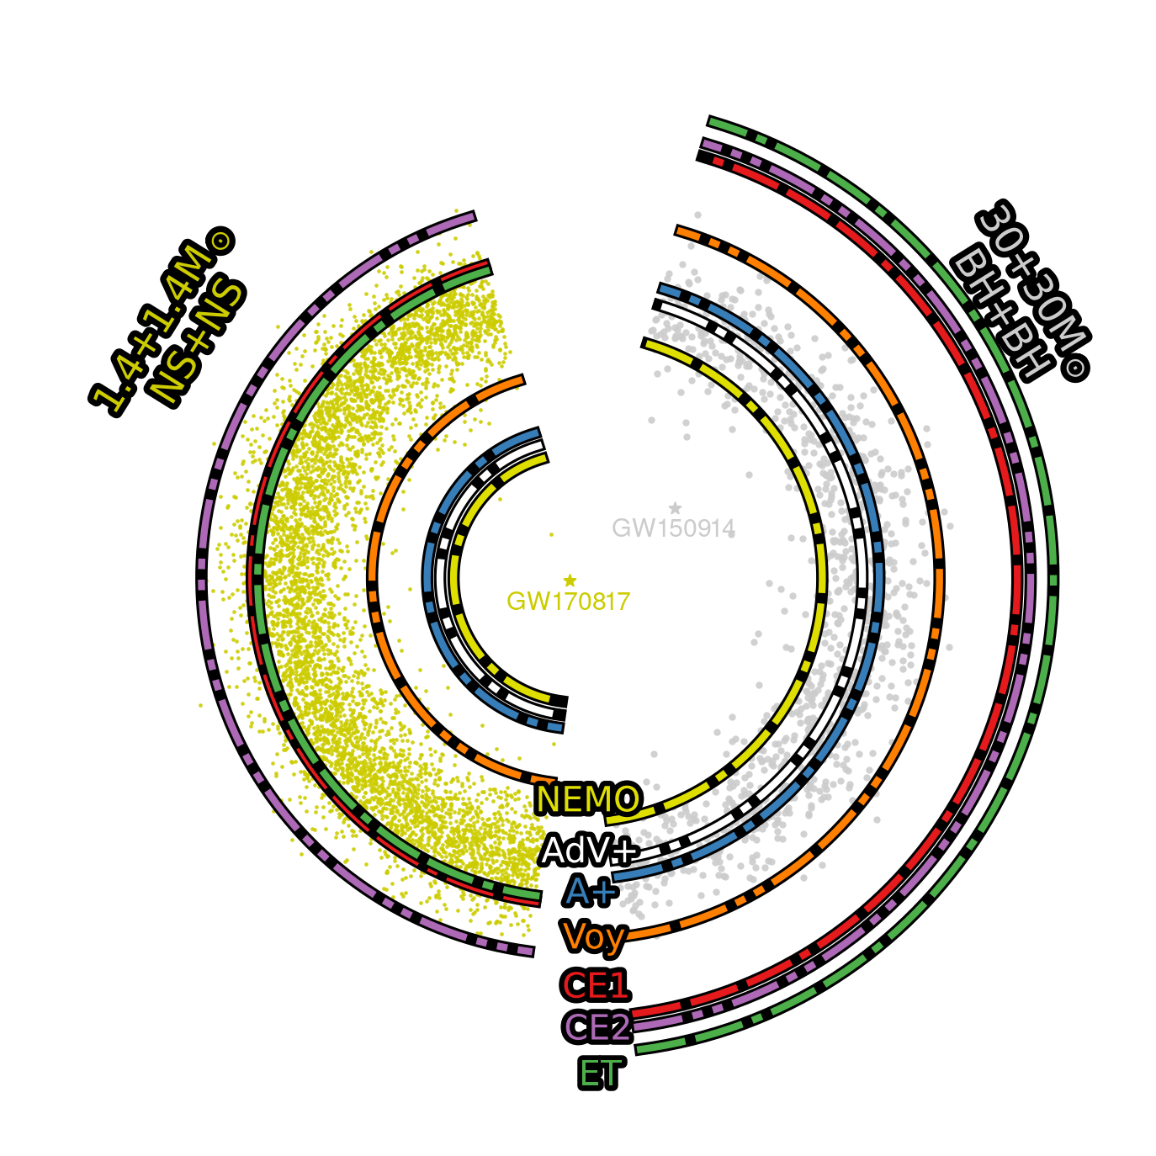

Why?
Advanced LIGO worked spectacularly
  But antenna size << wavelength/4
  And limited by mirror displacement noise (mostly thermal noise)
  Scale up! (up to x10 arm length)
Observation Range
$∝$ strain sensitivity
Enables access to
Gravitational Waves
throughout Cosmic Time
This way to the future

Slide 3
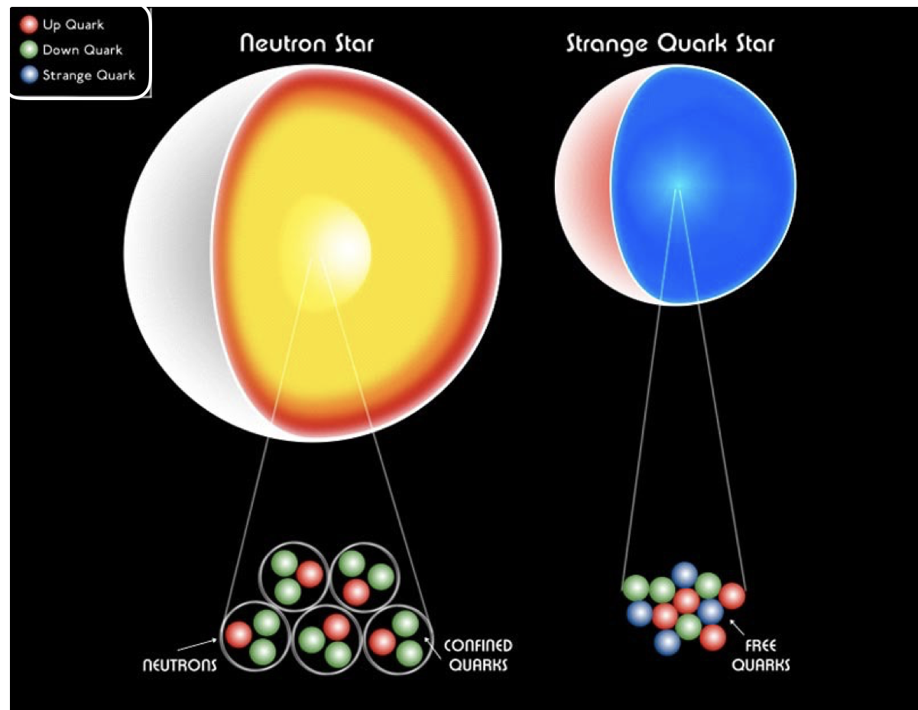
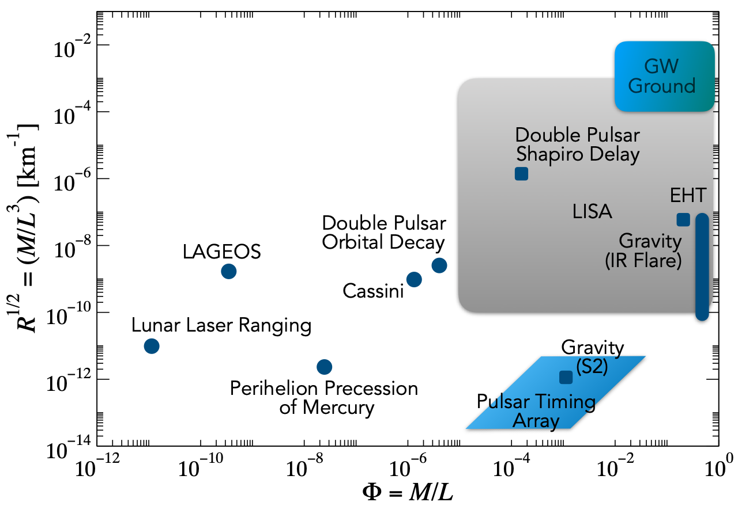
Highlights:
Accessible Science
Observing Stellar Mass / Primordial Black Holes Throughout Cosmic Time
Access to Nuclear Matter at Neutron Star & Post-merger Densities
Probing Extreme Gravity and Searching for New Physics
Much more: see other sessions

Slide 4
Comparing Detectors

Slide 5
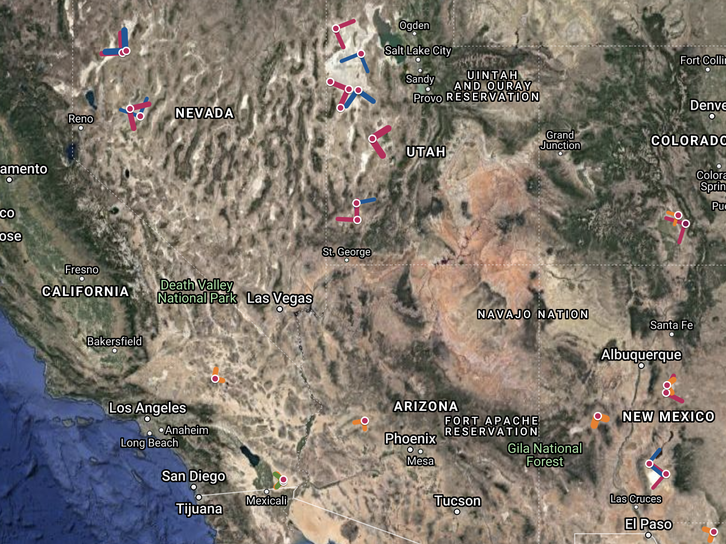
Possible Site?
We are investigating 3 reference sites for costing of 20 and 40km detectors
Initial investigations focus on producing realistic cost estimates for these reference sites which can be parameterized to work for estimating project cost at other potential candidate locations

Slide 6
Technology Progression

Slide 7
Technology R&D
Improved squeezed light and other quantum metrology techniques
Large (hundreds of kg), low-loss fused silica optics for test masses
Large (hundreds of kg) single crystal silicon as a test mass material
Optical coatings for the larger test masses that have low optical loss and low thermal noise
Cryogenics with low vibrational noise
Improved active vibration isolation
2 um wavelength technology: high power, low noise lasers, and high quantum efficiency photodiodes
Low cost UHV vacuum tubes, as the total construction cost of a 40km gravitational wave observatory is driven by the cost of the vacuum system.
Significant technology overlap with particle physics.

Slide 8
CE Consortium
Open to experts inside and outside the LIGO Scientific Collaboration
Join if interested!
Upcoming
CE meeting:
Oct 26-30 (zoom)
https://cosmicexplorer.org
https://sites.psu.edu/cosmicexplorermeeting

Slide 9
Thank you!
Questions?
Example location:
Bonneville Salt Flats, Utah, USA

